Slide 1
Assessing local variability of radon backgrounds in the subsurface using high density field measurements
Justin D. Lowrey, Xiao Luo, Christine Johnson, Joshua Feldman, Mark Rockhold
Pacific Northwest National Laboratory
Radon is a naturally occurring radioactive gas in the subsurface. While it is a decay product from natural uranium and thorium, the variability of radon is poorly understood. In this poster, we examine this variability at a number of collocated subsurface sample locations and compare to detailed gas flow models.
We present a series of radon measurements at a meso-scale geologic testbed utilizing eight boreholes consisting of eight gas sampling intervals each. Measurements are compared to gas simulations using a detailed testbed model to assess the variability.
Radon sampling in a 10mx10mx60m testbed yielded measurements spanning 5kBq/m³ to 70kBq/m³ over roughly three days. Radon simulations assuming 2.5ppm U-238 in the testbed captured a large part of this variability, though not accurately at each location.
Comparison of high-density radon measurements and results of detailed subsurface gas simulations suggest radon backgrounds are heavily influenced by subsurface porosity and water saturation.
Please do not use this space, a QR code will be automatically overlayed
PNNL-SA-186205
P2.4-822

Slide 2
Introduction – Radon Gas Background
Radon is a naturally occurring radioactive gas produced as a decay product of uranium and thorium in geologic media. Radon is therefore a nearly ubiquitous gas background in the subsurface environment.
In the context of nuclear explosion monitoring:
radon influences RN detector sensitivities as an interfering signal
radon’s presence in whole-air gas samples is an indicator of atmospheric and subsurface air mixing.
radon has been of increased interest as a signature of UNE activity as a geogenic gas likely to be released in earth-damaging activity
PROBLEM:
As seen (right), radon gas variability in the ground is complicated:
It can vary temporally even from one minute to another.
We demonstrate in this work that it is also highly spatially variable.
Influenced by subsurface gas dynamics.
Air Leak!
Please do not use this space, a QR code will be automatically overlayed
P2.4-822

Slide 3
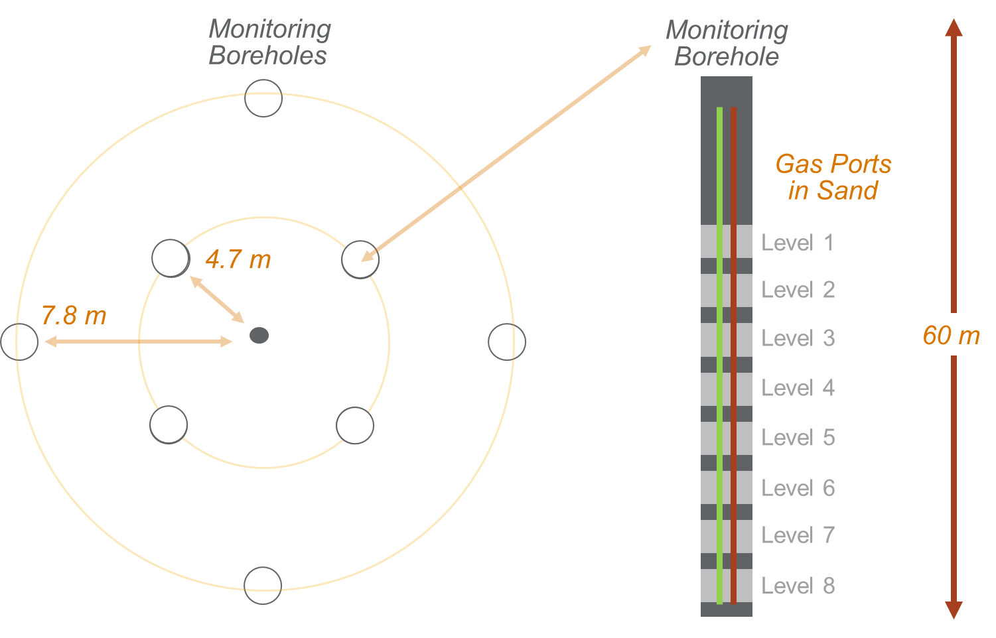
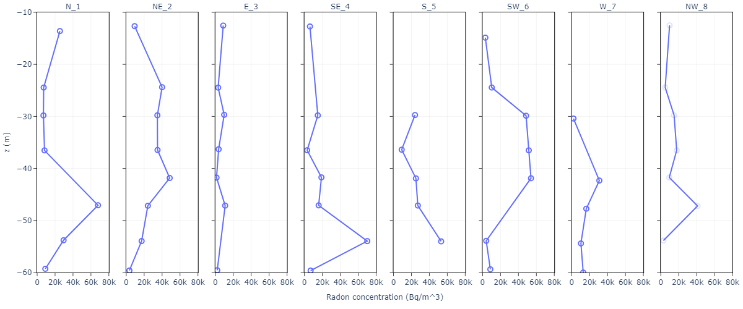
Objectives
Research Objective: Use numerical transport models of subsurface gas transport built using detailed geologic site characterization information to assess radon gas concentration variability observed in high density field measurements.
Radon was measured using RAD7 instruments for 30 minutes per interval. Mean radon concentrations for each zone per borehole are shown below as a function of depth (m). Signals varied from 5-70kBq/m³.
Radon measurements were taken at a mesoscale testbed in New Mexico, USA consisting of 8 vertical boreholes each with 8 sampling intervals.
Please do not use this space, a QR code will be automatically overlayed
P2.4-822

Slide 4
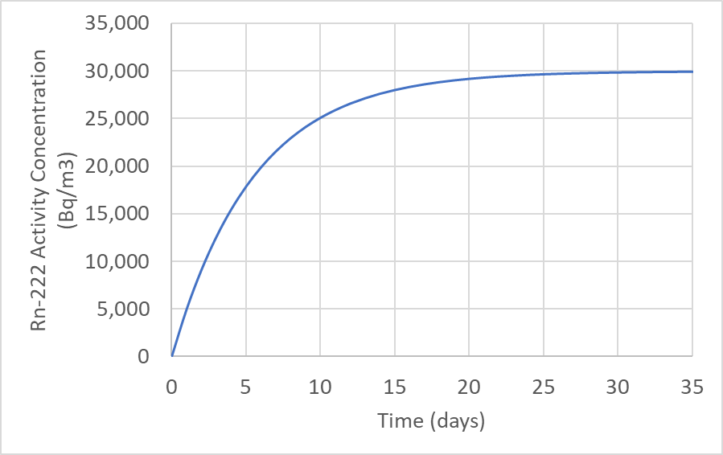
Methods/data
Methods Summary: We used field-measured electrical conductivity (using electrical resistivity tomography) and seismic velocity measurements to calculate 3D maps of the testbed porosity and water saturation (presented in P2.4-817). These maps were incorporated into a high-fidelity subsurface transport model in PFLOTRAN used to simulate radon gas evolution.
Radon Source Assumptions:
Assumed homogeneous radon source based on mean field measurements of about 30 kBq/m³.
Assumed a 0.22 radon emanation fraction based on literature measurements in rhyolite.
Corresponds to roughly 2.5 ppm U-238 in rock.
Please do not use this space, a QR code will be automatically overlayed
Derived gas saturation (left) and porosity (right) maps of the testbed, vertical slice.
P2.4-822

Slide 5
Results
30-day radon evolution was simulated; radon shown to concentrate naturally despite uniform source term
Some simulated sampling zones track well with the observed radon variability (top). Other zones (bottom) under- or overestimate the observed values significantly. Very low radon observables could be a result of leak paths. We clearly aren’t capturing ALL of the variability.
Please do not use this space, a QR code will be automatically overlayed
P2.4-822

Slide 6
Conclusion
High density field measurements performed at a mesoscale testbed demonstrate radon gas concentrations vary significantly over short intervals of both time (hours to days) as well and space (meter-scale).
PFLOTRAN simulations of radon evolution using a high-fidelity derived porosity and water saturation model of the same testbed demonstrate the same local variability, even assuming a uniform source.
From model results, the variability is significantly driven by both variable water saturation and rock porosity, though it is likely a function of gas permeability, especially in fractured rock.
In reality, U/Th minerals are not uniformly distributed in the subsurface, which certainly further enhance to variability demonstrated in the simpler simulation scenario.
Please do not use this space, a QR code will be automatically overlayed
P2.4-822

Slide 7
References
Funtua, I. I., Onojah, A., Jonah, S. A., Jimba, B. W., & Umar, I. M. (1997). Radon emanation study of uranium ore samples from NE Nigeria. Applied radiation and isotopes, 48(6), 867-869.
Piyoosh Jaysaval, Glenn E. Hammond, and Timothy C. Johnson. Massively parallel modeling and inversion of electrical resistivity tomography data using PFLOTRAN. Geoscientific Model Development, 16(3):961--976, 2023.
Johnson, T.C., Knox, H.A., Strickland, C., Johnson, C., Lowrey, J., Sprinkle, D.P., Linneman, D., Vermeul, V., Robey, E., Chojnicki, K. and Ingraham, M., 2022. 3D Time-Lapse Electrical Resistivity Imaging of Rock Damage Patterns and Gas Flow Paths Resulting from Two Underground Chemical Explosions. Pure and Applied Geophysics, pp.1-17.
Acknowledgment
This Low Yield Nuclear Monitoring (LYNM) research was funded by the National Nuclear Security Administration, Defense Nuclear Nonproliferation Research and Development (NNSA DNN R&D). The authors acknowledge important interdisciplinary collaboration with scientists and engineers from LANL, LLNL, NNSS, PNNL, and SNL.
Please do not use this space, a QR code will be automatically overlayed
P2.4-822

