Slide 1
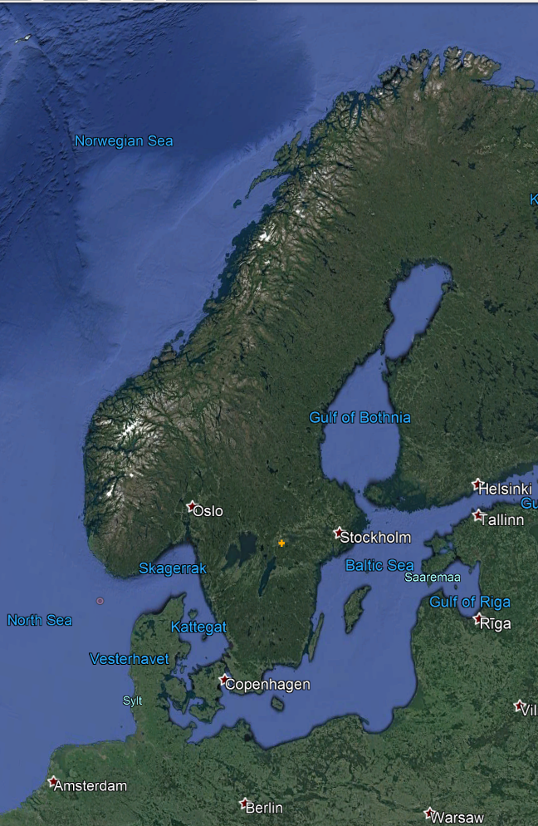
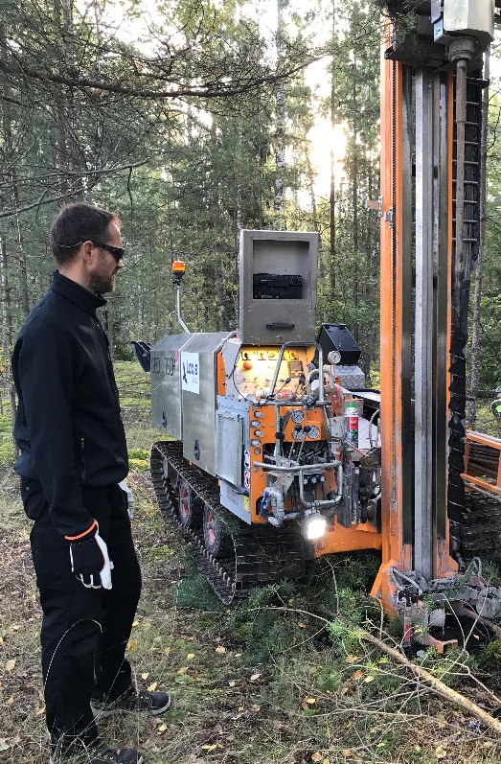
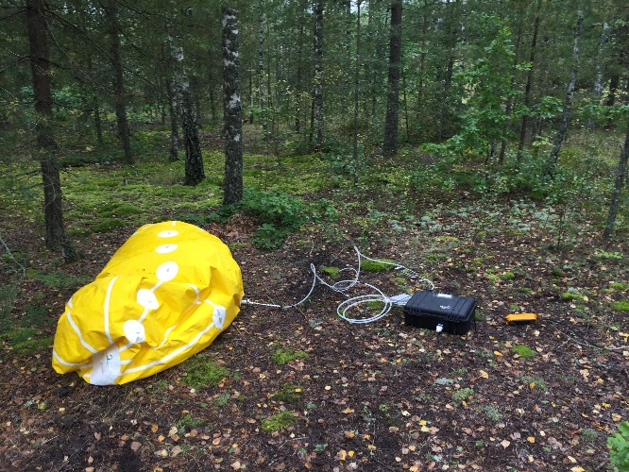
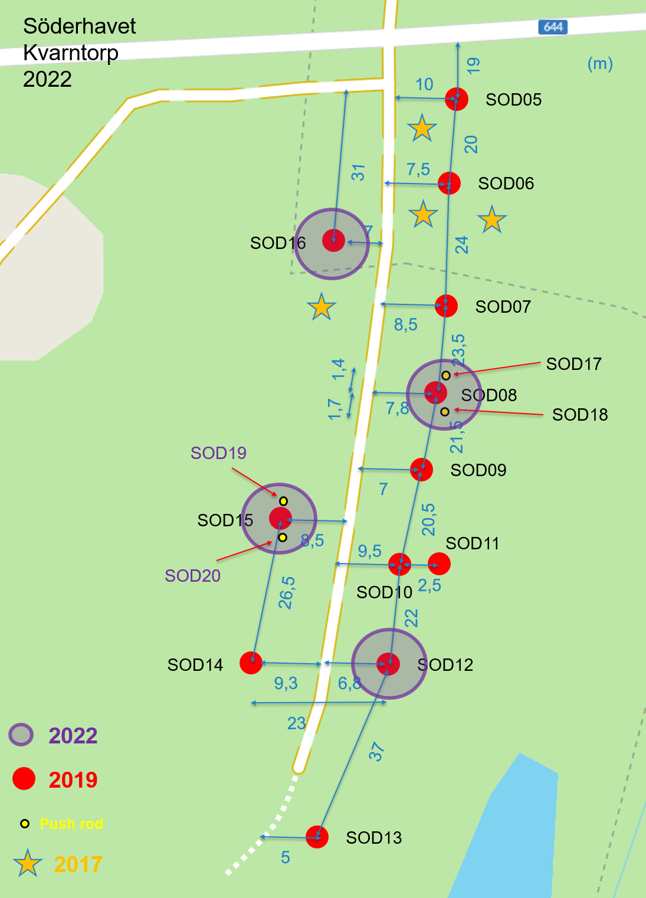
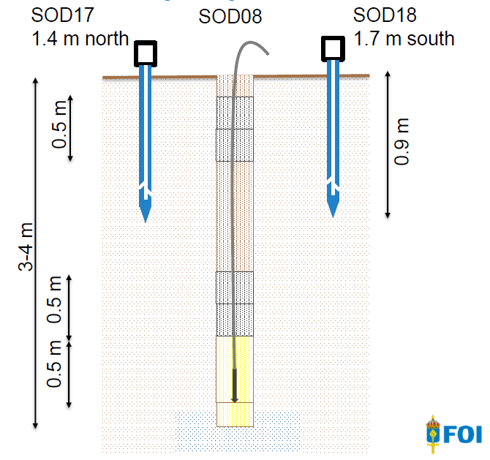
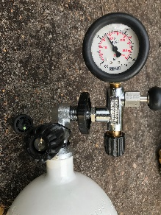
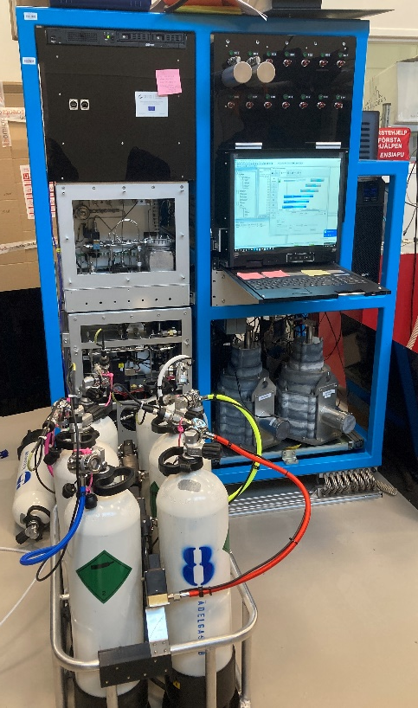
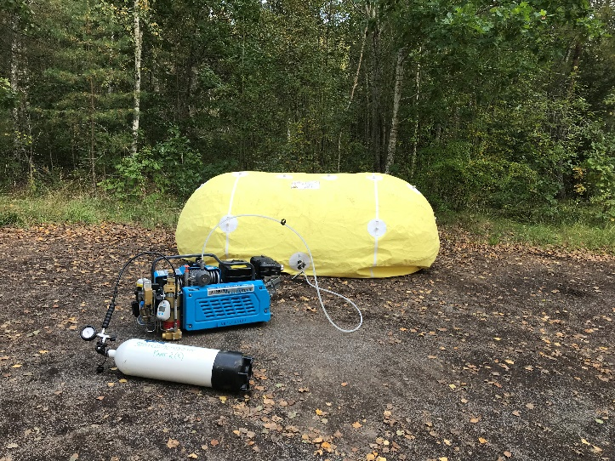
A study of radioxenon in soil gas in Sweden
M. Aldener, T. Fritioff, K. Elmgren, L. Karlkvist, J. Kastlander, H. Olsson and C. Söderström
Swedish Defence Research Agency (FOI)
P2.4-637
¹³³Xe detections in soil gas in Sweden
Three periods in 2019-2022, to study varying conditions and trend over time
Shallow and deeper sites
H₂O, U, Rn, CO₂ and diffusion

