Slide 1
Novel rock evaluation for geological modeling using electrical conductivity and p-wave velocity measurements
Justin D. Lowrey, Xiao Luo, Christine Johnson, Joshua Feldman, Mark Rockhold
Pacific Northwest National Laboratory
Place your institution logo here
(remove this text box)
The inaccessibility of the subsurface environment makes evaluating radionuclide movement underground challenging. New methods and technology are needed for studying gas mobility related to underground nuclear explosion science.
We have collected a large geological site characterization dataset with the objective of testing new methods for evaluating rock properties needed for validating subsurface transport models.
We combined electrical conductivity tomography and seismic velocity measurements to estimate 3-dimensional maps of the testbed properties for gas transport modeling at the site. Results of these simulations were compared to experimental injections of nitrogen gas in the field to evaluate the joint inversion methodology.
The subsurface is STILL complicated, but multi-phenomenology joint inversion method presented here offers a novel way to directly image and evaluate certain underground features like fracture networks that critically influence how materials migrate.
PNNL-SA-186213
Please do not use this space, a QR code will be automatically overlayed
P2.4-817

Slide 2
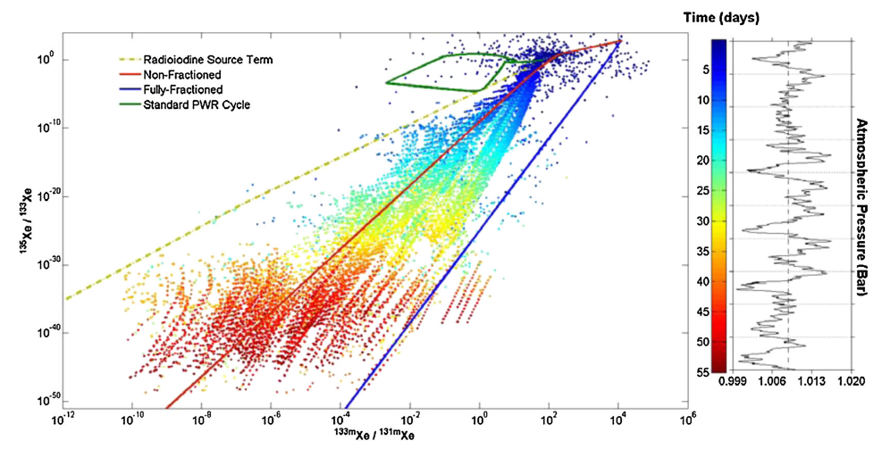
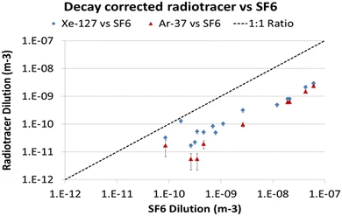
Introduction
Detection of radionuclides generated from underground nuclear explosions depends, first and foremost, on the movement of nuclides from source to detector. The subsurface environment therefore has a critical role in determining how and when material signatures become detectable.
Field-scale tracer experiments are essential to furthering scientific understanding of how the subsurface contains nuclear explosion signatures. However, the inaccessibility of the below ground environment remains a significant hurdle in using such experiments to validate material transport models.
New methods and technology are needed for studying gas mobility related to underground nuclear explosion science
Lowrey (2013)
Olsen (2016)
Bourret (2020)
Carrigan (1996)
Please do not use this space, a QR code will be automatically overlayed
P2.4-817

Slide 3
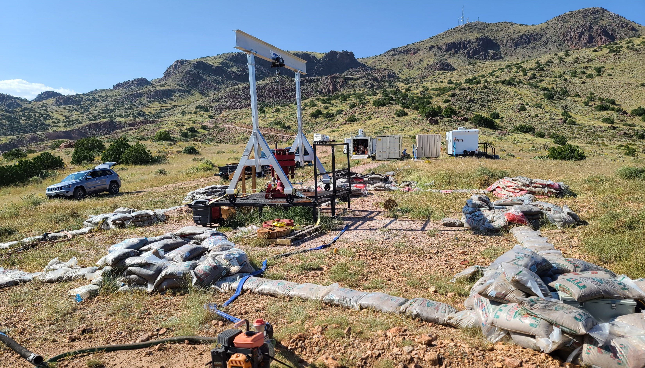
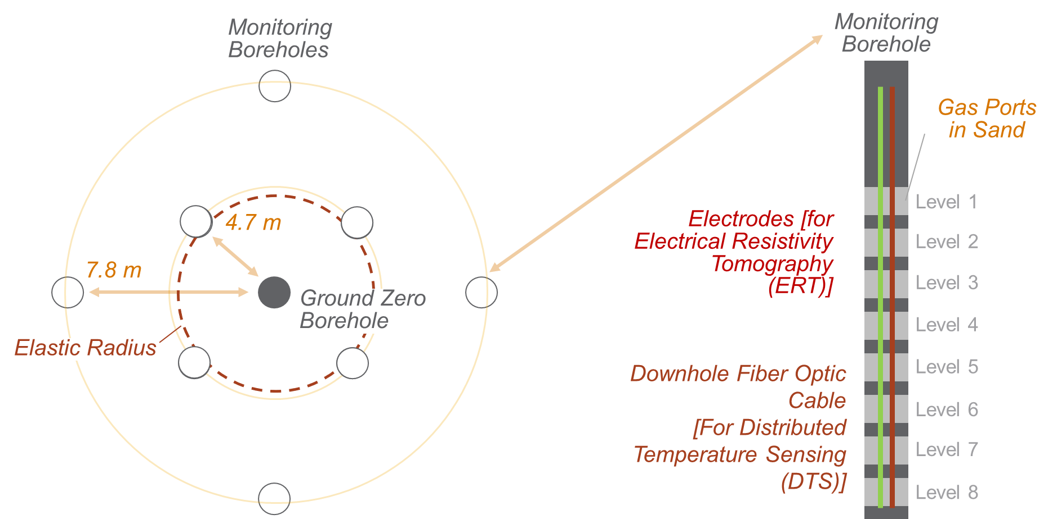
Objectives
PNNL has contributed to the development of a mesoscale testbed at Blue Canyon Dome in New Mexico, USA to investigate:
Fluid and tracer transport in the subsurface
Novel field scale characterization techniques
Effects of explosive rock damage on subsequent gas mobility
Site consists of central (GZ) borehole surrounded by 8 concentric monitoring wells that allow for gas sampling, electrical resistivity (ERT) imaging, and distributed acoustic and temperature sensing.
BCD testbed at the Energetic Materials Research and Testing Center (EMRTC) showing ground zero and surrounding monitoring wells.
Please do not use this space, a QR code will be automatically overlayed
Research Objective: Demonstrate novel rock evaluation methodology for geological modeling using electrical conductivity and p-wave velocity measurements for simulation of subsurface tracer transport.
P2.4-817

Slide 4
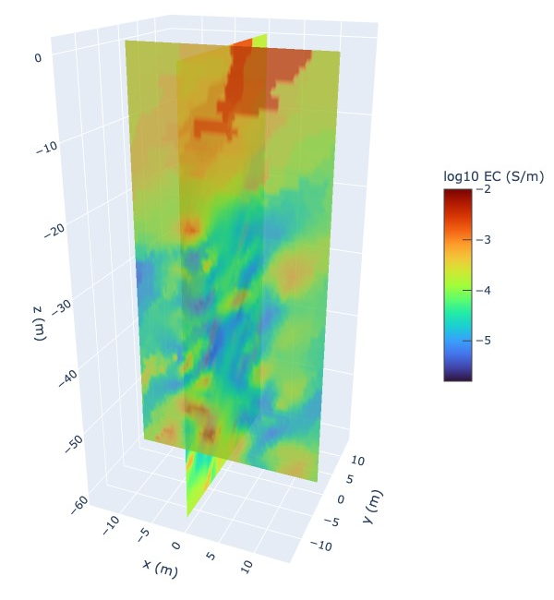
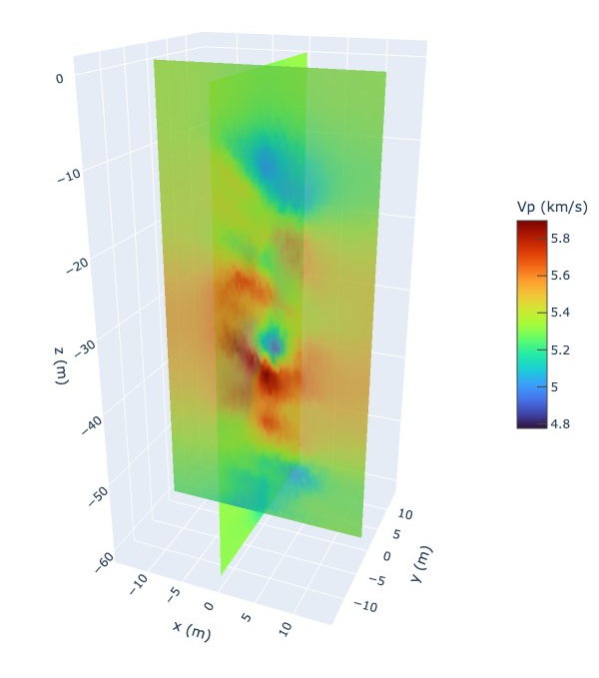
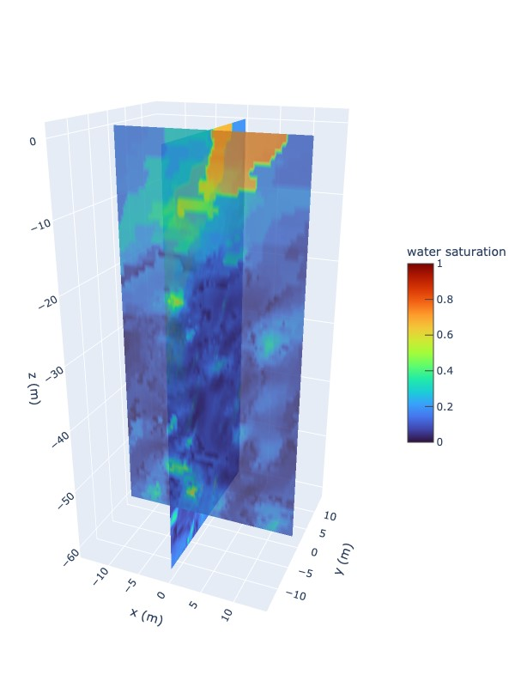
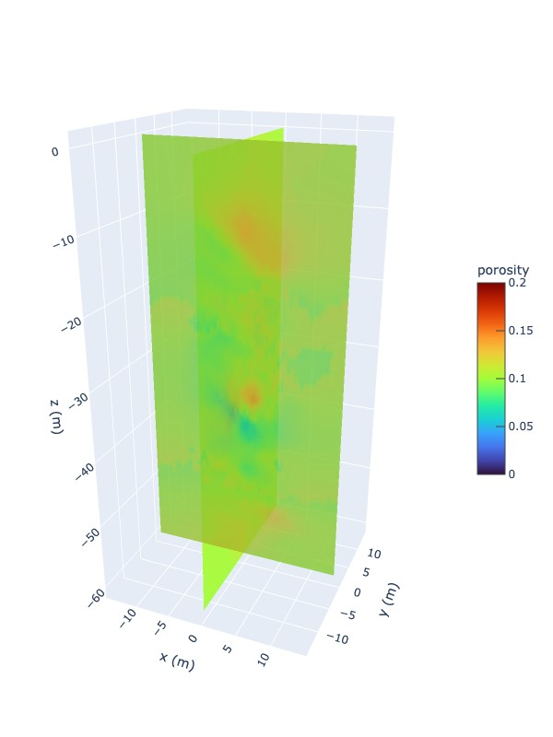
Methods
Along with other traditional geologic characterization techniques, we collected:
Electrical Resistivity Tomography – ERT measurements provide 3D mapping of electrical conductivity
Cross well seismic – p-wave velocity measurements
Joint inversion of these measurements was used to obtain porosity and water saturation maps (using Raymer’s equation and Archie’s law)
Other parameters (permeability, pressure saturation, relative permeability) were also estimated
Measured ERT and seismic velocity
Derived water saturation and porosity
Please do not use this space, a QR code will be automatically overlayed
P2.4-817

Slide 5
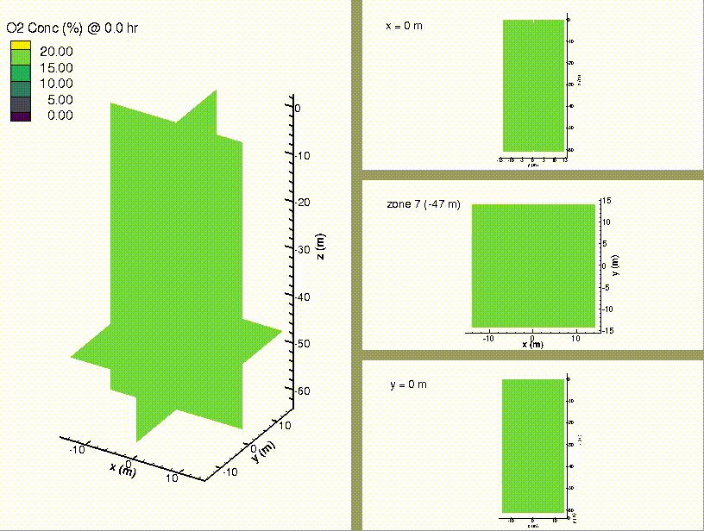
Results
Joint inversion results were used to build a subsurface transport model in PNNL’s STOMP code to compare with measurements of pressurized nitrogen gas injected into BCD’s GZ well and sampled at the 8 surrounding monitoring wells.
Animation of the simulated N₂ injection showing O₂ displacement.
Comparison of measured vs. simulated O2 drop as N2 arrives at monitoring wells.
Experiment
Simulation
Please do not use this space, a QR code will be automatically overlayed
P2.4-817

Slide 6
Conclusion
Cross-well seismic and electrical resistivity tomography can be used to produce subsurface models and estimate rock properties, and more specifically evaluate changes in these.
Work presented here demonstrated that gas arrivals and magnitudes were represented by simulations fairly well to first order, but overestimated the oxygen drop for several wells, meaning the model is likely overestimating the gas permeability in the testbed.
The BCD testbed is largely impermeable, and gas flow is most likely dominated by embedded fractures
The ERT measurements show conductivity changes at resolution that is much larger than the actual fractures likely carrying gas flow
Future efforts will consider other inversion techniques and should also incorporate discrete fracture estimation to better constrain the gas flow in smaller fractures.
Please do not use this space, a QR code will be automatically overlayed
P2.4-817

Slide 7
References
Lowrey, J.D., Biegalski, S.R., Osborne, A.G. and Deinert, M.R., 2013. Subsurface mass transport affects the radioxenon signatures that are used to identify clandestine nuclear tests. Geophysical research letters, 40(1), pp.111-115.
Olsen, K.B., Kirkham, R.R., Woods, V.T., Haas, D.H., Hayes, J.C., Bowyer, T.W., Mendoza, D.P., Lowrey, J.D., Lukins, C.D., Suarez, R.D. and Humble, P.H., 2016. Noble gas migration experiment to support the detection of underground nuclear explosions. Journal of Radioanalytical and Nuclear Chemistry, 307, pp.2603-2610.
Carrigan, C.R., Heinle, R.A., Hudson, G.B., Nitao, J.J. and Zucca, J.J., 1996. Trace gas emissions on geological faults as indicators of underground nuclear testing. Nature, 382(6591), pp.528-531.
Bourret, S.M., Kwicklis, E.M., Harp, D.R., Ortiz, J.P. and Stauffer, P.H., 2020. Beyond Barnwell: Applying lessons learned from the Barnwell site to other historic underground nuclear tests at Pahute Mesa to understand radioactive gas-seepage observations. Journal of Environmental Radioactivity, 222, p.106297.
Johnson, T.C., Knox, H.A., Strickland, C., Johnson, C., Lowrey, J., Sprinkle, D.P., Linneman, D., Vermeul, V., Robey, E., Chojnicki, K. and Ingraham, M., 2022. 3D Time-Lapse Electrical Resistivity Imaging of Rock Damage Patterns and Gas Flow Paths Resulting from Two Underground Chemical Explosions. Pure and Applied Geophysics, pp.1-17.
White, M.D. and Oostrom, M., 2003. STOMP subsurface transport over multiple phases version 3.0 User's guide (No. PNNL-14286). Pacific Northwest National Lab., Richland, WA (US).
Acknowledgment
This Low Yield Nuclear Monitoring (LYNM) research was funded by the National Nuclear Security Administration, Defense Nuclear Nonproliferation Research and Development (NNSA DNN R&D). The authors acknowledge important interdisciplinary collaboration with scientists and engineers from LANL, LLNL, NNSS, PNNL, and SNL.
Please do not use this space, a QR code will be automatically overlayed
P2.4-817

