Slide 1
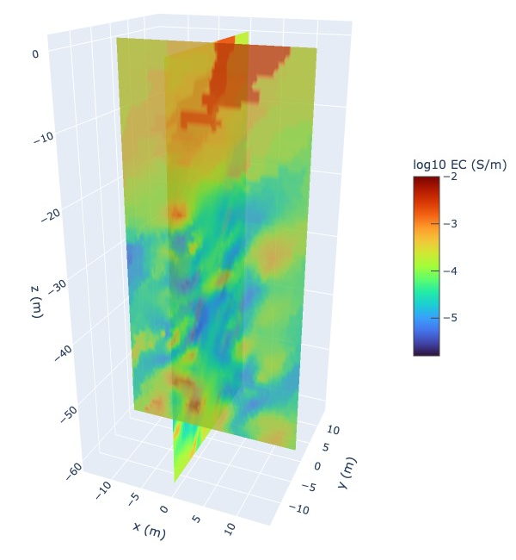
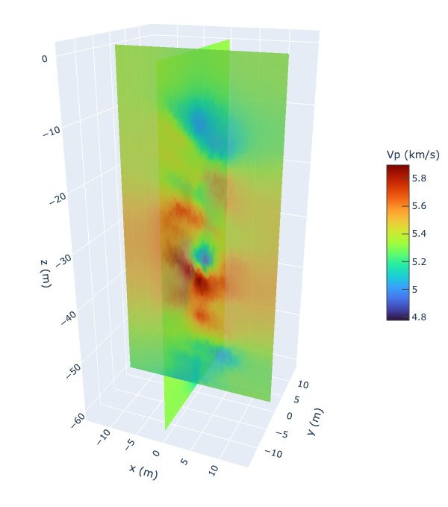
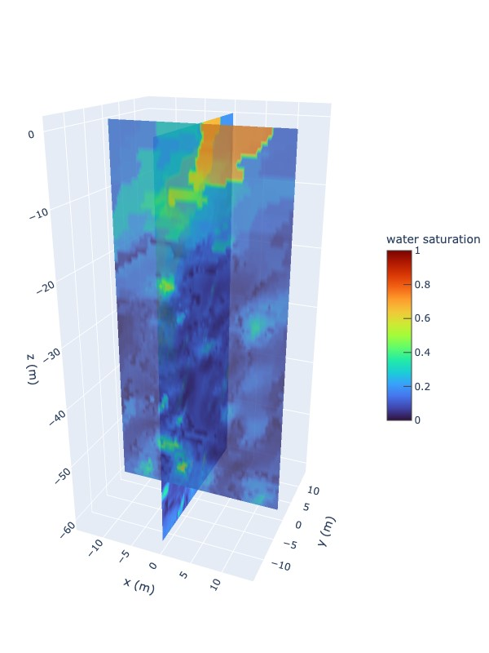
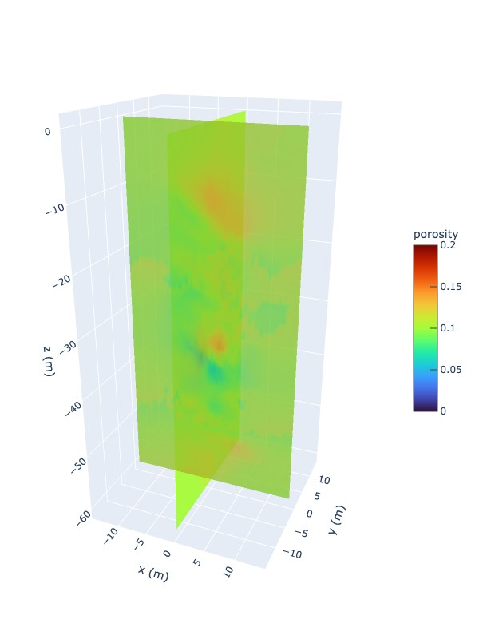
Novel rock evaluation for geological modeling using electrical conductivity and p-wave velocity measurements
Justin D. Lowrey, Xiao Luo, Christine Johnson, Joshua Feldman, Mark Rockhold
Pacific Northwest National Laboratory
PNNL-SA-186213
P2.4-817
Research Objective: Demonstrate novel rock evaluation methodology for geological modeling using electrical conductivity and p-wave velocity measurements for simulation of subsurface tracer transport.
Measured ERT and seismic velocity
Derived water saturation and porosity

