Slide 1
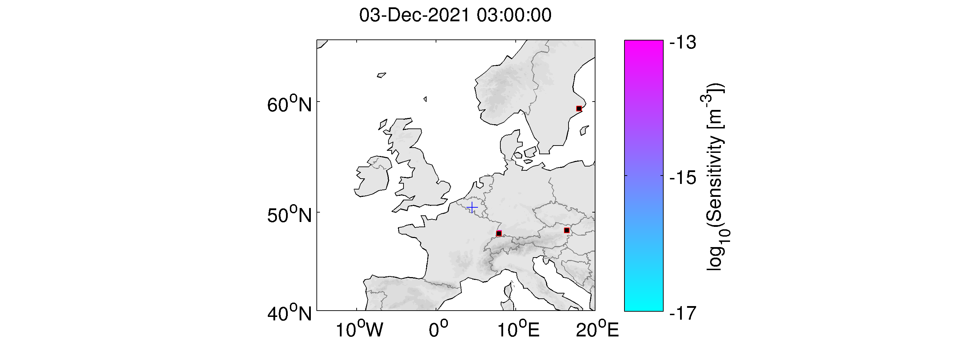
Assessment of Backward ATM Localization Capability
for Increased Xenon Sampling Frequency
at Mount Schauinsland, Germany
New xenon systems have shorter sampling times Xenon International with 6 h sampling period was tested at RN 33 July 2021-April 2022
Backward ATM was performed for the ~1000 samples from the test phase ATM is crucial to make use of the higher sampling frequency
Schauinsland specific ATM challenging meteorology due to local orographic effects
24 h 6 h
Retroplumes for 24 h SPALAX and 6 h Xenon International Sample (HYSPLIT 0.25° GFS met-data)
J. Ole Ross*, Sofia Brander#, Peter Gaebler*, Andreas Bollhöfer#, Lars Ceranna*
*Federal Institute for Geosciences and Natural Resources (BGR)
#Federal Office for Radiation Protection (BfS)
P2.4-818

