Slide 1
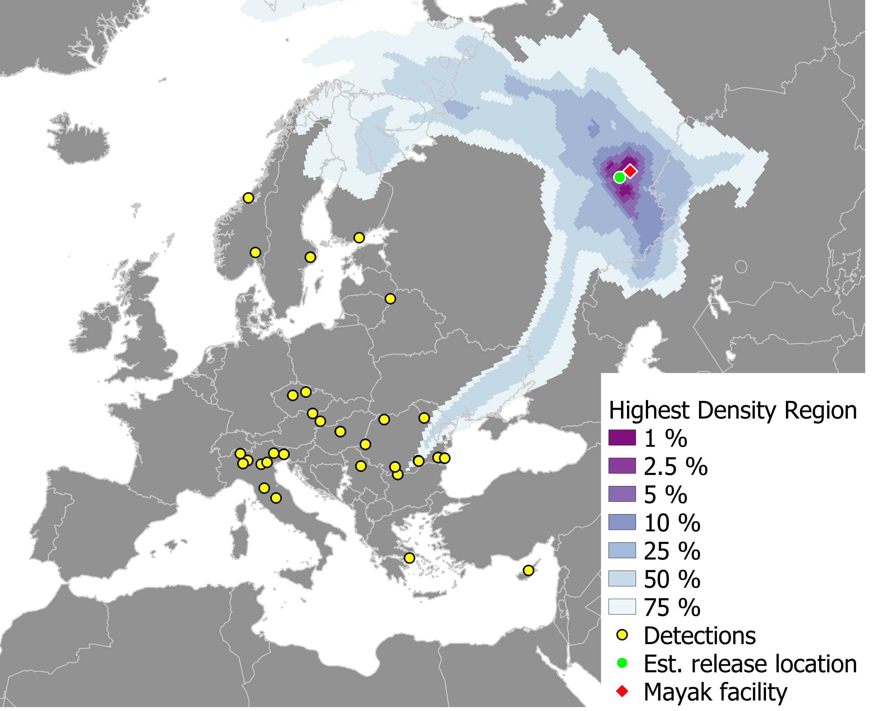
Inverse Atmospheric Dispersion Modelling and Realistic Training for Assessment of Releases of Radioactivity
Jasper Tomas et al.
RIVM - National Institute for Public Health and the Environment
Px.x-xxx
SHERLOC
We developed the inverse atmospheric transport model SHERLOC.
We validated SHERLOC by applying it to the ETEX1-experiment.
Subsequently we applied it to the case of Ruthenium-106 detections over Europe in 2017 →→→
RODIN
Adequate response to radiological emergencies can be achieved by exercises with involved organizations. Proper exercises require a balance between exercise goals, scenario and participants.
We developed the exercise tool RODIN that
is based on a scenario and real-time meteorology;
simulates measurements in real-time during the exercise;
allows for changes in the scenario during the exercise.
Goals
Participants
Exercise
If you want to learn more about this, come see my e-poster during session 2.4 on Thursday June 22 at 11:00 or access it online on the SnT2023 Conference platform!
Scenario

