Slide 1

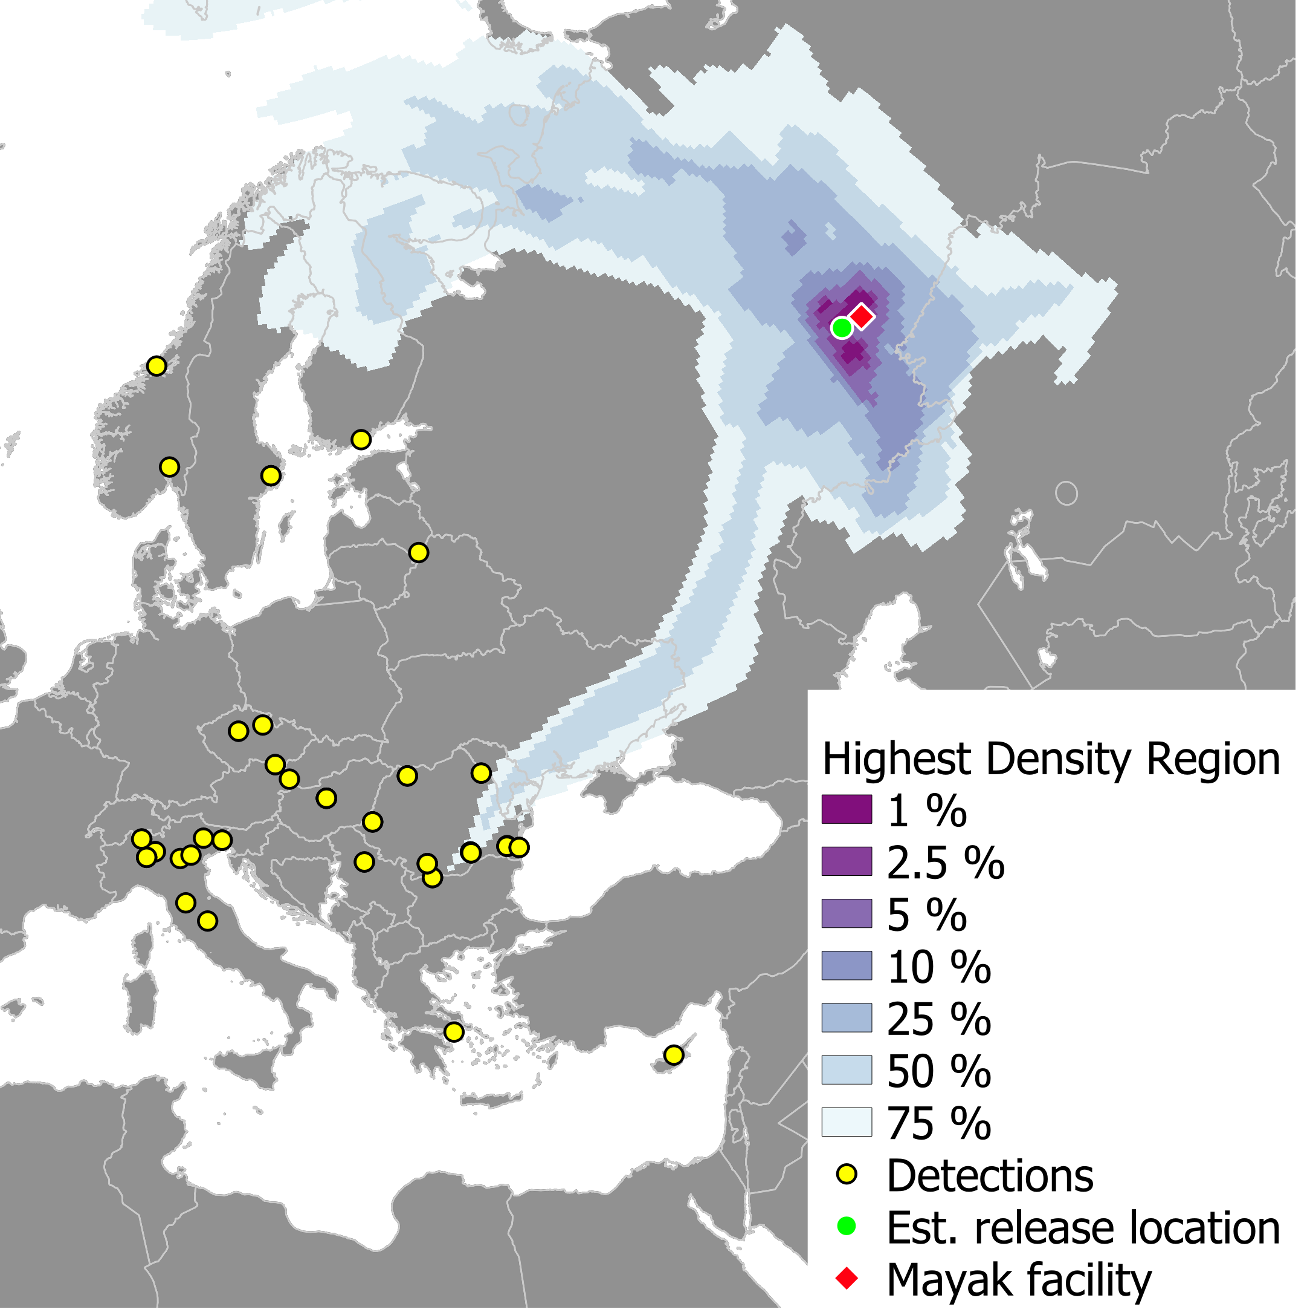
Inverse Atmospheric Dispersion Modelling and Realistic Training for Assessment of Releases of Radioactivity
Jasper Tomas, Astrid Kloosterman, Michiel de Bode,
Peter den Outer
RIVM - National Institute for Public Health and the Environment
¹⁰⁶Ru detections in Europe, 2017
When radioactivity is detected of unknown origin, inverse modelling can pinpoint the likely source.
Operating such models during an emergency requires proper training and exercise. However, exercises often lack sufficient and realistic simulated measurements to drive the exercise.
We present the inverse atmospheric transport model SHERLOC and apply it to the case of ¹⁰⁶Ru detections in Europe in 2017
In addition, we present the training and exercise tool RODIN that can generate realistic measurements during exercises.
REPLACE THIS TEXT
With your
Results
DO NOT CHANGE or RESIZE the Text or the Textbox
Approximately 1.33 PBq of ¹⁰⁶Ru was released in the southern urals in the night of 25th to 26th of September 2017.
In the vicinity of the emission effective dose levels may have exceeded 100 mSv.
Please do not use this space, a QR code will be automatically overlayed
P2.4-499

Slide 2
Introduction
Situations can occur where radioactivity is detected, but the origin is unknown, e.g.:
Chernobyl disaster (1986).
Acerinox accident of a ¹³⁷Cs source in a scap metal reprocessing plant (Cádiz, Spain,1998).
¹⁰⁶Ru detections in atmosphere over Europe in September 2017 (unconfirmed).
→ There is a need for a model that can estimate source term parameters based on measurements using inverse atmospheric transport modelling
In addition, adequate response to radiological emergencies can be achieved by exercises with involved organizations. Proper exercises require a balance between exercise goals, scenario and participants.
→ There is a need for a tool that:
Supports exercise and learning goals
Matches the tasks of the participants and their interaction during an actual emergency
Simulates measurements on request during the exercise, in their corresponding formats
Goals
Participants
Exercise
Please do not use this space, a QR code will be automatically overlayed
Scenario
P2.4-499

Slide 3


Introduction
Objective 1
In case of detection of radioactivity from unknown source
Estimate:
Release location
Moment of release
Released quantity
SHERLOC
Measurements
Incident scenario
Source term estimation
Atmospheric transport modelling
Dose estimation
Protective actions
Exercise of unknown source scenario
Objective 2
Simulate in real time:
Multiple samples and detector outputs
with realistic uncertainties,
in actual formats,
consistent with the (changing) scenario.
In case of exercise with hypothetical scenario
RODIN
Measurements
Please do not use this space, a QR code will be automatically overlayed
Exercise
Incident scenario
Source term estimation
Atmospheric transport modelling
Dose estimation
Protective actions
P2.4-499

Slide 4

Inverse atmospheric transport model SHERLOC
Inverse atmospheric transport modelling based on concentration measurements.
The objective is to quickly find:
x_{s}=(x_{s},y_{s}) the source location (a single release is assumed);
t_{s} the moment that the release occurred (an instantaneous release is assumed);
Q_{s} the released quantity.
The method considers the correlation coefficient of modelled (c^{m}) and observed atmospheric concentrations (cº), similar to Efthimiou et al. (2017) and Kovalets et al. (2018). This is done for each possible source location x and moment in time t. An innovation is that the source location is estimated by considering the correlation coefficient integrated over the assessment period T:
Then the p.d.f. for the source location is:
(Ω represents the domain)
where the modelled concentrations c^{m} at the detection locations are generated by solving the ‘adjoint’ transport equation for adjoint tracer c*,
where is the adjoint tracer released from the receptor location and determined at the source location.
The source location can be estimated by the region where 𝓟(x) reaches its maximum value.
Moment of release:$t_{s}=\text{arg}\max_{t}\left(r\left({\text{x}}_{s},t\right)\right)$ Released quantity: $Q_{s}=\frac{\sum_{n=1}^{N}{c_{n}^{∗}\left({\text{x}}_{s},t_{s}\right)c^{o}\left({\text{x}}_{s},t_{s}\right)}}{\sum_{n=1}^{N}{{\left(c_{n}^{∗}\left({\text{x}}_{s},t_{s}\right)\right)}^{2}}}$
with
Please do not use this space, a QR code will be automatically overlayed
P2.4-499

Slide 5
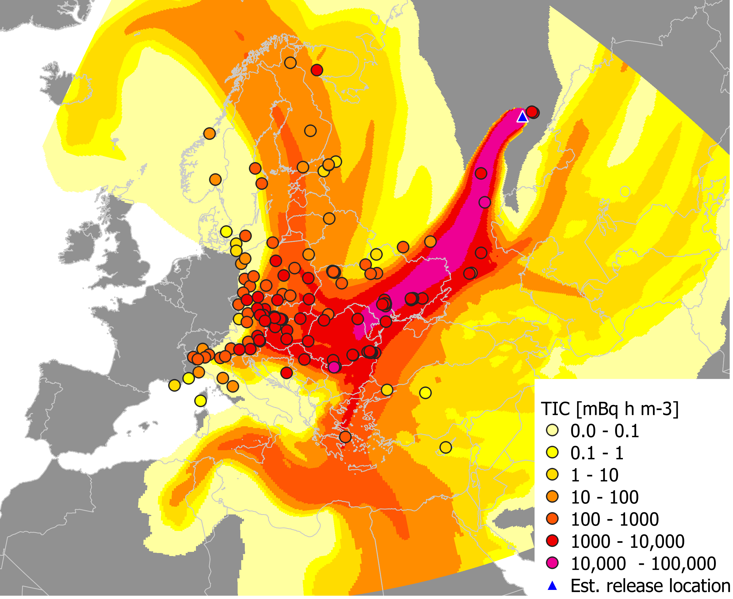
Results SHERLOC on the case of ¹⁰⁶Ru in Europe (2017)
Case: ¹⁰⁶Ru detected in Europe (<150 mBq m⁻³) in Sept. and Oct. 2017
Measurement dataset as collected and reported by IRSN (IRSN, 2018).
Assessment period between 23-09-2017 and 05-10-2017.
Detections with collection interval ≤ 1 day: 63 in total at 33 locations.
Estimated release: 1.33 PBq (1.33 x 10¹⁵ Bq) at Sep. 26th ~02:50 UTC
Mayak nuclear facility is a plausible source. (see also e.g. Masson et al. (2019)).
Forward simulations with this source term indicate 100 mSv effective dose may have been exceeded in the vicinity of the release
Forward dispersion calculation of based on the estimated source term: calculated time-integrated concentration shown with time-integrated concentration measurements
SHERLOC result: Map of highest probability density for the source location of the ¹⁰⁶Ru emission
Please do not use this space, a QR code will be automatically overlayed
Tomas, J.M., V. Peereboom, A. Kloosterman and A. van Dijk, 2021. Detection of radioactivity of unknown origin: Protective actions based on inverse modelling. Journal of Environmental Radioactivity 235-236: 106643. https://doi.org/10.1016/j.jenvrad.2021.106643
P2.4-499

Slide 6
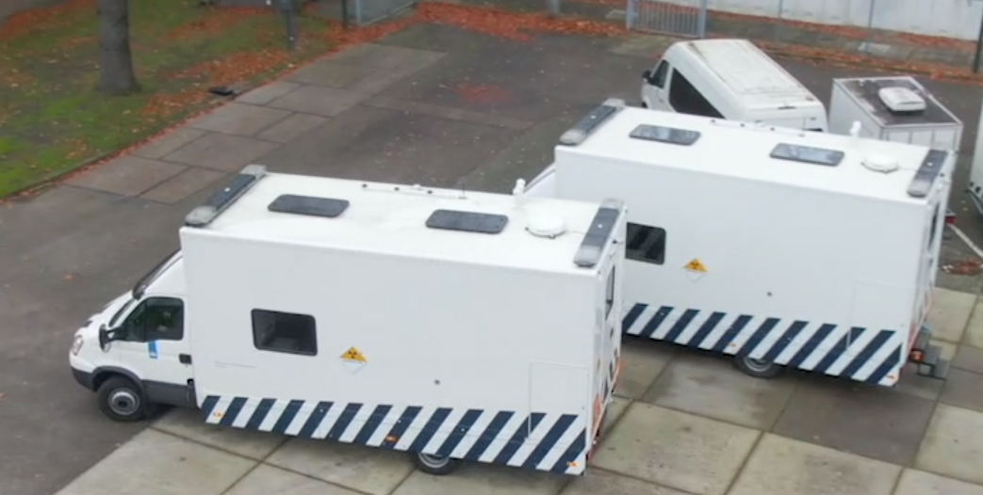
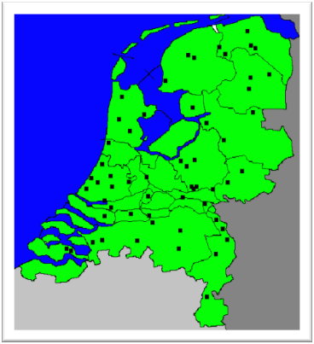
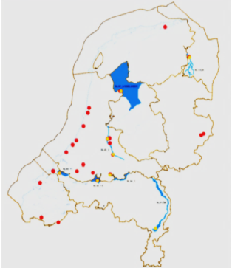
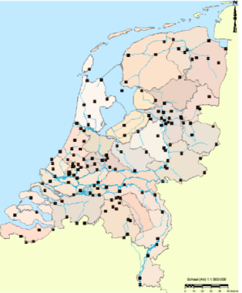
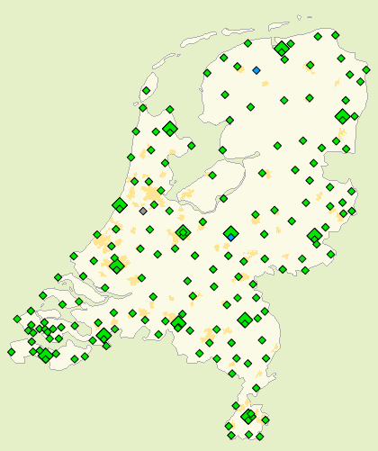
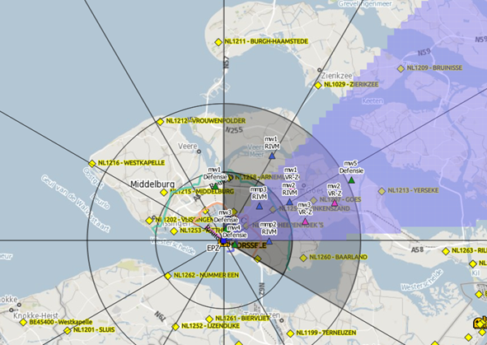
Training and exercise tool RODIN
RODIN: Real time Online Detector simulator In Nuclear exercises:
is fed with a release scenario that may be altered during the exercise;
uses atmospheric transport and dose modelling model NPK-Puff using real-time meteorology data as well as deposition based on radar data;
simulates measurements of multiple monitoring networks:
  EURDEP network (ambient dose rate);
  Dutch monitoring networks (ambient dose rate, aerosol activity, food stuff and water);
  Measurement vehicles (aerosol activity, ambient dose rate);
  Surface and drinking water reservoirs (contamination);
  Green houses (contamination);
  ad hoc measurements;
  ...
can be consulted real-time;
uses formats that correspond
with the applied measuring method.
Measurement vehicles can move where they want during the exercise; RODIN wil provide measurement data where and when requested.
Please do not use this space, a QR code will be automatically overlayed
P2.4-499

Slide 7
Conclusions
The inverse atmospheric transport model SHERLOC:
can estimate the source term that corresponds with atmospheric detectsions of radioactivity within hours after detection.
is applied to the detection of ¹⁰⁶Ru in Europe in Sept. 2017 from which it can be concluded that the Mayak nuclear facility is a plausible source.
  Approximately 1.33 PBq of ¹⁰⁶Ru was released in the night of 25th to 26th of September 2017.
  In the vicinity of the emission the maximum committed dose received by the public may have exceeded 100 mSv.
The exercise tool RODIN:
improves the competence of the emergency response organization as it adds realism to exercise and training.
allows measuring teams to perfom their normal tasks (sample parameters, preparation, handling) that have a direct effect on their results.
provides a large number of internally consistent measurements, the number of which is realistic in an actual nuclear emergency
Please do not use this space, a QR code will be automatically overlayed
P2.4-499

Slide 8
References
References
Efthimiou, G.C., Kovalets, I.V., Venetsanos, A., Andronopoulos, S., Argyropoulos, C.D., Kakosimos, K., 2017. An optimized inverse modelling method for determining the location and strength of a point source releasing airborne material in urban environment. Atmospheric Environment 170, 118 – 129.
IRSN, 2018. Report on the IRSN’s investigations following the widespread detection of Ru-106 in Europe early October 2017.
Kovalets, I.V., Efthimiou, G.C., Andronopoulos, S., Venetsanos, A.G., Argyropoulos, C.D., Kakosimos, K.E., 2018. Inverse identification of unknown finite-duration air pollutant release from a point source in urban environment. Atmospheric Environment 181, 82 – 96.
Masson, O., Steinhauser, G., Zok, D., Saunier, O., et al., 2019. Airborne concentrations and chemical considerations of radioactive ruthenium from an undeclared major nuclear release in 2017 116, 16750–16759.
Tomas, J.M., V. Peereboom, A. Kloosterman and A. van Dijk, 2021. Detection of radioactivity of unknown origin: Protective actions based on inverse modelling. Journal of Environmental Radioactivity 235-236: 106643. https://doi.org/10.1016/j.jenvrad.2021.106643
Please do not use this space, a QR code will be automatically overlayed
P2.4-499

