Slide 1
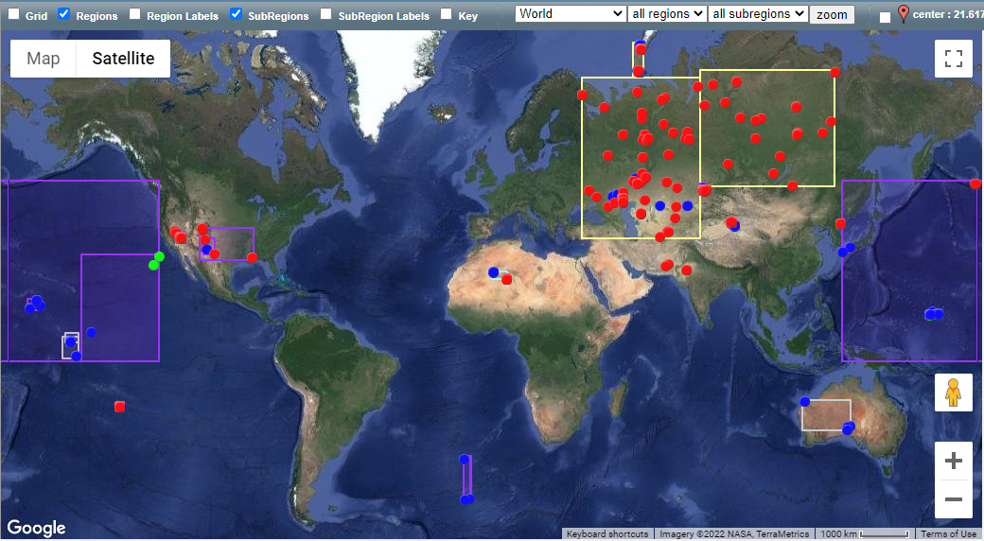
Waveforms From Nuclear Explosions (WFNE) Repository
Victoria Oancea, Yu-Long Kung, Jack Murphy, Paul Piraino, Jeffrey Given
Leidos, USA
P2.5-238
WFNE repository: collection of data for the 2157 nuclear explosions detonated in the world, obtained from open sources:
waveform segments and their associated metadata (station / instrument)
origin information, geophysical data and bulletin information for each nuclear explosion
Web-based access, updated presentation:
map and tabular display and selection
waveform preview interface and download
capability
New data added. Data collection continues.
User access is now open.
Please request access via web page:
https://www.wfne.info/

