Slide 1

Waveforms From Nuclear Explosions (WFNE) Repository
Victoria Oancea, Yu-Long Kung, Jack Murphy, Paul Piraino, Jeffrey Given
Leidos, USA
WFNE Repository includes data for all the 2157 underground, atmospheric and underwater nuclear explosions that were detonated in the world during 1945-2017. Web-based access allows users to visualize, select and download data.
Data were collected from OPEN sources: waveforms with associated metadata on station/instrument, source data, other geophysical data, and seismic bulletins. Data collection continues. Users are invited to contribute with their data.
WFNE stores over 81,000 waveforms associated to 802 of the nuclear explosions. Waveforms and parametric data can be easily accessed and downloaded. Table or map selection can be used. Event summaries for each test site are posted.
User access is now open. Request access via
https://www.wfne.info/
Please do not use this space, a QR code will be automatically overlayed
Cleared for release
P2.5-238

Slide 2
Introduction - 1
WFNE repository was developed and is maintained by Leidos under DTRA sponsorship:
  Built as a trusted data set, starting from the previous data repository “Nuclear Explosion Database (NEDB)” that was accessed in the past by numerous users in the US and international nuclear explosion community.
  Includes detailed information (origin, bulletin, other geophysical data) on all the 2,157 atmospheric, underground and underwater nuclear explosions detonated in the world during 1945 and 2017.
  Over 81,000 waveforms associated to 802 of the nuclear explosions ranging from digitized analog recordings for the oldest explosions to recent IMS data are included in WFNE, and their station/instrument information, as collected from many sources.
The web-based access and the presentation were updated and modernized and rendered ready for active user access.
Please do not use this space, a QR code will be automatically overlayed
P2.5-238

Slide 3
Introduction - 2
Users can search, visualize and download data of interest for their own research.
Data continues to be collected from newly identified sources. Recent efforts on rescue of pre-digital seismic data via scanning and digitization provide interesting data to be added to WFNE, after completeness and quality checks. WFNE is now open for the research community’s access to source parameter data and associated waveforms from worldwide nuclear explosions, at:
https://www.wfne.info/
Approved for public release (23-LEIDOS-0413-26279); distribution is unlimited.
The financial support for this effort was provided by the U.S. Department of Defense/Defense Threat Reduction Agency/Nuclear Arms Control Technology Program. Cleared for Release.
Please do not use this space, a QR code will be automatically overlayed
P2.5-238

Slide 4
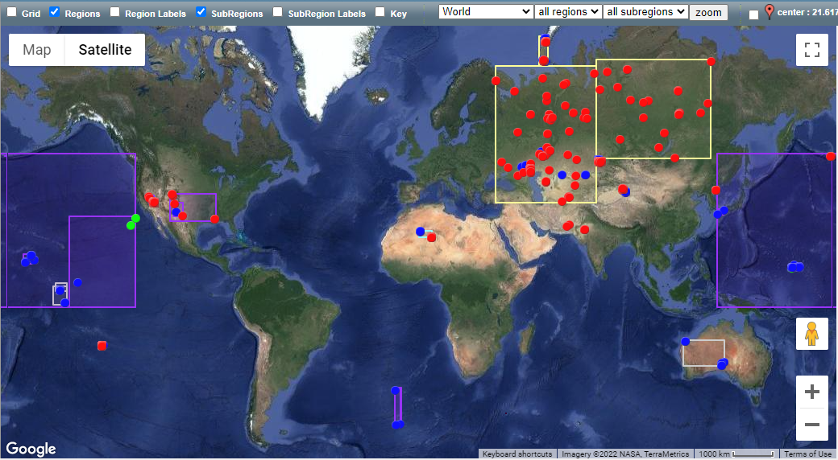
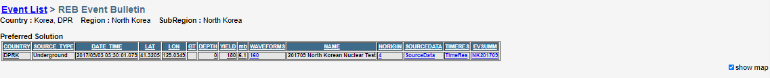
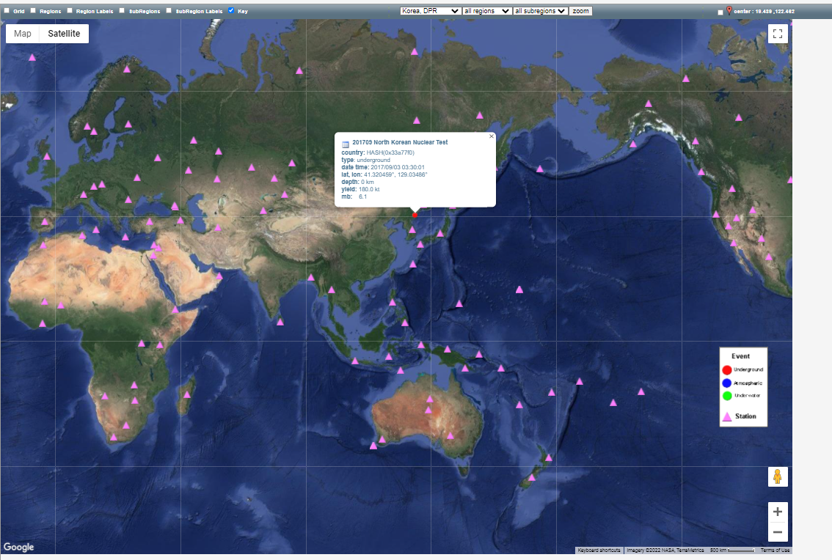
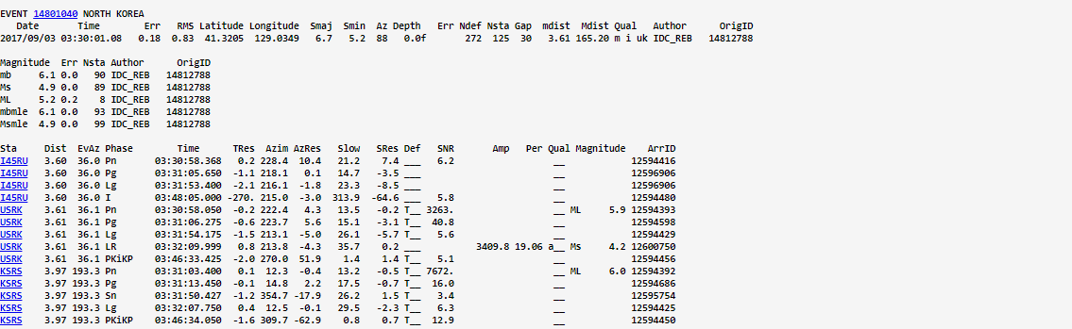
Objectives
Collect waveforms and metadata for the 2157 nuclear explosions detonated during 1945 – 2017:
  1631 underground, 518 atmospheric, 8 underwater
  18 regions and 45 sub-regions defined based on the geographical and geological setting of the explosions
Collect source data for all tests:
  7021 distinct origins for the 2157 nuclear explosions; a preferred origin for each test
  1524 GT 0-10 locations
  mb for 925 tests
  Ms magnitude for 230 tests
  yield for 2115 nuclear explosions
Collect other geophysical data
Collect bulletin data for 1155 tests: REB and ISC
Please do not use this space, a QR code will be automatically overlayed
Bulletin and station map
P2.5-238

Slide 5
Data - 1
Waveform data and associated metadata collected from open data sources :
  FDSN data centers
  IMS open stations
  national institutions
  published datasets
802 nuclear explosions
with associated waveforms
  Waveforms in CSS and SAC format
  For each waveform, station / instrument metadata is stored in the WFNE repository
  For each nuclear explosion origin information, bulletin data and geophysical data are stored in the repository
WFNE users are invited to contribute with data from
their institutions’ archives!
  Number of nuclear explosions detonated each year
  Number of nuclear explosions detonated by each country and number of tests with waveforms in WFNE
Please do not use this space, a QR code will be automatically overlayed
P2.5-238

Slide 6
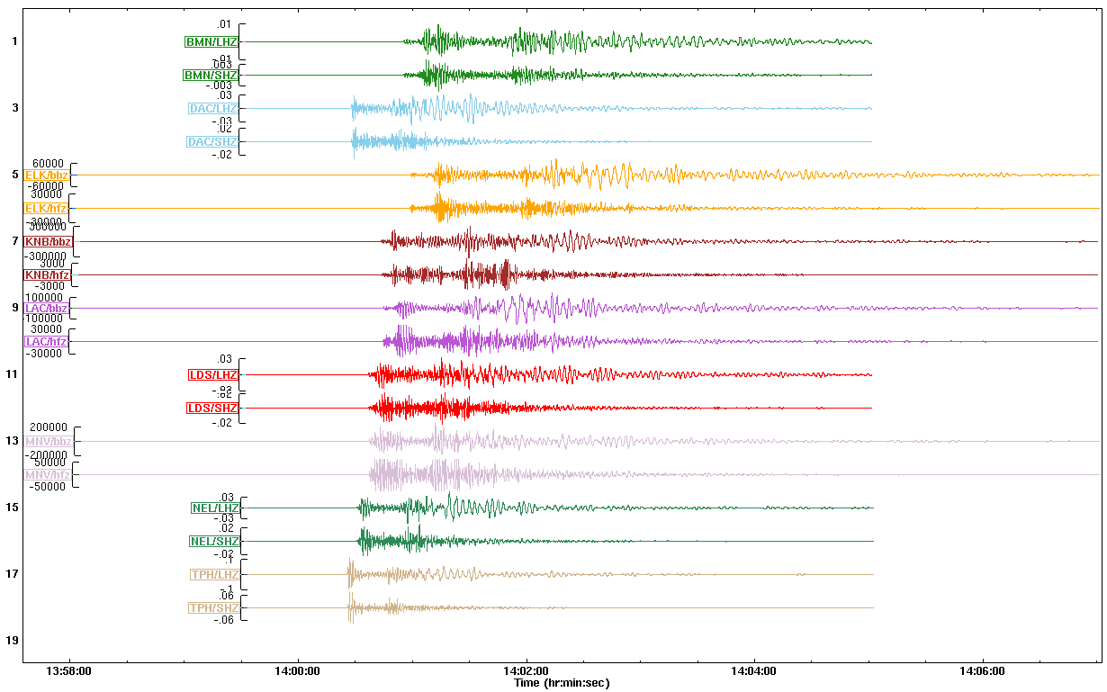
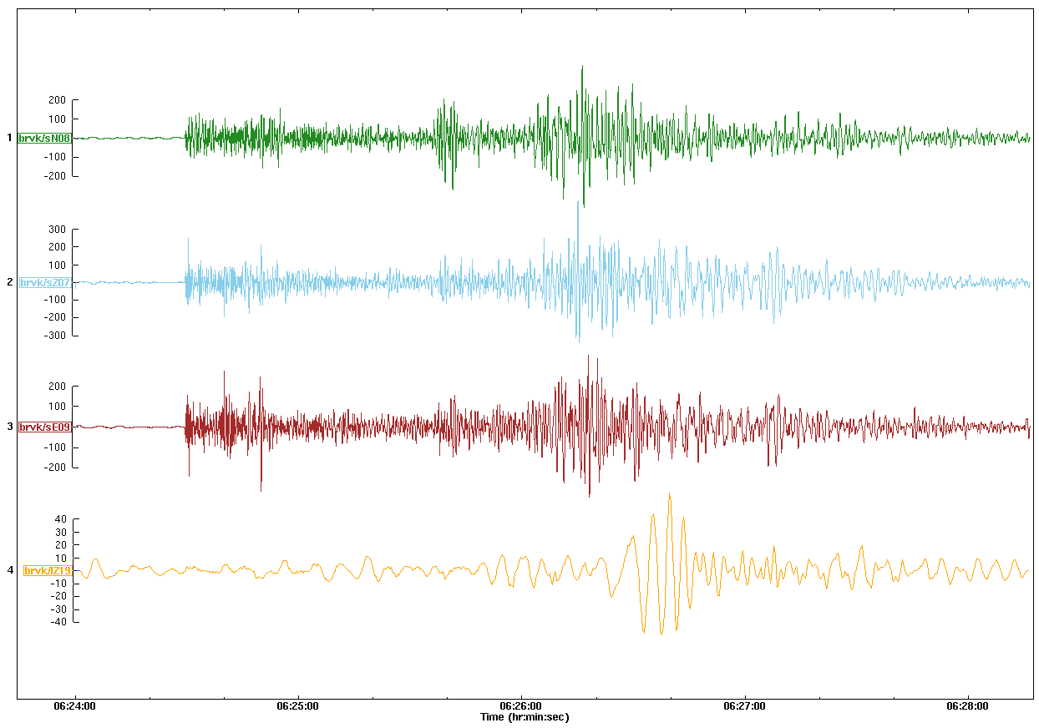
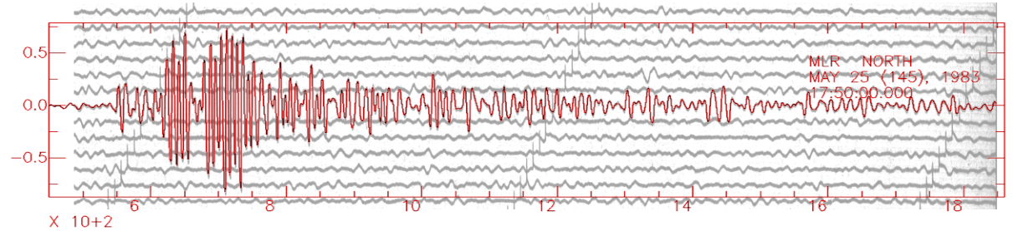
Data - 2
Data collection continues, including rescued legacy data.
Recently added data:
Recent efforts on rescue of pre-digital seismic data provide interesting data to be added
Waveforms from Western US dataset (Walter et al, 2004) – left , and from BRV deglitched dataset (Kim et al, 2010) – right.
Result of analog data digitization: nuclear explosion in
French Polynesia, May 25, 1983, mb 5.9, Muntele Rosu (MLR) station in Romania, 153 degrees: overlap - scanned analog seismogram and digitized seismogram (Oancea et al., 2021).
Please do not use this space, a QR code will be automatically overlayed
Result of analog data digitization: nuclear explosion in Semipalatinsk, Dec. 27, 1987, mb 6.0, Ak-Kiya (AAK) station in Kyrgyzstan, 8 degrees (Richards et al., 2015).
P2.5-238

Slide 7
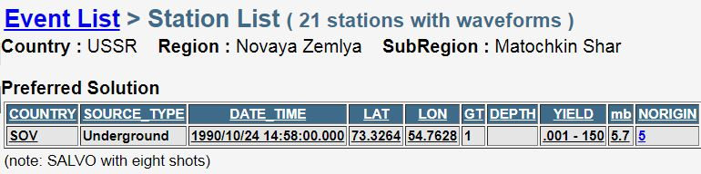
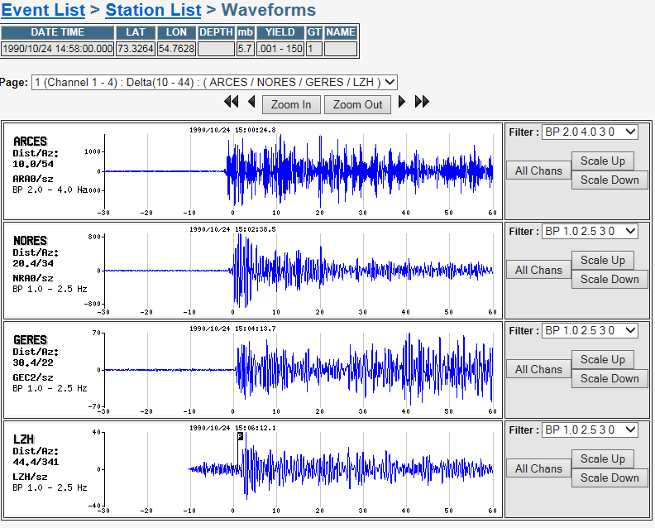
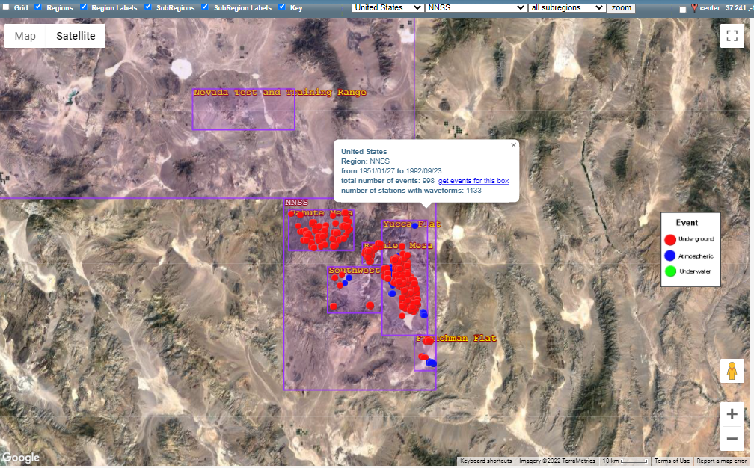
Results – 1
Archived waveform data for 802 WFNE nuclear explosions (over 81,000 segments): search, visualize and download
Availability of waveforms/station coverage
- Waveform selection and preview options
- Waveform and parametric data downloads (event bundles).
Please do not use this space, a QR code will be automatically overlayed
Map or tabular-based event selection
P2.5-238

Slide 8
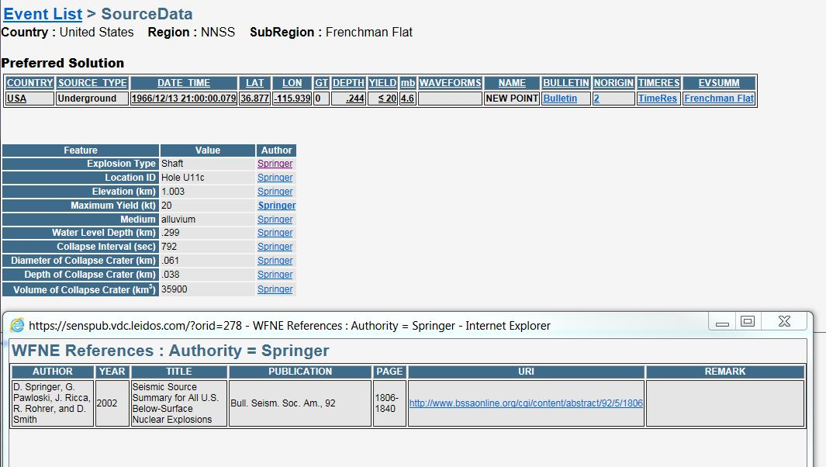
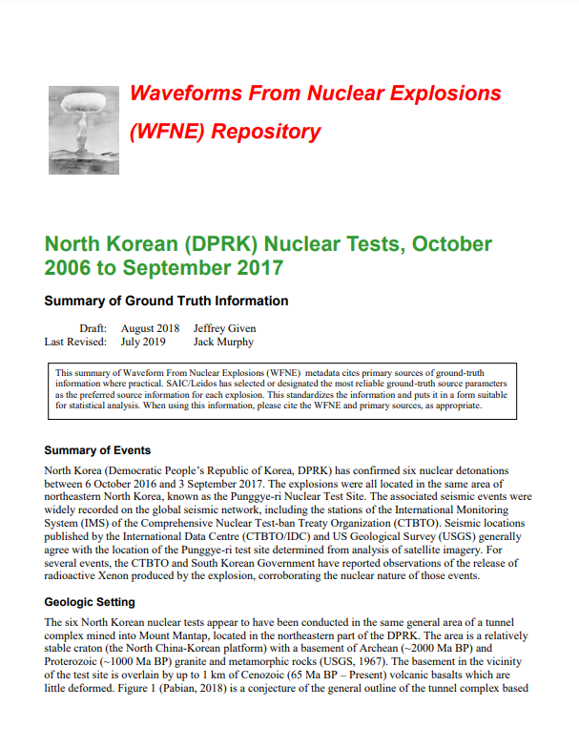
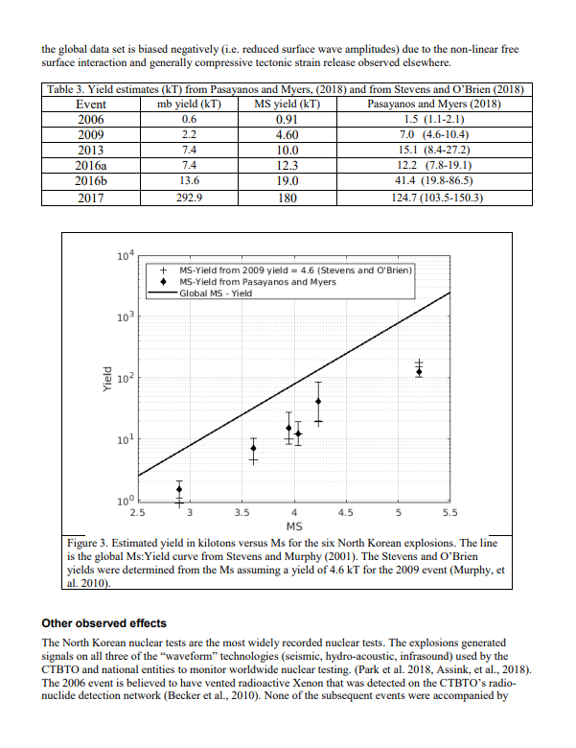
Results - 2
Associated geophysical metadata and references:
Event Summaries for each region:
Summary of ground truth and historical information for the explosions detonated in the region
Discussion of geological information, imagery vs. the seismic locations, magnitude and yield estimate, etc.
References
REB or ISC bulletin and station map can be visualized.
Seismic Travel Time Residuals for ISC and REB initial P relative to predictions from preferred origins using IASP91 (table and map) can be visualized.
Please do not use this space, a QR code will be automatically overlayed
P2.5-238

Slide 9
Conclusion - 1
WFNE repository contains waveform segments and their associated metadata (station/instrument).
For each nuclear explosion, origin information, geophysical data and bulletin information is included.
Information from new sources is being collected and added.
WFNE Web interface allows selection and display of repository data.
Event bundles can be downloaded. Bundles include parametric data, waveforms (in CSS and SAC format) and their associated metadata for each nuclear explosion.
Please do not use this space, a QR code will be automatically overlayed
P2.5-238

Slide 10
Conclusion - 2
User access is now open.
Please request access via web page:
https://www.wfne.info/
Please provide feedback using email on web page.
Please contact us to contribute with data from your institutions/stations/national networks.
Please do not use this space, a QR code will be automatically overlayed
P2.5-238

