Slide 1
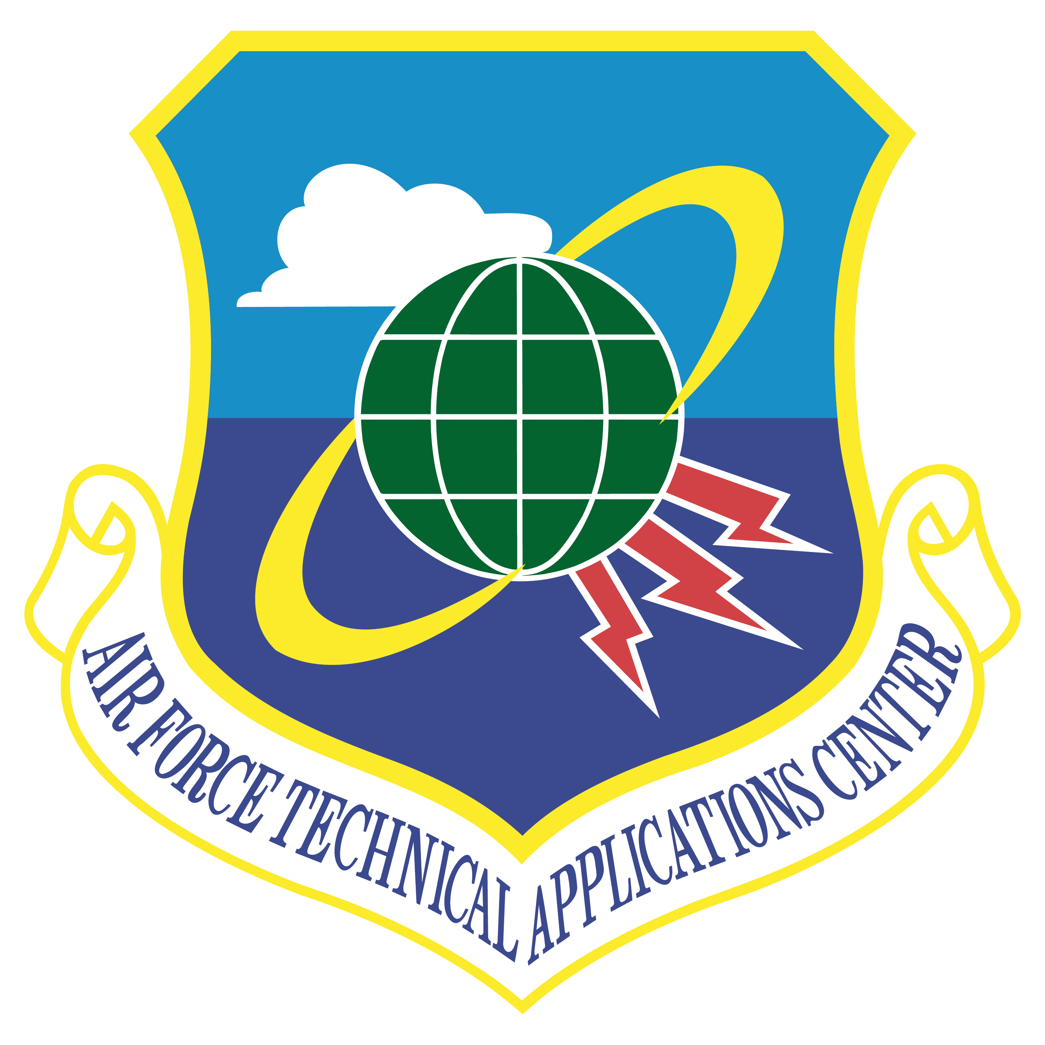
The Air Force Technical Application Center (AFTAC) Efforts to Collect, Preserve and Integrate Historic Geophysical Data
Lillian Soto-Cordero, Michael Jezard, Alan Poffenberger
P2.5-439
Historical geophysical data provide critical empirical information to better understand, discriminate and model nuclear explosions.
Please join our poster presentation to learn about AFTAC’s efforts to preserve and use historic data from nuclear tests.
Using digitized legacy data AFTAC seeks to:
create a curated reference database
identify continuously operating stations (stations that recorded historic nuclear tests and continue to operate at present)
Regarding our analog data, we will:
describe our effort to identify their content, condition, and preservation needs
discuss how we assess the level of deterioration and ways to slow-down the vinegar
syndrome affecting some of our microfiches

