Slide 1
The Air Force Technical Application Center (AFTAC) Efforts to Collect, Preserve and Integrate Historic Geophysical Data
Lillian Soto-Cordero, Michael Jezard, Alan Poffenberger
Geophysical Capabilities and Assessments, AFTAC
We provide an overview of AFTAC’s work to rescue and preserve legacy data through two separate efforts: one focused on historic nuclear test data already digitized and a second one on analog data.
We seek to create a curated reference database and identify continuously operating stations to be integrated into our systems.
We implemented quality control criteria (Slide 4, Slide 5) for our analysis of digitized data.
We are investigating our analog data holdings to identify its content and preservation needs.
We identified a couple of dozen continuously operating stations by using QC measures as part of our analysis of data from ~300 stations.
AFTAC analog holdings show a diverse volume of media. Emphasis was placed on assessing the level of deterioration and how to slow-down the vinegar syndrome affecting some of our microfiches.
Emphasis on waveform & station metadata QC supports the development of a curated reference database for historic nuclear explosions, as well as other products.
An effort to inventory AFTAC’s analog geophysical nuclear test data identify various challenges that need to be considered when developing strategies for the preservation of our data.
Please do not use this space, a QR code will be automatically overlayed
P2.5-439

Slide 2
AFTAC’s Legacy Data Efforts – Present and Future
Digitized Geophysical Data
Analog Geophysical Data
Products
Quality Control (QC)
Develop Waveform QC criteria
Develop metadata QC criteria
Product
Future needs
Inventory & interface
Continuous Stations
Inventory
Triage
Curated database
Assess methodologies & equipment to scan and digitize
Present day conditions assessment
Develop QC assessment GUI
Apply for funding
Data Collection
Collect AFTAC digitized data
Collect data from external sources
Scanning & digitization
Please do not use this space, a QR code will be automatically overlayed
Legend for task/product status:
Not started
In progress
Completed
Green=task; orange=products
P2.5-439

Slide 3
Objectives
Digitized geophysical data:
1. Development of Quality Control (QC) criteria for:
legacy waveforms
metadata
present-day stations conditions
2. Application of QC criteria to identify Continuous Stations that:
have recorded legacy events
have documented instrument information during the legacy time period
continue to operate at the present
and have current station metadata and instrument information
Analog geophysical data:
1. Fact-finding mission for identification of:
media types
location and accessibility
volume
level of deterioration
prioritization criteria for rescue & preservation
Please do not use this space, a QR code will be automatically overlayed
P2.5-439

Slide 4
Methods – Digitized Geophysical Data
Digitized geophysical data – Waveform QC
Criteria | Description | Criteria Score | Weight (%)
Phase Onset | Clear, well-defined, easily identifiable onset of seismic waves | 1 – Clear P & S/Lg waves onsets 0.5 – Clear P wave onset, ambiguous S onset; vice versa 0 – Ambiguous/imperceptible P & S onsets | 20
Whole Waveform | A substantial part of the wave train present which will potentially support CodaMag calculations and/or waveform modeling | 1 – Entirety of the signal present; Signal duration for regional events: a. 10 minutes from Origin Time (surface waves) b. 5 minutes from Lg (for CodaMag calculations) 0.5 – Segment of waveform including a phase (P, S, Lg) 0 – Small segment of waveform with no clear phase arrival | 20
Clipping | Lack of clipped signals; signal amplitude greater than the instrument dynamic range. Shown as cut across trace | 1 – No clipping identified 0 – Clipping observed | 15
Spurious Signal | Lack of spurious signals (e.g., data spikes) | 1 – No spurious signals present 0 – Spurious signals present | 12.5
Anomalous Recording | Lack of anomalies such as: error with sensor/recorder, DC offset, jumps(steps), multiple arrivals (constructive/deconstructive interference from other sources) | 1 – No anomalies identified 0 – Anomalies observed | 12.5
Background Signal | Length of background signal before P onset | 1 - 10 or more seconds of background signal present 0 - Less than 10 seconds of background signal present | 10
Data Gap | Lack of data gaps A gap is defined as missing data for more than 1 second | 1 – No gaps identified 0 – Data gaps present as defined | 10
Please do not use this space, a QR code will be automatically overlayed
P2.5-439

Slide 5
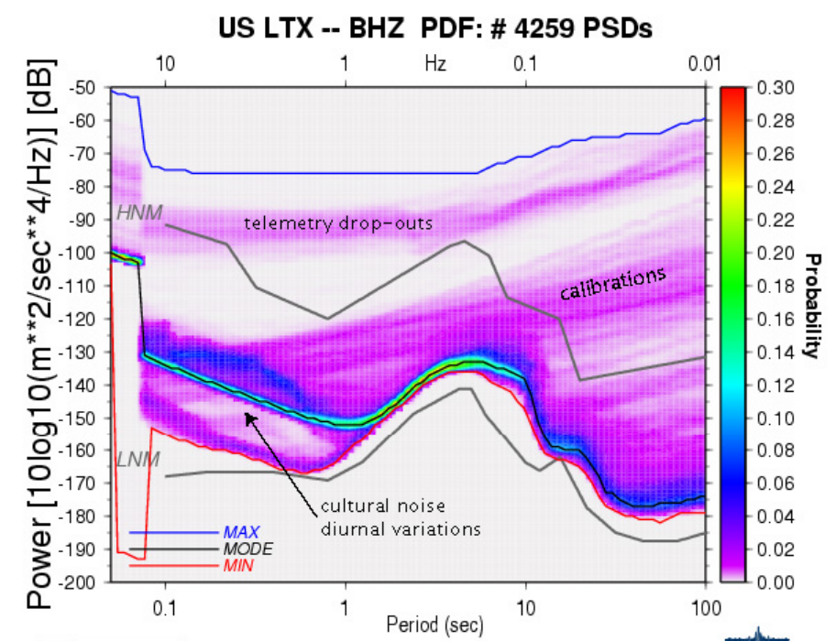
Methods – Digitized Geophysical Data
Digitized geophysical data – Metadata QC
Criteria | Description | Options | Weight
Station Coordinates | Station latitude, longitude, and elevation during legacy time | 1 - All three parameters provided 0 - Missing at least one parameter | 40
Instrument Response | Instrument response available | 1 - Instrument response is available for the station 0 - No instrument information available | 35
Corrections | Documentation of corrections during digitization: time corrections, corrections for curvilinearity, etc. | 1 - Documentation of corrections applied is available 0 - No corrections documented | 25
Digitized geophysical data – Present-day station conditions assessment
Station data availability >70%
Seismic power spectral density function:
station minimum power below -155 dB
mode below -135 dB; for the 1-10 Hz range
1- and 10-year period evaluated
Use of IRIS LASSO &
MUSTANG tools
McNamara and Boaz, 2005
Please do not use this space, a QR code will be automatically overlayed
Bad <70% data availability
Acceptable >70% availability & 1 noise threshold
Good >70% availability & 2 noise thresholds
Categories
P2.5-439

Slide 6
Results – Digitized Geophysical Data
Digitized geophysical data -- integration of QC results for Continuous Stations identification
Network | Station | Current Conditions Station Quality | Legacy Data Quality
A | X1 | Good | Acceptable
B | M5 | Acceptable | Acceptable
B | V3 | Good | Good
A | J8 | Bad (borderline acceptable) | Acceptable
C | S6 | Acceptable | Good
 | Will recommend. Current station quality=Good & Legacy data quality=Good
 | Likely to recommend. Current station quality=Good & Legacy data quality=Acceptable or vice versa.
 | Do not recommend. Current station quality=Acceptable & Legacy data quality=Acceptable.
 | Do not recommend. Current station quality or Legacy data quality=Bad.
Example
Analysis of over 300 stations from 1 dataset with respect to a region of interest (ROI):
A couple of dozen stations identified for potential integration into our systems.
Additional Considerations:
Each dataset is evaluated by a single analyst
Project analysts undergo a period of training
A guide with examples for each quality control criteria is used as a training tool
Document describing continuous station procedures facilitates replicability
Please do not use this space, a QR code will be automatically overlayed
P2.5-439

Slide 7
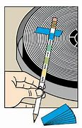
Results – Analog Geophysical Data
Analog geophysical data
Some Challenges:
Data volume - ~ ¼ to ½ million microfiches, thousands of films and magnetic tapes, countless paper records
Vinegar syndrome - a chemical reaction (temperature and relative humidity (Rh) dependent) that deteriorates acetate film/microfiche over time. It releases acetic acid which, in turn, accelerates degradation.
Vinegar syndrome assessment:
level of deterioration
media handling & storage
staff health & safety
A-D strips testing
Most containers are Ok
2 – low level of degradation
Adopted procedures from Film Industry
Daily T and Rh monitoring
Air purifier
Gloves use
Use different rooms for microfiche storage and QC
AFTAC Safety Office
Independent air quality assessments
Results much lower than the irritative threshold for acetic acid
Granted Ok to continue work
Please do not use this space, a QR code will be automatically overlayed
P2.5-439

Slide 8
Conclusions
Main takeaways:
AFTAC’s efforts with digitized legacy data is focused on developing products that support our research & operational needs: continuous stations identification, curated reference database and inventory & interface.
AFTAC is developing uniform and systematic criteria for event inclusion into a curated reference database.
Emphasis on waveform & station metadata QC
An effort recently started to inventory, rescue and preserve AFTAC’s analog geophysical nuclear test data. We are confronting the following challenges: data volume, impact of and need to slow-down vinegar syndrome affecting microfiches, limited resources and funding.
Please do not use this space, a QR code will be automatically overlayed
P2.5-439

