Slide 1
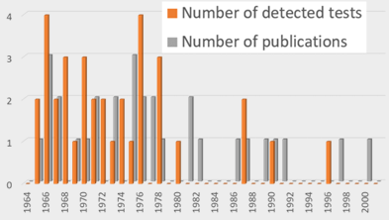
Frequency of radionuclides reported in remote atmospheric observations of historic nuclear test explosions
Martin Kalinowski
International Data Centre (IDC), Comprehensive Nuclear-Test-Ban Treaty Organization (CTBTO), Vienna, Austria
This study is breaking ground by digging into the treasure of historic radionuclide observations associated with nuclear test explosions.
These data are precious for method validation and training to be based on real events of CTBT relevance.
The frequency of historic reported radionuclides is compared with lists of CTBT relevant isotopes.
Good to know: All 17 historically observed fission products and all but one activation product in IMS-like samples are included in the CTBTO list of relevant radionuclides.
List of radioisotopes that are reduced to put focus on most significant radioisotopes are missing several ones.
Challenge for screening and event characterization:
14 of the 25 isotopes most frequently observed in IMS radionuclide samples were observed in debris from nuclear tests.
More important lessons are still to be learned from historic data.
Please do not use this space, a QR code will be automatically overlayed
P2.5-320

Slide 2
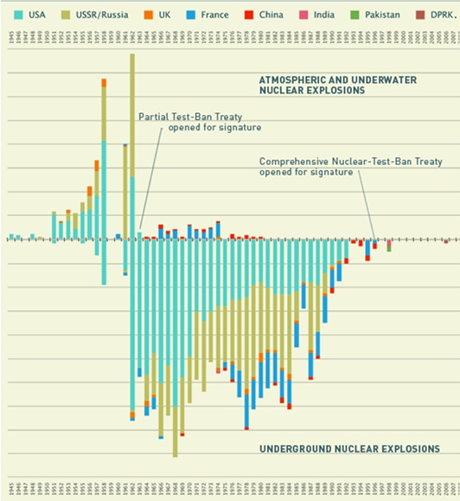
Introduction
All atmospheric and underground tests
The observation of atmospheric radionuclides that are associated with nuclear test explosions has a long history that started already in the 1940s.
Over the decades of nuclear testing the methods were refined and mounted into the high-quality systems implemented in the International Monitoring System of the CTBTO.
The project presented here is reviewing the publications about off-site monitoring of nuclear tests.
In fact, many observations were done at large distances and often nuclear tests were detected at multiple locations, in general in the same hemisphere.
Most publications are associated to tests that occurred in the atmosphere but observation of nuclear debris from venting of underground nuclear tests were also found.
P2.5-320
Please do not use this space, a QR code will be automatically overlayed

Slide 3
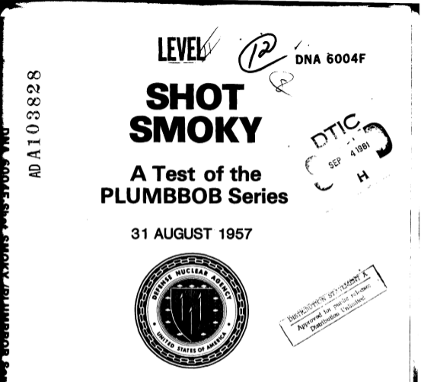
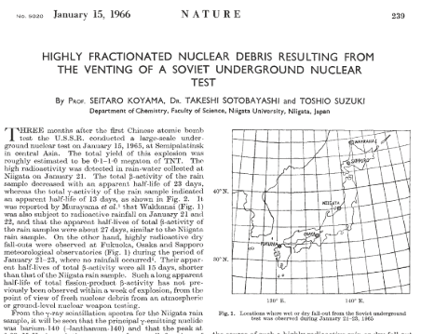
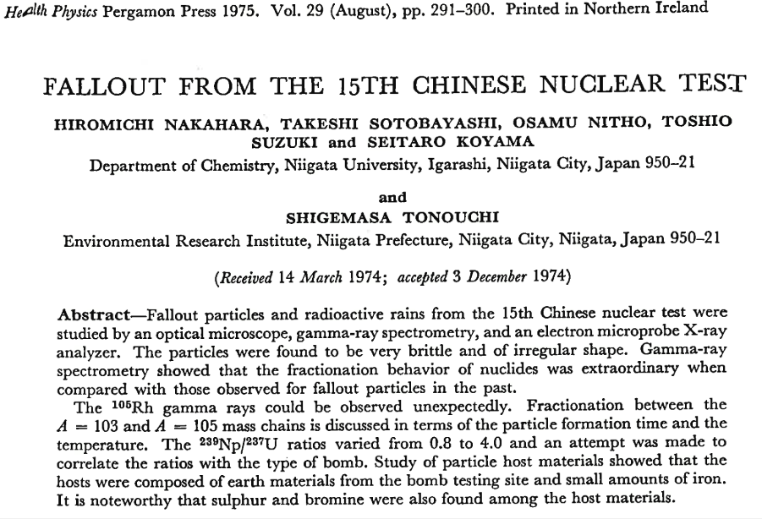
Objectives
What can we learn from historic radionuclide observations in the atmosphere that are associated with nuclear test explosions?
This presentation uses data of historic nuclear tests to check how well currently implemented methods for CTBT radioactivity monitoring match historic experience.
P2.5-320
Please do not use this space, a QR code will be automatically overlayed

Slide 4
Methods(1/2)
Literature review retrieved 74 original publications that report with sufficient detail about historic observations of atmospheric radioactivity associated with a specific nuclear test.
Numbers over the years, according to Kalinowski (2021) for
Tests per year that were detected (in total: 35) and
Publications (in total: 30 out of the total of 74)
P2.5-320
Please do not use this space, a QR code will be automatically overlayed

Slide 5
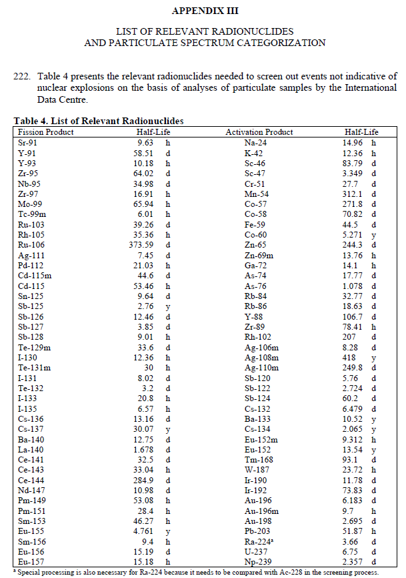
Methods (2/2)
The frequency of radionuclides in remote atmospheric observations of historic nuclear test explosions is compared to several radionuclide lists considered for nuclear explosion monitoring to explore how these lists match the historic evidence.
CTBTO (2020): CTBT-relevant radionuclides for sample categorization
De Geer (2001): CTBT-relevant radionuclides according to model and experience
Miley et al. (2001): Likelihood of detecting radionuclides at IMS stations and laboratories
Matthews (2005): 20 fission products and 3 fuel products with verification significance
P2.5-320
Please do not use this space, a QR code will be automatically overlayed

Slide 6
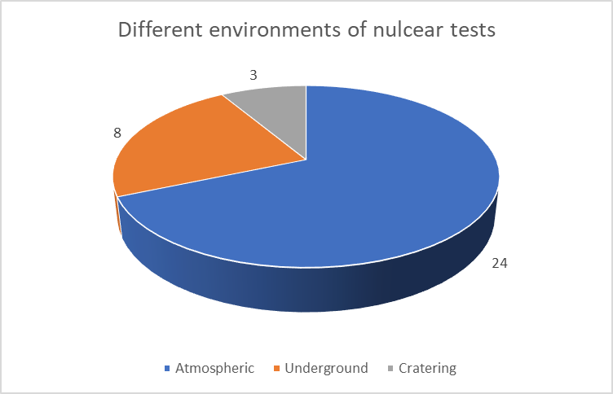
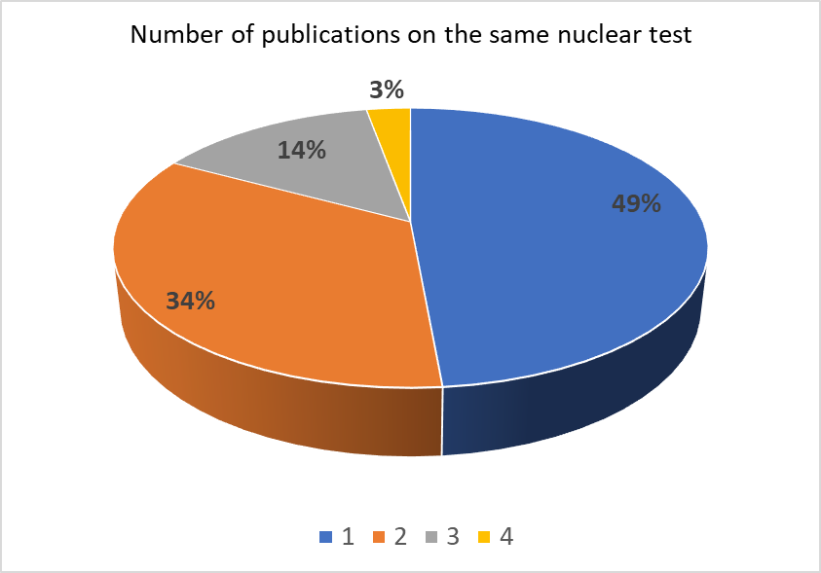
Results (1/4)
P2.5-320
Statistics on remote atmospheric observations of historic nuclear test explosions by:
Environment of nuclear test
Number of publications covering the same nuclear test
Please do not use this space, a QR code will be automatically overlayed

Slide 7
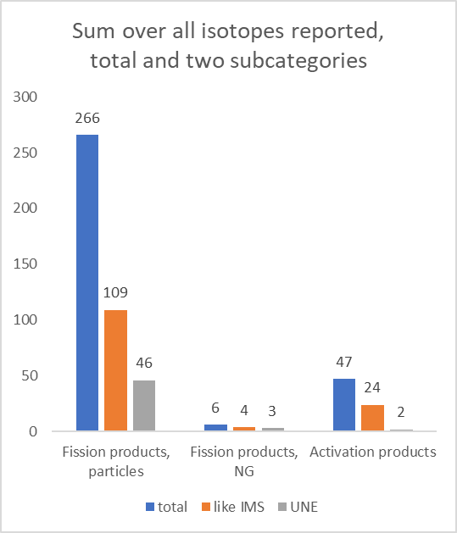
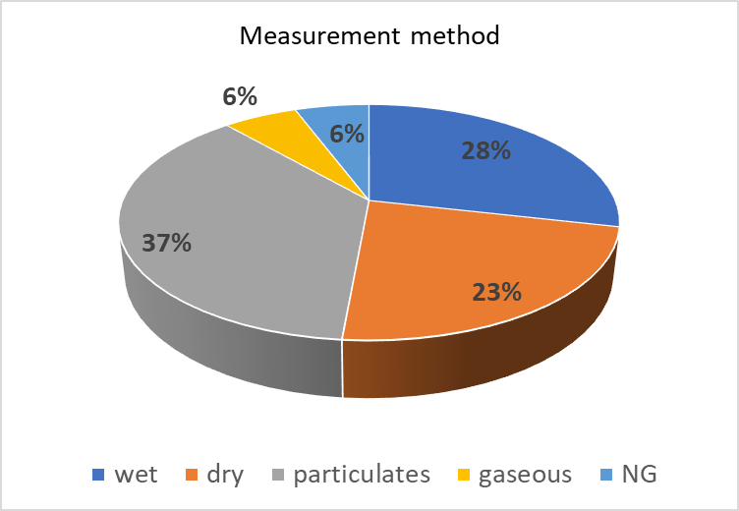
Results (2/4)
P2.5-320
Statistics on:
Measurement method
Frequency of radionuclides
Please do not use this space, a QR code will be automatically overlayed

Slide 8
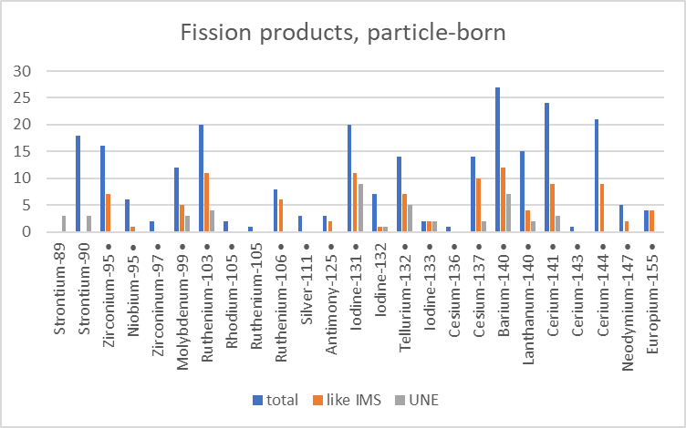
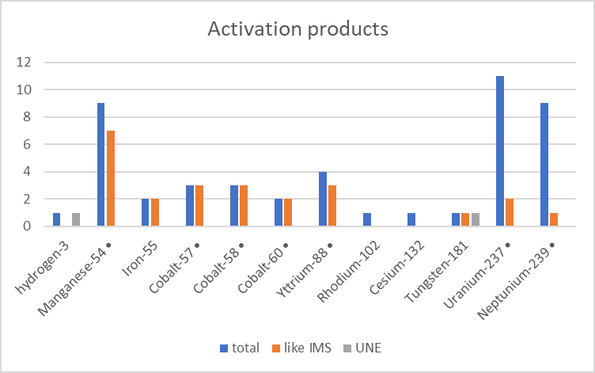
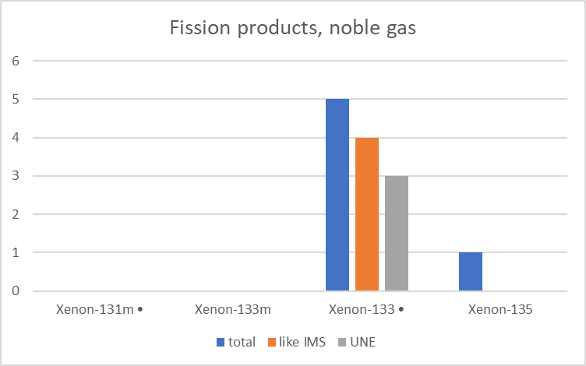
Results (3/4)
The frequency of radionuclides in remote atmospheric observations of historic nuclear test explosions by type:
Fission products, particle born
Fission products, noble gas
Activation products
P2.5-320
Please do not use this space, a QR code will be automatically overlayed

Slide 9
Results (4/4)
1. CTBTO (2020): CTBT-relevant radionuclides for sample categorization
All 17 historically observed fission products in IMS-like samples are included in the CTBTO list of relevant radionuclides.
All but one of 9 activation products in IMS-like samples are included as well.
Not included is Fe-55.
2. De Geer (2001): CTBT-relevant radionuclides according to model and experience
Same as above because CTBTO (2001) was mainly derived from De Geer (2001).
3. Miley et al. (2001): Likelihood of detecting radionuclides at IMS stations and laboratories
Ru-103, Sb-125 Eu-155 do not appear
Ru-106, I-131, I-132, I-133 appear in the list of isotopes to be detected in the laboratory
no activation products considered
4. Matthews (2005): 20 fission products and 3 fuel products with verification significance
Ru-106, Sb-135, Cs-137, Eu-155 do not appear
U-237 and Np-239 appear as fuel products
but no activation products considered
P2.5-320
Please do not use this space, a QR code will be automatically overlayed

Slide 10
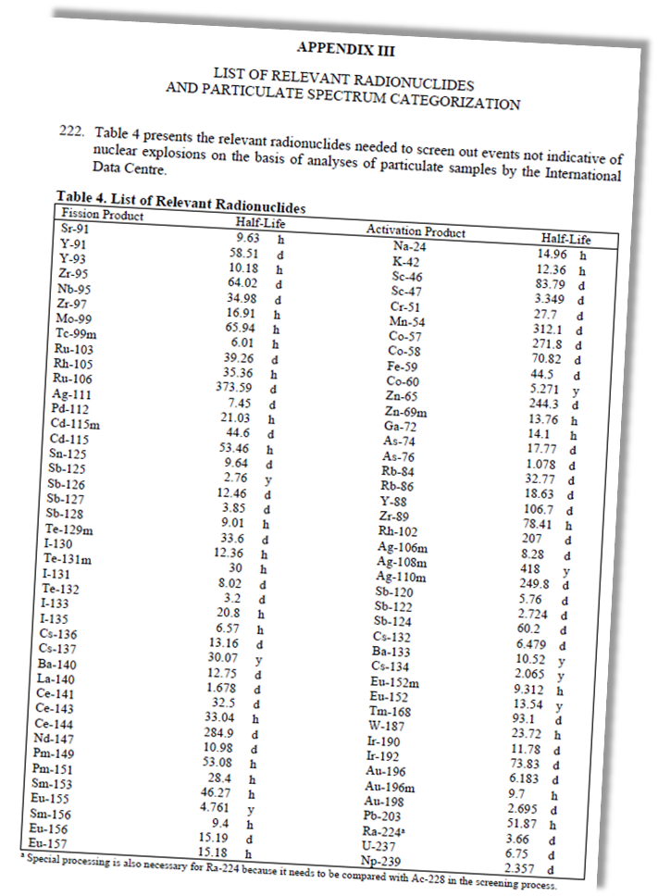
Conclusions (1/2)
Conclusions from reported isotope frequencies for event screening
Radionuclide lists considered for nuclear explosion monitoring:
CTBTO (2001) and De Geer (2001): is sufficiently comprehensive because it includes all isotopes that were reported from historic tests except Fe-55 (observed two times). This is not a surprise because historic observations were used for aggregating the list of CTBT relevant isotope.
List of radioisotopes that are reduced to put focus on most significant radioisotopes: missing several ones that were actually observed following nuclear tests.
Comparison with the 25 radioisotopes most frequently seen by the IMS
14 of the 25 isotopes most frequently observed in IMS radionuclide samples were observed in debris from nuclear tests.
Out of these, the 4 radioxenon isotopes are among the top 6 most frequently observed isotopes while being the most likely ones to escape from underground nuclear tests.
P2.5-320
Please do not use this space, a QR code will be automatically overlayed

Slide 11
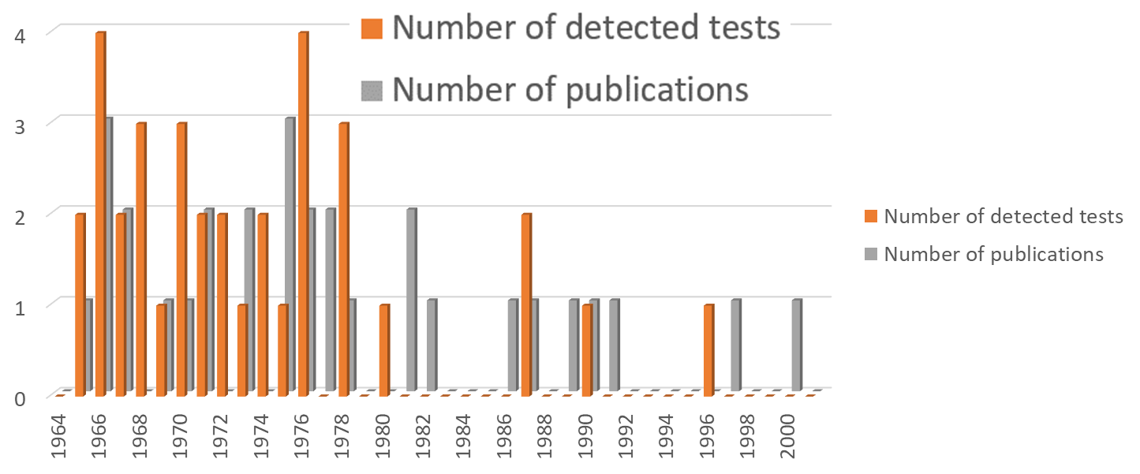
Conclusions (2/2)
Conclusions on the relevance of historic radionuclide data
The historic radionuclide observations associated with nuclear test explosions remain an almost untapped treasure. There are more data to be retrieved and more lessons to be learned.
The data set presented here is of value for validating and enhancing methods based on radionuclide analysis and related atmospheric transport simulations with the objective of identifying and characterizing the source of an event that is of relevance for CTBT radioactivity monitoring.
Historic observations may serve for trainings, NDC preparedness exercises and scenarios for developing methods and procedures of Expert Technical Analysis of events of special interest.
In addition to reports about measurements and their interpretation, the raw spectral data could be of interest for testing spectrum analysis software and interactive review.
P2.5-320
Please do not use this space, a QR code will be automatically overlayed

Slide 12
References
De Geer, L. E. (2001). Comprehensive nuclear-test-ban treaty: relevant radionuclides. Kerntechnik, 66(3), 113-120.
CTBTO (2020) Draft Operational Manual for the International Data Centre. CTBT/WGB/TL-11,17/19/Rev.7. 20 July 2020 (latest available revision).
Kalinowski (2021). Overview on historic atmospheric radionuclide monitoring data associated with nuclear test explosions conducted between 1964 and 1996. Presentation O2.5-481 at SnT2021. https://conferences.ctbto.org/event/7/contributions/1007/attachments/321/806/O2.5-481_HistoricRNobservations.pptx
Matthews, K. M. (2005). The CTBT verification significance of particulate radionuclides detected by the International Monitoring System. Ministry of Health, National Radiation Laboratory. https://www.moh.govt.nz/notebook/nbbooks.nsf/ea5ef2c0e4ab8ac485256caa0065e3eb/856377d65427ad6fcc257346006f47e0/$FILE/2005-1.pdf.
Miley, H. S., Arthur, R. J., Lepel, E. A., Pratt, S. L., & Thomas, C. W. (2001). Evaluation of fission product isotopes for field or laboratory detection. Journal of Radioanalytical and Nuclear Chemistry, 248(3), 651-656. https://link.springer.com/article/10.1023/A:1010628325496
P2.5-320
Please do not use this space, a QR code will be automatically overlayed

