Slide 1
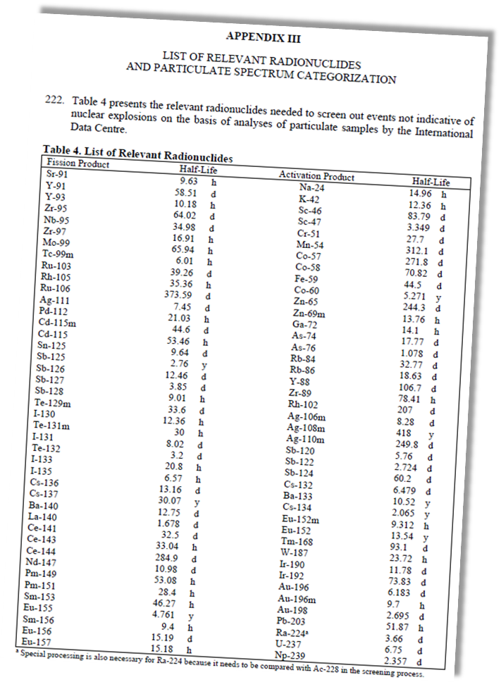
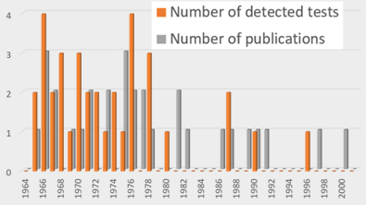
Frequency of radionuclides reported in remote atmospheric observations of historic nuclear test explosions
Martin Kalinowski
International Data Centre (IDC), Comprehensive Nuclear-Test-Ban Treaty Organization (CTBTO), Vienna, Austria
P2.5-320
Objective: What can we learn from publications about radionuclide observations of historic nuclear tests?
Method: The number of reports for each radionuclide are compared with four different lists of CTBT relevant radionuclides.
How many different nuclides were found?
Which nuclides were most frequently reported?
Are lists of CTBT relevant nuclides matching real observations?
Any “surprise” isotopes?
How do nuclear test signals compare to normal background of IMS observations?
See the e-poster and discuss with us the conclusions that we draw.

