Slide 1
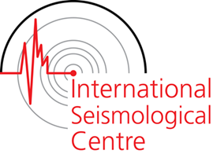
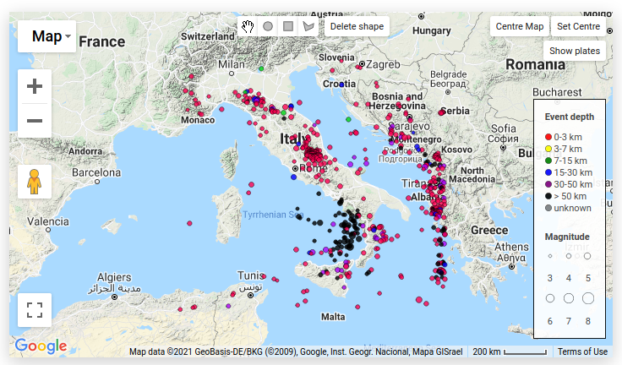
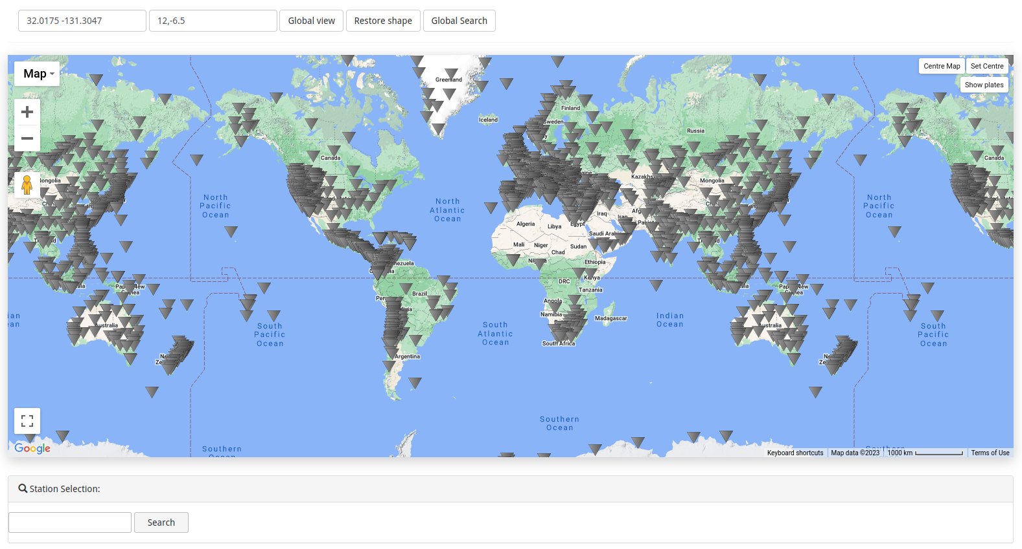
CTBTO Link to the ISC Database Providing Access To Present and Historical Data
D. A. Storchak, R. Gallacher
P2.5-450
The International Seismological Centre (ISC) maintains the most long-term, complete and accurate account of seismic events recorded at seismic stations of ~150 networks worldwide
The CTBTO Link website provides NDCs and PTS with access to ISC products: ISC Bulletin, Ground Truth list (including nuclear explosions), ISC-EHB, ISC Event Bibliography and the IDC Reviewed Event Bulletin (REB)
Please stop by the ISC Booth (13) if you have any questions!

