Slide 1
Relocation of the Central Asia Comprehensive Seismic Bulletin
István Bondár¹, Kevin Mackey², Anna Berezina³, Natalia Mikhalova⁴, Rengin Gök⁵, Andrea Chiang⁵
¹Institute for Geological and Geochemical Research, Research Centre for Astronomy and Earth Sciences, ELKH, Budapest, Hungary
²Michigan State University, East Lansing, MI, USA
³Institute of Seismology NAS KR, Bishkek, Kyrgyzstan
⁴Kazakhstan National Data Center, Almaty, Kazakhstan
⁵Lawrence Livermore National Laboratory, Livermore, CA, USA
Place your QR Code here after removing this text box!
P2.5-186

Slide 2
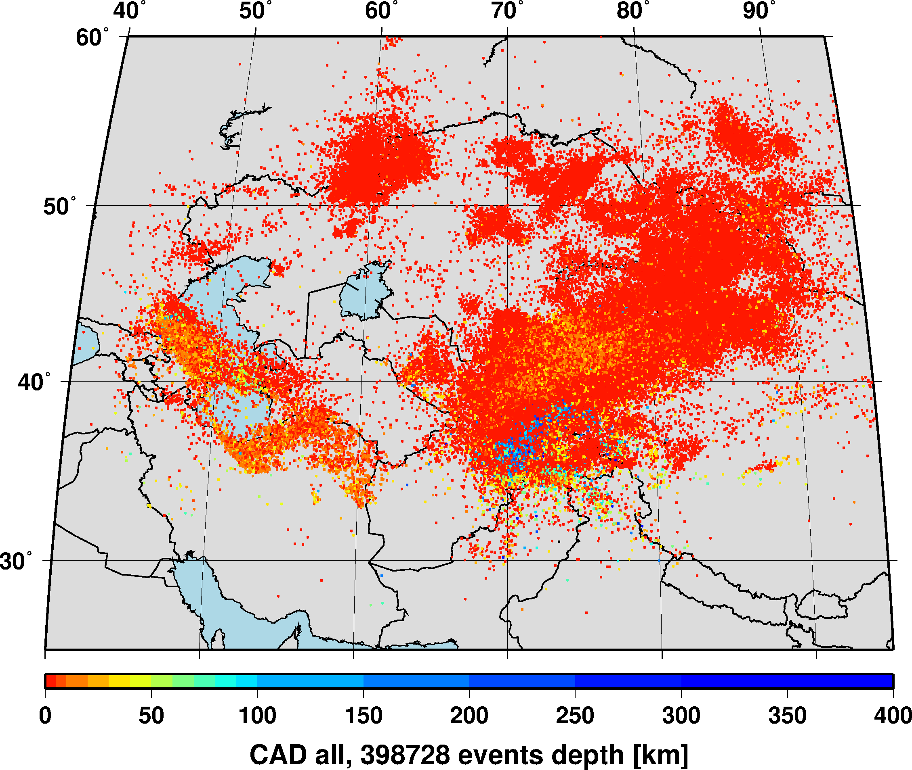
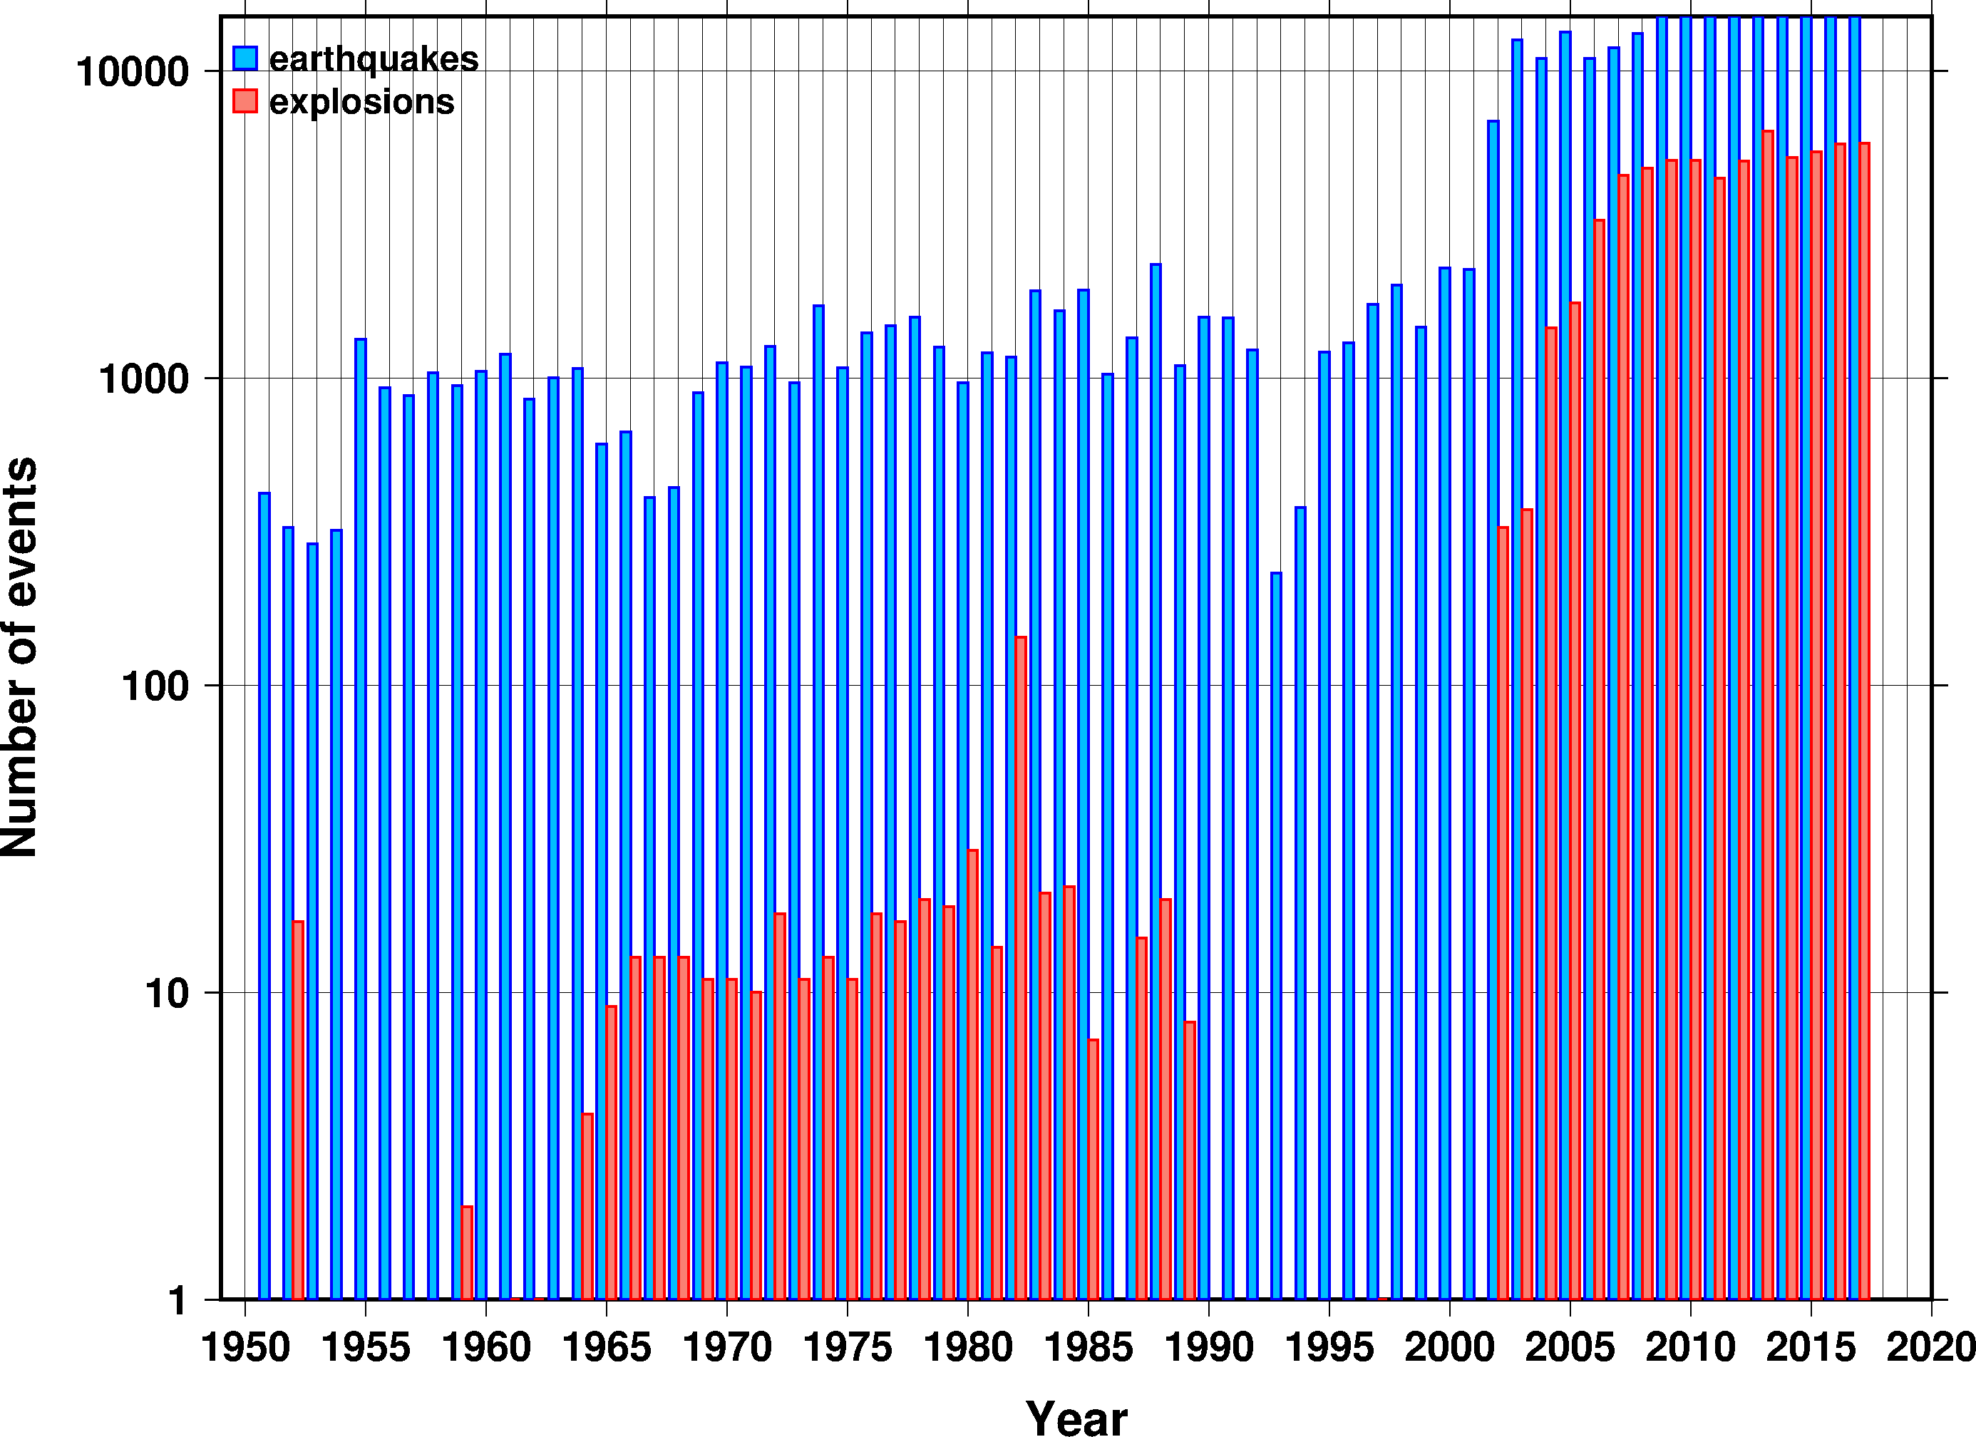
Introduction
The Lawrence Livermore National Laboratory, Michigan State University, and NDCs in Central Asia (Kazakhstan, Kyrgyzstan and Tajikistan) digitized seismic bulletins of analog stations between 1951 and 1992. The metadata of all seismic stations of that period were also collected. The national network bulletin data were then combined with the International Seismological Centre bulletin to form the comprehensive bulletin for Central Asia between 1951 and 2017. The bulletin consists of ~400,000 events and will serve the basis of the new probabilistic seismic hazard analysis for the region.
We present the relocation results of the comprehensive Central Asia bulletin. We selected events with less than 355° secondary azimuthal gap, and using the MSU High Performance Computing facilities, we relocated ~250,000 events with iLoc, a single event location algorithm using RSTT predictions to improve locations. We developed a hierarchical review strategy to perform a thorough manual review with strict quality control. We show that each stage of the manual review brings incremental improvements. We also identified new Ground Truth and anthropogenic events in the region.
The results show significant improvements in the view of seismicity, providing reliable input for the PSHA and allowing for a more accurate determination of active seismic zone boundaries.
Place your QR Code here after removing this text box!
P2.5-186

Slide 3
Objectives
Compile a comprehensive seismic bulletin for Central Asia in cooperation with the NDCs in Kazakhstan, Kyrgyzstan and Tajikistan by digitizing and adding data not yet reported to the ISC
Relocate the events with iLoc using the three-dimensional RSTT velocity model travel time predictions
Review the automatic iLoc locations to improve the bulletin
Identify new ground truth events
The results shall serve as input for Probabilistic Seismic Hazard Analysis in the region as well as for seismic tomography studies
Place your QR Code here after removing this text box!
P2.5-186

Slide 4
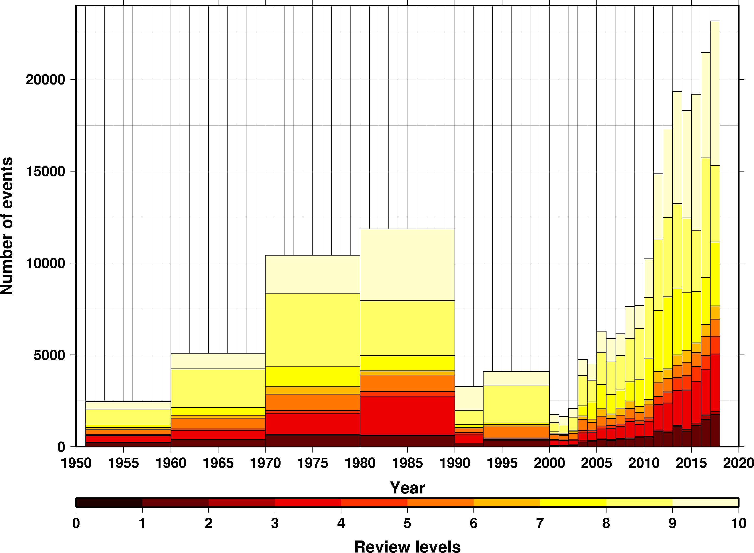
Methods/data
The number of events to be reviewed is almost exponentially increasing with time. Automatic solutions may get stuck in a local minima, produced airquakes or the default depth value was not the best choice for depth. A manual review may also detect split/joined or fake events. No automatic procedure can deal with these issues.
We devised a strategy for the manual review that prioritizes the events by the potential severity of location problems
During the manual review we improved locations, threw out poorly located events, and paid special attention to deep events.
Place your QR Code here after removing this text box!
P2.5-186

Slide 5
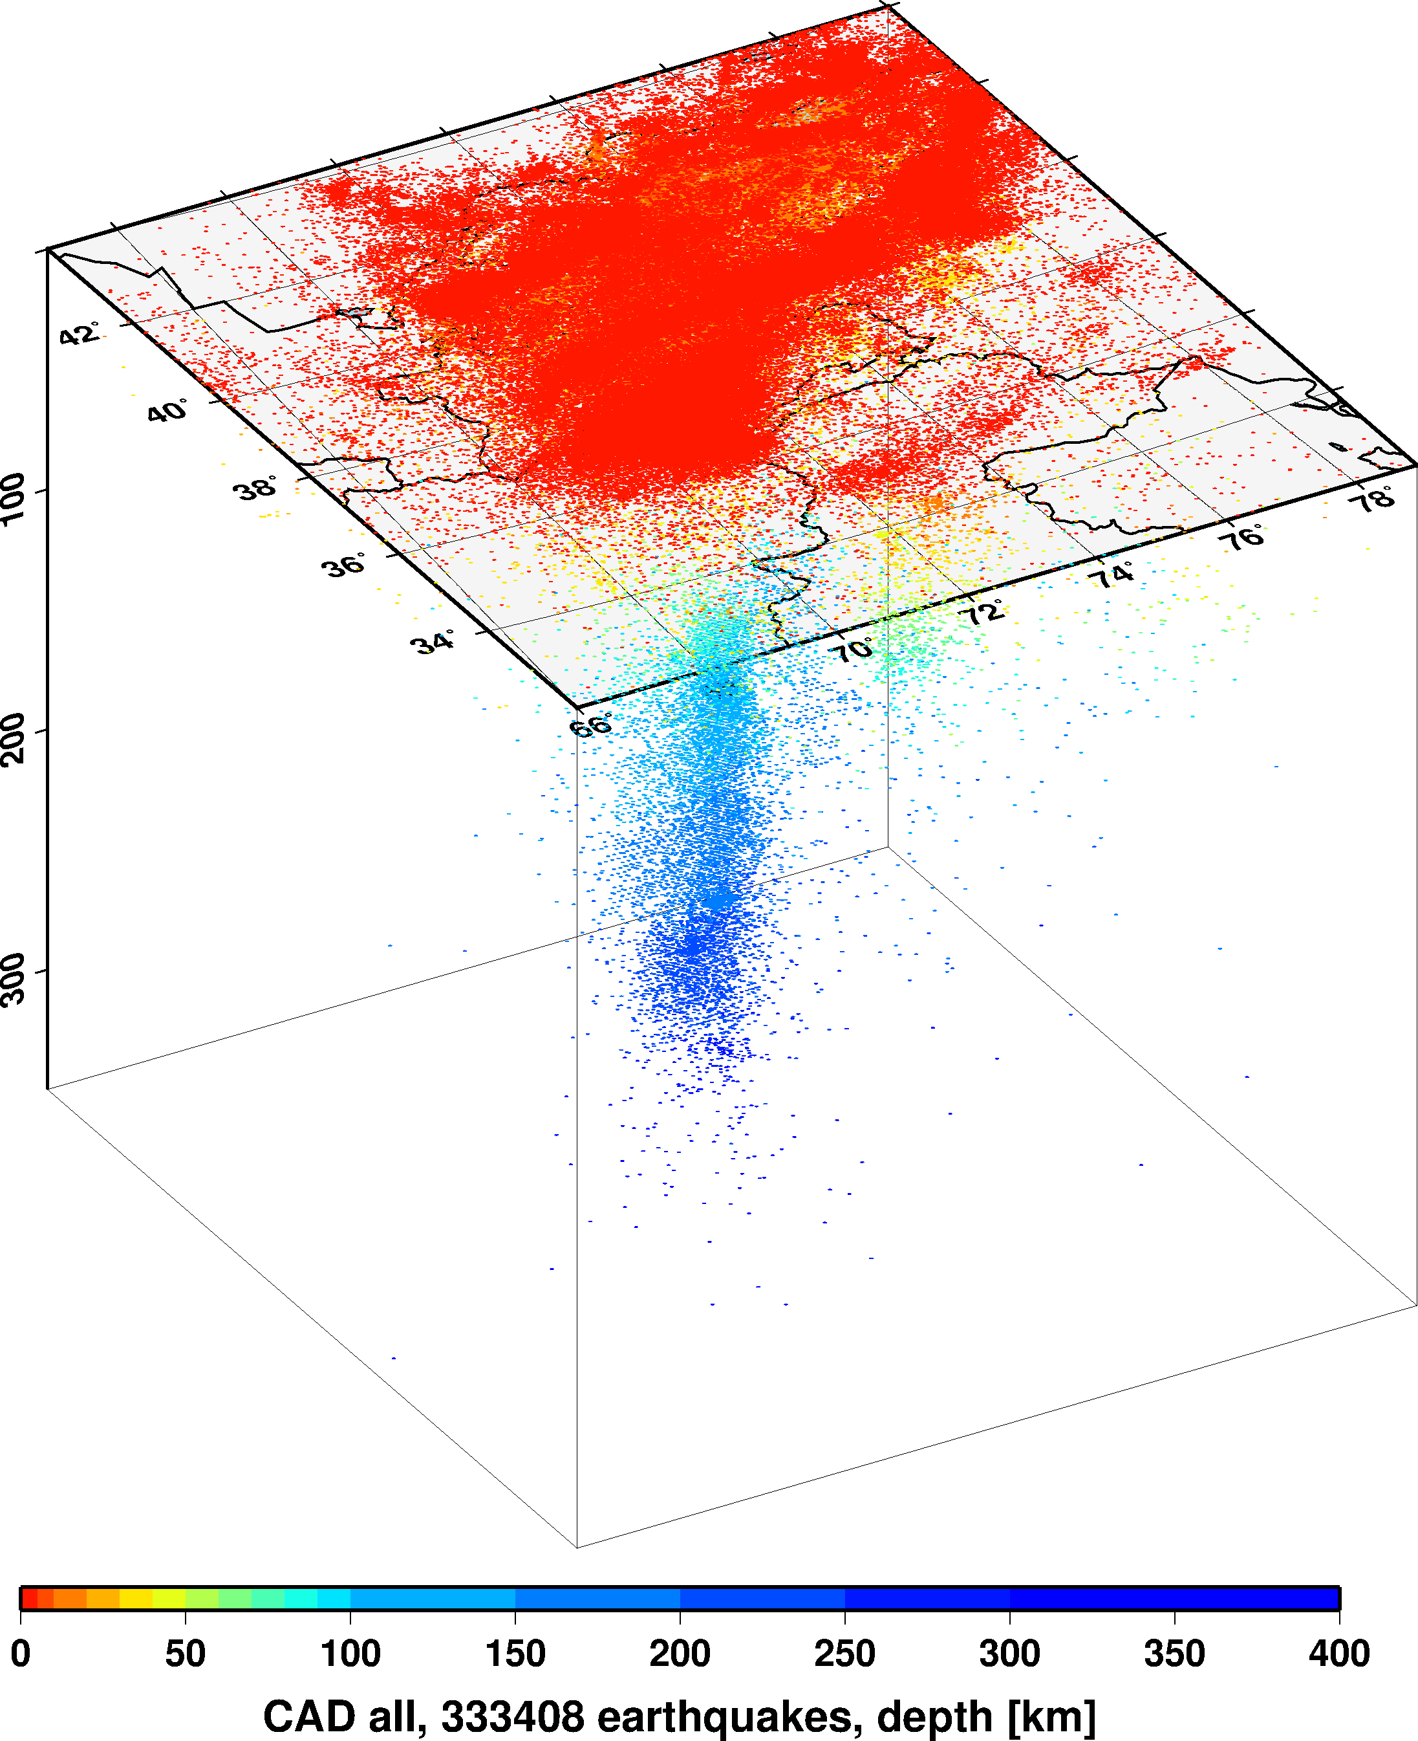
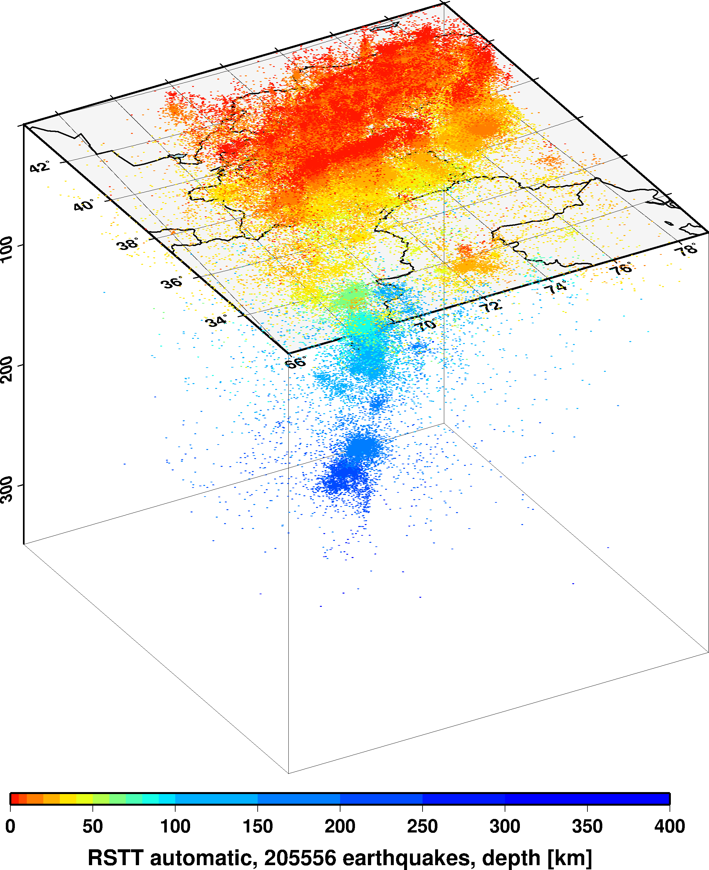
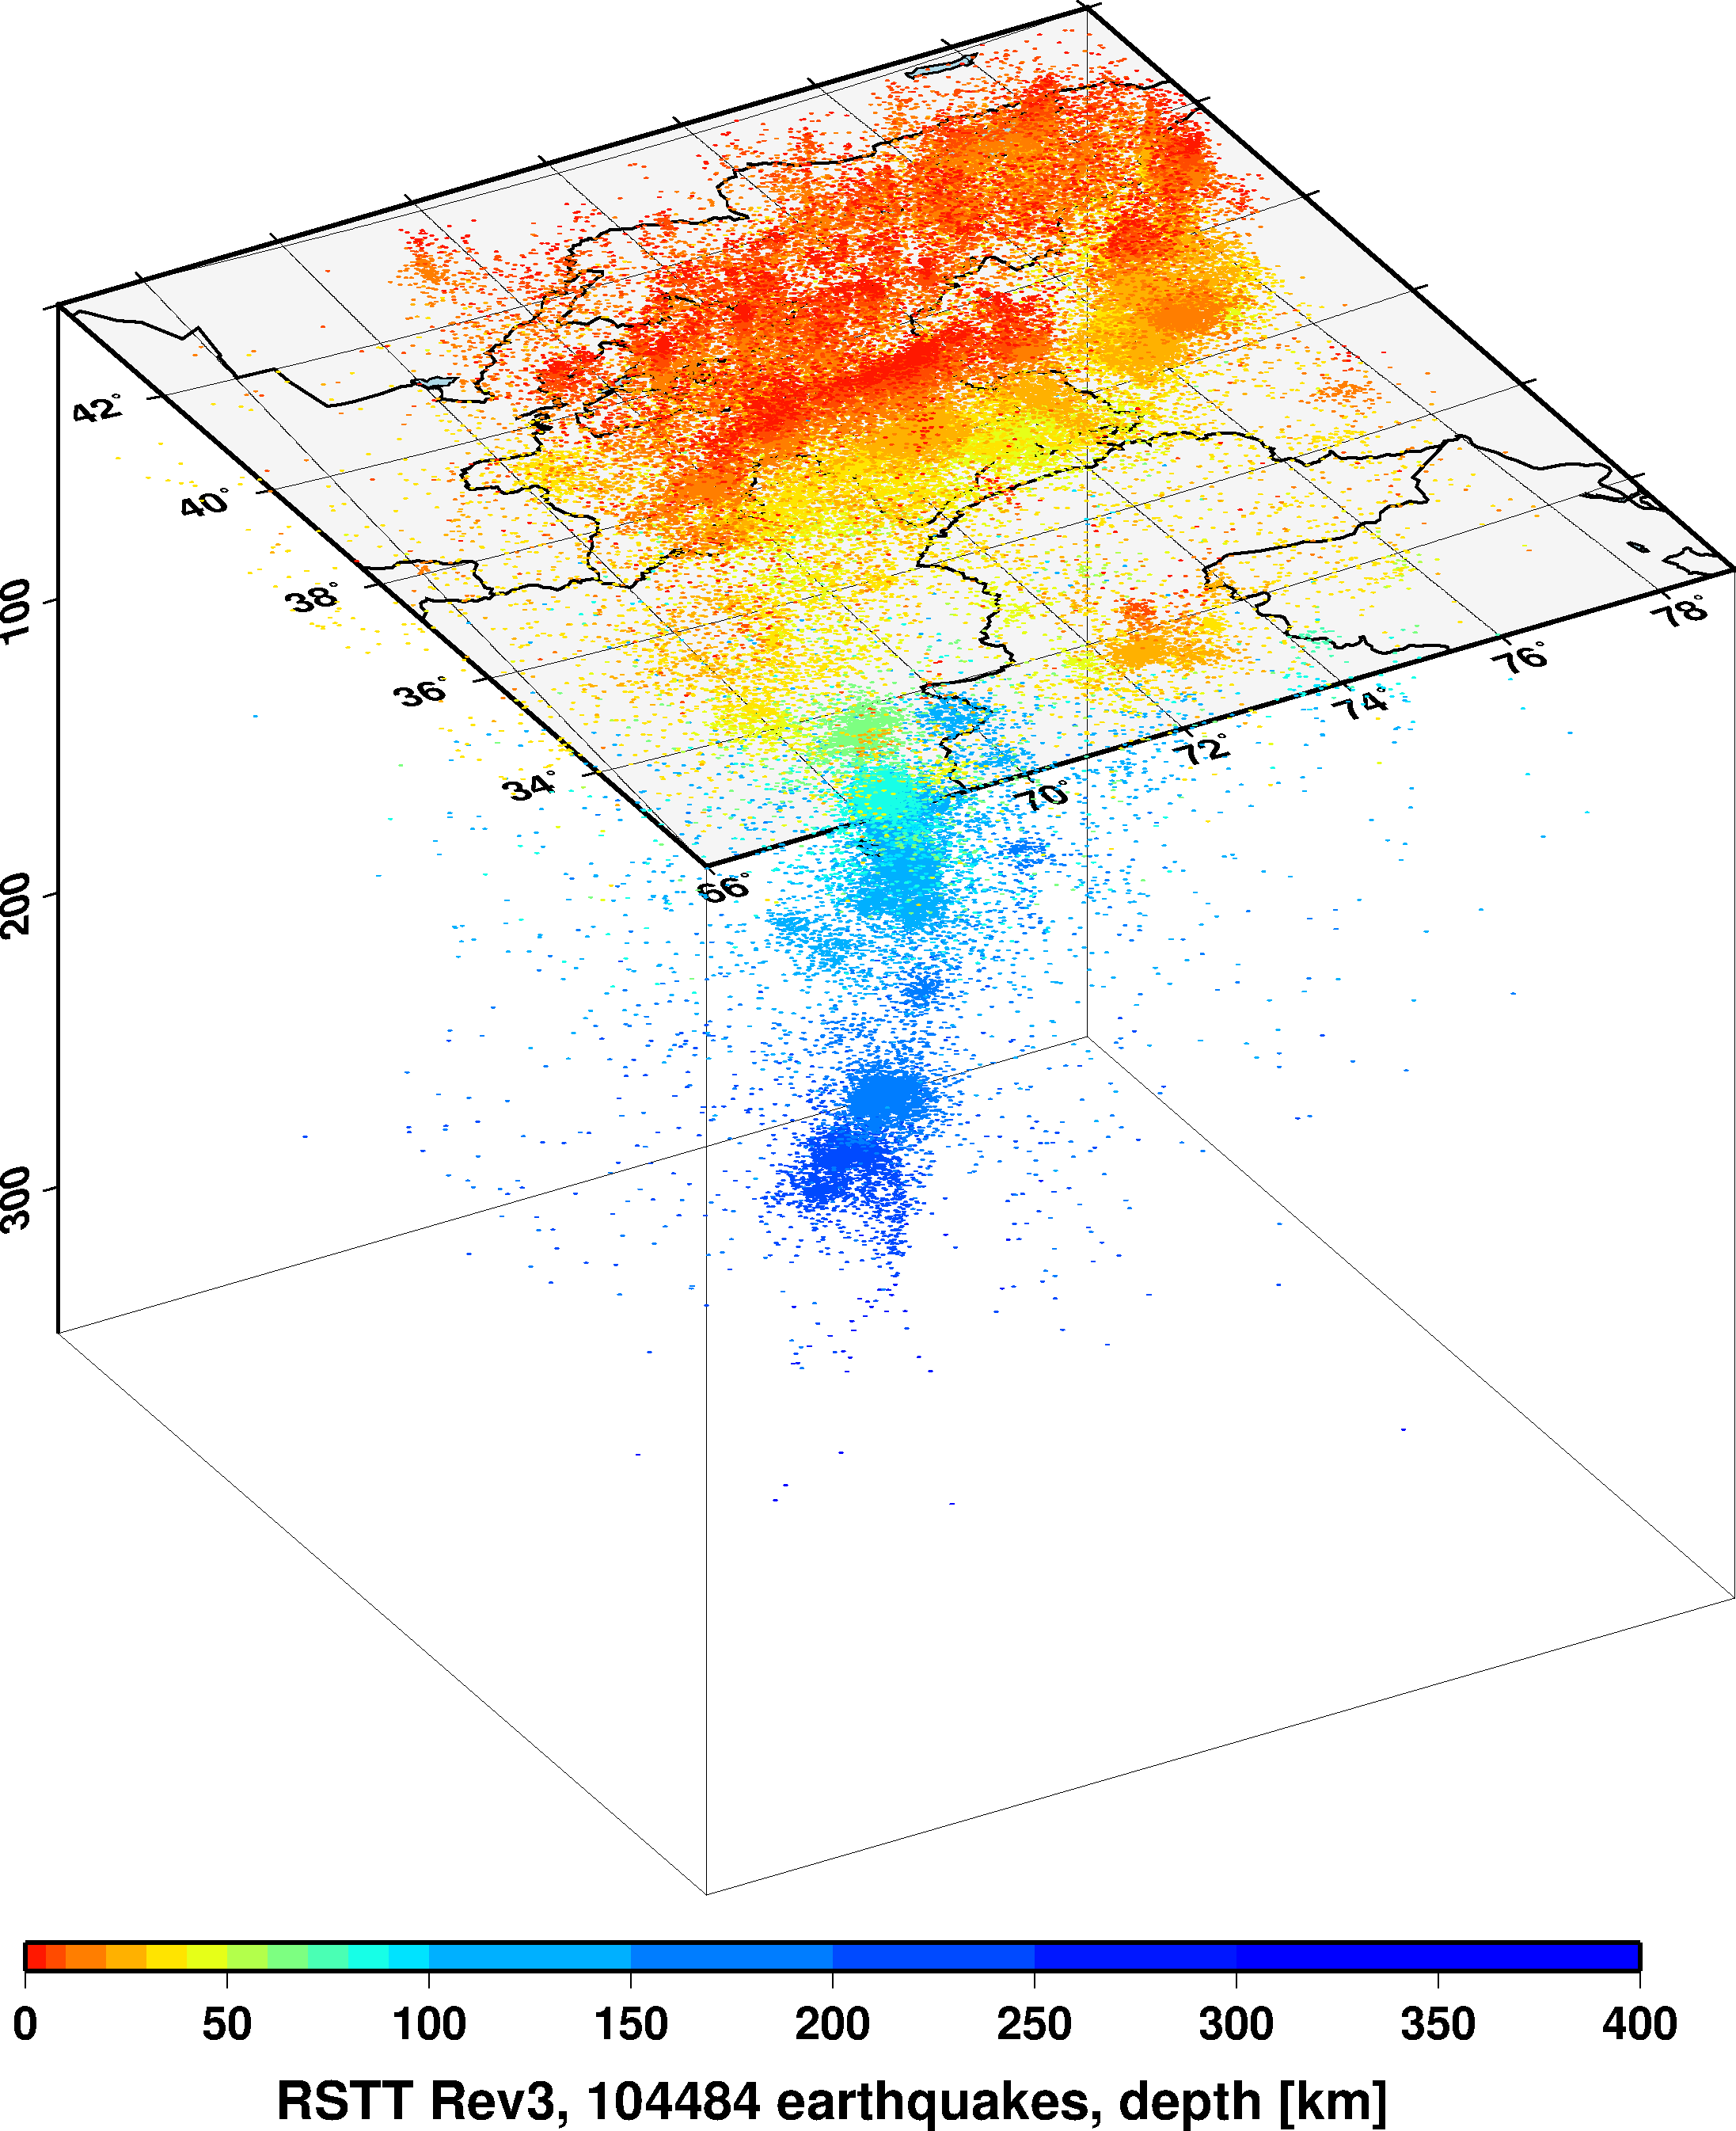
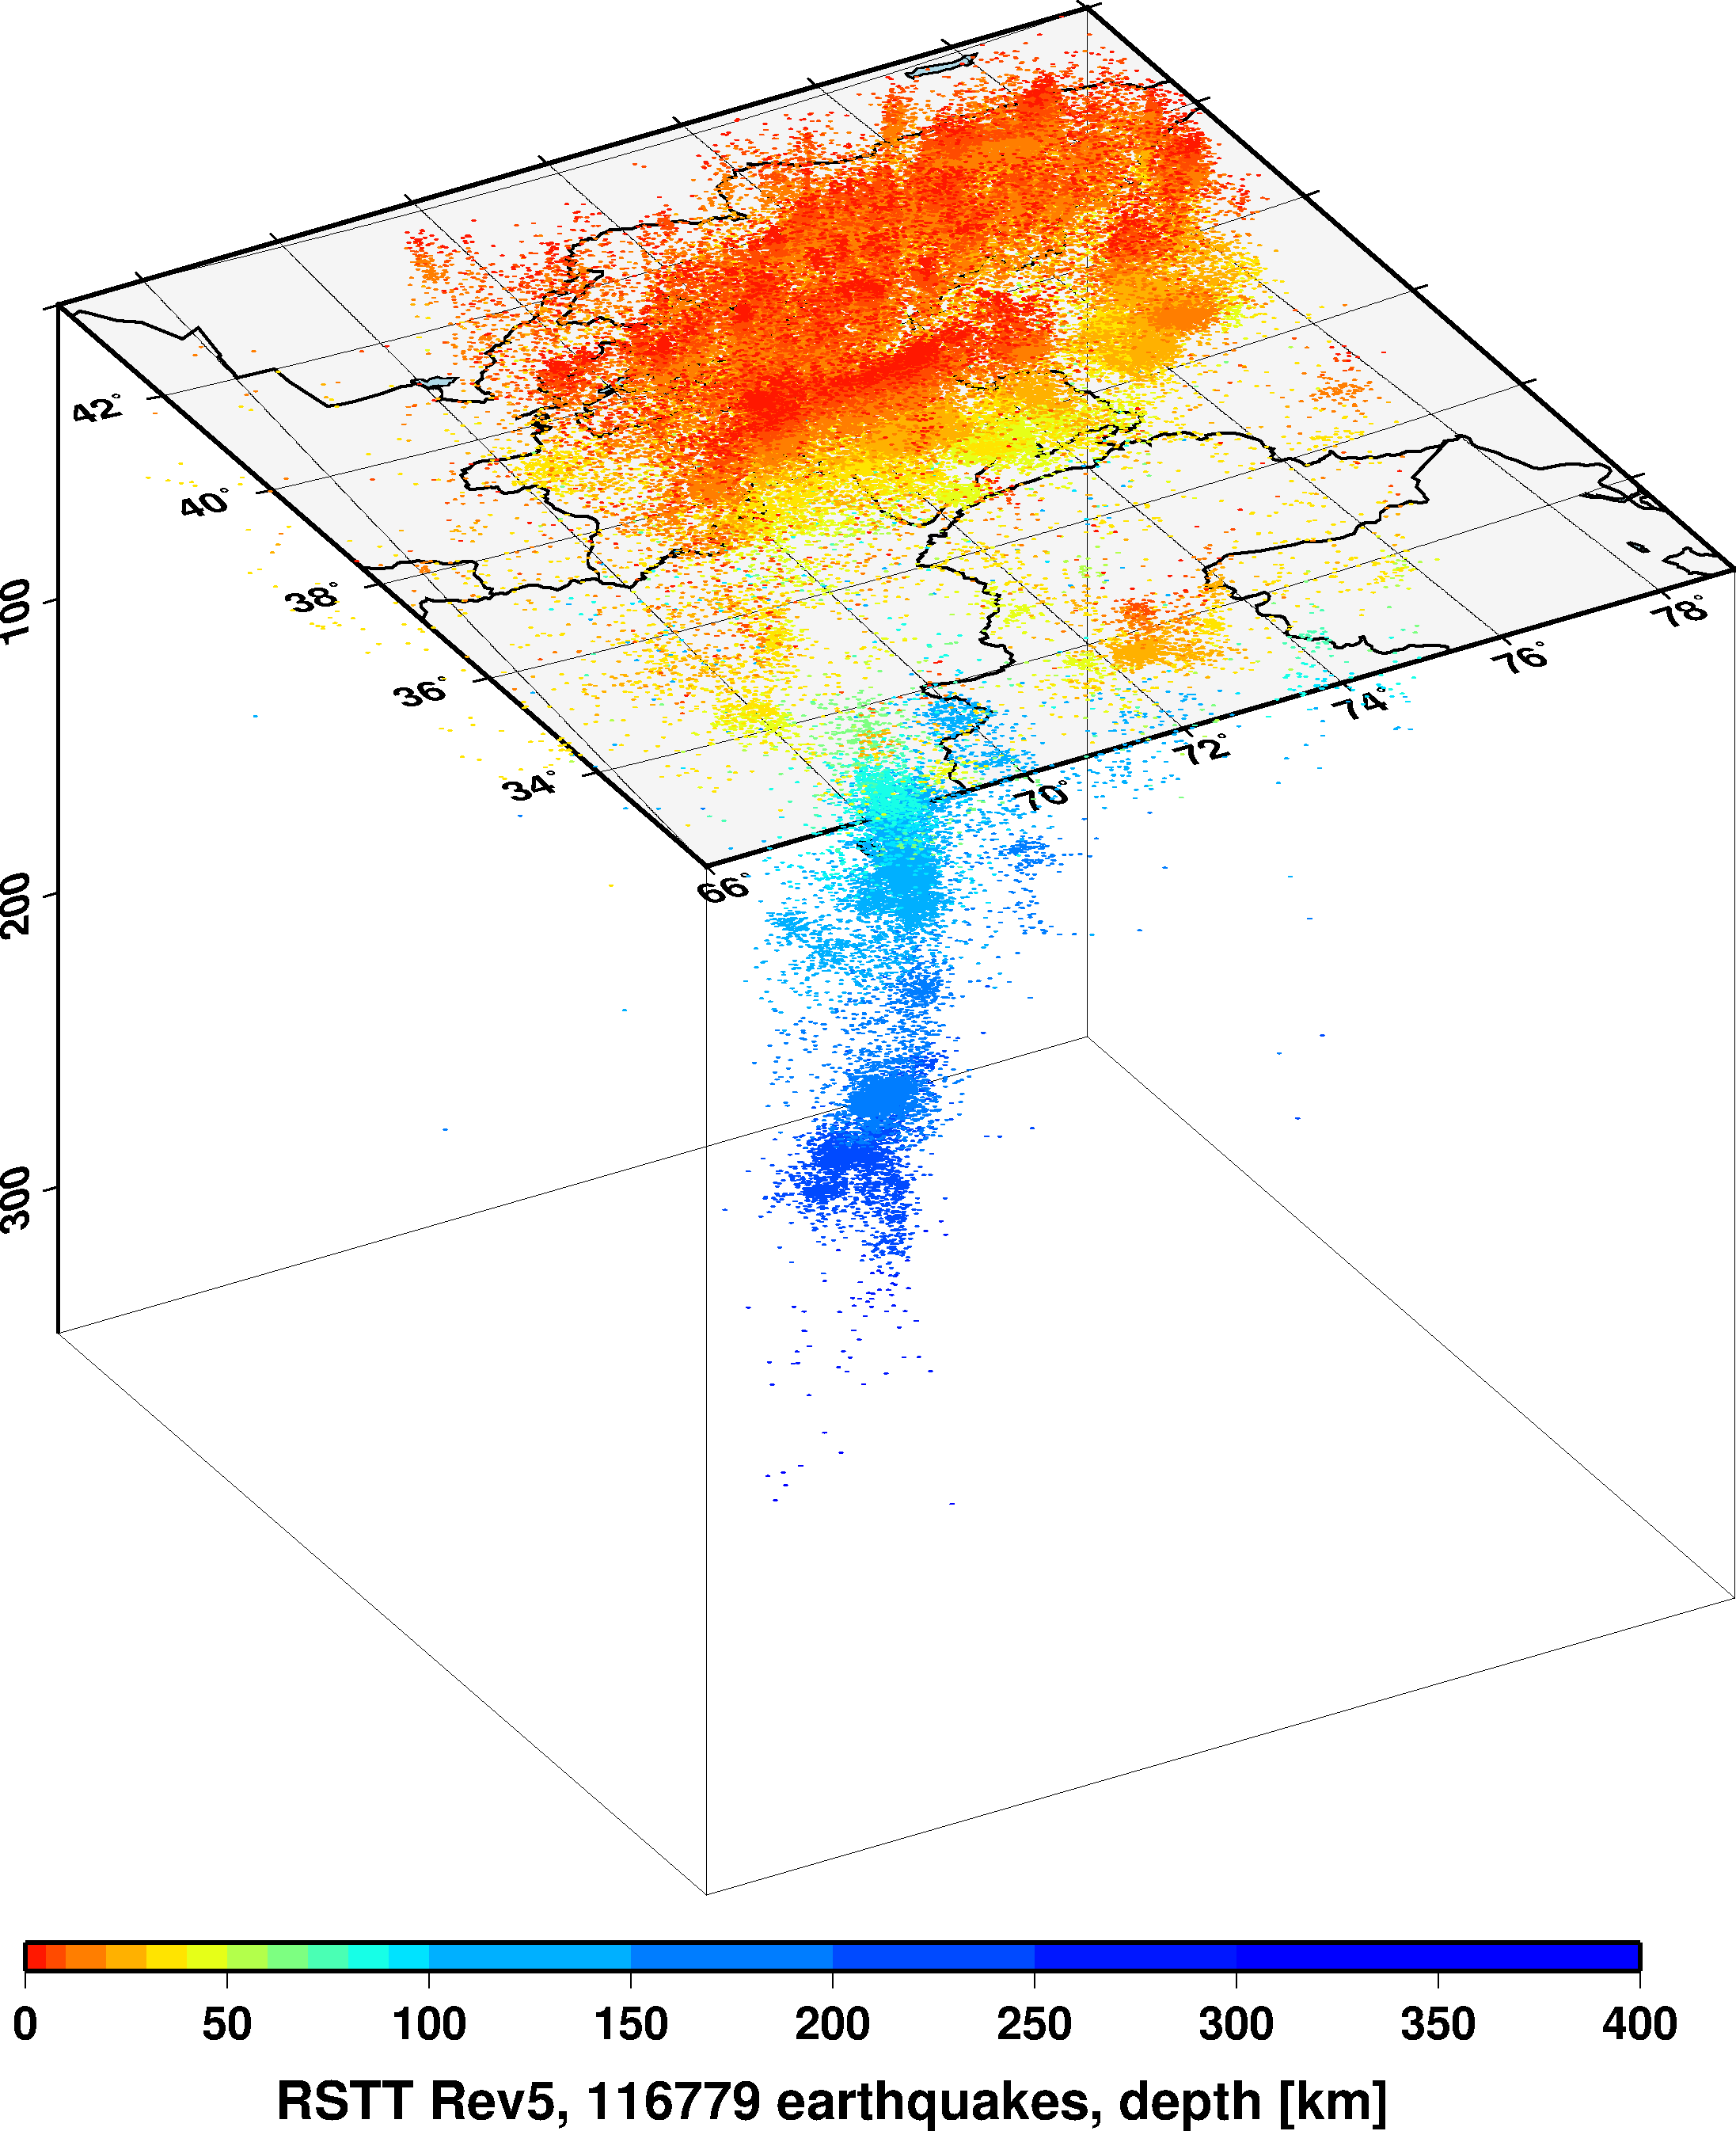
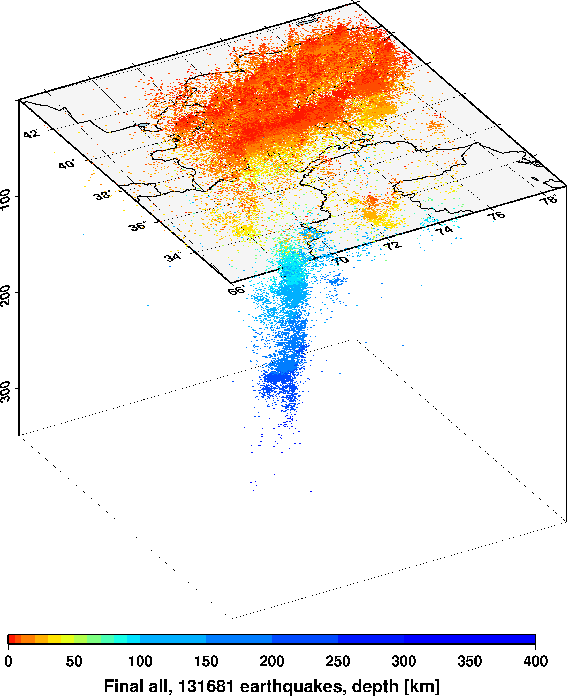
Progress in manual review
Place your QR Code here after removing this text box!
P2.5-186

Slide 6
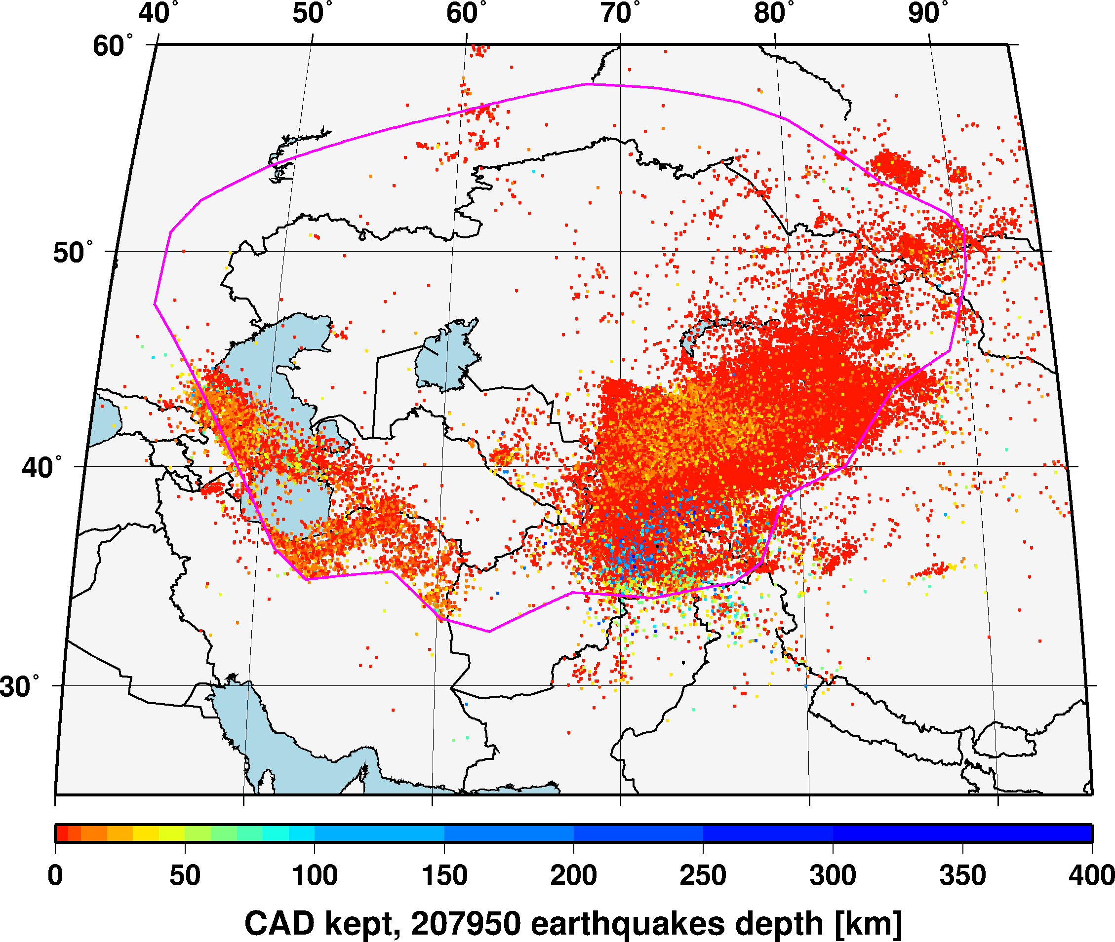
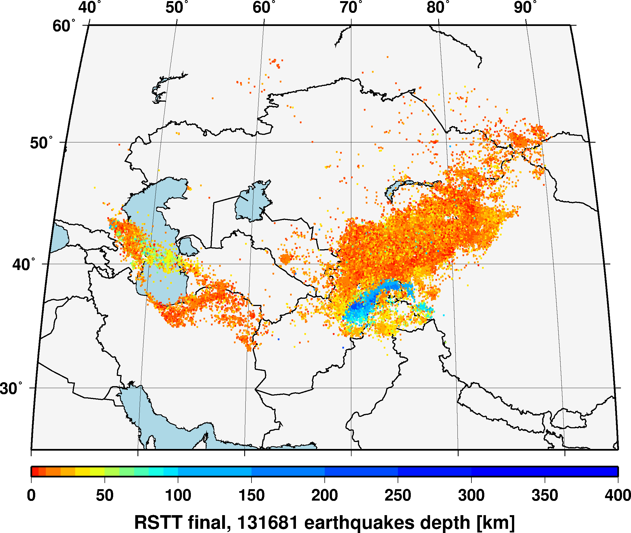
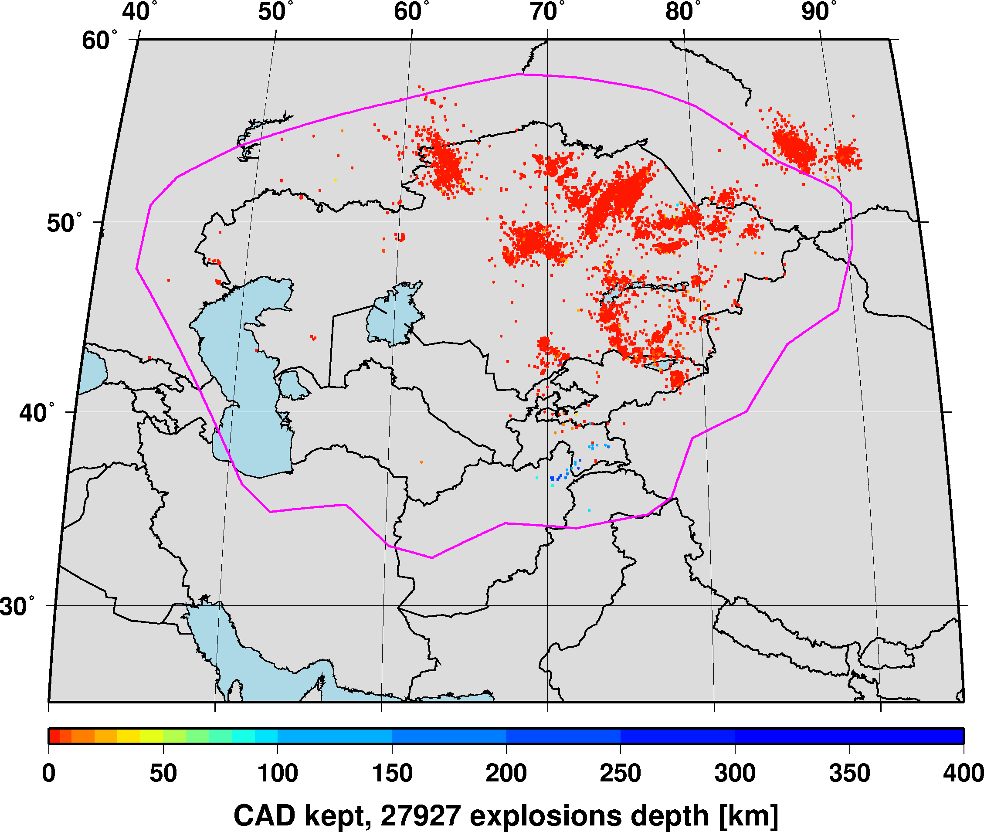
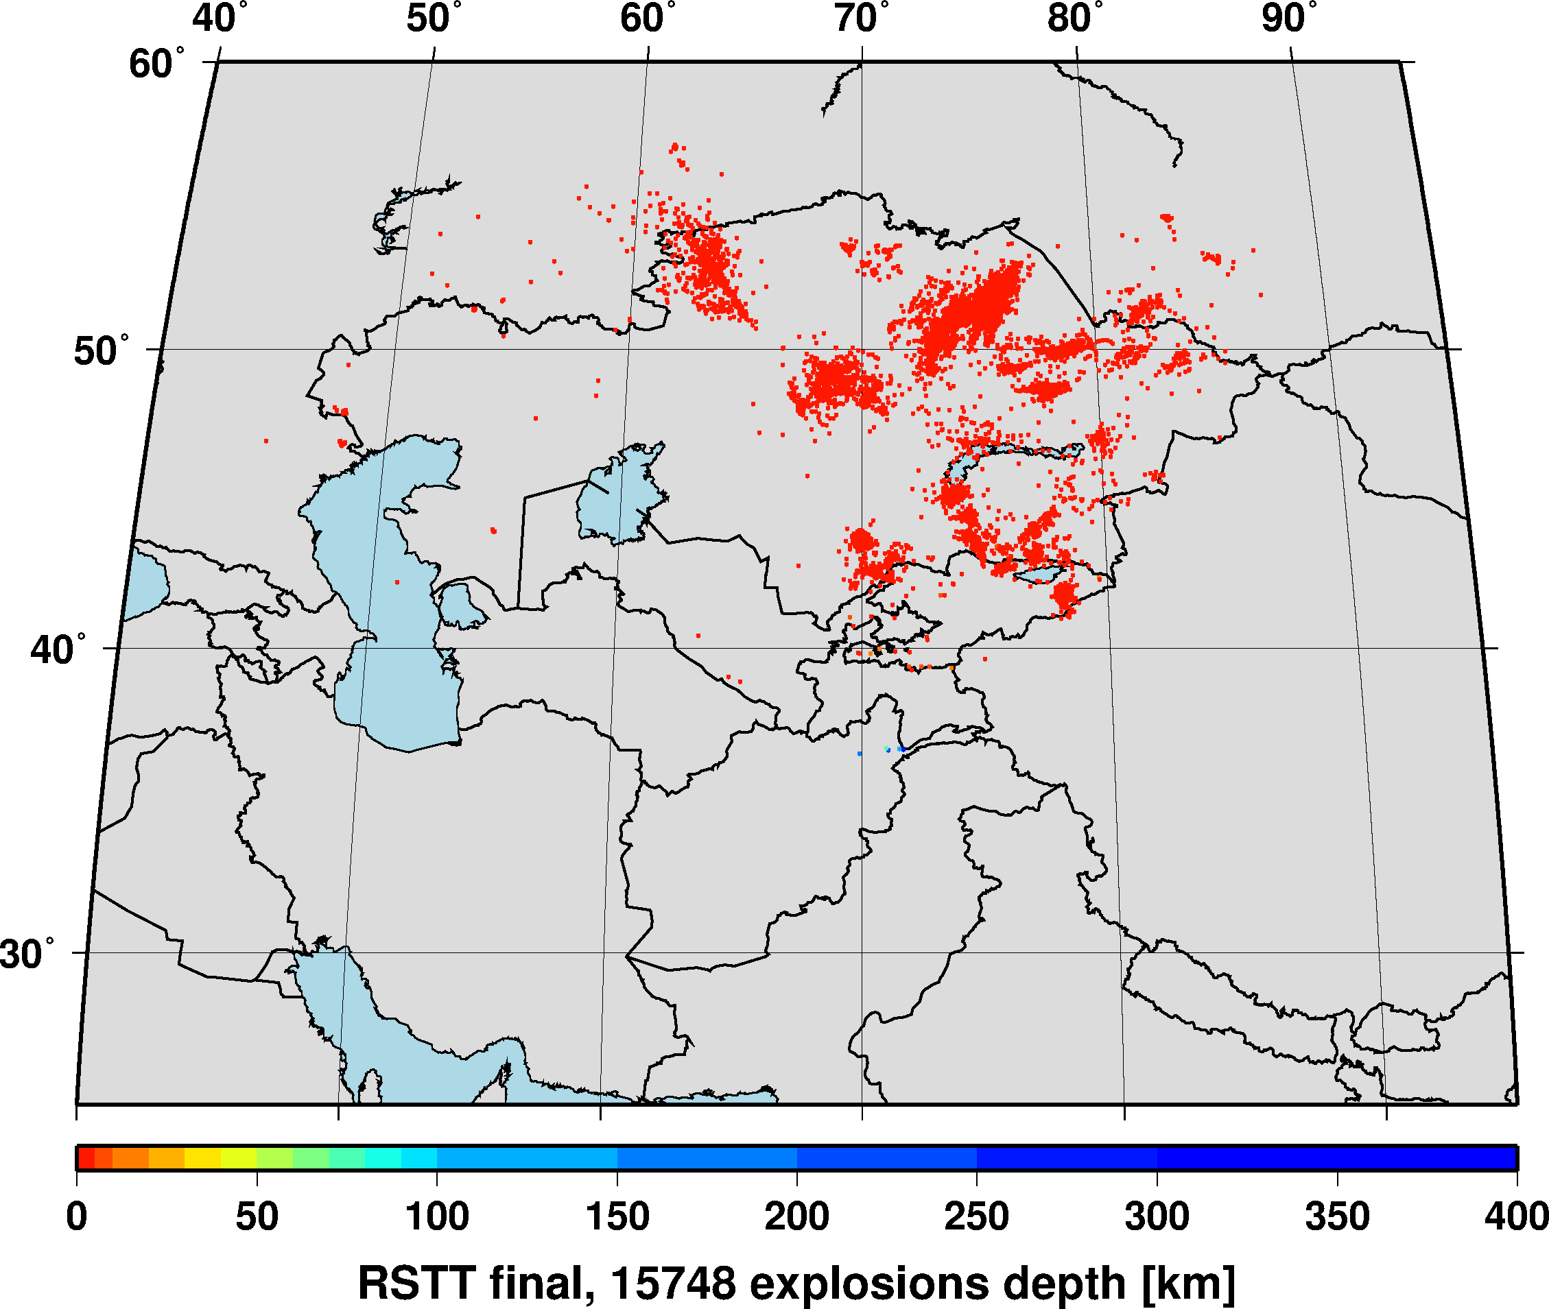
Results
The final, reviewed iLoc locations tighten the seismicity. RSTT travel time predictions outperform 1D model predictions, result in better depth estimates and clustering of events.
The NDCs helped to identify recent quarry blasts and explosions.
The improved earthquake bulletin will help to better delineate the seismogenic zones for the probabilistic seismic hazard analysis of the region.
iLoc
Place your QR Code here after removing this text box!
P2.5-186

Slide 7
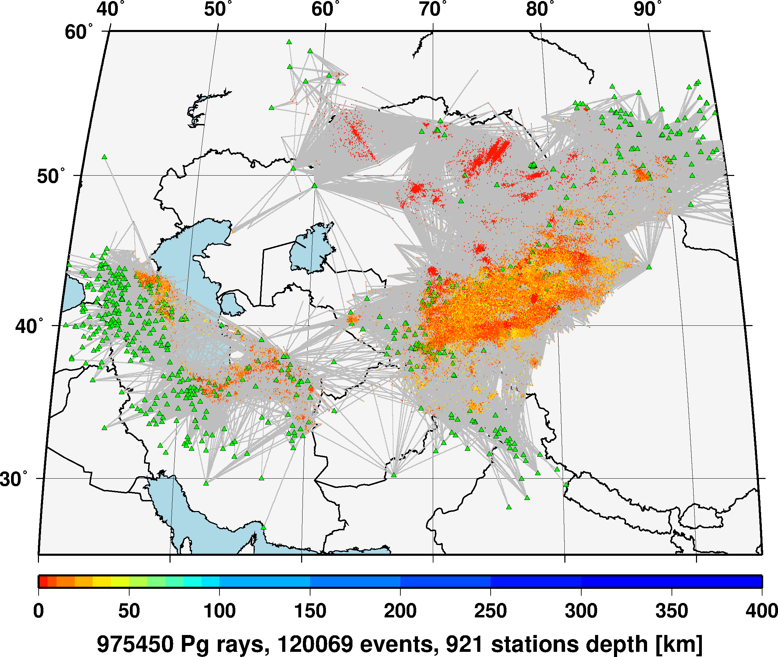
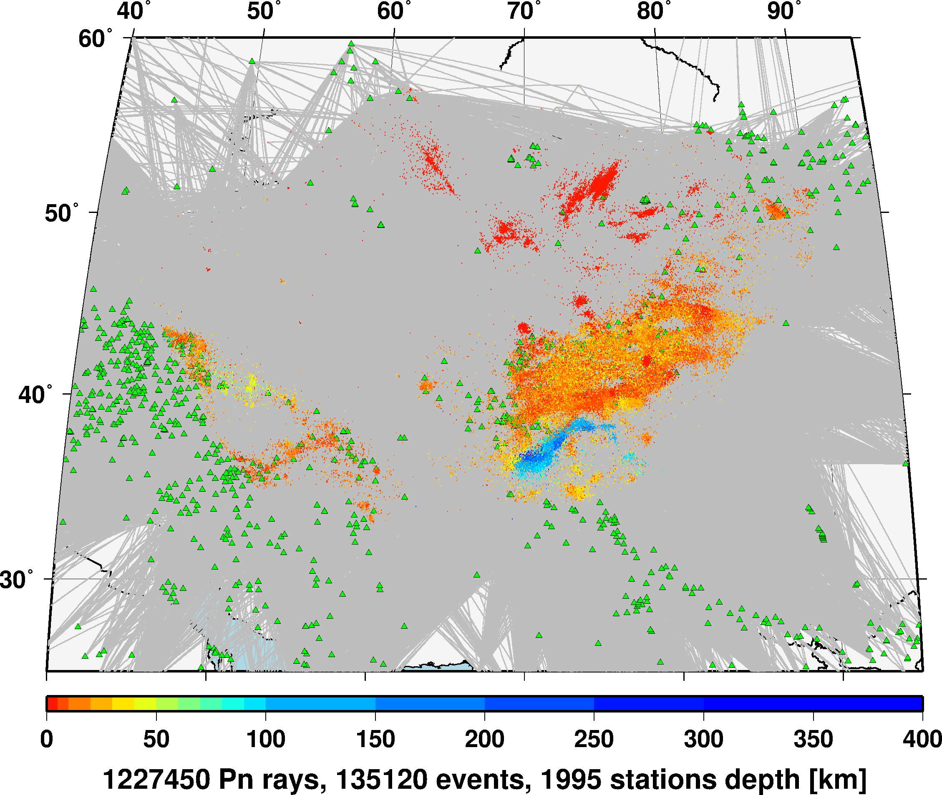
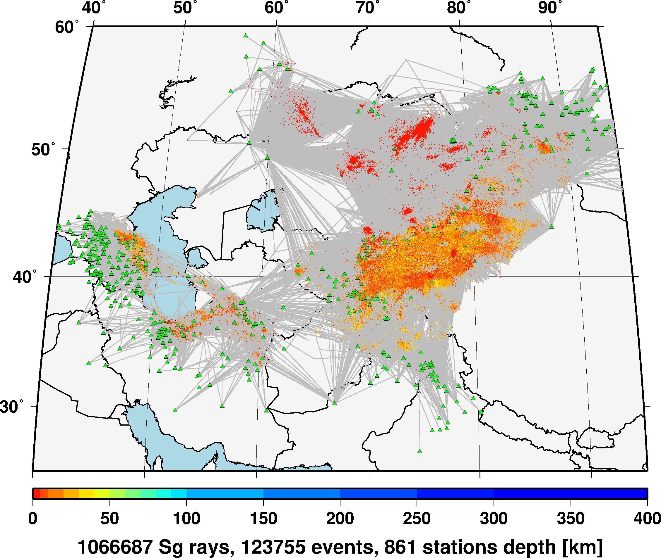
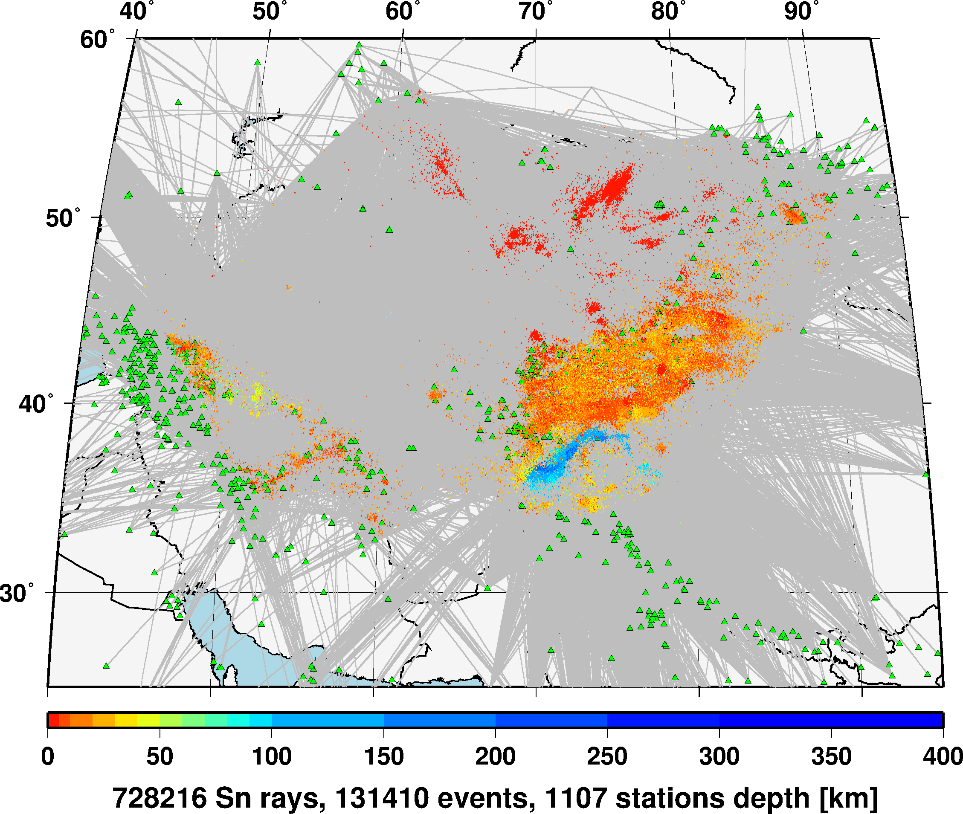
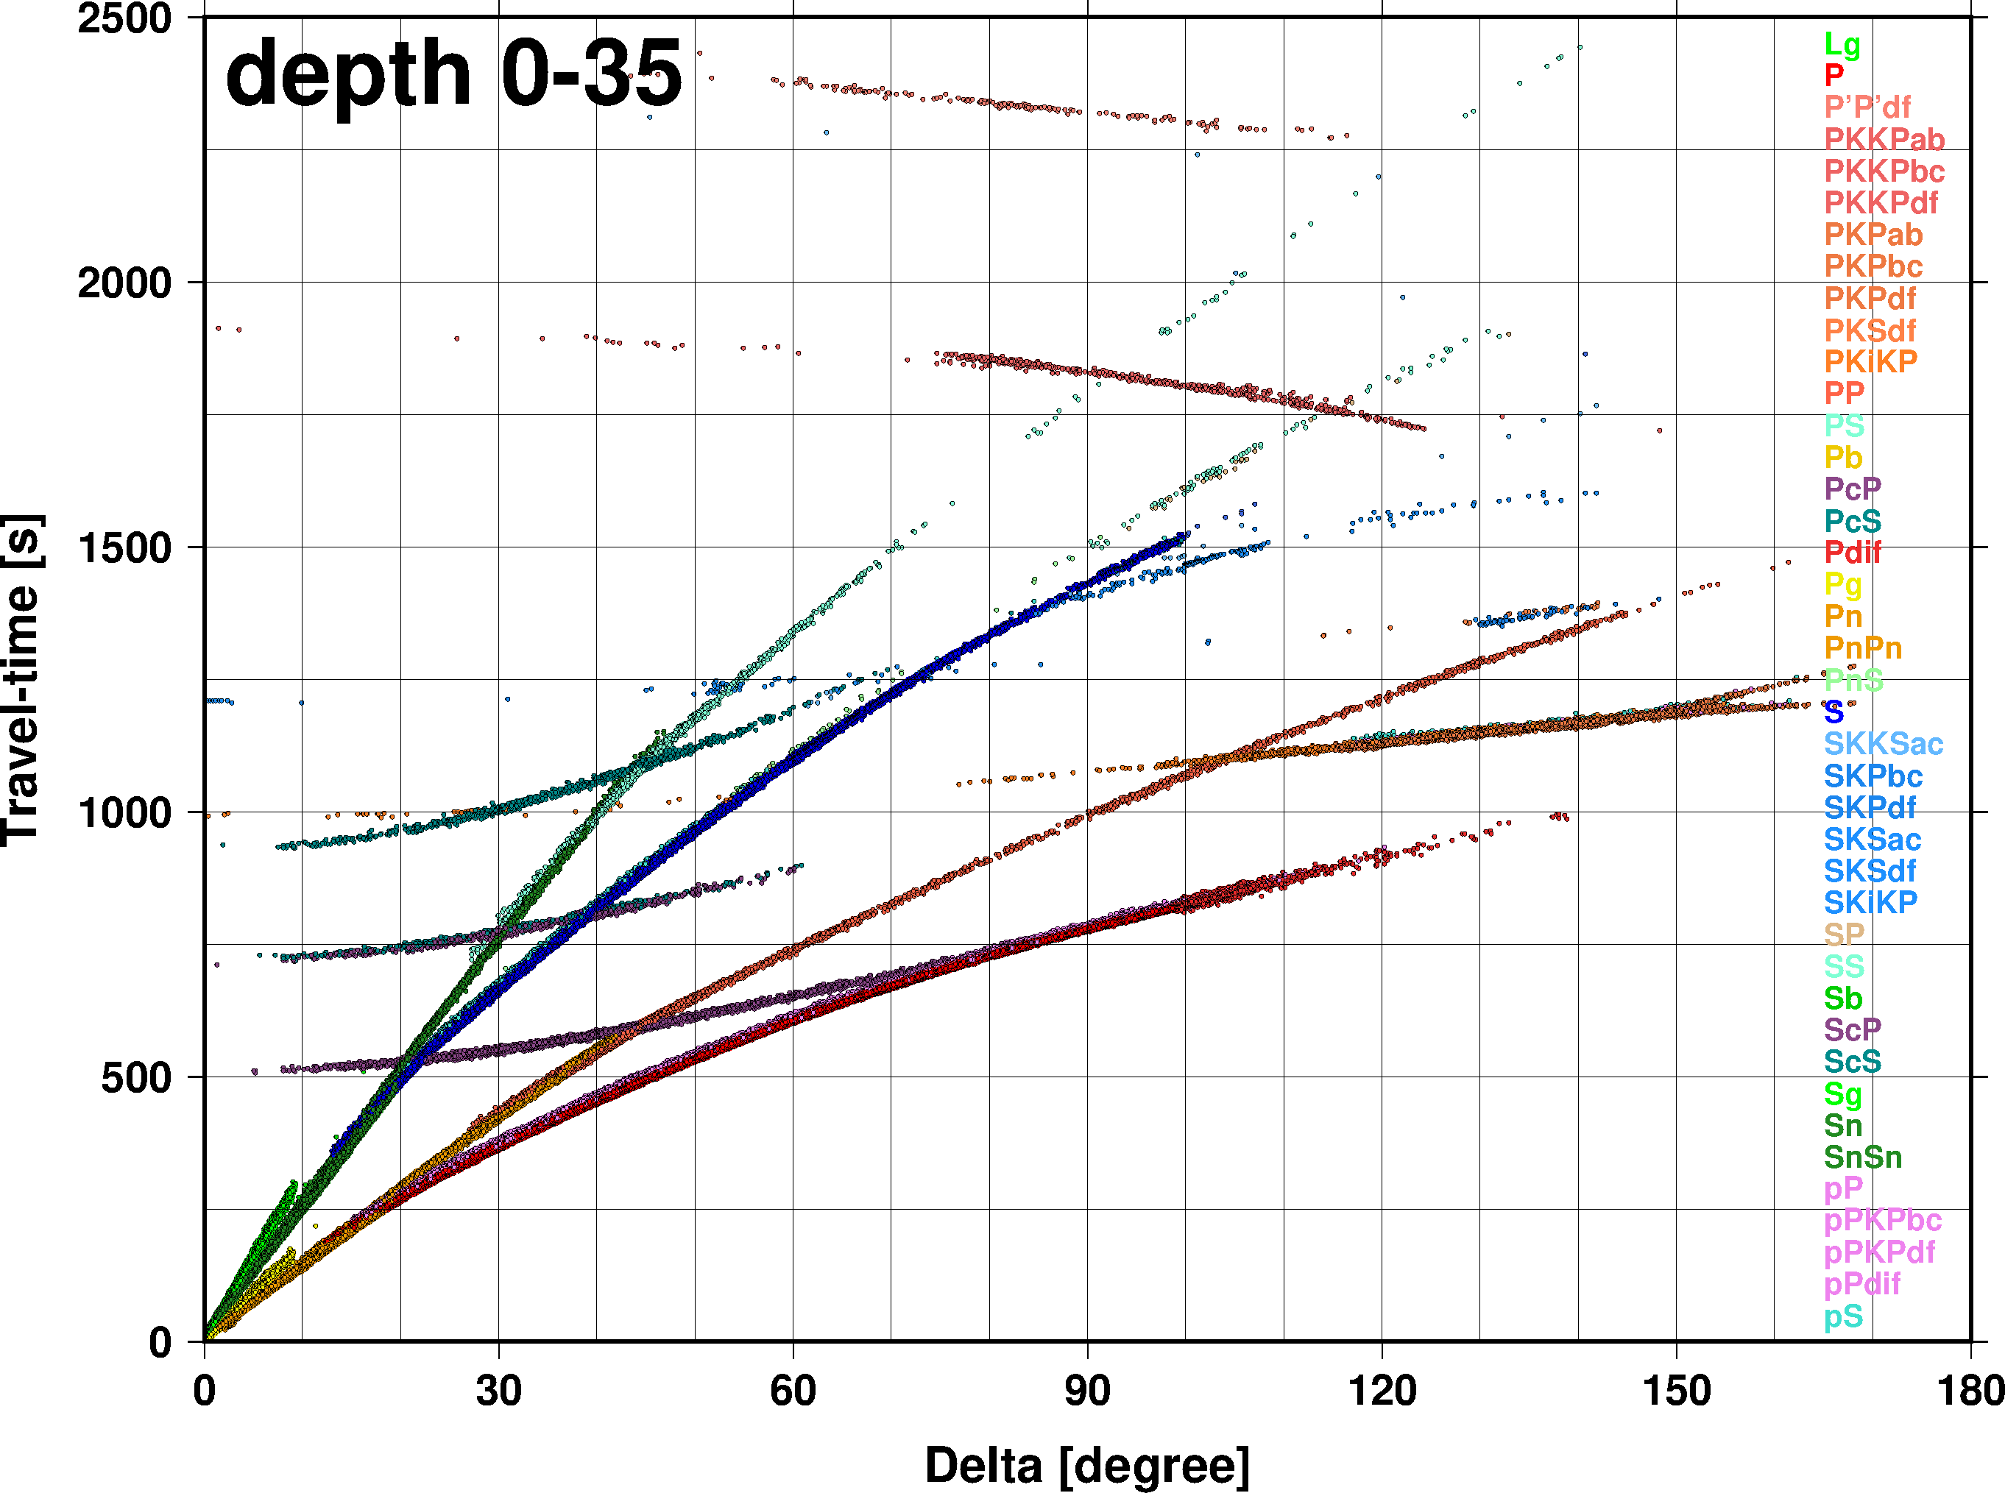
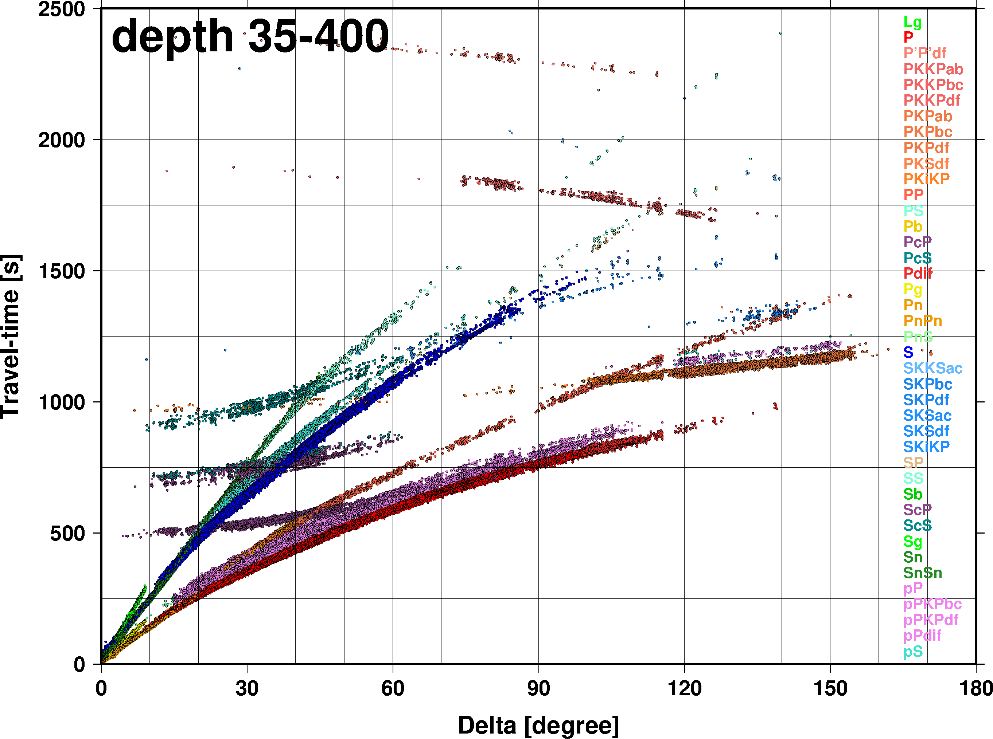
Results
Pg, Pn, Lg/Sg and Sn ray paths
Owing to the collection of data previously not reported to the ISC and the better locations, the increased regional ray coverage, together with the identified GT events will provide the starting point for future three-dimensional tomographic models and an improved RSTT for the use at the IDC.
Place your QR Code here after removing this text box!
Observed travel times
P2.5-186

Slide 8
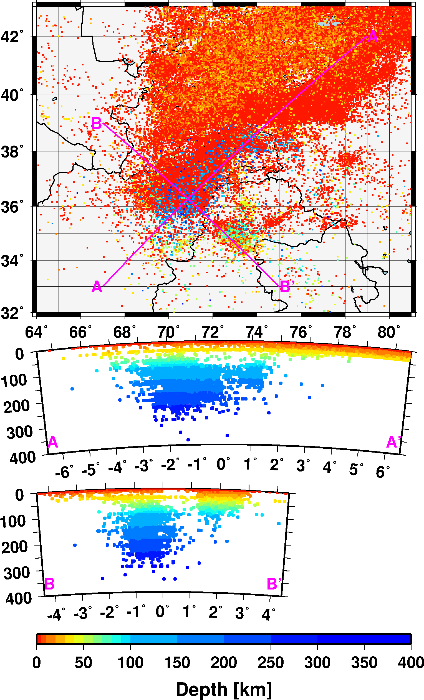
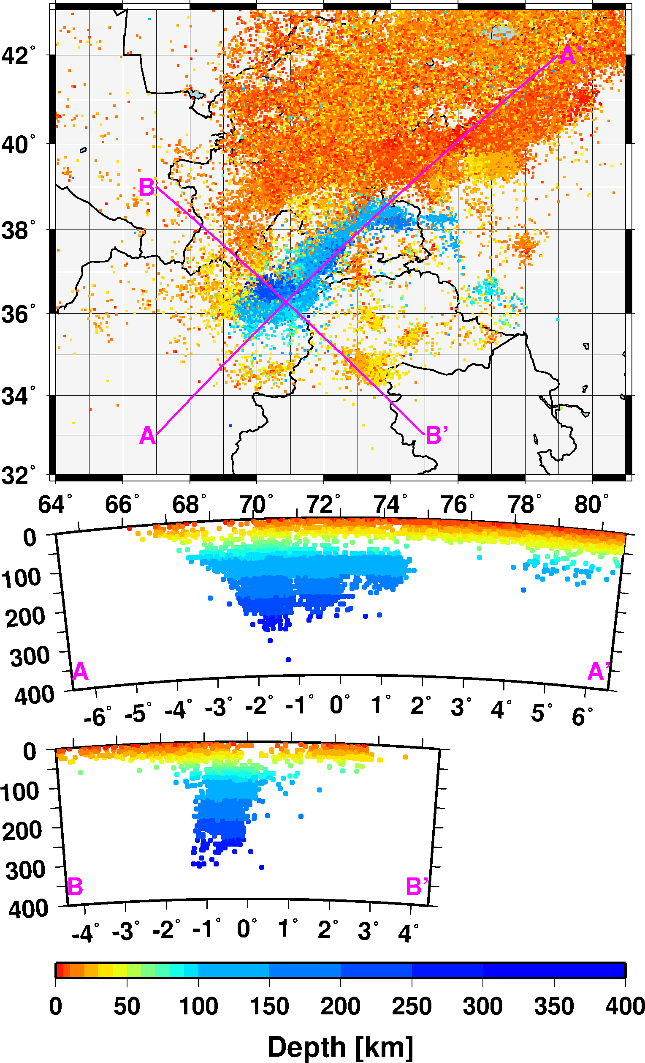
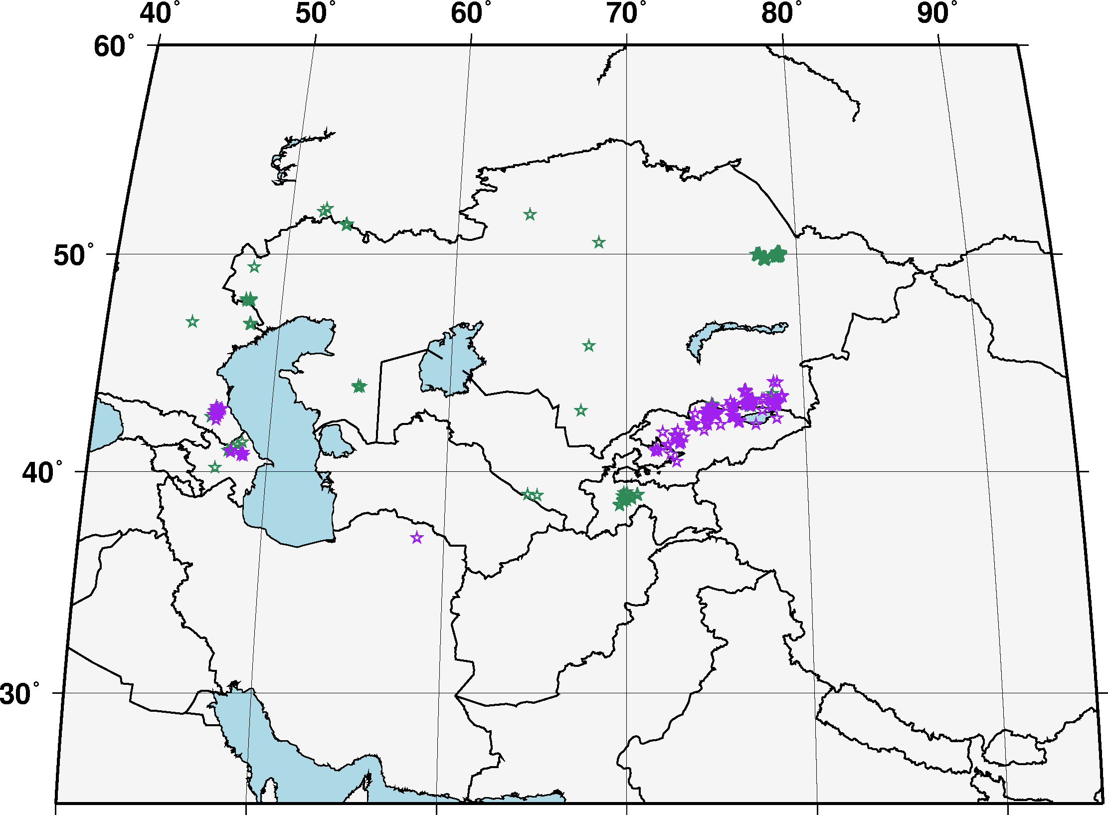
Conclusions
The data collection effort closed a large gap in the ISC bulletin
The relocations with iLoc using RSTT travel time predictions provided significant improvements in the view of seismicity
Each step of manual review brought incremental improvements
We increased the number of ground truth events from 371 to 627
Central Asia Bulletin
Reviewed iLoc locations with RSTT
iLoc
Place your QR Code here after removing this text box!
Hindu Kush – Pamir region
P2.5-186
Existing (green) and new (magenta) GT events

Slide 9
References
Begnaud, M.L., S.C. Myers, B. Young, J.R. Hipp, D. Dodge. W.S. Phillips, Updates to the Regional Seismic Travel Time (RSTT) Model: 1. Tomography, Pure Appl. Geophys., 178, 2475–2498, https://doi.org/10.1007/s00024-020-02619-5, 2021.
Begnaud, M.L., D.N. Anderson, S.C. Myers, B. Young, J.R. Hipp, W.S. Phillips, Correction to: Updates to the Regional Seismic Travel Time (RSTT) Model: 2. Path-dependent travel-time uncertainty, Pure Appl. Geophys., 178, 2499-2525, https://doi.org/10.1007/s00024-021-02696-0, 2021.
Begnaud, M.L., D.N. Anderson, S.C. Myers, B. Young, J.R. Hipp, W.S. Phillips, Updates to the Regional Seismic Travel Time (RSTT) Model: 2. Path-dependent travel-time uncertainty, Pure Appl. Geophys., 178, 313-339, https://doi.org/10.1007/s00024-021-02657-7, 2021.
Bondár, I. P. Mónus, Cs. Czanik, M. Kiszely, Z. Gráczer, Z. Wéber, and the AlpArrayWorking Group, Relocation of Seismicity in the Pannonian Basin Using a Global 3D Velocity Model, Seismol. Res. Lett., 89, 2284-2293, doi:10.1785/0220180143, 2018.
Bondár, I., and D. Storchak, Improved location procedures at the International Seismological Centre, Geophys. J. Int., 186, 1220-1244, https://doi.org/10.1111/j.1365-246X.2011.05107.x, 2011.
Myers, S. C., M. L. Begnaud, S. Ballard, M. E. Pasyanos,W. S. Phillips, A. L. Ramirez, M. S. Antolik, K. D. Hutchenson, J. J. Dwyer, C. A. Rowe, and G. S. Wagner, A crust and upper-mantle model for Eurasia and North Africa for Pn travel-time calculation, Bull. Seismol. Soc. Am., 100, 640–656, 2010.
Place your QR Code here after removing this text box!
P2.5-186

