Slide 1
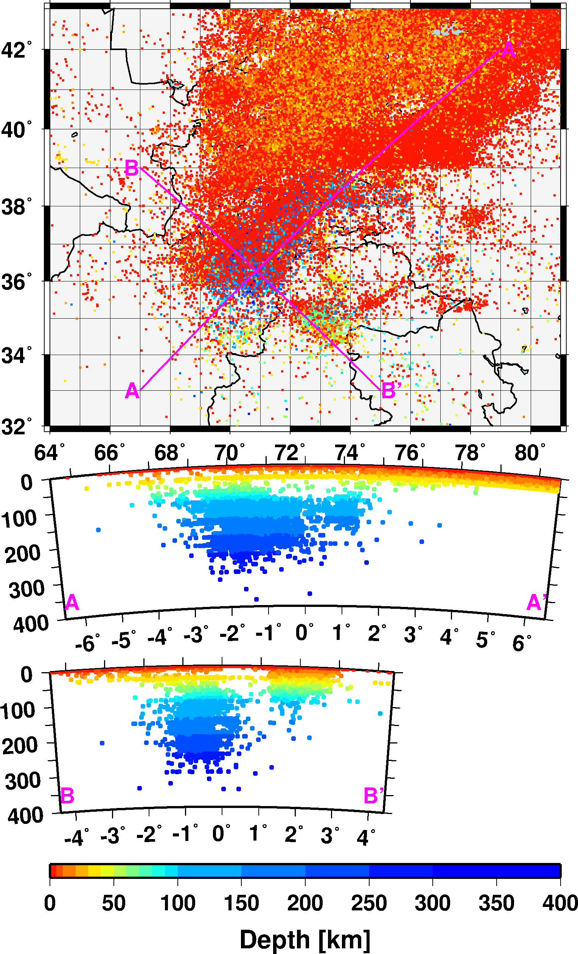
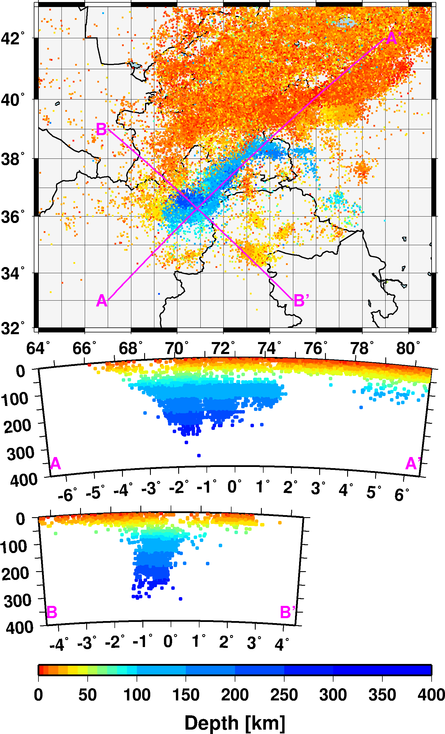
Relocation of the Central Asia Comprehensive Seismic Bulletin
István Bondár, Kevin Mackey, Anna Berezina, Natalia Mikhalova, Rengin Gök, Andrea Chiang
P2.5-186
Central Asia Bulletin
Reviewed iLoc locations with RSTT
Data collection and digitisation of analog and digital bulletin data was carried out in cooperation with LLNL, Michigan State University, the Kazakh, Kyrgyz and Tajik NDCs and complemented with the ISC bulletin.
We relocated the comprehensive bulletin of some 400,000 events with iLoc using the global upper mantle RSTT model travel time predictions.
After a thorough manual review and quality control we present ~130,000 reliably located earthquakes and ~15,000 explosions.
The result will serve the basis for a PSHA in the region.
iLoc
Hindu Kush – Pamir region

