Slide 1


PARAMETERIZATION OF SEISMIC RECORDS OF NUCLEAR TESTS, CONDUCTED AT THE LOP NOR TEST SITE
S. Abyshova¹, A. Berezina¹, I. Sokolova², E. Pershina¹, B. Omukeeva¹
¹ - Institute of Seismology, NAS KR, Bishkek, Kyrgyzstan
² – IGR NNC RK, Kurchatov, Kazakhstan
Particular importance for monitoring problems are historical analog, digital and digitized records of nuclear tests, recorded both at regional and teleseismic distances.
For the compilation of seismic bulletin of the main seismic phases, 428 seismograms of 30 explosions from the area of the Lop Nor test site were used for 1966-1996.
More than 400 seismograms were processed (1966-1996). An analysis of the dynamic parameters of seismic records of nuclear explosions depending on the power of the explosion and the test environment has been carried out.
According to historical seismograms analysis, a seismic bulletin was created for nuclear explosions from the area of the Lop Nor test site, magnitudes mb, mpv, and energy class K were calculated.
Please do not use this space, a QR code will be automatically overlayed
P2.5-329

Slide 2
INTRODUCTION
During the years of nuclear testing, a network of seismic stations of the Institute of Seismology of National Academy of Sciences of the Kyrgyz Republic has operated on the territory of Kyrgyzstan, the data of which is of great value for research in the seismic monitoring area. Most of these stations were installed far from natural and anthropogenic sources of seismic noise, on bedrock, in specially equipped adits and tunnels. In addition, most of the nuclear tests at the Central Asian test sites (Semipalatinsk test site (STS, Kazakhstan), Lop Nor (China), Pokharan (India), Chagay (Pakistan)), as well as peaceful nuclear explosions on the territory of the former USSR, were carried out at regional distances from the stations of Kyrgyz network. In addition, powerful chemical explosions were carried out on the territory of Central Asia for industrial and research purposes, the parameters of such explosions are known with good accuracy. Seismograms of explosions and earthquakes recorded by seismic stations in Kyrgyzstan can be used for various tasks of seismology: specification of the parameters of historical seismic events, studying of geodynamic processes in Central and South Asia, explosions and earthquakes discrimination, seismic stations calibration, seismic hazard assessment, regional travel time curves creation and etc. In purpose to preserve the archive of historical seismograms, IS NAS KR conducts a number of works related to seismograms scanning, metadata collecting, historical seismograms and seismic bulletins digitizing, corresponding databases creation, etc.
Please do not use this space, a QR code will be automatically overlayed
P2.5-329

Slide 3
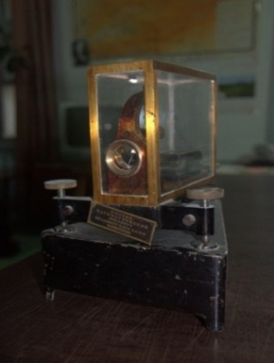
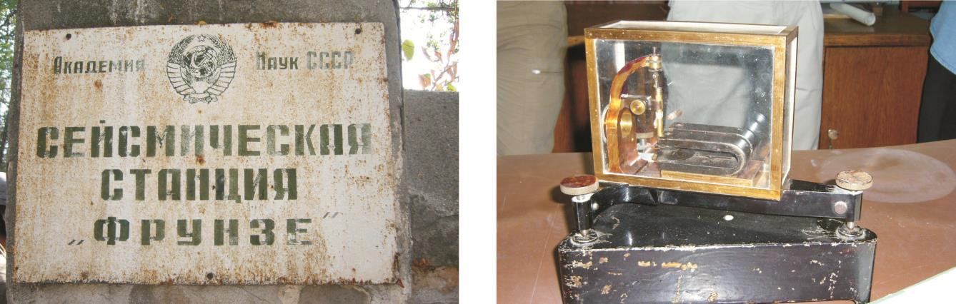
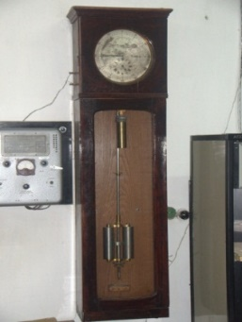

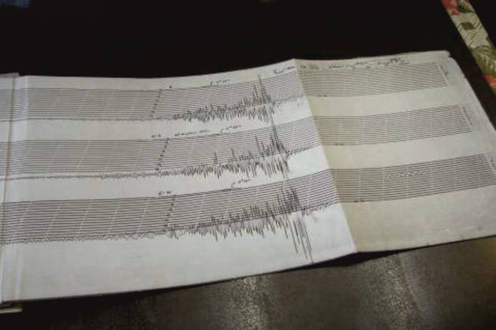
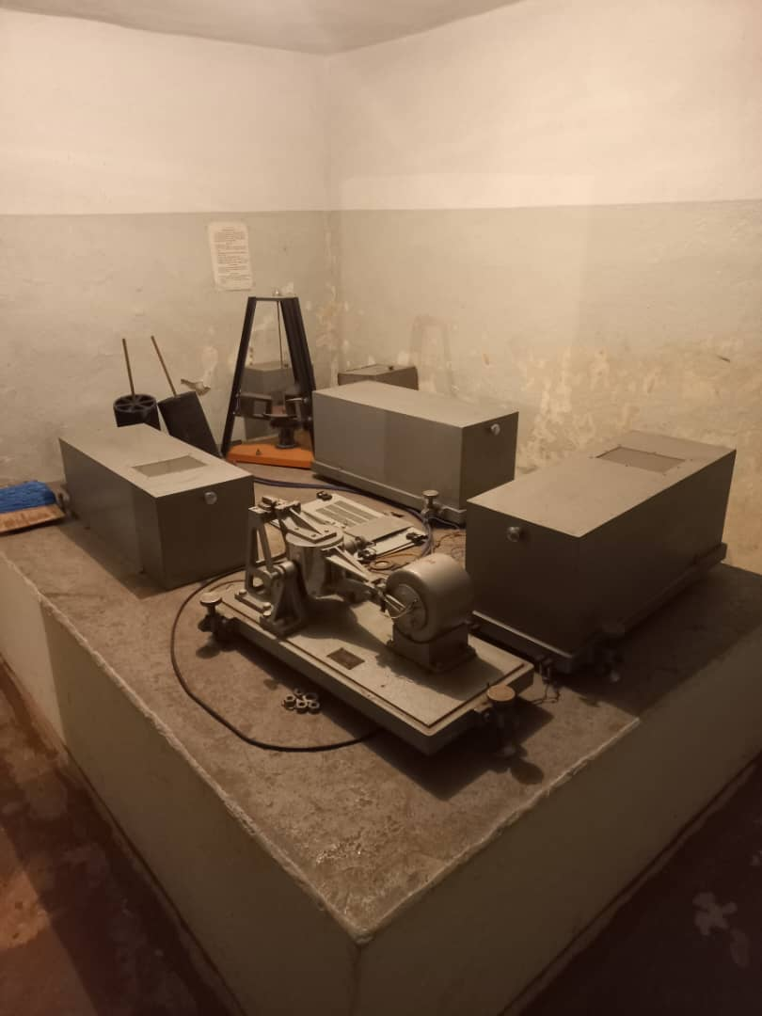
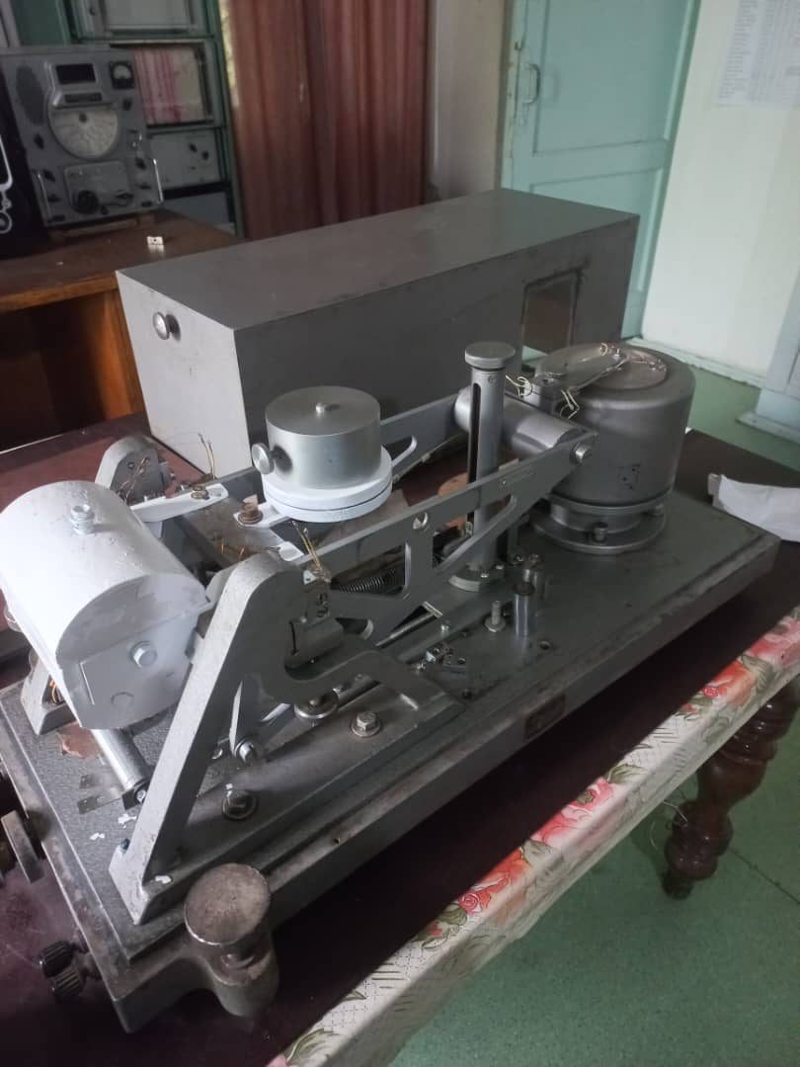
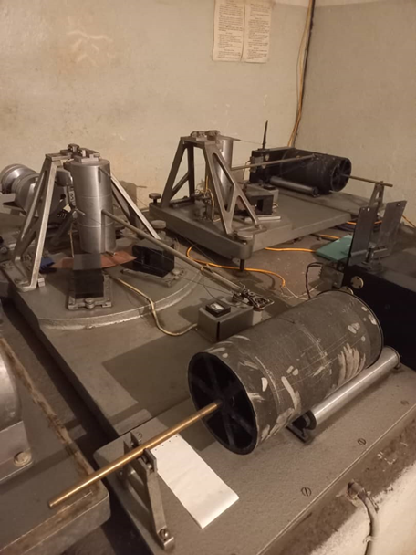
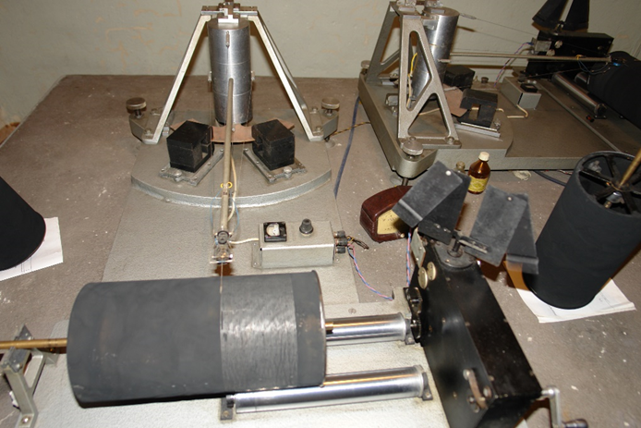
MONITORING SYSTEM AND DATA USED
Instrumental seismic observations in Kyrgyzstan began in 1927, when the first seismic station Frunze (FRU) was established and a seismograph with direct optical registration, developed by P. Nikiforov, was installed (Figure 1, 2).
Since 1969, Kyrgyzstan has established its own regional network, the development of which was completed by the mid of 1980s. The network consisted of 34 permanent stations evenly distributed over the territory of Kyrgyzstan (Figure 3). All stations were equipped with the standard Kirnos seismometers SKM-3 with magnification V=20000 and SKD with magnification of 1000.
Figure 1. Seismograph with direct optical registration, designed by P. Nikiforov. Frunze station (FRU) of the Institute of Seismology of National Academy of Sciences of the Kyrgyz Republic (1927-1950, NS, EW components).
Please do not use this space, a QR code will be automatically overlayed
P2.5-329
Figure 2. Photos of equipment, installed at the Frunze station (FRU) in different time of monitoring.

Slide 4

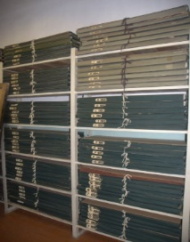
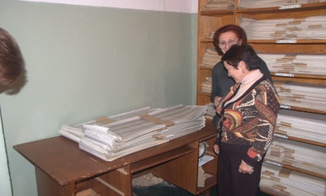
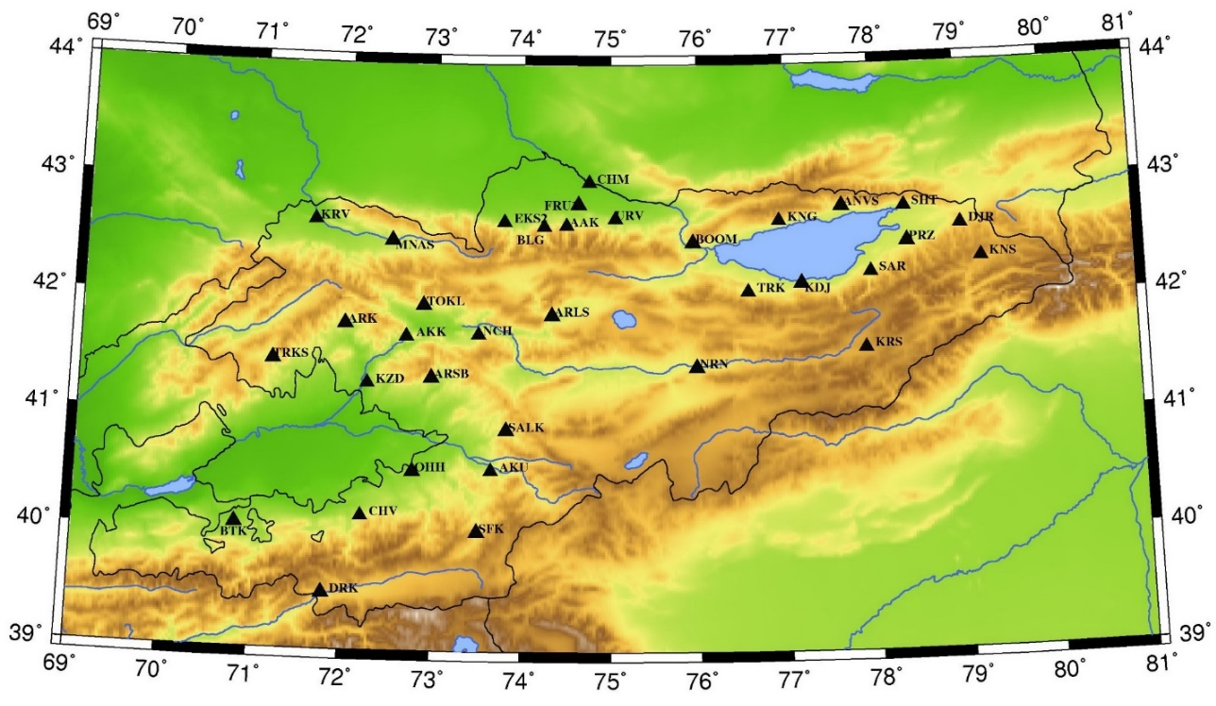

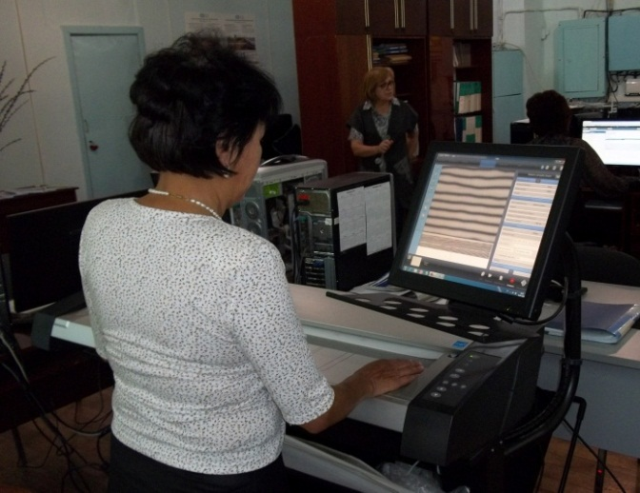
MONITORING SYSTEM AND DATA USED
Historical analog seismic records of the IS NAS KR network (Figure 3) are stored in an archive containing hundreds of thousands of seismograms for time period from 1927 to 2010 in Bishkek, and, of course the problem of historical archive preservation is one of an important tasks of the Kyrgyz NDC (NDC-KG), which consists in scanning and digitizing of historical analogue seismograms of nuclear tests and tectonic earthquakes. Figure 4 shows the photo of part of the IS NAS KR archive, and the process of seismograms scanning.
Scanning is conducted on a CONTEX HD Ultra i4250s ScanStation Repro scanner with 1200 DPI. At present, approximately 109000 seismograms of earthquakes with M ≥ 3.5, ~26500 nuclear tests, ~2500 chemical explosions and 600 records of strong motions have been scanned. In total, 170,000 seismograms with registration on photographic paper were scanned.
Figure 3. Map of location of analog seismic stations of the IS NAS KR.
Please do not use this space, a QR code will be automatically overlayed
Figure 4. Part of the historical archive of IS NAS KR. Photo of seismogram’s scanning in the NDC-KG.
P2.5-329

Slide 5
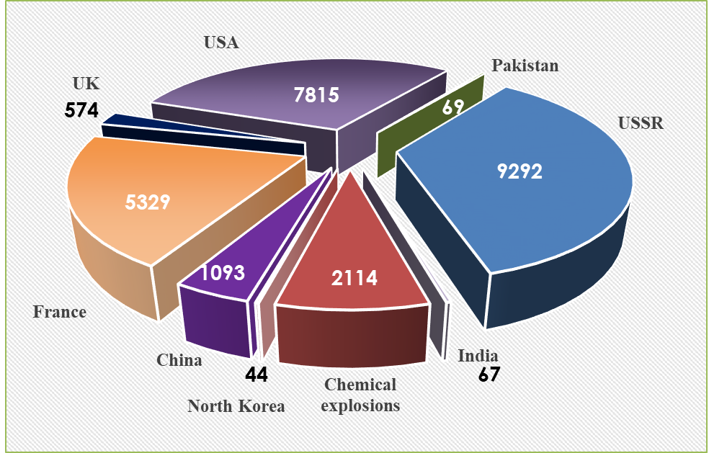
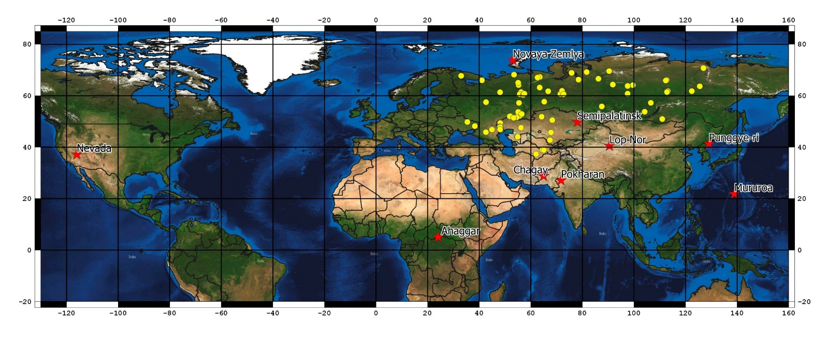
MONITORING SYSTEM AND DATA USED
Figure 5 shows a map of the location of nuclear test sites, as well as peaceful nuclear explosions carried out on the territory of the former USSR, the records of which were scanned during the work. In total 26397 seismograms for the period of 1962-2009 were scanned. Figure 6 shows a diagram of scanned seismograms due to test sites and type of explosion, and Figure 7 shows the seismograms of UNEs from different test sites of Asia, recorded by the Naryn seismic station.
Figure 5. Map of the location of nuclear test sites, as well as peaceful nuclear explosions carried out on the territory of former USSR, the records of which were scanned.
Figure 6. Diagram of scanned seismograms distribution due to the test sites.
Figure 7. Digitized seismograms of Naryn station. From top to bottom: Semipalatinsk test site (Kazakhstan), 01/30/1967, t0=04-01-57.6, ϕ=49.876°, λ=78.029°; Lop Nor (China), 10/05/1993, t0=01-59-56.6, ϕ=41.667°, λ=88.695°; Pokharan (India), 5/11/1998, t0=10-13-41.7, ϕ=27.105°, λ=71.802°; Peaceful nuclear explosion (USSR), 5/21/1968, t0=03:59:56.6, ϕ=38.918°, λ=65.032°; Chagay (Pakistan), 5/28/1998 t0=10-16-15.2, ϕ=28.902°, λ=64.789°.
Please do not use this space, a QR code will be automatically overlayed
P2.5-329

Slide 6
RESULTS OF PROCESSING. COMBINED TRAVEL-TIME PLOT
For the compilation of seismic bulletin of the main seismic phases, 428 seismograms of 30 explosions from the area of the Lop Nor test site were used for 1966-1996. In total 1566 measurements of the main regional phases were made at epicentral distances of 755-1554 km (Figure 8).
For routine processing in the Kyrgyz NDC, the IASPEI9 travel time plot is currently used. For processing of events, occurred in the territory of Kyrgyzstan, the Kyrgyz travel time plot (Sabitova T.) is used. From the seismic bulletin, compiled according to historical data from the archive of the IS NAS KR, measurements of the arrival times of the main regional phases for underground nuclear explosions, the parameters of which are well known, were selected. The travel time plots of all major regional waves were created using linear regression data analysis and computed in such a way as to achieve the best approximation of the estimated straight line to the observed values, i.e. obtaining the minimum root-mean-square deviation of the travel times from the averaging line of the travel time plot. Figure 9 shows the travel time plots of the major waves according to the data of nuclear explosions conducted on the territory of the Lop Nor test site. The travel times of the main regional seismic phases, depending on the epicentral distance, can be represented by the following equations given in Table 1.
Table 1. Travel time equations for the main phases of seismic waves.
Phase | Distance range | Equation | Velocity
Pn | 755-1554 | 10.117+0.121*Δ | 8.26
Pg | 755-1554 | 8.170+0.154*Δ | 6.49
Sn | 755-1554 | 4.909+0.225*Δ | 4.44
Lg | 755-1554 | 2.152+0.289*Δ | 3.46
Please do not use this space, a QR code will be automatically overlayed
P2.5-329

Slide 7
RESULTS OF PROCESSING. COMBINED TRAVEL-TIME PLOT
Please do not use this space, a QR code will be automatically overlayed
Figure 8. Histogram of epicentral distances of processed UNE seismograms recorded by Kyrgyzstan’s stations.
Figure 9. Travel time plots of the main phases of waves according to the data of nuclear explosions conducted on the territory of the Lop Nor test site.
P2.5-329

Slide 8
ON THE RELATIONSHIP BETWEEN MAGNITUDES AND POWER OF THE NUCLEAR TESTS
For researchers in the seismic monitoring, the study of the dependence of magnitudes on the power of the explosion is of great interest. Under the creation of a seismic bulletin for nuclear tests from the area of the Lop Nor test site, the magnitudes mpv, mb, and energy class K_{R} were calculated for energy estimation. It should be noted that for the same explosion, a dispersion in magnitudes was observed, which is associated with the fact that some of the stations are located in urban areas on sedimentary soils. In this regard, at such stations, the values of energy characteristics are systematically overestimated. That is why, it is necessary to study the station corrections for each station, however, this is a rather complicated task that requires the analysis of statistically representative material and a large amount of research, so now we have limited ourselves to using station magnitudes without corrections.
Figure 10 shows the dependence of the magnitudes mpv and K_{R} for nuclear explosions, carried out in different conditions, on the power of the explosion. It can be seen that the seismic effect of explosions differs significantly depending on the type of source, thus for underground nuclear explosions the seismic effect is much higher than for atmospheric ones.
For underground nuclear explosions:
K_{R}=11.29+1.25*lg(Y(kt)), correlation coefficient, R=0.91; mpv=5.266+0.67*lg(Y(kt)), correlation coefficient, R=0.78.
Figure 10. Dependence of a) K_{R}, b) mpv on the power of nuclear explosions carried out in different conditions. By white circles the underground nuclear explosions are indicated, and by red ones the atmospheric nuclear explosions are indicated.
Please do not use this space, a QR code will be automatically overlayed
P2.5-329

Slide 9
CONCLUSION
Currently, the National Data Center of Kyrgyzstan (IS NAS KR) is doing a lot of work to preserve unique historical analog seismograms of nuclear explosions and earthquakes from the IS NAS KR archive. Metadata more than 136 seismic stations (both temporary and permanent), operated in the territory of Kyrgyzstan in different time periods of observation, were collected, including coordinates refined by modern methods, amplitude-frequency characteristics, etc. More than 26500 analogue seismograms of nuclear explosions and earthquakes were scanned with a resolution of 1200 DPI, the digitizing of which is conducted. According to historical seismograms analysis, a seismic bulletin was created for nuclear explosions from the area of the Lop Nor test site, magnitudes mb, mpv, and energy class K were calculated. More than 400 seismograms were processed (1966-1996). An analysis of the dynamic parameters of seismic records of nuclear explosions depending on the power of the explosion and the test environment has been carried out.
Please do not use this space, a QR code will be automatically overlayed
P2.5-329

