Slide 1
Possible Historical Seismic Recordings of the 6 July 1962, Sedan Nuclear Explosion by the Mechanical Seismographic Stations of the National Seismological Service of Mexico
Miguel Angel Santoyo (Universidad Nacional Autónoma de México (UNAM)
Raúl Corona-Fernandez (Universidad Nacional Autónoma de México (UNAM)
Poster Nr: P2.5-837
Presentation Date: 21 Jun 2023, 10:00
We analyze the historical seismic recordings obtained by the Mechanical Seismographic Stations of the National Seismological Service of Mexico (SSN), for potential evidence of nuclear tests recordings (e.g., July 6, 1962, Sedan Nuclear Explosion)
We assess the reliability and accuracy of the legacy seismic data for studies on nuclear tests, by examining the seismic records and comparing them with other available data sources.
We will use TIITBA, a new GUI for the vectorization of analog records for the analysis of these data, including historical earthquakes or nuclear tests.
We have found that during July 6, 1962,some ground motions correspond to an earthquake occurred in Afghanistan. Also, three explosions were recorded at this station between 16:14 and 16:17hrs.
Due to the frequency content of recorded motions, it is unlikely that these explosions correspond to the nuclear test.
We are looking for records of stations in Mexico closer to the Arizona test site (e.g., Chihuahua station).
Leave empty – QR code will be overlayed on touchscreen
P2.4-123

Slide 2
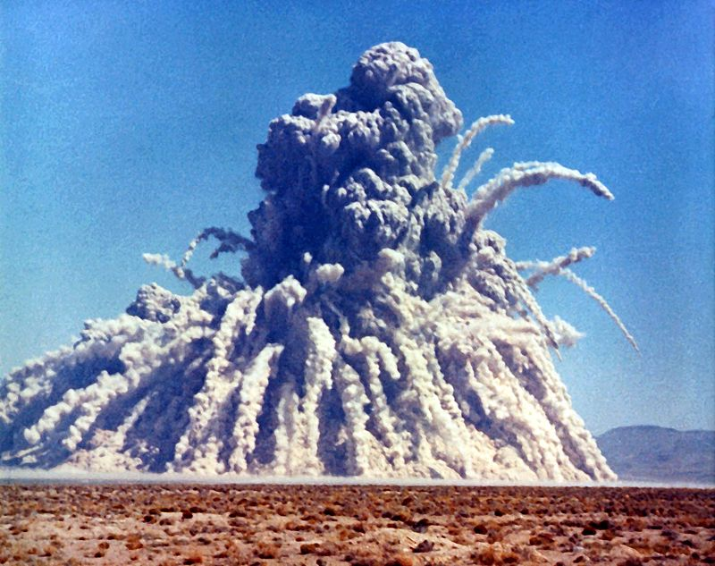
Introduction: Possible Historical Seismic Recordings of the 6 July 1962, Sedan Nuclear Explosion by the Mechanical Seismographic Stations of the National Seismological Service of Mexico
During the first half of the 20th century, most earthquake ground motions in Mexico were recorded by the Mexican seismological network, equipped with different Wiechert mechanical seismographs on smoked paper. Nowadays, the analogue seismographic collection of Mexico is stored and maintained at the Joint Library of Earth Sciences of UNAM, as part of the Sismoteca-SSN project, to preserve, digitize and reuse these legacy seismic data.
Due to the availability this collection, we have found different smoked paper seismograms at the Tacubaya (TAC) Central station for the period from 5 to 7 July 1962. On July 6, 1962, a shallow underground nuclear test was conducted in the Yucca Flat, Nevada. This event, known as the Storax Sedan nuclear test had an estimated energy yield equivalent to 104 kilotons TNT (Figure 1).
Figure 1. Image from the National Nuclear Security Administration Nevada Site Office Photo Library under number XX-13.
Leave empty – QR code will be overlayed on touchscreen

Slide 3
Objectives of the Conference
Main objectives:
To investigate and analyze the historical seismograms obtained by the mechanical seismographic stations of the National Seismological Service of Mexico for potential evidence of nuclear tests recordings (e.g., the July 6, 1962, Sedan Nuclear Explosion).
To assess the reliability and accuracy of the legacy seismic data for studies on nuclear tests.
Contribute to a better understanding of the regional and global seismic impact of the 6 July 1962 Sedan Nuclear Explosion, by examining the seismic records and comparing them with other available data sources.
The use of TIITBA, a new GUI for the vectorization of analog records for the analysis of these data, such as historical earthquakes or nuclear tests, will help for the study of these recordings.
Leave empty – QR code will be overlayed on touchscreen

Slide 4
Methods and Data used for the Conference
Analog records from July 6, 1962.
Wiechert 1,700kg at TAC-NS
Wiechert 1,700kg at TAC-EW
Leave empty – QR code will be overlayed on touchscreen
Figure 2. Analog seismograms from July 6, 1962, at the Tacubaya central seismographic station, in Mexico City.

Slide 5
Methods and Data used for the Conference
TIITBA (vectorization and Analyses GUI)
Analog records from July 6, 1962.
Wiechert 1,700kg at TAC-NS
Figure 3a. Arrows show the seismic recordings observed at the NS component. Open circle shows the explosions recordings.
Wiechert 1,700kg at TAC-EW
To vectorize the records in the analog seismograms, and to analyze the origin of each record, we will use the based- open-access sofware TIITBA (Corona-Fernandez & Santoyo, 2023).
Leave empty – QR code will be overlayed on touchscreen
Figure 3b. In the EW component seismic recordings are difficult to observe. So far, for this date (July 6, 1962) we have only found records at the Tacubaya central station.

Slide 6
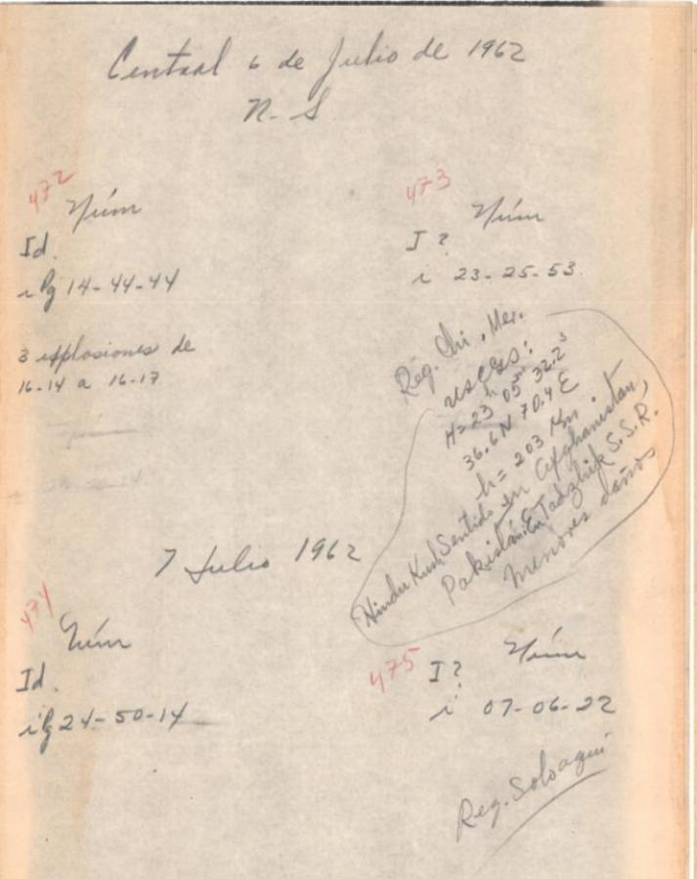
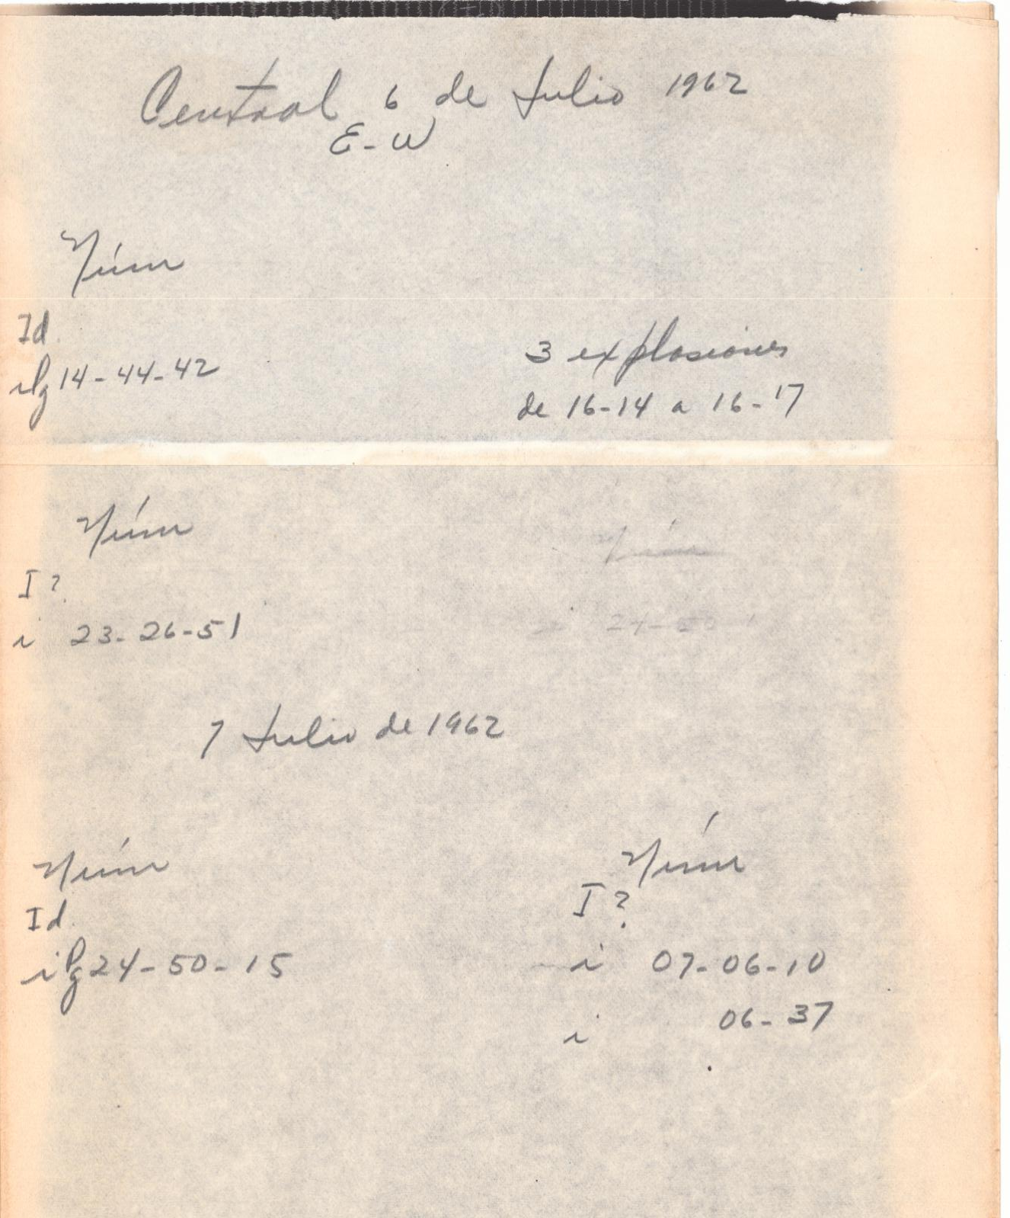
Results presented at the Conference
Analyzing the different events recorded in the analog seismogram and the notes of the operators at the TAC, station, we find that:
For this day (July 6, 1962) it is observed a note, indicating the recordings from the Afghanistan earthquake (no further information on the back of the seismograms is found about this earthquake).
Also three explosions are annotated between 16:14 to 16:17hrs.
Leave empty – QR code will be overlayed on touchscreen
Figure 4. Backside of the NS and EW Tacubaya station, 17,000 kg Wiechert seismograms . Annotations are in Spanish language.

Slide 7
Conclusion Slide Title goes here [Font: Arial Regular Size 20]
CONCLUSIONS
Some of the ground motions observed in the NS component appears to correspond to the teleseismic recordings of the July 6, 1962, Afghanistan (M6.7) earthquake, occurred in the Badakhshan region, in addition to two possible aftershocks.
Due to the apparent frequency content, and time length of the recorded explosions, it appears unlikely that these ground motions correspond to the SEDAN nuclear test.
We are looking for additional records of stations in Mexico closer to the Arizona test site (e.g., Chihuahua station).
TIITBA–GUI software will be used in order to perform a detailed analysis of these recordings.
https://web.archive.org/web/http://www.nv.doe.gov/library/photos/photodetails.aspx?ID=1035
Corona-Fernández, R.D. & Santoyo, M.Á. (2023) Re-examination of the 1928 Parral, Mexico earthquake (M6.3) using a new multiplatform graphical vectorization and correction software for legacy seismic data. Geoscience Data Journal, 10, 178– 192. Available from: https://doi.org/10.1002/gdj3.159
Leave empty – QR code will be overlayed on touchscreen

