Slide 1
Monitoring of Radiocesium Traces in Indonesian Waters and Lands As an Indicator of Nuclear Weapon Testing Activities
Budi SETIAWAN1, and Heny SUSENO2
1. Research Center for Nuclear Fuel Cycle and Radioactive Waste Technology –BRIN
2. Research Center for Radiopharmaceuticals, Radioisotopes and Biomedicine –BRIN
Science and Technology Campus of BJ. Habibie-Serpong, Banten-Indonesia 15314
In sea waters:
- Cs-137 in the west coast:
0.12 ~ 0.66 Bq/m3,
- Cs-137 in the east coast: 0.12 ~ 0.39 Bq/m3,
No Cs-134 was found
In lands:
High radiation emission came from high natural BG radiation areas,
No Cs-134 was found
Traces of Cs-137 radioactivity have been found in Indonesian waters and land, while traces of Cs-134 radioactivity zero at all monitoring points. This indicator shows that Indonesia has never carried out nuclear weapon test activities to fulfill the agreement.
CTBTO members are required to report activities related to the implementation of the total ban on nuclear weapon testing throughout the country via Cs-134 and Cs-137 traces monitoring in their waters and lands.
The data were collected from various open data of Cs-137 and Cs-134 traces monitoring activities in Indonesian coastal and land areas
Leave empty – QR code will be overlayed on touchscreen
P2.5-121

Slide 2
Introduction
Comprehensive Nuclear Test Ban Treaty Organization (CTBTO) is an international organization under IAEA laws that was established in 1996 with the objective of stopping the spread of nuclear weapons through a total ban on nuclear weapon testing. In this regard, all members who have ratified the agreement are required to report activities related to the implementation of the agreement, including Indonesia. One of them is reporting on the condition of monitoring the release of radionuclides due to nuclear weapons testing in waters, as well as on land throughout the country. The position of Indonesia in geostrategy and world trade (at the equator, as a gateway for northern and southern goods traffic) is important to maintain its security, including protecting the environment and region from nuclear incident or nuclear arm race. For this reason, the paper presents some data from monitoring activities that have been carried out around Indonesian waters and land. These monitoring activities are mainly carried out in order to maintain environmental safety against exposure to radioactivity in the environment and anticipate the possibility of radiocesium release due to the Fukushima accident, especially at the entrance to Indonesian waters. It can also be used to monitor possible traces of radiocesium residues from nuclear weapons experiments around Indonesia, including Cs-134. The purpose of this activity is to collect data related to the results of monitoring traces of radiocesium in waters and land around Indonesia. As an indicator for monitoring nuclear weapon testing throughout Indonesia, the ratio of Cs-134 to Cs-137 has been used.
P2.5-121
Leave empty – QR code will be overlayed on touchscreen

Slide 3
Objectives
The monitoring activities were carried out to maintain environmental safety against radioactivity exposure on the Indonesian coastal, and anticipate the possibility of radiocesium release due to the Fukushima accident, especially at the entrance to Indonesian waters. This data can also be used to indicate possible nuclear testing activities in Indonesia and surrounding areas.
P2.5-121
Leave empty – QR code will be overlayed on touchscreen

Slide 4
Methods
The data were collected from various open data of radiocesium traces monitoring activities in Indonesian coastal areas, including West Sumatra, Bangka Island, North and South Java Island, Madura Island, Lombok Strait, Flores Sea, and North and South Sulawesi island, and also in land. The data is then processed and compiled as comprehensive open information.
P2.5-121
Leave empty – QR code will be overlayed on touchscreen

Slide 5
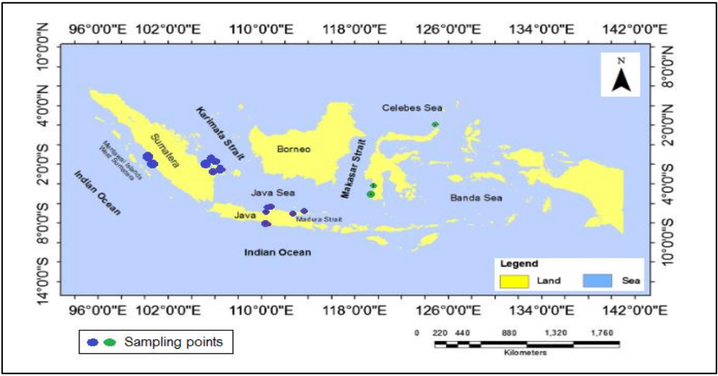
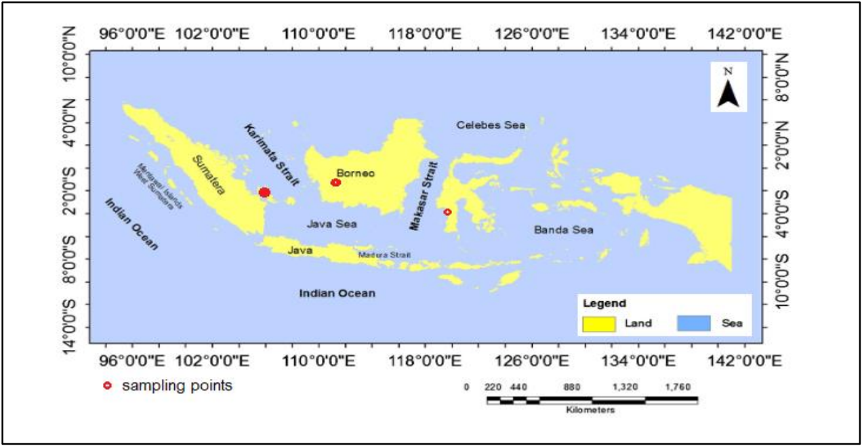
Results
The spread of radiocesium traces is strongly influenced by the circulation of wind and ocean currents around Indonesia. The upper thermocline of the North Pacific water is a major part of the ITF that is transported from the Mindanao current into the Indonesian Sea through the Makassar Strait. Seawater from ITF that enters into Indonesian marine water area could distribute Cs-137.
The monitoring activities in these study areas were performed during a period of northwest monsoons, when the wind pushes down the warm seawater from the Pacific Ocean to the Indian Ocean. The influence of currents from the Pacific Ocean when entering the ITF can wash away radiocesium originating from the Pacific Ocean.
In the west coast: Cs-137 ~ 0.12 to 0.66 Bq/m3.
In the eastern coast: Cs-137 ~ 0.12 to 0.39 Bq/m3.
No radioactivity of Cs-134 was found at all monitoring point.
Monitoring traces of radiocesium on land also showed similar results. In some areas in Indonesia have very high levels of abnormal radiation emissions, traces of Cs-137 radioactivity were recorded slightly over the background counting, such as in Mamuju, Kalimantan and Bangka with potential annual effective doses which are even higher than the 20 mSv , mostly from K-40, U-238, and Th-232 and their decays. These area are included in the high natural background radiation areas (HNBRAs). This area includes anomalous areas for exposure to natural radiation.
No traces of Cs-134 radioactivity were found at all monitoring points.
It is confirmed that Indonesia has never carried out nuclear weapon testing.
Radionuclide Cs-137 originating from research and industrial activities is processed at the radioactive waste treatment in Serpong-Indonesia. Waste packages in the form of cementation is the final form of low-level radioactive waste in Indonesia, all of which are stored safely in IS facilities.
P2.5-121
Leave empty – QR code will be overlayed on touchscreen

Slide 6
Conclusion
Data collection was carried out from monitoring traces of radiocesium in Indonesian waters and land. Traces of Cs-137 radioactivity have been found in Indonesian waters and land, while traces of Cs-134 radioactivity have been nil at all monitoring points. This indicator shows that Indonesia has never carried out nuclear weapon test activities to fulfill the agreement.
P2.5-121
Leave empty – QR code will be overlayed on touchscreen

Slide 7
References
You, Y., Chern, C.S., Yang, Y., Liu, C.T., Liu, K.K., Pai, S.C. The South China Sea, a cul-de sac of North Pacific Intermediate Water. J. Oceanography 61, 509-527 (2005).
Ding, X., Bassinot, F., Guichard, F., Fang, N.Q. Indonesian Throughflow and Monsoon Activity Records in the Timor Sea Since the Last Glacial Maximum. Mar. Micropaleontol. 101, 115–126 (2013).
Sprintall, J., Wijffels, S.E., Molcard, R., Jaya, I. Direct Estimates of the Indonesian Throughflow Entering the Indian Ocean: 2004–2006. J. Geophys. Res. 114, C07001 (2009).
Suseno, H., Prihatiningsih, W.R. Monitoring 137Cs and 134Cs at Marine Coasts in Indonesia between 2011 and 2013, Marine Pollution Bulletin 88 (1-2), 319-324 (2014).
Suseno, H., Wahono, I.B. Present Status of 137Cs in Seawaters of the Lombok Strait and the Flores Sea at the Indonesia Through Flow (ITF) Following the Fukushima Accident, Marine pollution bulletin 127, 458-462 (2018).
Alkatiri, A., Suseno, H., Hudiyono, S., Moersidik, S.S. The Distribution of Radiocesium in the Indian Ocean and Its Relation to the Exit Passage of the Indonesian Throughflow, , Regional Studies in Marine Science 25, 100496 (2019).
IAEA. Worldwide Marine Radioactivity Studies (WOMARS): Radionuclide levels in oceans and seas. IAEA TECDOC-1429, Vienna, Austria, IAEA (2005).
Nugraha, E.D., Hosoda, M., Kusdiana et al. Comprehensive Exposure Assessments from the Viewpoint of Health in a Unique High Natural Background Radiation Area, Mamuju, Indonesia. Sci Rep 11, 14578 (2021).
Cakrabuana, W., , Argianto, E.N.S., Ciputra, R.C., Kamajati,D. Geological, Geochemical, and Radiometric Study of Sandstone-type Uranium Deposit Exploration in Menukung Area, West Borneo. IAGI Journal Volume 1 No. 1, 1–12 (2021).
Lestiani, D.D., Kurniawati, S., Kusmartini, I., Adventini, N., Syahfitri, W.Y.N., and Santoso, M. Assessment of Environmental Safety Related Radioactivity Exposure in Zircon Sand, Ecolab Vol. 13 No. 1, 1 – 60 (2019).
P2.5-121
Please do not use this space, a QR code will be automatically overlayed

