Slide 1

STUDY OF HISTORICAL PEACEFUL NUCLEAR EXPLOSIONS PARAMETERS CONDUCTED ON THE USSR TERRITORY
Aristova I.L., Komekbayev D.K., Sokolova I.N., Velikanov A.Ye.
Kazakhstan NDC / National Nuclear Center of the Republic of Kazakhstan
Investigation of historical seismograms of peaceful nuclear explosions conducted on the USSR territory is a topical task as the explosions were conducted on the vast territory of Northern Eurasia in different geological settings, various depths etc., and its parameters are well known. These records can be used for calculation of magnitude dependence on yield, for construction of regional travel-time curves, investigation of lithosphere structure, stations calibration. .
Data of analogue seismograms from CSE IPE AS USSR archive and digital data of Borovoye station were used.
A seismic bulletin of peaceful nuclear explosions was compiled. Regional travel-time curves were constructed, magnitude and energy class dependencies on explosion yield were calculated
Collected, systematized, processed data on peaceful nuclear explosions can serve as a database of reference events for its application as calibration sources. Other countries can supplement the created database with data available in their archives.
Please do not use this space, a QR code will be automatically overlayed
P2.5-395

Slide 2
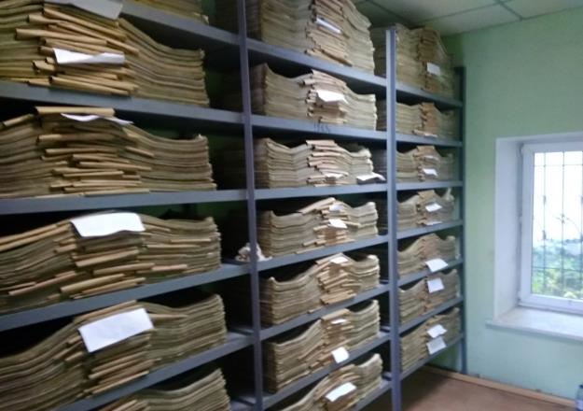
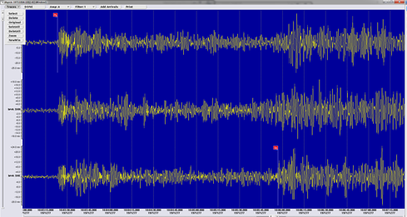
Introduction
Currently, the researchers in the field of seismic monitoring are interested in records of historical nuclear tests conducted in different environments. In this regard, the investigation of archive seismograms of peaceful nuclear explosions conducted on the USSR territory is a topical task. Peaceful nuclear explosions were conducted on the vast territory of Northern Eurasia in different geological settings, various depths etc., and its parameters are well known. In total, there were 124 PNE on the USSR territory, among them 117 were outside the test sites borders. A seismic bulletin for 98 peaceful nuclear explosions conducted on the USSR territory from 1965 to 1988 was compiled by analogue seismograms and digital records. In total, 1557 records were processed, among them 1501 analogue records, 56 digital records. The records from CSE IPE AS USSR stations network archive and Borovoye station currently stored at KNDC were used for the investigation. The stations are located at epicentral distances 240-8496 km.
Seismograms archive in KNDC
Example of explosion record
10.04.1971 at 10:00:00
for Borovoye station
Please do not use this space, a QR code will be automatically overlayed
P2.5-395

Slide 3
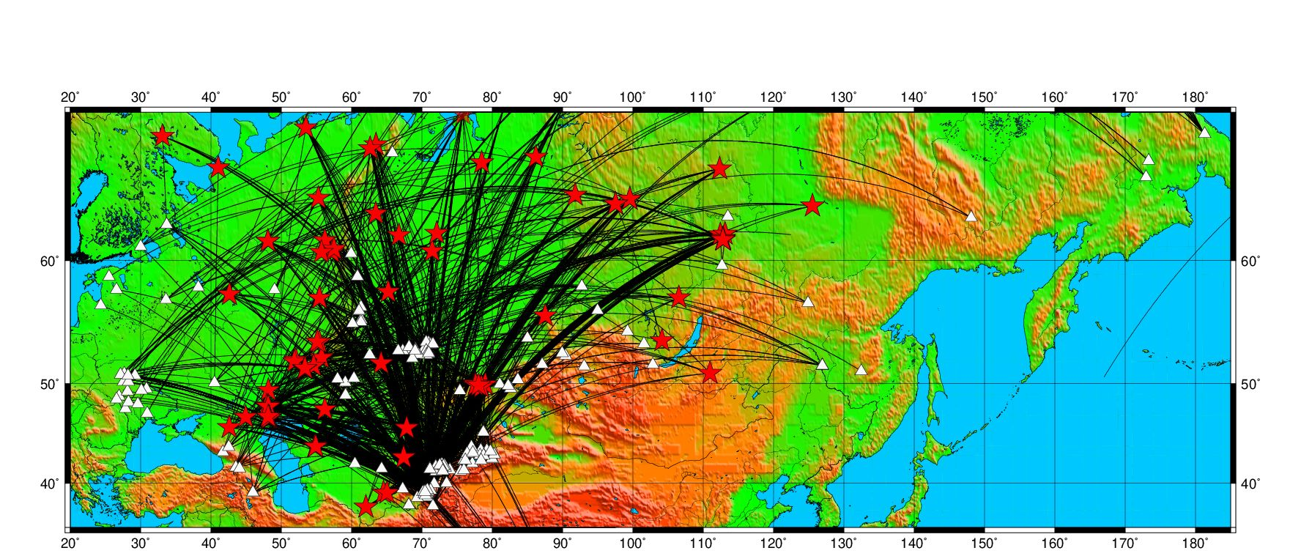
Methods/data
For each explosion a seismological bulletin was created, magnitude and energy class were calculated. The map shows the location of seismic stations the data of which were used for the bulletin compilation, and places where PNE were conducted.
Please do not use this space, a QR code will be automatically overlayed
The map of used traces from PNE epicenters to the recorded them stations. Stars – places where PNE were conducted, triangles – CSE seismic stations.
P2.5-395

Slide 4
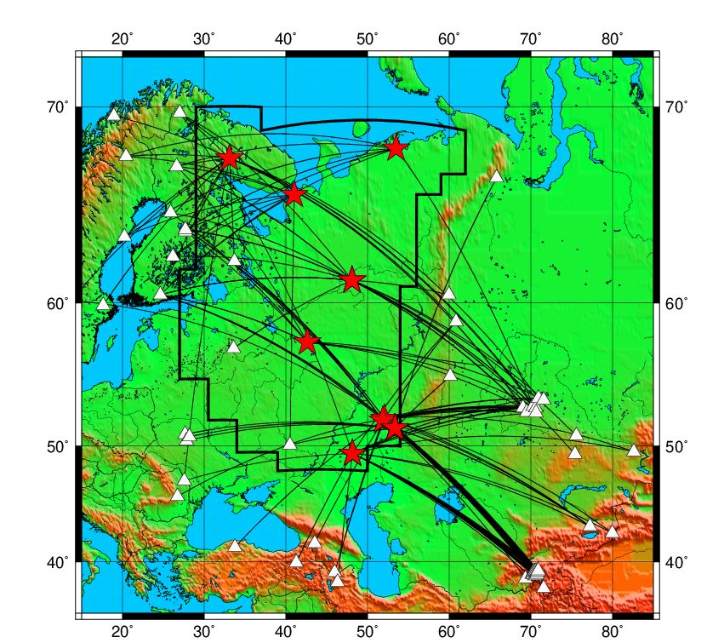
Results
Construction of a travel-time curve for the East-European platform.
From the seismic bulletin created by historical data, the arrival times of the main regional phases were selected and travel time for the investigated territory was measured.
For the travel-time curve construction, the measurements of other 6 stations (KJF, SOD, KEV, KIR, UME, NUR) from the ISC catalogue were used to improve the azimuthal coverage. The travel-time curves of all main regional types of waves were constructed using the linear regression analysis of data and calculated in a way to achieve the best approximation of the estimated direct line to the observed values. The Figure shows the travel-time curves of the main types of waves for the East-European platform, the Table shows the travel-time curve equations.
Travel-time curves of the main types of waves for the East-European platform.
The map of the East-European platform for the used traces from PNE epicenters to the recorded them stations. Stars – PNE place, triangles – CSE seismic stations.
The equations of the travel-time curves for
The main types of seismic waves.
Please do not use this space, a QR code will be automatically overlayed
Phase | Equation | Velocity
Pn | 14.687+0,116*Δ | 8, 64
Pg | 5.813+0.155*Δ | 6,45
Sn | 15.254+0.213*Δ | 4,70
Lg | 2.186+0,278Δ | 3.61
P2.5-395

Slide 5
Results
Connection between nuclear explosions magnitude and its yield
All peaceful nuclear explosions in the USSR were divided into four genetic rock types depending on the state of its crystallization: salt (crystalline), sediments (detrital uncrystalline), intrusive rocks (crystalline), effusive rocks (non-holocrystalline). The dependence of magnitude and class on explosion yield for PNE conducted in different geological environment was calculated.
K=10.5+1.86*lg(Y(kt)), correlation coefficient R=0.91 (salt)
K=11.8+0.83*lg(Y(kt)), correlation coefficient R=0.44 (sediments)
mb=4.56+0.75*lg(Y(kt)), correlation coefficient R=0.78 (salt)
mb=4.73+0.48*lg(Y(kt)), correlation coefficient R=0.54 (sediments)
Please do not use this space, a QR code will be automatically overlayed
Dependence of mb magnitudes on explosion yield for nuclear explosions conducted in different geological environment. 1 - salt, 2 - sediments, 3- intrusive, 4 – effusive, 5 – linear regression for explosions in salt, 2 – linear regression for explosions in sediments
Dependence of K energy class on explosion yield for nuclear explosions conducted in different geological environment. 1 - salt, 2 - sediments, 3- intrusive, 4 – effusive, 5 – linear regression for explosions in salt, 2 – linear regression for explosions in sediments
P2.5-395

Slide 6

Conclusion
Collected, systematized, processed data on peaceful nuclear explosions can serve as a database of reference events for its application as calibration sources. Other countries can supplement the created database with data available in their archives. In addition, the created bulletin can be used for detection and discrimination of nuclear tests within the CTBT.
Thank you for your attention.
Please do not use this space, a QR code will be automatically overlayed
P2.5-395

