Slide 1
Analysis of different nature events records from the Semipalatinsk Test Site region.
Ryabenko P.V., Sokolova I.N., Aleshenko I.B., Mackey K., Burk D. National Nuclear Center of the Republic of Kazakhstan/Michigan State University, USA
Currently, the interest to historical geophysical data increases in the whole world. The work presents the archive seismograms of stations operated in 1961-1981 on the territory of former USSR, and records of underground nuclear explosions conducted at Degelen experimental field of the Semipalatinsk Test Site.
Analogue seismograms were scanned using wide-format scanner with resolution 600 DPI. The scanned records were digitized using WaveTrack software byselecting peak amplitudes. The digitized data were saved in MiniSEED format , and SAC. Each digitized record passed 3 quality control stages. The digitized historical seismograms were compared with digital records of events from Semipalatinsk Test Site having different nature: chemical explosions and earthquakes.
The database of digitized seismograms of underground nuclear explosions was created (1083 components). The archive records of underground nuclear explosions allowed for determining dynamic characteristics of different wave types, and calculating magnitudes and energy classes.
The created database of digitized historical seismograms of underground nuclear explosions conducted at Semipalatinsk Test Site allows for discriminating the sources, studying different effects related to nuclear explosions including the repeated explosions conducted under the same conditions.
Please do not use this space, a QR code will be automatically overlayed
P2.5-543

Slide 2
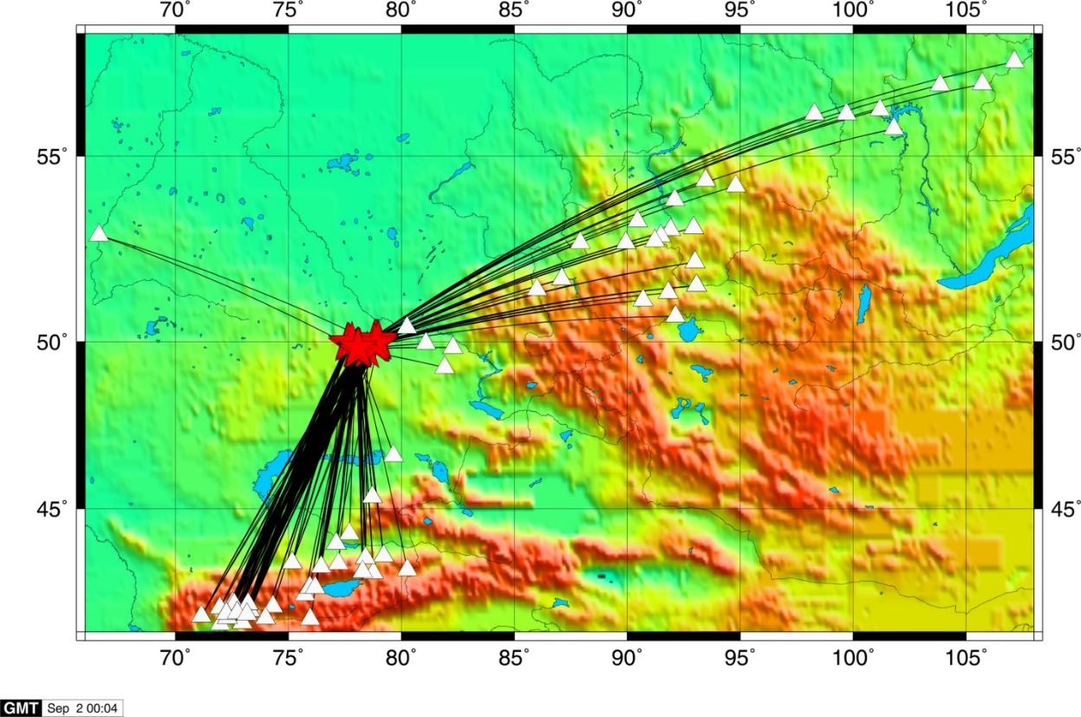
INTRODUCTION
From August 2020, the IGR together with Michigan State University (MSU, USA) have been conducting some work on digitization of UNE records from the STS region recorded by stations at regional distances. The seismograms were selected from the archive of historical seismograms that previously belonged to the Complex Seismological expedition (CSE) IPE AS USSR, and that is currently located at KNDC IGR NNC RK. The digitized records were of 1961-1981; that time the CSE seismic stations was equipped with SKM, RVZT, and KSE instruments. At the initial stage, the seismograms recorded by SKM seismometer on photo-paper were digitized. Each seismic station was equipped with two horizontal and one vertical seismometer to record three components of seismic signal. The Figure shows the map of stations location (triangles) and UNE (stars) which data were used for digitization.
Please do not use this space, a QR code will be automatically overlayed
P2.5-543

Slide 3
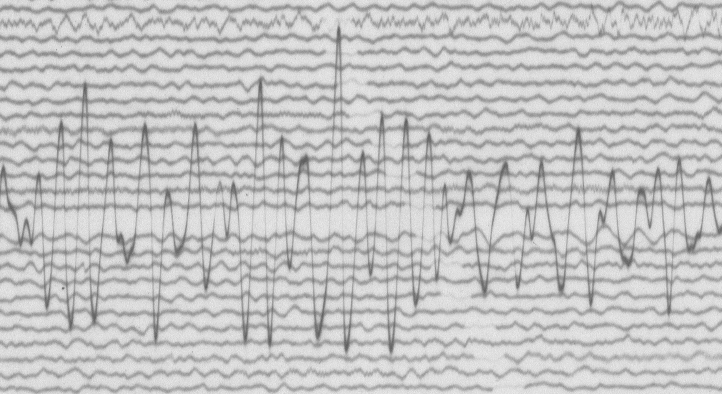
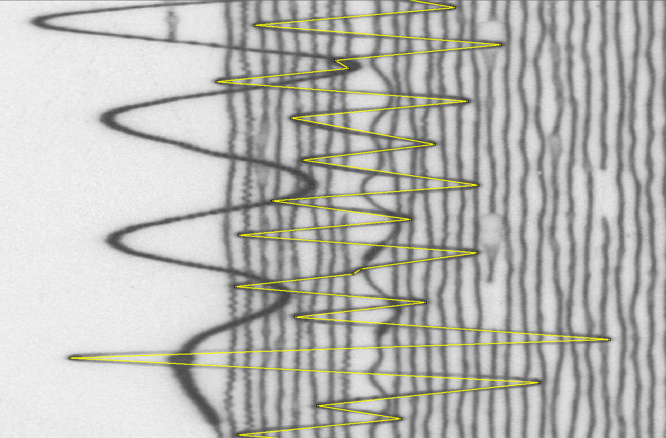
METHODS/DATA
The seismograms were sanned using wide-format scanner Contex HD Ultra X 4290 with resolution 600 DPI in BMP format. The digitization was conducted by selecting the amplitude peaks.
One minute of noise before the event start was also digitized.
Please do not use this space, a QR code will be automatically overlayed
P2.5-543

Slide 4
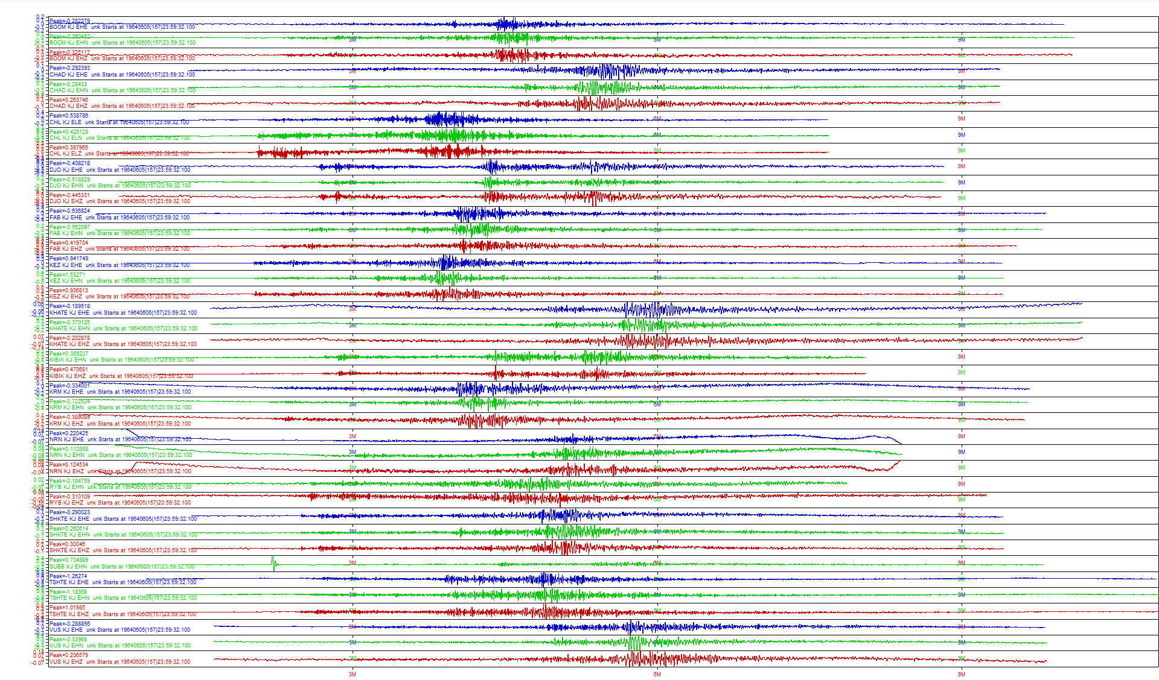
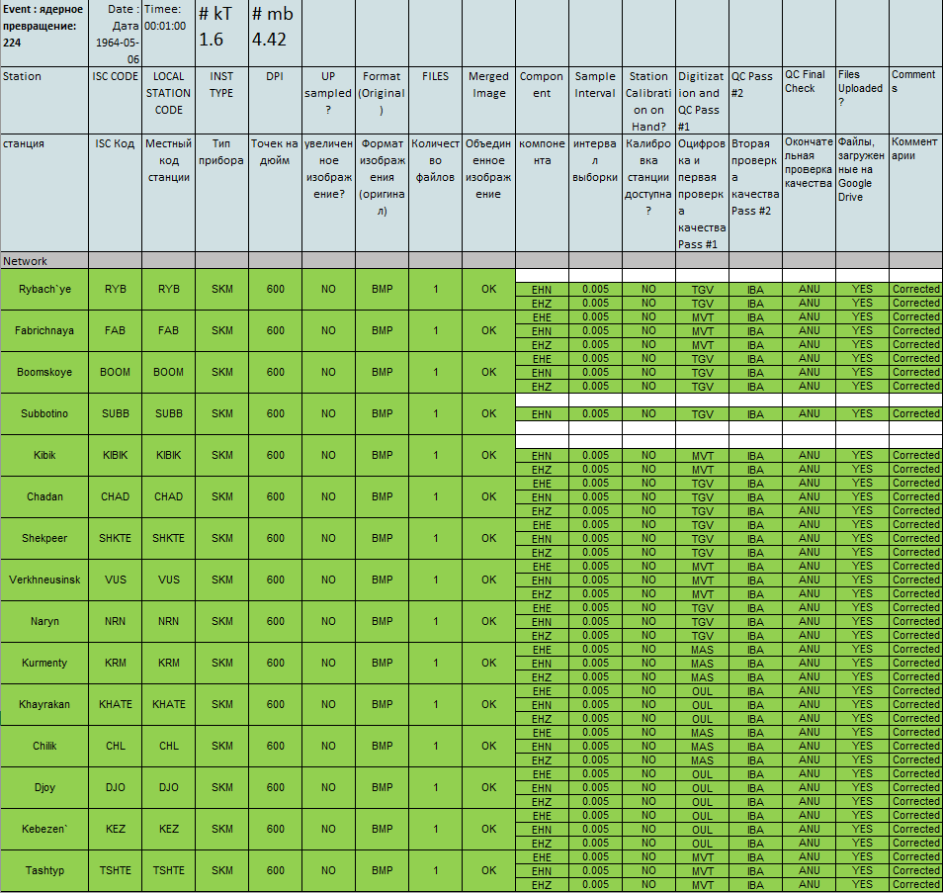
RESULTS
The database of digitized seismograms of underground nuclear explosions includes the scanned seismograms, peak selection files, log files of data conversion, digital form records in MiniSEED and SAC formats, quality control sheet that shows all stages of digitization. The archive records of nuclear explosions allowed for determining the dynamic characteristics of different wave types, caluclating magnitudes and energy classes of explosions.
Please do not use this space, a QR code will be automatically overlayed
P2.5-543

Slide 5
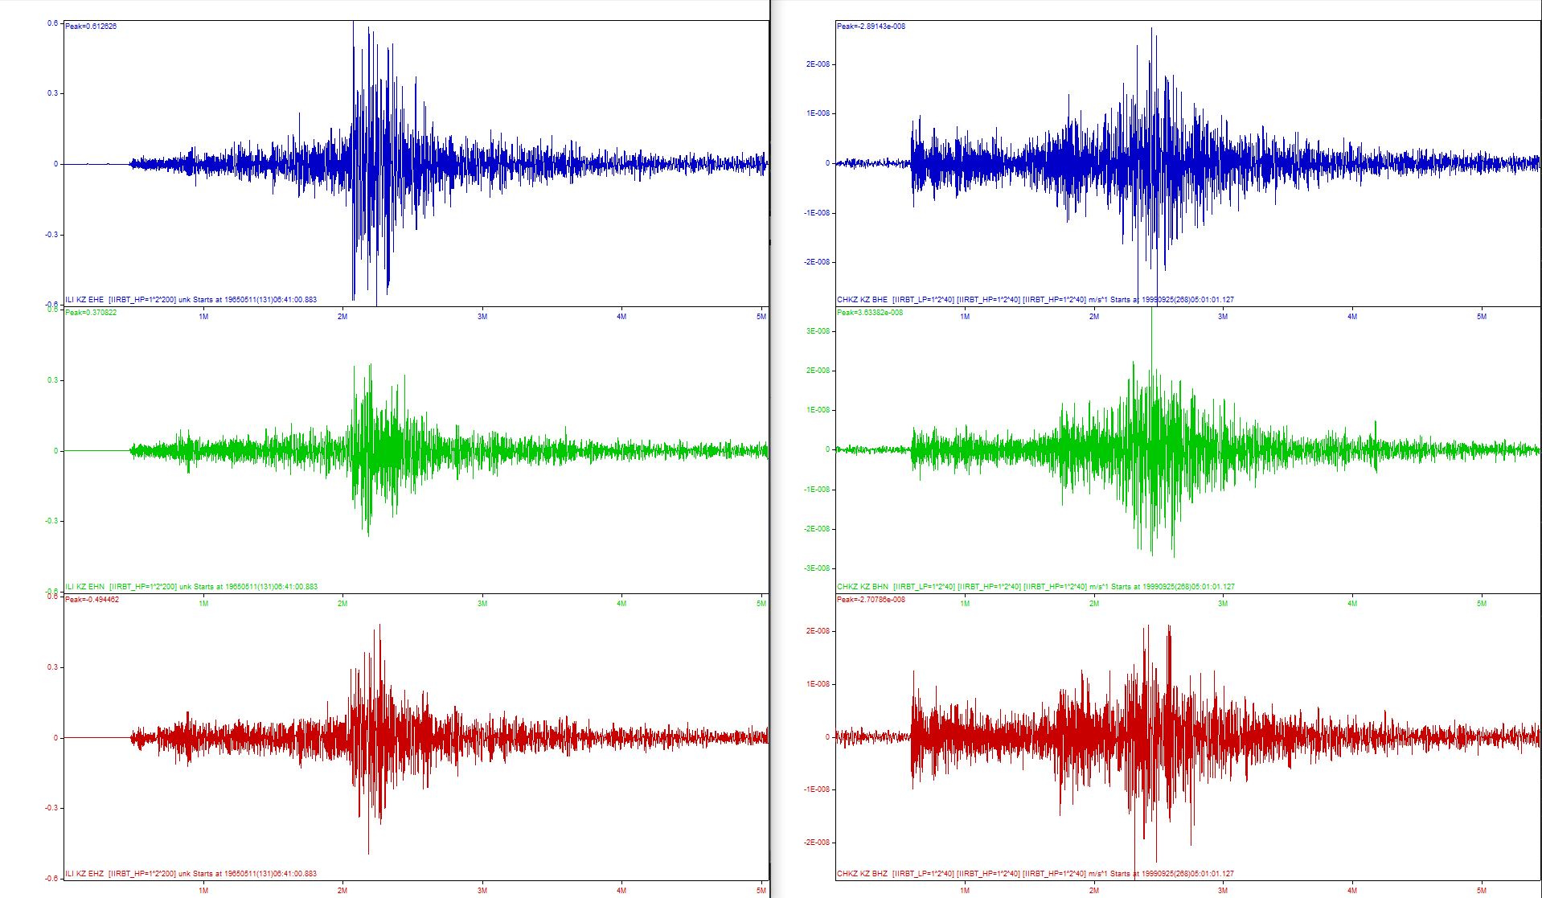
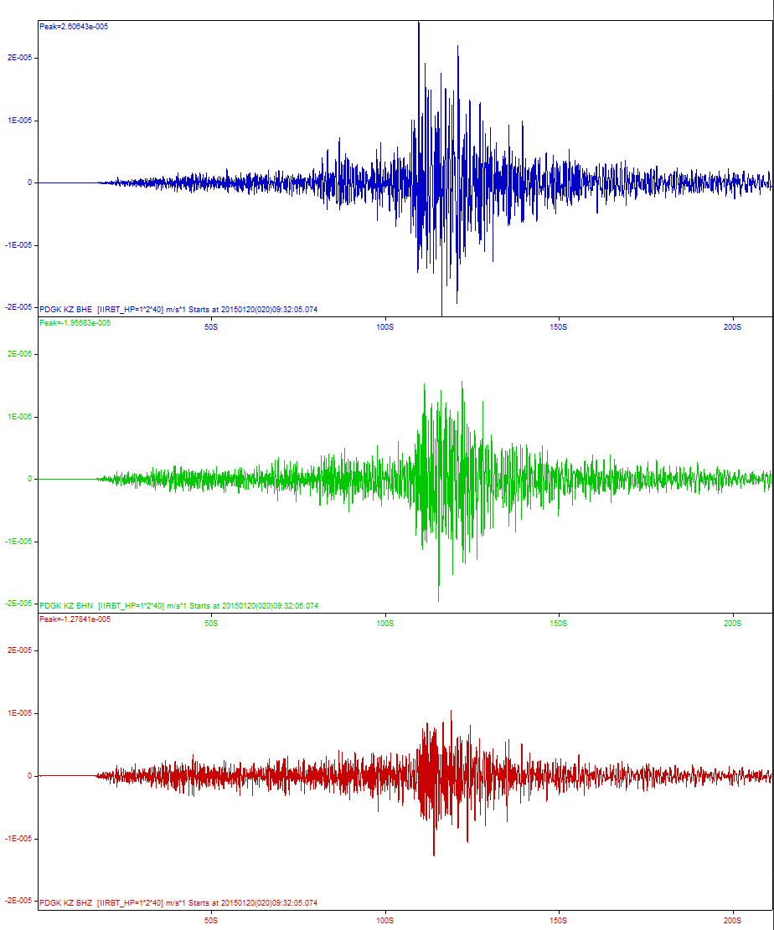
RESULTS
P
P
P
The slide shows 3 records of different nature events from Semipalatinsk Test Site. On the left is a digitized UNE record by ILI station, distance to the source is 656 km. In the center is a digital record of chemical explosions Omega-2 by CHKZ station, distance to the source is 668 km. On the right is a digital record of earthquake occurred on the STS territory and recorded by PDGK station, distance to the source is 800 km. These data can be compared and analyzed.
Please do not use this space, a QR code will be automatically overlayed
P2.5-543

Slide 6
CONCLUSION
The created database of digitized historical seismograms of underground nuclear explosions conducted at Semipalatinsk Test Site allows for discriminating the sources, studying different effects related to nuclear explosions including the repeated explosions conducted under the same conditions.
Please do not use this space, a QR code will be automatically overlayed
P2.5-543

