Slide 1


FEATURES OF THE WAVE PATTERN OF NUCLEAR EXPLOSIONS AND EARTHQUAKES FROM THE LOP NOR TEST SITE AREA ACCORDING TO THE DATA OF SEISMIC STATIONS IN KYRGYZSTAN
A. Berezina¹, K. Mackey³, I. Sokolova², D. Burk³, E.Pershina¹, T. Nikitenko¹
¹ - Institute of Seismology, NAS KR, Bishkek, Kyrgyzstan, ² – IGR NNC RK, Kurchatov, Kazakhstan, ³ – Michigan State University, Michigan, USA
Records of historical nuclear tests at regional distances are of particular value, this interest is associated, in first of all, with the task of detecting and recognizing nuclear tests within the framework of the CTBT, creating a database of reference events for calibration of IMS network, and other tasks.
WaveTrack software, developed at the SB RAS, allows to qualitatively digitize a record on an analog seismogram, to correct non-linear time scales and can be used to trace complex waveforms.
The structure of short-period seismic fields of underground nuclear explosions conducted at the Lop Nor test site, as well as earthquakes with epicenters close to the test site, were studied. The ratios of the amplitudes of different phases of longitudinal and transverse waves were analyzed.
Historical data preservation work is continuing and will contribute to a more reliable monitoring of the implementation of the Comprehensive Nuclear-Test-Ban Treaty.
Please do not use this space, a QR code will be automatically overlayed
P2.5-190

Slide 2
INTRODUCTION
The task of historical seismograms preservation and digitizing is very actual for researchers in the field of seismology and geophysics, which allows you to clarify the parameters of seismic events, study the structure of the lithosphere, study geodynamic processes, etc. Records of historical nuclear tests at regional distances are of particular value, this interest is associated, in first of all, with the task of detecting and recognizing nuclear tests within the framework of the CTBT, creating a database of reference events for calibration of IMS network, and other tasks. During the period when most of the nuclear tests were carried out, only a small number of digital stations were operating, but there are analogue recordings that can be digitized. Kyrgyz stations have a number of advantages, primarily due to their good location, all of them are located at regional distances from the test sites: Lop Nor (China), Semipalatinsk test site (STS, Kazakhstan), Pokharan (India) and Chagay (Pakistan). Of greatest interest is the Lop Nor nuclear test site, which is located in the province of Xinjiang (Northwest China), approximately in 600 km southeast of the Kazakh-Chinese border. In the period 1964-1996 47 nuclear tests were conducted here, including 3 ground, 19 atmospheric and 25 underground explosions. Underground nuclear tests were carried out in boreholes and horizontal tunnels. The maximum power of atmospheric nuclear explosions reached Y=4 Mt for the test on November 17, 1976; for underground nuclear tests, the maximum power was Y=660 Kt for the explosion on May 21, 1992. It is necessary to add, that geographically, the area of the Lop Nor test site is located in the seismically active region of the Eastern Tien Shan, and is characterized by a complex tectonic conditions, so, in addition to the records of nuclear tests, seismograms of tectonic earthquakes can be studied.
It should be noted that from 47 nuclear tests conducted at the Lop Nor test site, the ISC bulletins contain information on 28 nuclear tests from the Lop Nor test site. Until 1990, ISC bulletins were compiled mainly from data from remote seismic stations, at distances of more than 1500 km, since seismic bulletins of nuclear explosions were not provided to International Centers based on data from stations in Central Asia and Kazakhstan in Soviet times. In this regard, the work on creation of database of digitized seismograms based on the records of Kyrgyz stations is a very urgent task and will improve the quality of the catalog of nuclear explosions from the Lop Nor test site, calibrate modern seismic stations, create a regional travel time curve for the territory of Dzungaria and Xinjiang, and other monitoring tasks.
Please do not use this space, a QR code will be automatically overlayed
P2.5-190

Slide 3
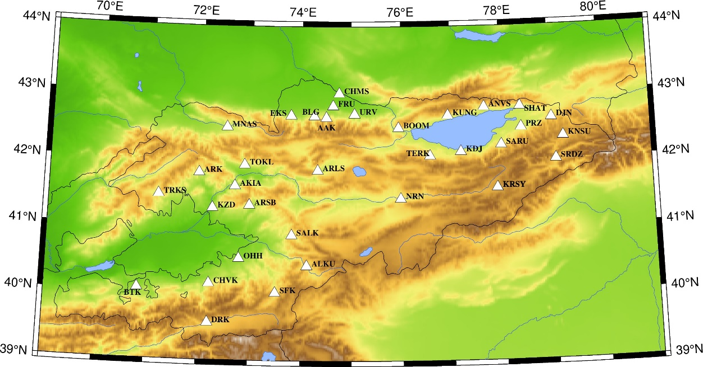
OBSERVATIONAL SYSTEM AND DATA USED
During the operation of the Lop Nor test site, in Kyrgyzstan a regional network of seismic stations was operating. The network consisted of 31 stationary stations evenly distributed throughout the territory of Kyrgyzstan. All stations were equipped with standard equipment Kirnos SKM-3 with a magnification of 20000 and SKD with a magnification of 1000. Most of these stations are located at bedrock outcrops, in tunnels, which allowed to register weak underground nuclear explosions (Figure 1).
In 2018-2020 within the framework of the ISTC project metadata for seismic stations were collected and refined. Frequency response calibration data were collected and presented in zero and pole format, such a representation is convenient for saving parameters in various formats, such as SEED, as well as for information exchange and processing of digital and digitized data. To unify the data on the frequency response of devices, the PZ-calc software is used to calculate the zeros and poles of the amplitude-frequency characteristic of historical analog stations. The program was developed by D.Burk from Michigan State University, USA.
Please do not use this space, a QR code will be automatically overlayed
Figure 1. Map of location of stations, records of which were used for digitizing purpose.
P2.5-190

Slide 4
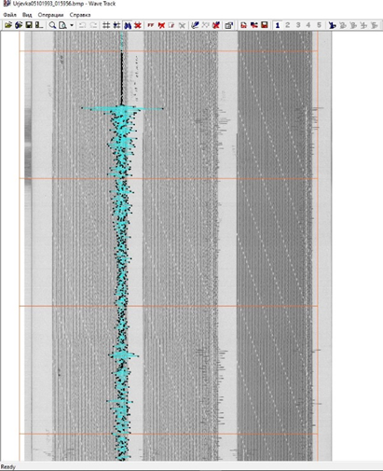
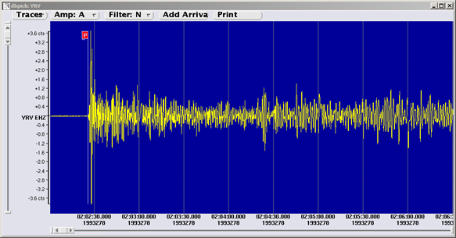
DIGITIZATION METHODOLOGY
WaveTrack software, developed at the Institute of Petroleum Geology and Geophysics named after A.A. Trofimuk of SB RAS, was chosen as the digitization program. This software allows to qualitatively digitize a record on an analog seismogram, to correct non-linear time scales and can be used to trace complex waveforms and was written for the Windows operating system.
Figure 2 shows the digitization of the nuclear explosion that took place on October 5, 1993 at 01:59:57 UTC at the Lop Nor test site (China), according to the Yurievka station data.
Please do not use this space, a QR code will be automatically overlayed
a)
b)
Figure 2. Digitization of the Lop Nor nuclear explosion on October 5, 1993 at 01:59:57 UTC according to the Yurievka station data.
P2.5-190

Slide 5
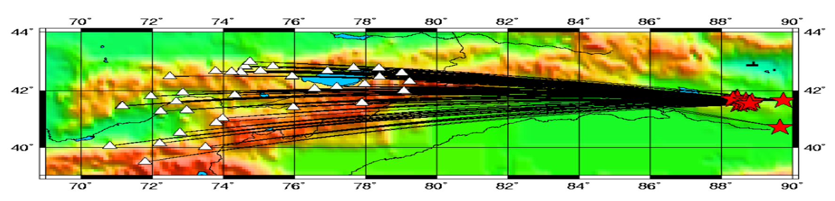
DIGITIZATION RESULTS
The Kyrgyz NDC staff digitized seismograms of 26 nuclear explosions from the area of the Lop Nor test site (China). The magnitude range was mb=4.4÷6.5. Figure 3 shows a map of the location of seismic stations and UNEs for which digitization was carried out. The range of epicentral distances is 754-1599 km (Figure 4). A total 235 seismograms, 699 components, were digitized.
Figure 4. Histogram of distribution of digitized seismograms according to epicentral distances.
Figure 3. Map of the location of seismic stations whose records were used for digitization and nuclear tests from the area of the Lop Nor test site.
Please do not use this space, a QR code will be automatically overlayed
P2.5-190

Slide 6
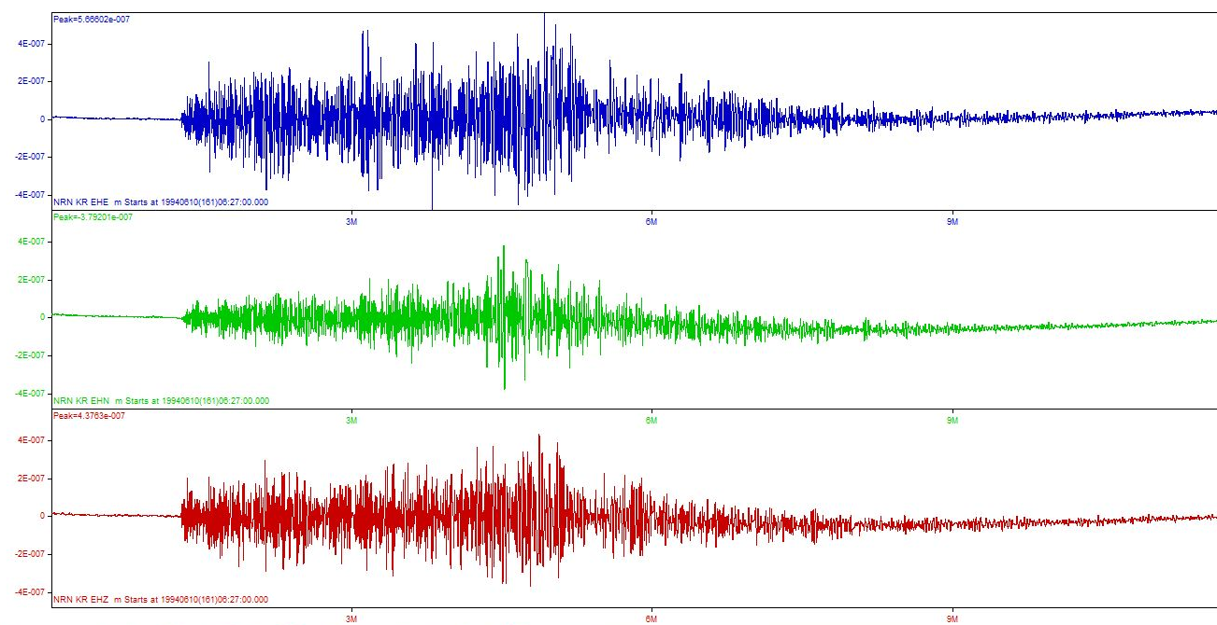
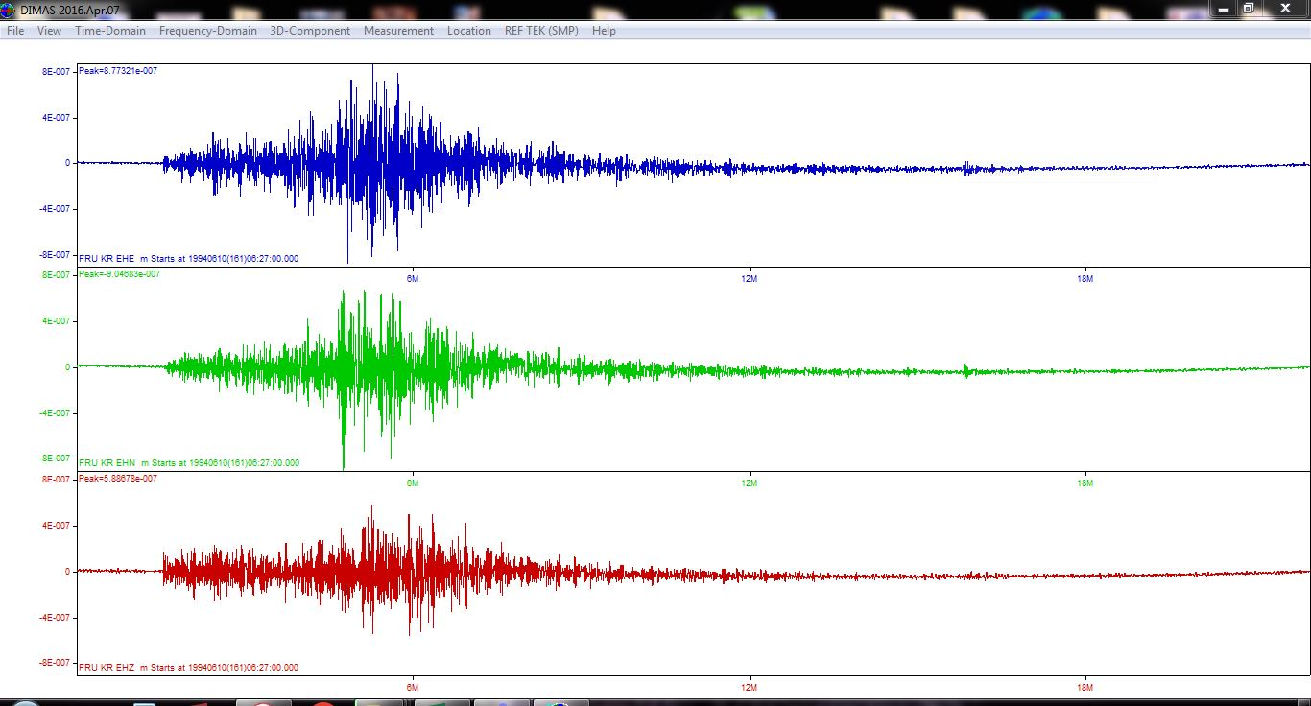
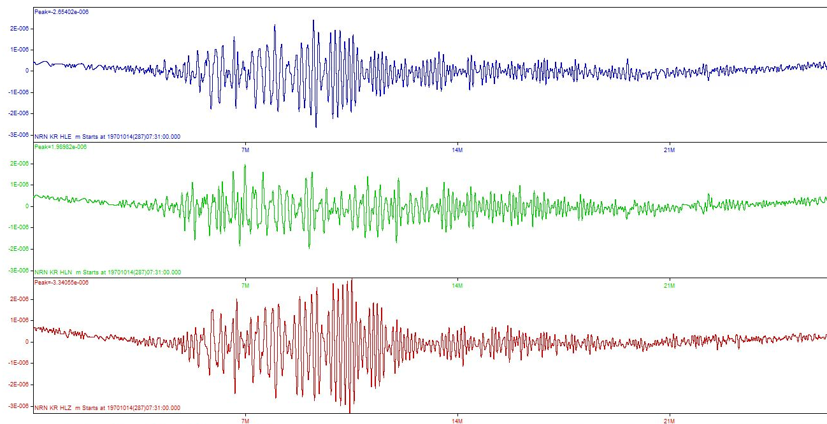
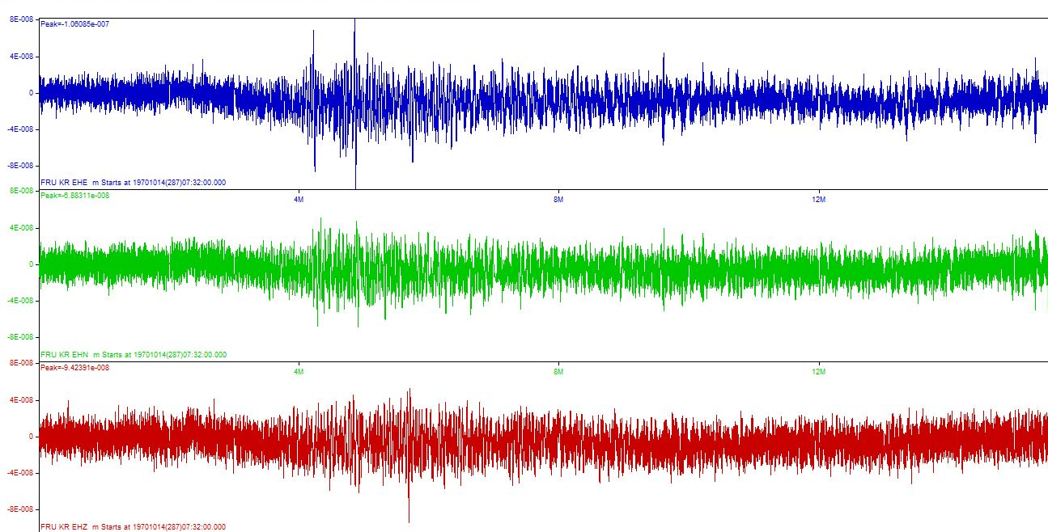
DIGITIZATION RESULTS
Figure 5 shows an example of digitized seismograms of the underground nuclear test on June 10, 1994, t0=06:25:57.9, ϕ=41.53°, λ=88.71°, Y=90 Kt of the Naryn station (NRN) at an epicentral distance of 1061 km, Frunze (FRU) at a distance of 1168 km. The waveforms have a number of similar features: a clear arrival of Pn; Pn, Pg, Sn, Lg regional seismic phases are clearly distinguished on seismic records; Lg waves dominate on seismograms, the ratio of maximum amplitudes A(Lg) / A(Pg) > 1, A(Sn)/A(Pn) > 1.
Figure 5. Digitized seismograms of the underground nuclear test on June 10, 1994, t0=06:25:57.9, ϕ=41.53°, λ=88.71°, Y=90 Kt: a) Naryn station, b) Frunze station.
a)
b)
Figure 6 shows an example of digitized seismograms of the atmospheric nuclear test of 1970 October 14, t0=07:29:56.91, ϕ=40.520°, λ=89.7790° at 3000 m, Y=3400 kt of Naryn station (NRN) at an epicentral distance of 1163 km, Frunze (FRU) at a distance of 1282 km. The waveforms of atmospheric nuclear tests recorded by the seismic stations of Kyrgyzstan have a number of similar features: the seismic effect is lower than for underground nuclear tests, the equivocal arrival of Pn phase; surface waves with long periods dominate on the seismograms.
Please do not use this space, a QR code will be automatically overlayed
Figure 6. Digitized seismograms of the atmospheric nuclear test on October 14, 1970, t0=07:29:56.91, ϕ=40.520°, λ=89.7790° at 3000 m, Y=3400 Kt: a) Naryn station, b) Frunze station.
a)
b)
P2.6-190

Slide 7
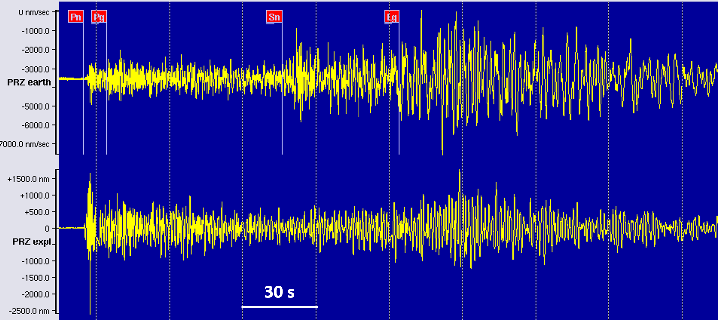
DIGITIZATION RESULTS
Figure 7 shows the digitized seismogram of the underground nuclear test on October 7, 1994, t0=03:25:58.1, ϕ=41.66°, λ=88.75°, Y=90.6 Kt, Z-component – lower seismogram, digital seismogram of the June 24, 2015 earthquake, t0=19:12:52, ϕ=41.72°, λ=88.93°, mb=4.7, Z – component, – upper record of PRZ station (Przevalsk). The explosion record is of higher frequency, the amplitude of the Pn wave dominates in it, while the amplitude of the earthquake record is dominated by the Lg waves.
Please do not use this space, a QR code will be automatically overlayed
Figure 7. Digitized seismogram of the underground nuclear test on October 7, 1994, t0=03:25:58.1, ϕ=41.66°, λ=88.75°, Y=90.6 Kt, Z-component – lower seismogram, digital seismogram of the June 24, 2015 earthquake , t0=19:12:52, ϕ=41.72°, λ=88.93°, mb=4.7 – upper entry.
P2.2-190

Slide 8
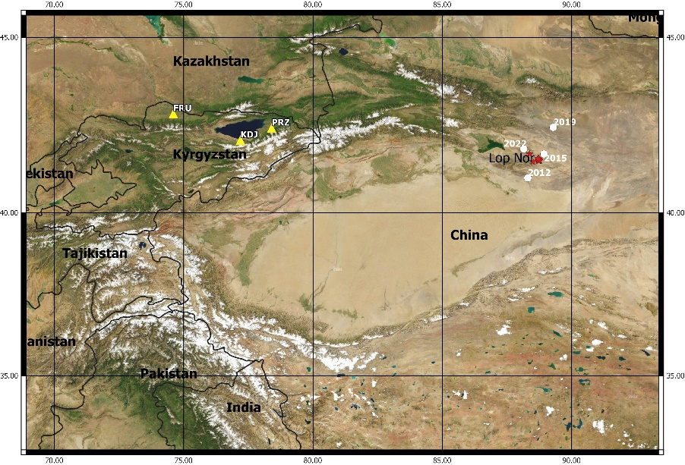
DIGITIZATION RESULTS
For research, records of 14 underground nuclear explosions for the period 1982-1996, conducted on the territory of the Lop Nor test site, with magnitudes mb=4.4÷6.5, as well as 4 tectonic earthquakes of 2012-2022, with mb=4.3÷4.7 (Figure 8) were chosen. For events from the area of the test site, the maximum amplitudes of the main regional phases (Pn, Pg, Sn, and Lg) were measured (Z-components). The processing’s technique included measuring the decimal logarithm of the ratios of the maximum amplitudes of transverse and longitudinal waves after narrow-band filtering Amax(Sn)/Amax(Pn), Amax(Lg)/Amax(Pg). Filters with center frequencies of 0.6, 1.25, 2.5, 5 Hz and a bandwidth of 2/3 octaves at a level of –3 dB from the maximum were used. Figures 9 shows the example of distribution of spectral ratios Lg/Pg and Sn/Pn for KDJ station.
Please do not use this space, a QR code will be automatically overlayed
Figure 9. Distribution of spectral ratios of the maximum amplitudes of regional seismic phases for the area of the Lop Nor test site: a) Lg/Pg, b) Sn/Pn for KDJ station.
Figure 8. Map of the study area. Asterisks - UNE, circles – earthquakes.
P2.2-190

Slide 9
CONCLUSION
Historical analog seismograms of nuclear explosions recorded by stations in Kyrgyzstan are digitized using the WaveTrack program. The digitized data has been successfully used for various monitoring tasks in support of the CTBT.
According to the data of the seismic stations Kadji-Say and Przevalsk, located in the Northern Tien Shan, the structure of short-period seismic fields of underground nuclear explosions produced at the Lop Nor test site, as well as earthquakes with epicenters close to the test site, were studied. The ratios of the amplitudes of different phases of longitudinal and transverse waves were analyzed for narrow-band filters with central frequencies of 0.6, 1.25, 2.5, and 5 Hz. The parameters providing the most efficient separation of explosions and earthquakes are determined. For the Lop Nor test site Sn/Pn, Lg/Pg it corresponds to 2.5, 5 Hz frequencies.
Historical data preservation work is continuing and will contribute to a more reliable monitoring of the implementation of the Comprehensive Nuclear-Test-Ban Treaty.
Please do not use this space, a QR code will be automatically overlayed
P2.2-190

