Slide 1
Integration of an Optical Based Sensor in a Mechanical Seismometer
Olivier ROUSSEAU, Fabrice LEPOINT, Serge OLIVIER, Daniel FOUQUET
Commissariat à l’Energie Atomique et aux énergies alternatives
]
Integration of optical distance measurement in a mechanical seismometer.
Measurement of self noise Comparison with conventional sensor on the same seismometer for accuracy determination.
The self noise of the optical sensor, without feedback control, is well below the seismic noise. The coherence with a coil-magnet device is 1 on all the measurement range possible.
Very broad band displacement sensor which allows very broadband seismometer 10⁻⁵-100 Hz.
Please do not use this space, a QR code will be automatically overlayed
P3.1-313

Slide 2
INTRODUCTION
In the last decades, scientist have used optical interferometer set-up to improve accuracy in displacement measurement. One of the most famous example is the detection of gravitational wave with huge interferometers VIRGO and LIGO. In this research, a new optical sensor is used to measure the suspended mass displacement in the seismometer. To integrate such optical devices in a seismometer, almost all the optical functions, as beam splitter and interference generations, are integrated in an optical substrate. The results show the accuracy and reliability of such optical sensor integrated in a mechanical seismometer.
Please do not use this space, a QR code will be automatically overlayed
P3.1-313

Slide 3
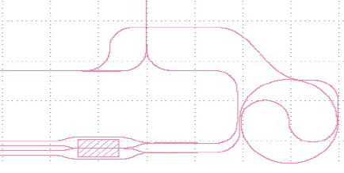
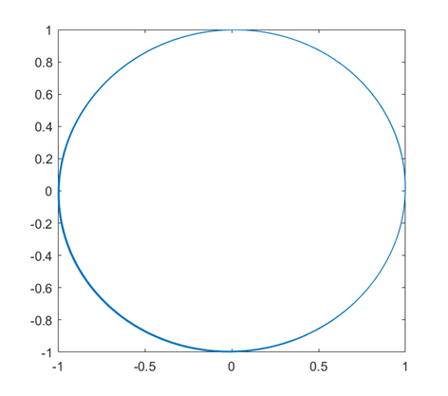
Optical Measurement of moving object and movement unwrapping
Moving mirror on a seismometer
Planar Lightwave Circuit PLC Few cm for integrated sensor
Light in free space
Beam splitter
PLC
Path 2
Path 1
Ref1 and Ref2 allows to correct from the absolute light intensity.
LASER λ
Time delay
Interference control
4 photodiodes
Ref2
Meas2
Meas1 Ref1
Meas1 and Meas2 measure the interference between the Path 1 and 2. There is a phase difference of π/2 between the 2 measured interferences.
To avoid aliasing, photodiode measurement frequency F_{p} is 100 kHz. Wavelength λ in vacuum is 1550 nm. The phase evolution between 2 measurements makes maximum significant velocity : λ/4*F_{p} = 3.875 cm/s.
Conversion of the measurement to speed at 250 Hz for size limited data in octet and easy comparison with other sensors.
Meas2 (a. u.)
Please do not use this space, a QR code will be automatically overlayed
Meas1 (a. u.)
P3.1-313

Slide 4
Methods of characterisation accuracy and reliabilitty
Self noise measurement i.e. accuracy
Reliability of the sensor in a mechanical seismometer
Displacement
mirror
Moving arm of a seismometer
mirror
Bulk material to avoid mirror movement.
Light in free space
Coil-magnet sensor
Light in free space
PLC interfero-meter
PLC interfero-meter
Acquisition system
Acquisition system
Please do not use this space, a QR code will be automatically overlayed
The mirror can not move.
Self noise measurement to determine accuracy.
Interferometer chip mounted in the seismometer presented in P3.1-333. Comparison with a reliable coil-magnet sensor.
P3.1-313

Slide 5
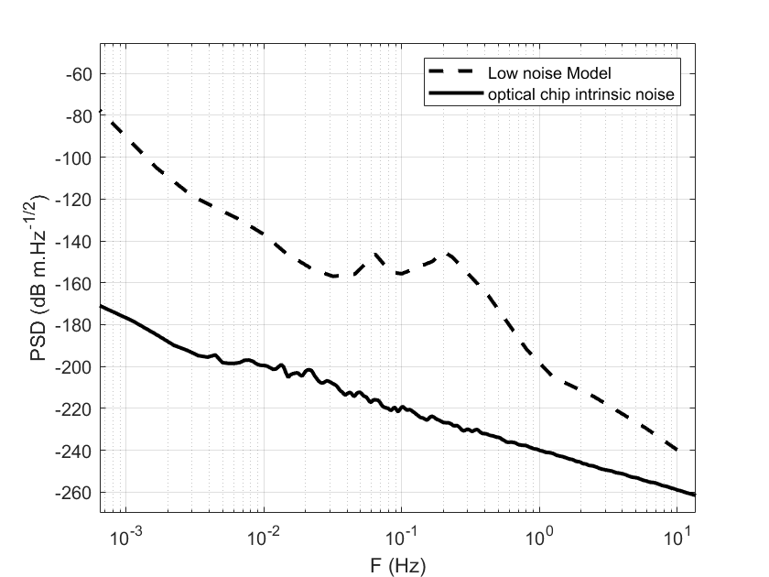
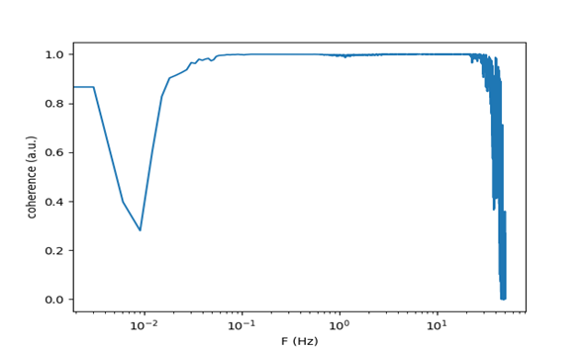
RESULT LOW NOISE AND ACCURATE MEASUREMENT
Self noise with non moving mirror
Coherence coil-magnet vs optical chip
Seismic noise reliability
The self noise of the sensor is well below the seismic low noise model. Temperature stable and vacuum gives lower noise. Good accuracy.
It allows its integration in a 8 s seismometer, without feedback, as in P3.1-333 while being 10 dB below the seismic low noise from 10⁻⁵ to 100 Hz. And 20 dB between 0.02 to 16 Hz.
Above 20 Hz environmental noises decrease coherence.
Below 0.06 Hz, the coil magnet is too noisy which reduces coherence.
After calibration by metrology, to correct from different positions on the moving seismometer arm, the values are the same.
Please do not use this space, a QR code will be automatically overlayed
P3.1-313

Slide 6
CONCLUSION
Successful integration of an optical sensor in a seismometer thanks to the PLC technology.
Characterisation of the sensor :
The self noise allows a very broad band seismometer between 10⁻⁵ and 100 Hz.
The coherence between optical sensor and traditional sensor is better than 5% from 0.02 to 16 Hz.
The new sensor is accurate and reliable.
Please do not use this space, a QR code will be automatically overlayed
P3.1-313

Slide 7
References [Optional slide Font: Arial Regular Size 20]
Please do not use this space, a QR code will be automatically overlayed
Px.x-xxx

