Slide 1
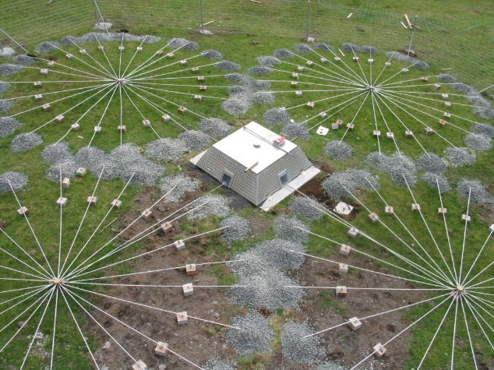
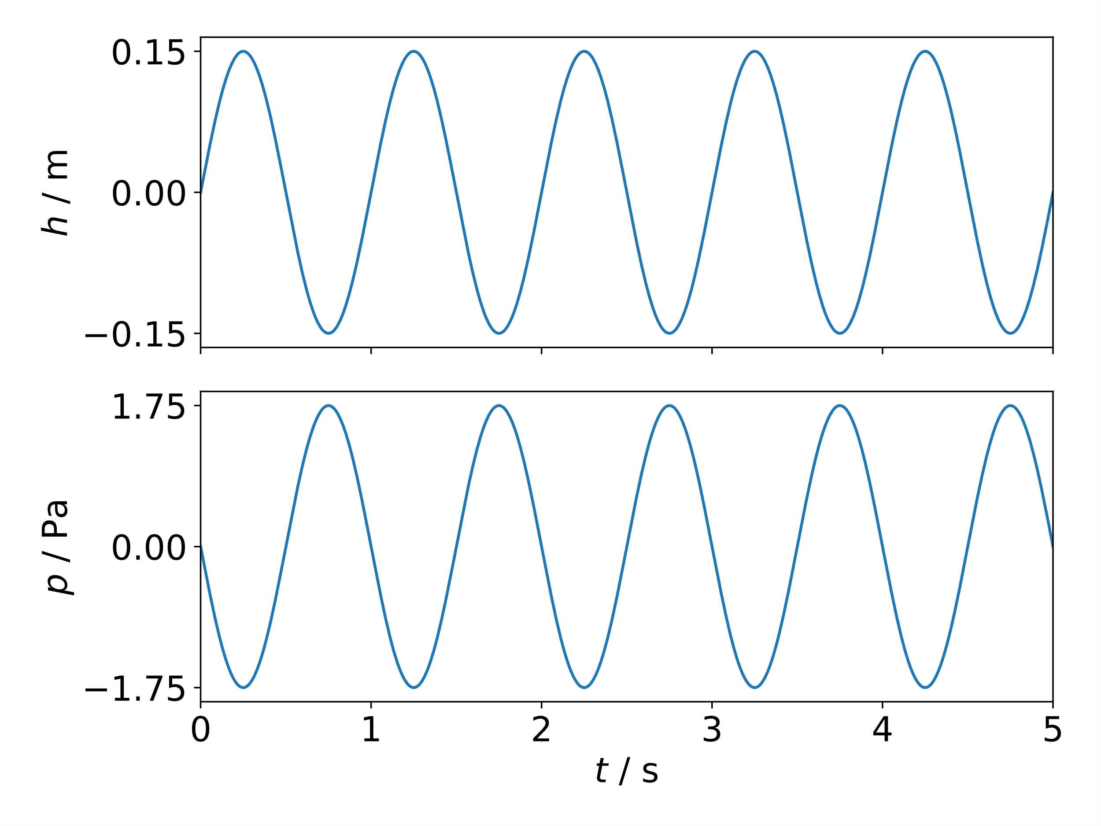
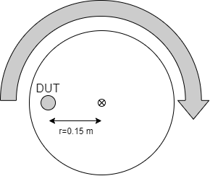
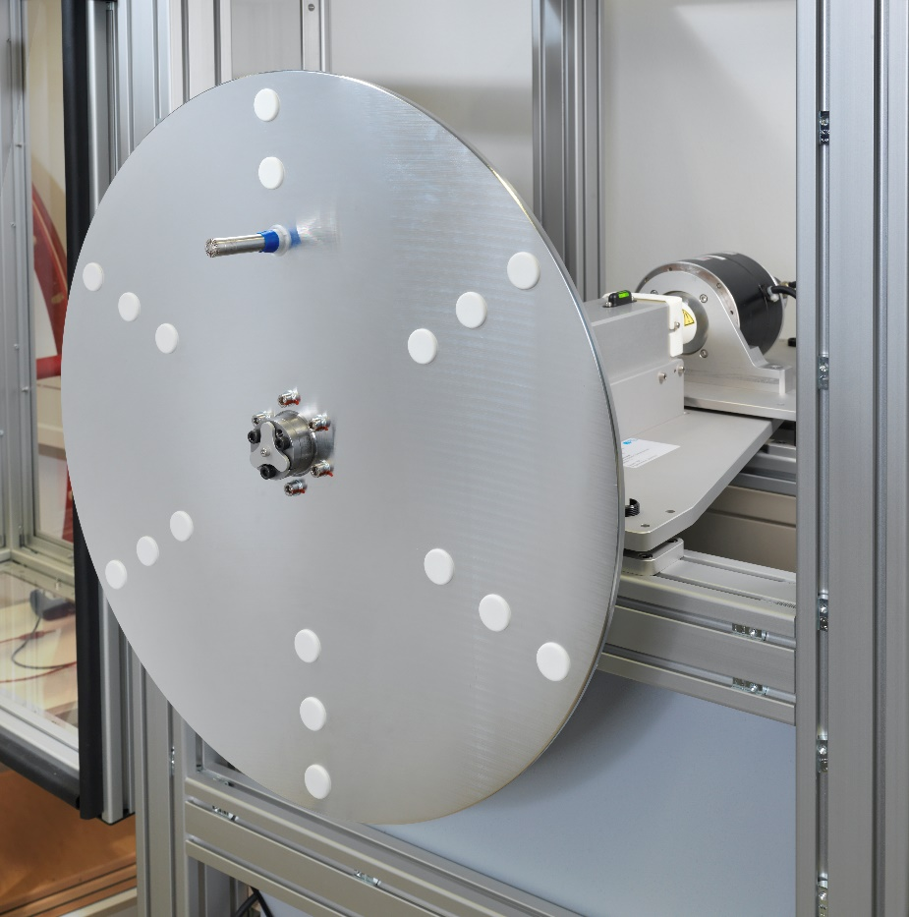
Microphone Carousel
Marvin Rust, Christoph Kling
Physikalisch-Technische Bundesanstalt, Germany
P3.1-646
Physikalisch-Technische Bundesanstalt, CC BY-ND 3.0
The Official CTBTO Photostream, CC BY 2.0, via Wikimedia Commons
The basis for the reliable and comparable measurement of any physical quantity is traceability to the international system of units (SI).
Stimulus: vertical gradient of the ambient pressure
Changing altitude → alternating pressure
$$Δp=−ρ⋅g⋅Δh$$
Calibration: Frequency range from 0.1 Hz to 5 Hz, uncertainty ≤0.07 dB
EMPIR-project Infra-AUV: Traceability for low-frequency airborne infrasound, underwater acoustics and seismic vibration
This work: Primary calibration method for airborne infrasound

