Slide 1
Microphone Carousel – Exploiting the Hydrostatic Pressure Gradient for the Calibration of Measurement Microphones
Marvin Rust, Christoph Kling
Physikalisch-Technische Bundesanstalt, Germany
Reliable and comparable measurements require traceability to the SI.
The first step in achieving traceability is the establishment of a primary calibration method which realizes the quantity of interest.
An alternating pressure with known amplitude is realized based on the vertical gradient of the ambient pressure. A measurement microphone is calibrated by periodically changing its altitude in a measurement setup called the “microphone carousel”.
Calibration results for a ½” measurement microphone set acquired in the microphone carousel and in a different measurement setup show a good agreement between the two different methods.
The microphone carousel is capable of calibrating measurement microphones in a frequency range from 0.1 Hz to 5 Hz with a planned extension to 10 Hz. The measurement uncertainty is lower than 0.1 dB.
Please do not use this space, a QR code will be automatically overlayed
P3.1-646

Slide 2
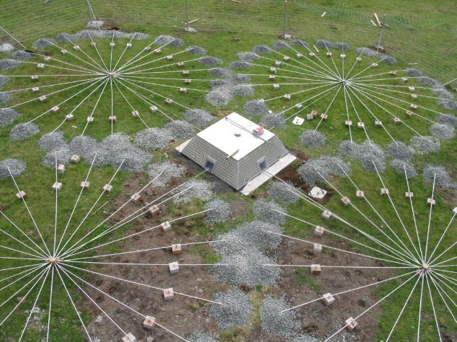
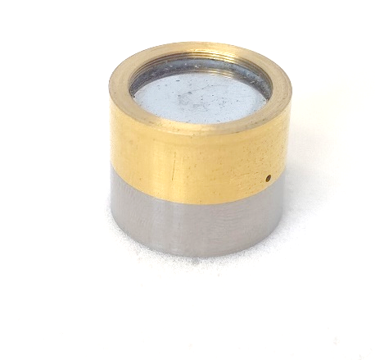
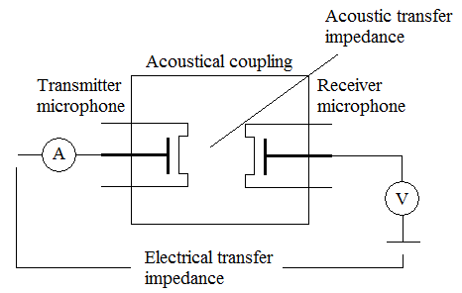
Introduction: Traceability
For frequencies of 20 Hz and above, the primary standard for airborne sound is traditionally realized by calibrating specialized microphones by the pressure reciprocity method. This method is currently only applicable for frequencies of 2 Hz and above and therefore covers only a small part of the frequency range of interest for the IMS. Furthermore, at frequencies below 10 Hz, multiple issues arise which limit the applicability of this method for the calibration of infrasound sensors. Most notably, the pressure reciprocity method heavily relies on models for the acoustical transfer impedance of a coupler, which introduce a significant uncertainty to the calibration results at low frequencies. Furthermore, the pressure reciprocity method is only suitable for the calibration of specialized laboratory standard microphones.
Physikalisch-Technische Bundesanstalt, CC BY-ND 3.0
The Official CTBTO Photostream, CC BY 2.0, via Wikimedia Commons
The basis for the reliable measurement of any physical quantity is traceability to the international system of units (SI). In the context of the IMS, this includes the traceable calibration of microbarometers, which quantify sound in air in the infrasound frequency range.
The first step in the traceability chain is the primary realization of a unit. In case of airborne infrasound, the quantity of interest is the alternating pressure p with the unit Pascal (Pa).
Laboratory standard microphone
IMS range of interest
T A B Milhomem and Z M D Soares 2016 J. Phys.: Conf. Ser. 733 012054
Please do not use this space, a QR code will be automatically overlayed

Slide 3
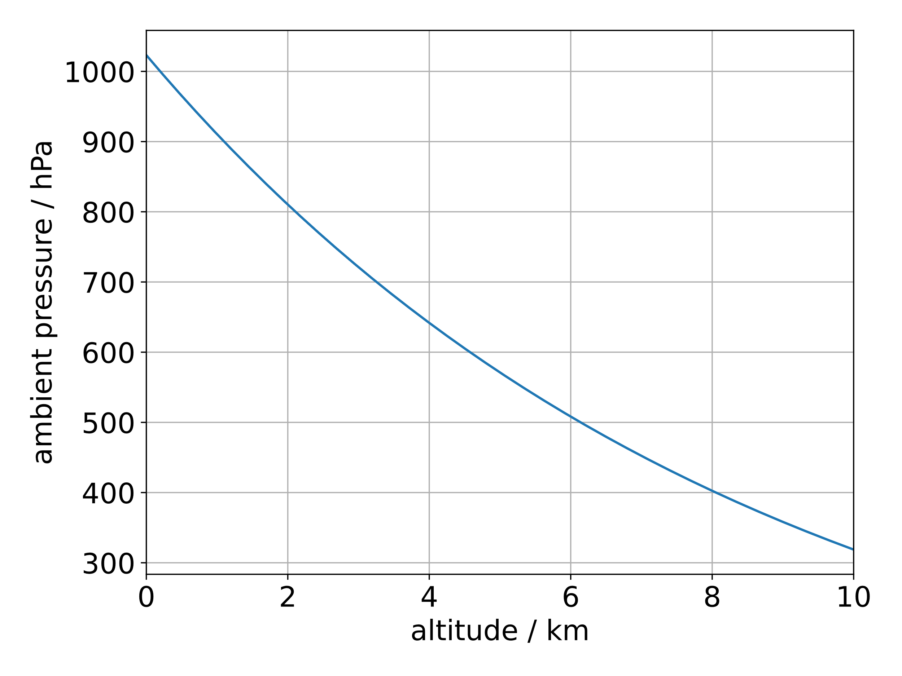
Objectives
This research work is part of the Infra-AUV project „Metrology for low-frequency sound and vibration” funded by the European Metrology Research Programme EMPIR. The objective of the project is to extend the frequency range for traceable measurements of infrasound, underwater acoustics and seismic vibration towards lower frequencies.
To reach this objective, primary calibration methods covering the low frequency range were developed for airborne acoustics, underwater acoustics and vibration sensing. To transfer the primary calibration capabilities to working standard devices, laboratory-based secondary calibration methods are developed. To establish traceability for measurement setups deployed in the field, already existing on-site calibration methods which allow the calibration of deployed devices are improved.
Regarding airborne infrasound, multiple primary calibration methods based on different physical principles are under development. The standards realized by these methods aim to cover the frequency range from 40 mHz to 20 Hz. One of these calibration methods is presented in this poster.
The calibration setup presented in this poster utilizes the vertical gradient of the ambient pressure as stimulus. This setup will enable the calibration of measurement microphones in a frequency range from 0.1 Hz to 10 Hz with an uncertainty of less than 0.1 dB.
To validate the performance of the calibration methods developed in the project, a project-internal comparison is currently running.
The standard realized with these methods will be transferred to field measurement devices such as microbarometers by means of secondary calibration to achieve traceability for the IMS.
More information about the project and Metrology for the IMS:
Side event Workshop on Metrology,
Wed 21/06 and Thu 22/06 09:00 Prinz Eugen Saal
Please do not use this space, a QR code will be automatically overlayed

Slide 4
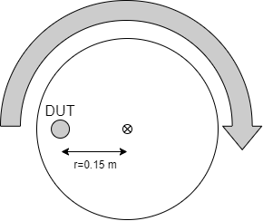
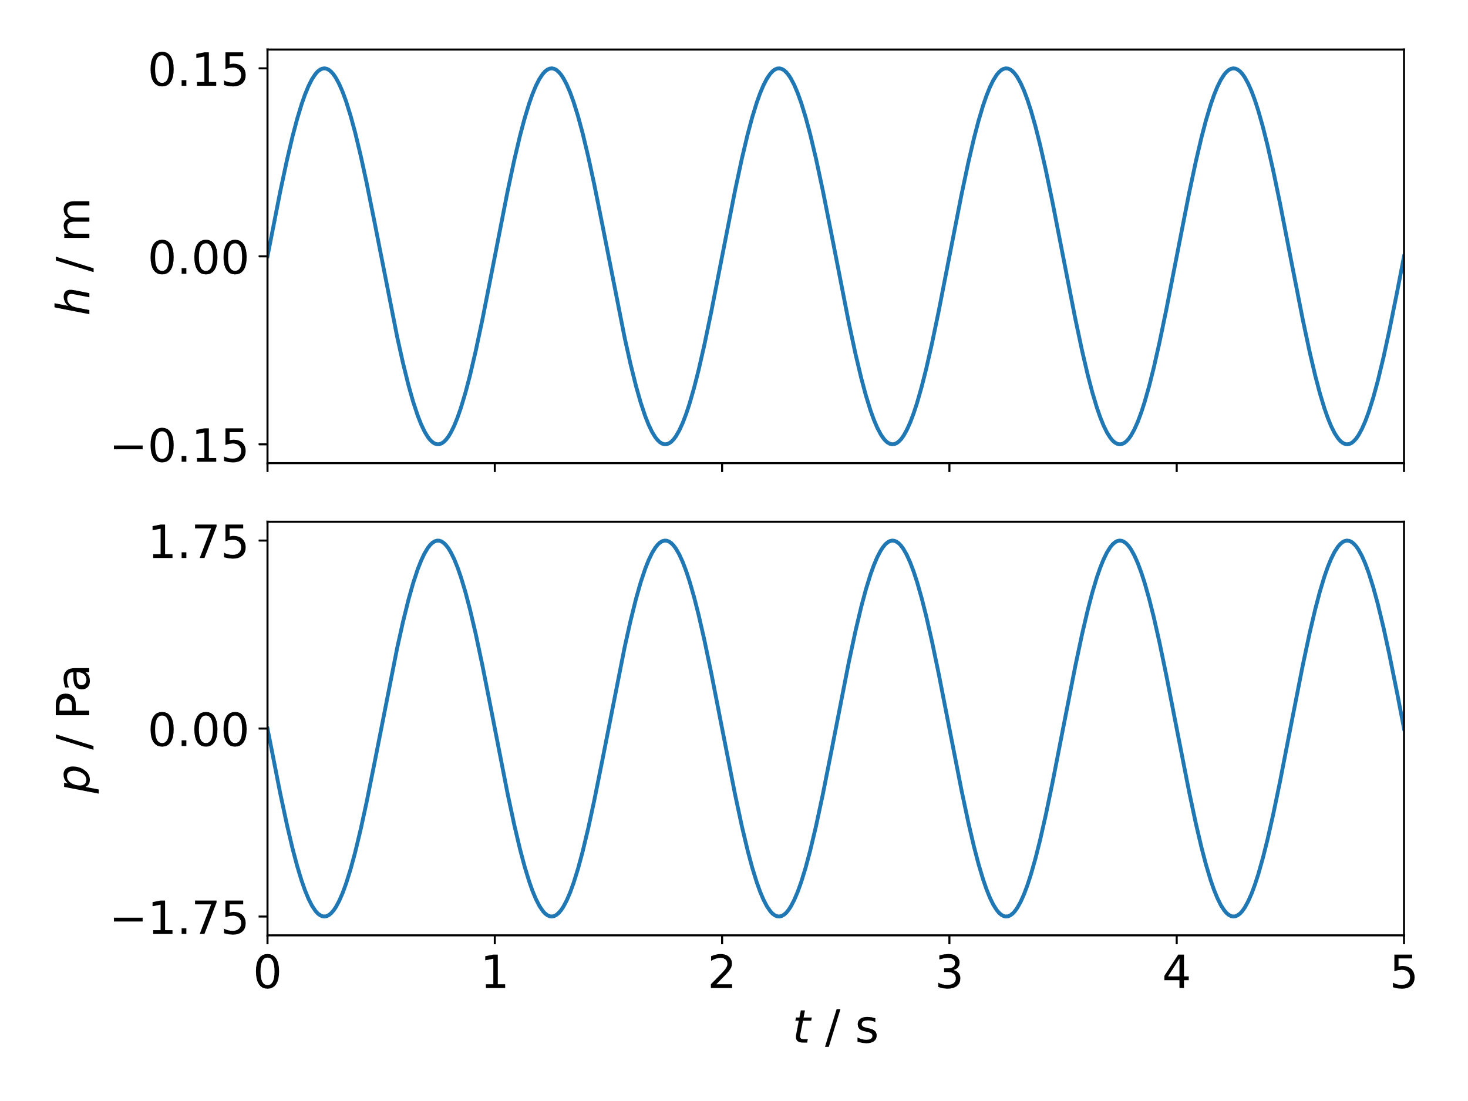
Methods: Working principle
A device under test (DUT) is subjected to an alternating pressure by periodically changing its altitude. The amplitude $Δp$ of this alternating pressure is determined by the barometric formula from the altitude difference 𝚫𝒉, gravity 𝒈, and air density 𝝆 and amounts to
$$Δp=−ρ⋅g⋅Δh.$$
The altitude difference 𝚫𝒉 is given by the measurement setup, the gravity 𝒈 is known from gravitational measurements at PTB and the air density 𝝆 is calculated via the CIPM-2007 model for the density of moist air. This model takes climate measurements as input parameters, which are conducted with commercially available equipment.
At laboratory conditions, an altitude amplitude of $Δh=±15 \text{cm}$ induces a calibration signal of $L_{Zeq}≈96 \text{dB}$, which is a typical calibration level.
In the measurement setup, colloquially called the “microphone carousel”, a periodic altitude change is realized by mounting the DUT eccentrically on a vertically rotating disk. When the disk rotates at a constant frequency, the DUT is subjected to a sinusoidal alternating pressure at this frequency.
To calibrate the DUT, the amplitude $\hat{U}$ of its output voltage is determined in response to the stimulus with amplitude $\hat{p}$. The amplitude sensitivity of the DUT in V/Pa is then calculated as
$$S=\frac{\hat{U}}{\hat{p}}$$
Temperature $t$
Relative humidity $RH$
CIPM-2007
model
Please do not use this space, a QR code will be automatically overlayed
Air density $ρ$
Static pressure $p$
Implementation details see next slide
CO₂ content $xCO2$

Slide 5
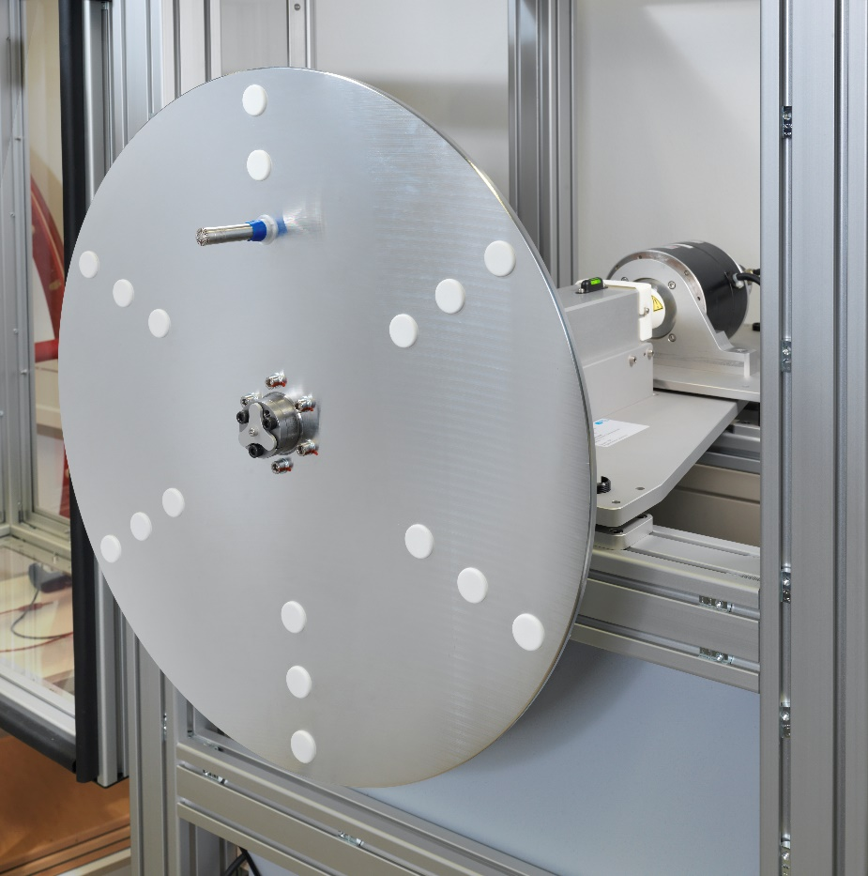
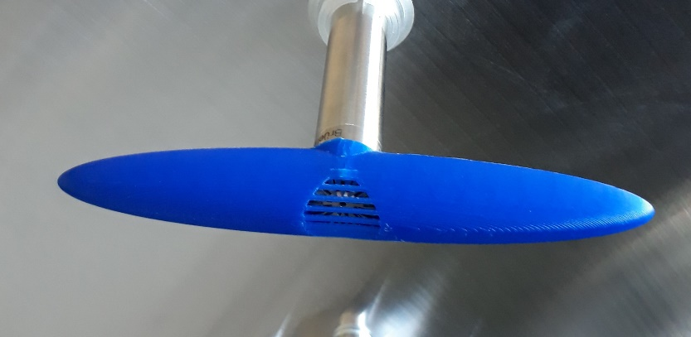
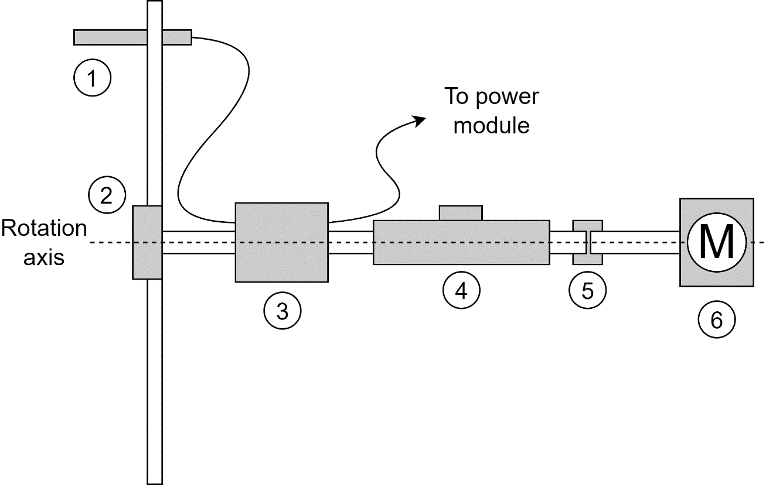
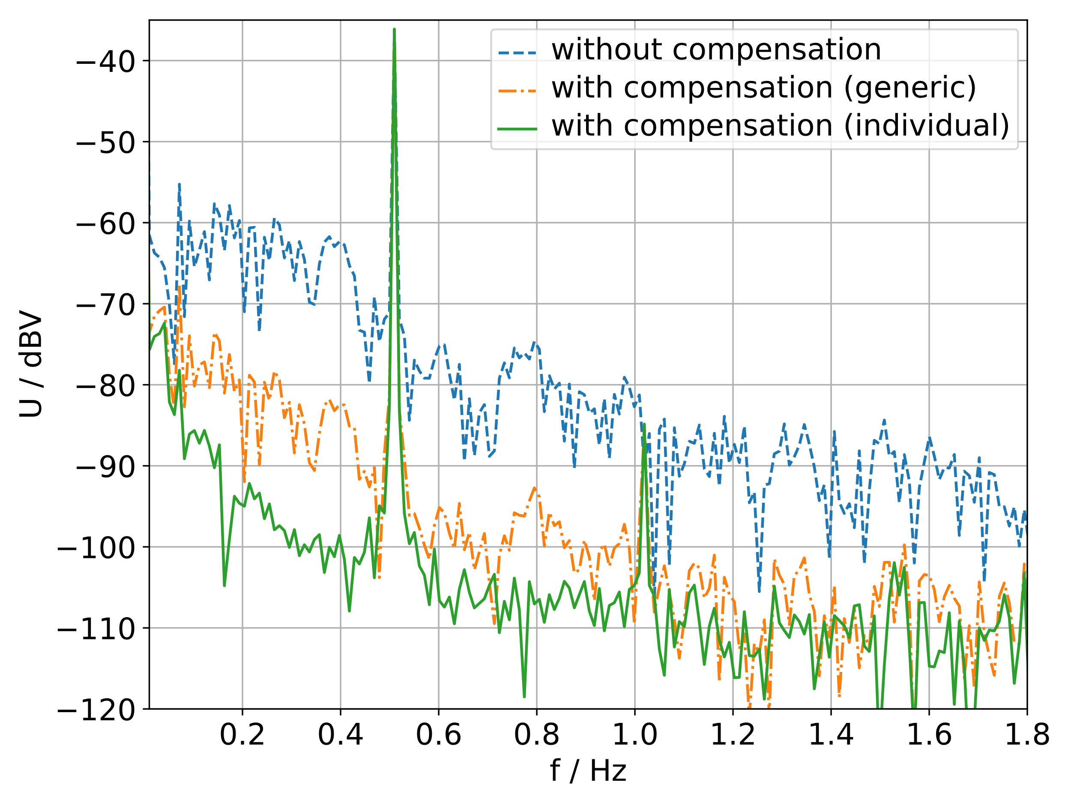
Methods: Measurement Setup
To ensure that the DUT moves on a circular orbit with a well-defined radius, several special mechanical components were implemented. The DUT (1) was mounted on the disk with self-centering clamps. The disk itself was mounted on the axis with a self-centering clamping set (2). The axis was kept parallel to the ground with a spirit level on the bearing block (4). The electrical connections for the DUT were transferred to the rotating disk using a slip ring (3).
During the construction of the microphone carousel, multiple challenges regarding different frequency ranges were faced. At high frequencies, wind noise becomes prevalent. A 3D printed nose cone was employed to mitigate this noise.
At low frequencies, outside noise disturbed the measurement and a microphone positioned in the background was employed for active noise compensation.
The microphone carousel is capable of calibrating measurement microphones in a frequency range from 0.1 Hz to 5 Hz with an uncertainty of 0.07 dB or less. An extension to an upper limit of 10 Hz is planned, when issues regarding the aerodynamics at high frequencies and therefore high rotation speeds will have been resolved.
DUT
Self-centering clamping set
Slip ring transferring the electrical signals
Bearing block
Elastomer coupling
Motor
Please do not use this space, a QR code will be automatically overlayed

Slide 6
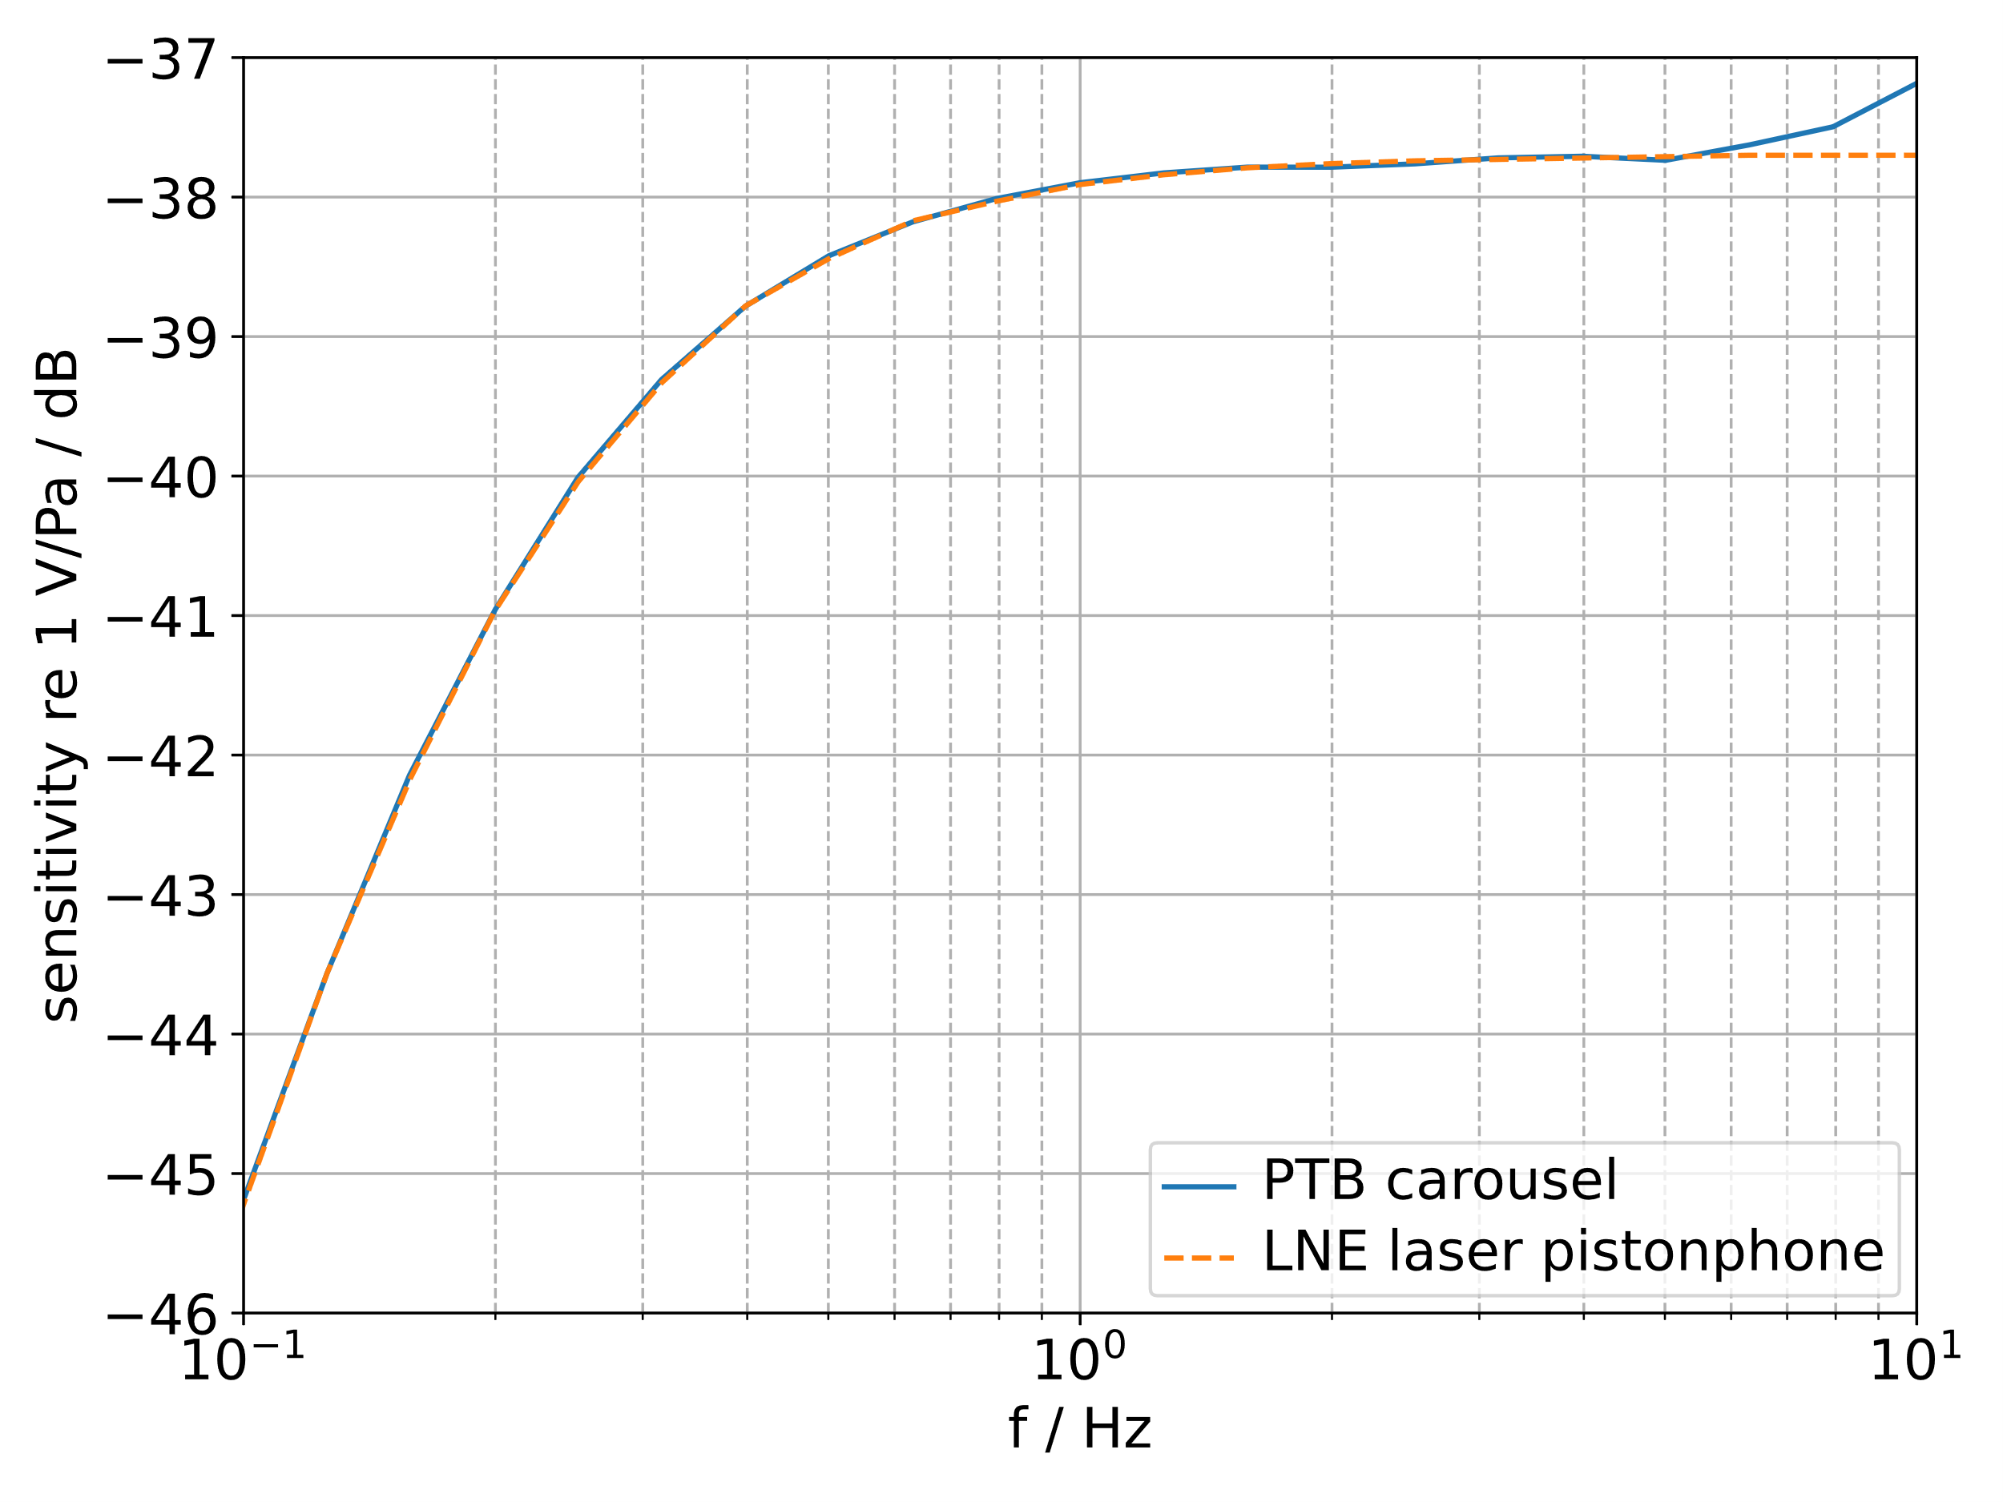
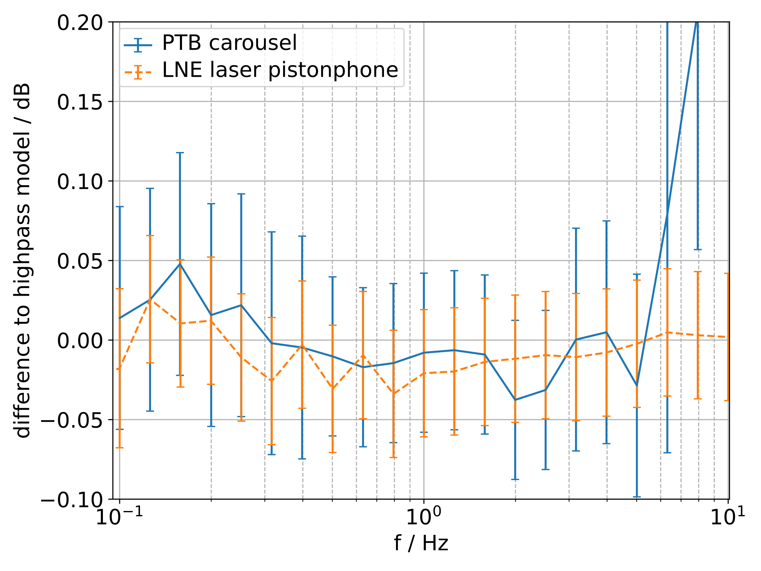
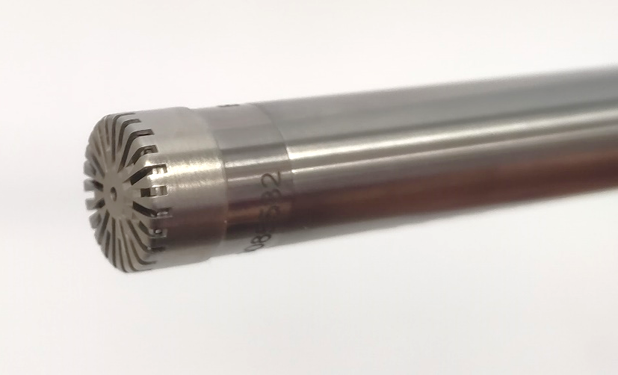
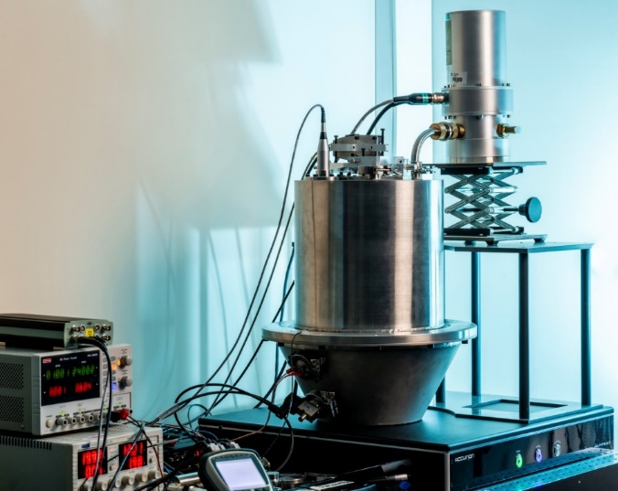
Results: Comparison to the LNE laser pistonphone
To validate the performance of the microphone carousel calibration technique, a comparison measurement with the laser pistonphone established at the Laboratoire national de métrologie et d'essais (LNE) was conducted. A microphone set consisting of a microphone cartridge Brüel & Kjær type 4193 and a preamplifier GRAS type 26AI was calibrated both in the LNE laser pistonphone and in the PTB microphone carousel. These calibration methods utilize very different physical principles and are therefore well suited for a mutual validation of the methods.
Figure (a) shows the sensitivities determined by both methods. For more detail, figure (b) shows the difference of both calibration results to a generic model describing the high pass behavior of the DUT. The error bars denote the measurement uncertainties of the calibration methods. For frequencies below 5 Hz, the results agree with a difference of 0.03 dB at maximum. For higher frequencies this difference increases, which is likely caused by aerodynamic effects occurring in the microphone carousel.
(a) Absolute sensitivity
Please do not use this space, a QR code will be automatically overlayed
DUT: ½“ measurement microphone
The LNE laser pistonphone
(b) Difference to generic highpass model

Slide 7
Conclusion
A novel setup utilizing the vertical gradient of the ambient pressure for the primary calibration of measurement microphones was realized. This measurement setup provides a reference for the calibration of measurement devices for an application in the field such as microbarometers or sound level meters.
The microphone carousel can calibrate measurement microphones in a frequency range from 0.1 Hz to 5 Hz with an uncertainty of 0.07 dB at maximum, thereby extending the frequency range for the traceable calibration of infrasound sensors towards lower frequencies. An extension of the upper frequency limit to 10 Hz is planned.
To validate the performance of the microphone carousel, all primary calibration methods developed or extended in the Infra-AUV project are compared in a project-internal comparison currently running.
References:
Infra-AUV project website:
https://www.ptb.de/empir2020/infra-auv/home/
PTB microphone carousel:
“Primary calibration for airborne infrasound utilizing the vertical gradient
of the ambient pressure”
Marvin Rust et al 2023 Metrologia 60 045001
https://doi.org/10.1088/1681-7575/acd941
LNE laser pistonphone:
“A laser pistonphone designed for absolute calibration of infrasound sensors from 10 mHz up to 20 Hz”
D Rodrigues et al 2023 Metrologia 60 015004 https://doi.org/10.1088/1681-7575/aca0f3
Infra-AUV has received funding from the EMPIR programme co-financed by the Participating States and from the European Union’s Horizon 2020 research and innovation programme.
We gratefully acknowledge the support of the Braunschweig International Graduate School of Metrology B-IGSM.
Please do not use this space, a QR code will be automatically overlayed

