Slide 1
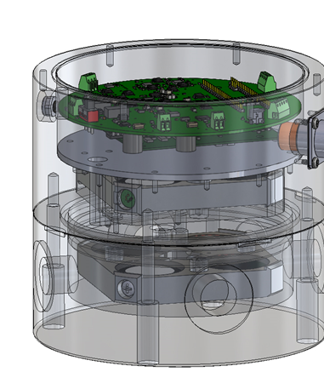
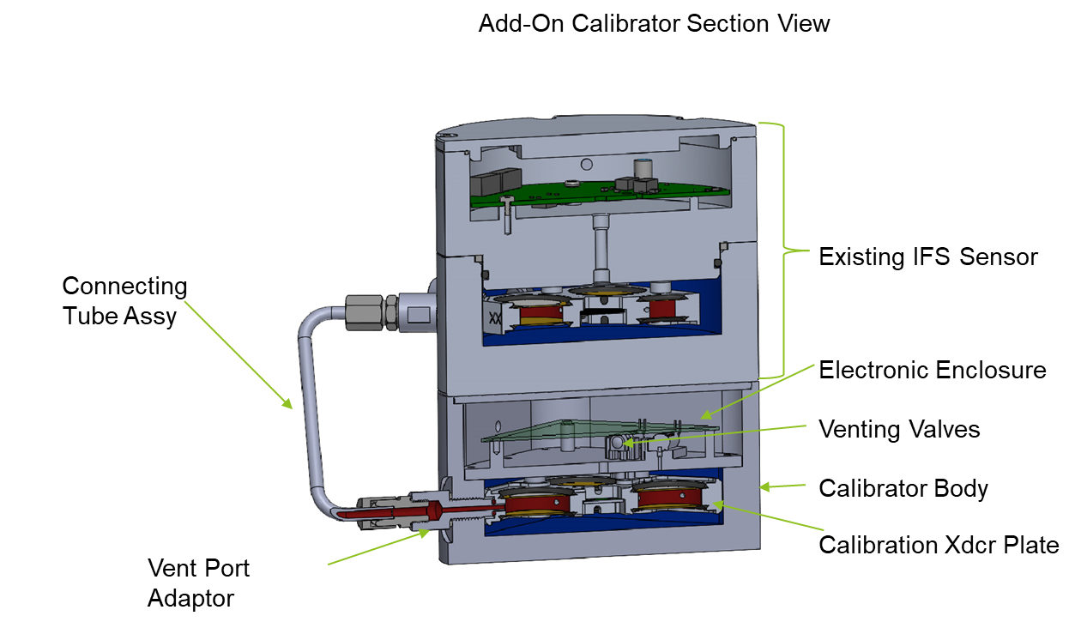
An External Calibrator for Hyperion Infrasound Sensors: Progress and Direction
David Harris, Jonathon Parsons, Carrick Talmadge
Hyperion Technologiy Group Inc. / NCPA
P3.1-671
Goals for in-situ verification of calibration for Hyperion Infrasound Sensors:
Validate source signal and electronics.
Demonstrate new electronics and external device function for existing sensor base
Develop internally integrated source driver and electronics for future sensors
If you want to learn more about this, come see my e-poster during session 3.1 on 20 Jun 2023, 10:00 A.M. or access it online on the SnT2023 Conference platform.

