Slide 1
Spectral characteristics of seismic and infrasound noise by data of monitoring network stations of the National Nuclear Center of the Republic of Kazakhstan.
Smirnov Yu.A., Smirnov A.A., Mikhailova N.N.
National Nuclear Center of the Republic of Kazakhstan.
The daily and season variations of seismic and infrasound noise were analyzed
Data of the NNC RK network and IRIS PQLX software were used
The observed peculiarities are well described by position and dynamics of microseism and microbarom sources located in North Atlantics
All conclusions and experimental data are important to enhance the effectiveness of works on seismic monitoring in the field of stations operation and data processing
.
Please do not use this space, a QR code will be automatically overlayed
P3.1-203

Slide 2
Introduction
One of the most important criteria of seismic stations sensitivity is background noise level. It is investigated at different stages of stations establishment and operation. Seismic noise is deliberately studied during the selection of sites for a new station construction, and while determining the aperture of a seismic array.
Another important aspect of noise investigation is the control for recording channels operation. Systematic estimation of noise parameters is an instrument to reveal any significant changes in instruments parameters.
Place your QR Code here after removing this text box!
Px.x-xxx

Slide 3
Methods, data
Spectral characteristics of seismic and infrasound noise were calculated using PQLX software by the waveforms of the NNC RK network stations. The calculation results were compared with Peterson low-noise model, and Brown model for infrasound. The daily and season noise variations were analyzed. Special attention is given to regularities of level change in microseismic maximum. The observed peculiarities are well explained by the position and dynamics of microseism and microbarom sources located in North Atlantics.

Slide 4
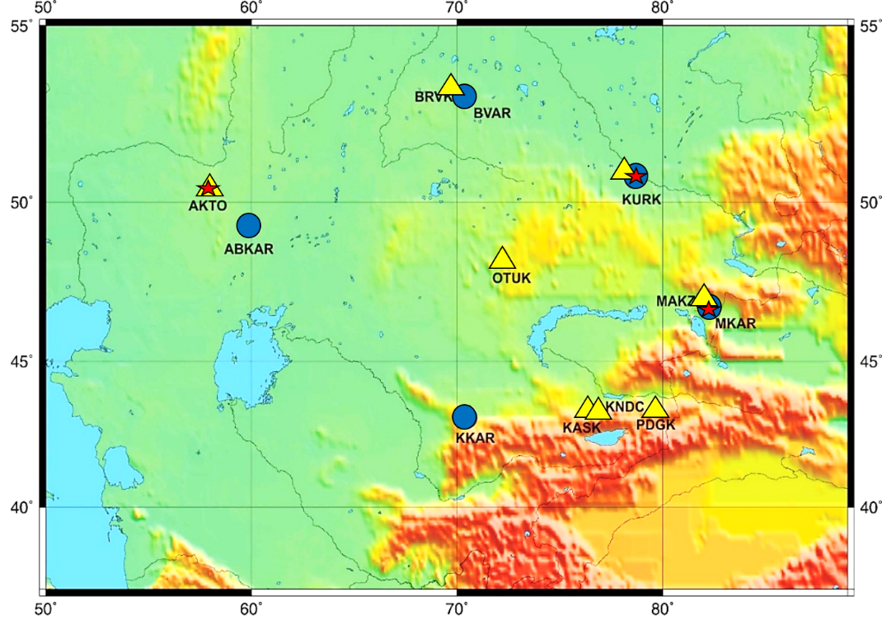
Objectives Slide Title goes here [Font: Arial Regular Size 20]
NNC RK seismic stations network is presented by stations some of which are included into different global networks, and some belong to NNC RK only; however, data from all stations arrive continuously to data Center in Almaty (KNDC) where they are archived and processed. Currently, the seismic network includes 5 seismic arrays and 8 three-component station. The Figure shows a chart of IGR seismic and infrasound stations location on the territory of Kazakhstan.
Legend: triangle – three-component seismic station; circle – seismic array; star – infrasound station.
Place your QR Code here after removing this text box!
Px.x-xxx

Slide 5
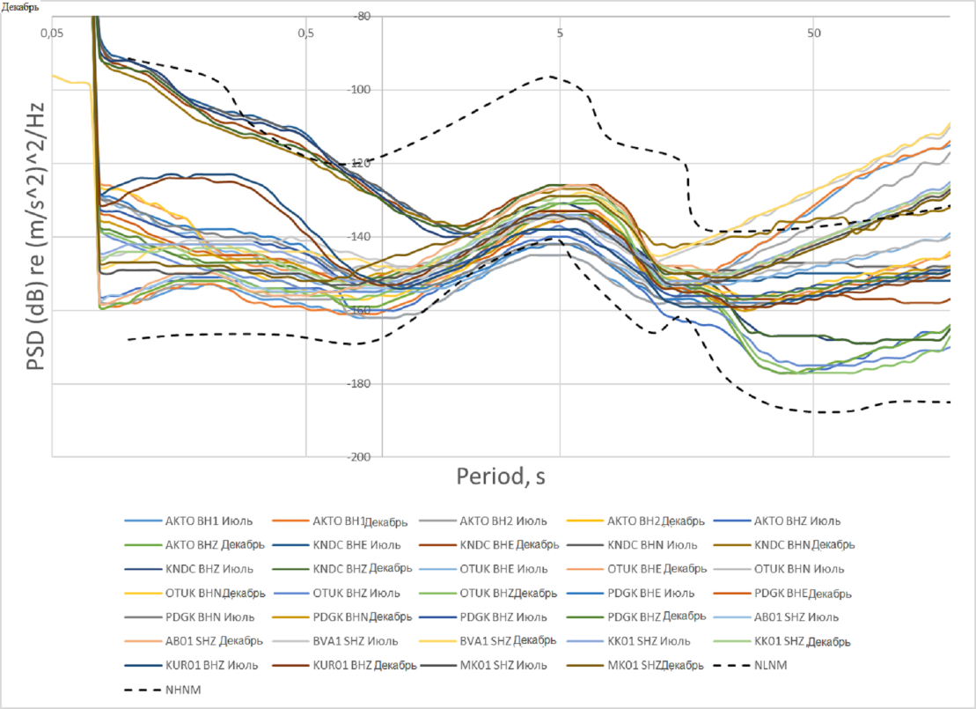
Results
Individual hourly graphs of PSD noise spectral curves with 30 minutes laps were calculated. After that the medians and percentiles were calculated, shown in Figure with different colors. The calculations were done for two months of 2017 – one summer month (July, 2017), and one winter month (December, 2017). The Figure shows the cumulative graph of noise spectra medians for all seismic stations by the waveforms obtained for day time from 01 to 13 GMT hour. Black dashed lines show the low-noise (NLNM) and high-noise (NHNM) Peterson models.
Place your QR Code here after removing this text box!
Px.x-xxx

Slide 6
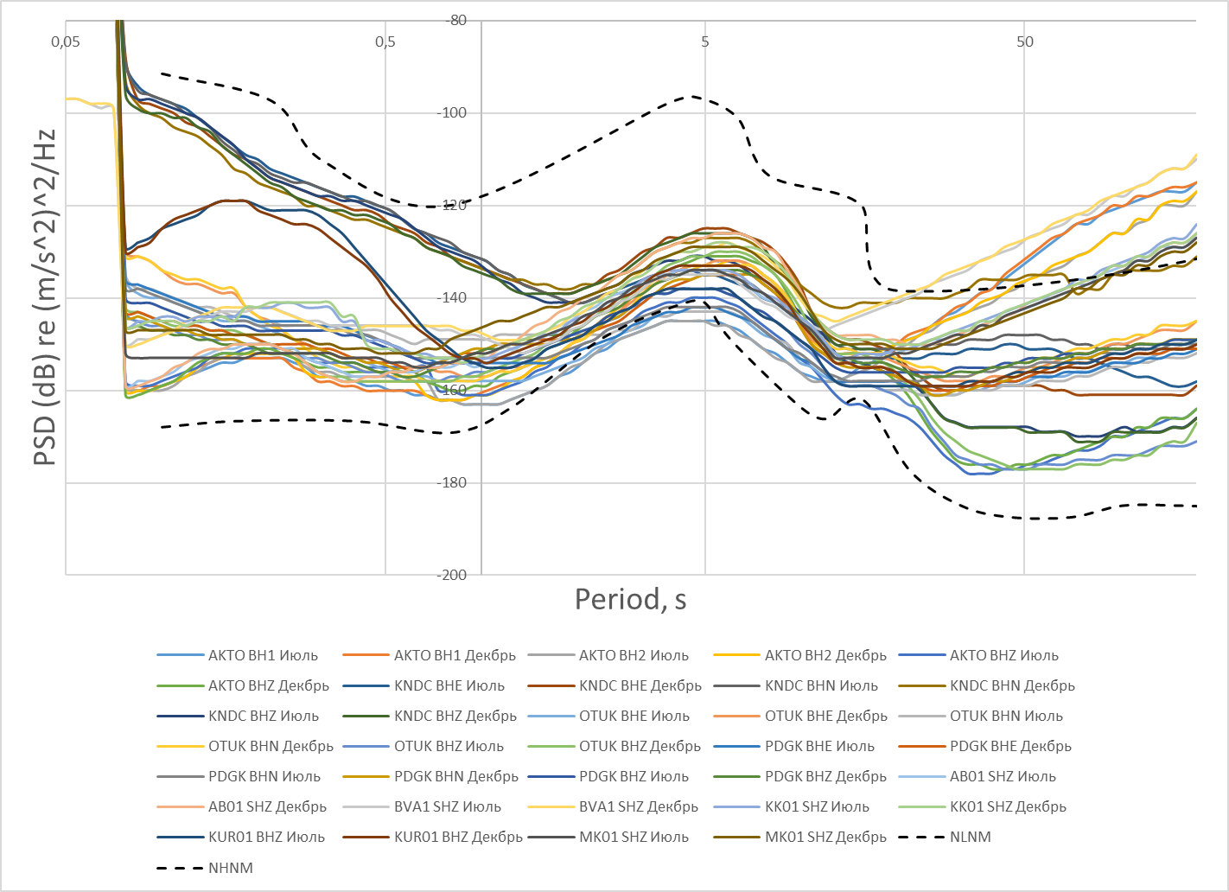
Results
The comparison of seismic noise characteristics showed that there are some common features in spectral characteristics for all seismic arrays:
- For all arrays, at large periods, the median value of spectral density is beyond the high-noise model by Peterson;
- For all stations, in summer time, the noise level at microseismic peak is close to low-noise model by Peterson;
- For all stations, in winter time, the noise level at microseismic peak is above the summer noise level;
The absolute level of seismic noise in microseismic frequency band (0.1 – 0.4 Hz) decreases with station remoteness from the main region of microseism sources – North Atlantics;
For all stations, the noise level in day time is higher than at night time.
The cumulative graph of noise spectra medians for all seismic stations by the waveforms obtained for day time from 01 to 13 GMT hour. Black dashed lines show the low-noise (NLNM) and high-noise (NHNM) Peterson models.
Place your QR Code here after removing this text box!
Px.x-xxx

Slide 7
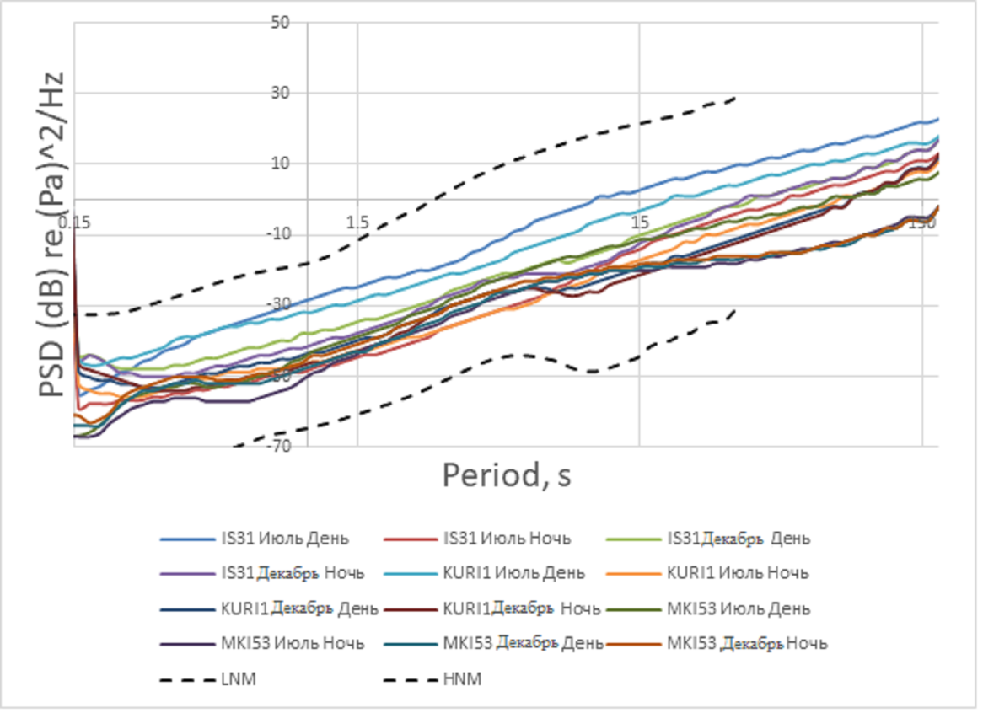
Results
The calculation of spectral curves of infrasound noise was the same as for the seismic stations. As PQLX software is not suitable for infrasound records processing, it was adapted for infrasound processing. Instead of the Peterson models inherent to the software, the Brown infrasound noise models were used (dashed lines). Spectral curves were constructed by infrasound arrays IS31, Kurchatov, and Makanchi for one summer and one winter months of 2017. To represent infrasound noise in the PSD form of infrasound noise, the set of spectral density curves were calculated for a month in the window of 1 hour length, and 50 percent lap.
The Figure shows median spectra of noise for all infrasound arrays
Place your QR Code here after removing this text box!
Px.x-xxx

Slide 8
Results
The comparison of infrasound noise characteristics showed that there is a range of common features in spectral characteristics for all infrasound arrays.
- For all stations, in summer time, microbarom peak at ~5 s period is not clear;
- For all stations, in winter time, microbarom peak is quite clear;
- For all stations, in winter time, the noise level at microseism peak is higher than summer noise level;
The absolute level of infrasound noise in microbarom frequency band (0.1 – 0.4 Hz) decreases with station remoteness from the main region of microseism sources – North Atlantics;
- For all stations the noise level in day time is higher than at night.

Slide 9
Results
The joint consideration of calculation results of noise spectral curves by seismic and infrasound stations of the NNC RK network stations shows that the observed change of absolute values of microseismic noise level from summer to winter through Kazakhstan territory corresponds completely to the results of observation and modeling of microseism and microbarom. At the same time, at short periods, each station shows the individual peculiarities.
The fact that the infrasound arrays of the NNC RK network are located close to seismic arrays (IS31 and Akbulak ABKAR) or near them (KURIS and Kurchatov-Cross, MKIAR and Makanchi MKAR) allowed for studying temporary variations of back-azimuths and amplitudes by detections at seismic and infrasound stations, conclude on mainly common sources of microseism and microbarom, and determine the location of these sources.

Slide 10
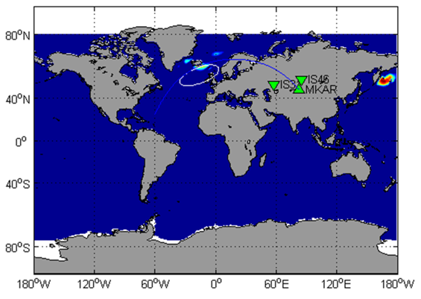
Results
Example of microbarom source region location by Kazakhstan stations. The map shows the results of microbarom intensity modeling. White line shows 90% error ellipse for locations determined by cross beam method by detections at IS31 and IS46 stations. Blue line shows back-azimuth calculated by MKAR seismic array.

Slide 11
Conclusion
The investigation of noise spectral characteristics allowed for assessing the capabilities of seismic and infrasound network on a new advanced technical level, study the common pattern and regularities of distribution and change of background noise in different frequency ranges, reveal individual peculiarities of noise spectral models for a range of stations.
The obtained results of seismic noise parameters estimation by all NNC RK stations show great capabilities of these stations in monitoring of nuclear explosions and earthquakes. The noise models are close to the world low-noise models of seismic noise. The range of noise variations during days and seasons is not large.
The joint consideration of results by seismic and infrasound stations allowed for concluding on coherent noise change in the field of microseismic peaks during the year seasons, and in spatial aspect of noise level distribution by Kazakhstan stations.
All conclusions and experimental data are important to enhance the efficiency of work on seismic monitoring in the field of stations operation and data processing.

