Slide 1
Main VNIIA Focus Areas Related to the CTBT Technologies
O.A. Gerasimchyk, A.V. Sokovishin, E.O. Kremenetskaya, G.S. Zasimov, E.G. Zhagrin, S.A. Piskarev, I.A. Kryuchkov]
FSUE VNIIA, ROSATOM
Place your institution logo here
(remove this text box)
VNIIA is a leading company of Rosatom State Atomic Energy Corporation in CTBT implementation
VNIIA develops a scientific & methodical support and hardware & software for the CTBT on-site inspection activities
VNIIA has developed a short-period vertical seismometer and three-component broad-band seismometers for the seismic monitoring systems.
VNIIA has generated a protective coating for a scintillation beta detector to reduce diffusion of the analyzed radioactive gas (memory effect) into the material of the detector cell
VNIIA participates in the analysis of events which reveal a possible non-compliance with CTBT on the part of other State Parties, collects the geophysical and radionuclide information
Please do not use this space, a QR code will be automatically overlayed
P3.1-182

Slide 2
Abstract
Place your institution logo here after removing this text box!
VNIIA is a leading company of Rosatom State Atomic Energy Corporation in CTBT implementation, which currently performs a range of researches:
develops a scientific & methodical support and hardware & software for the CTBT on-site inspection activities, provides a comprehensive assessment and analysis of efficiency of controls and data information content published by the International Data Centre (IDC);
participates in the analysis of events which reveal a possible non-compliance with CTBT on the part of other State Parties, collects the geophysical and radionuclide information based on products of the International Data Centre (IDC);
improves the data analytics system to use it in applied researches for monitoring the CTBT compliance;
investigates the ways to create an expert system for checking the procedure for CTBT on-site inspections and for using it in applied researches in the framework of the Rosatom activities in the field of CTBT compliance monitoring in order to predict and evaluate the on-site inspection (OSI) results;
has developed a short-period vertical seismometer and three-component broad-band seismometers for the seismic monitoring systems.
has generated a protective coating for a scintillation beta detector to reduce diffusion of the analyzed radioactive gas (memory effect) into the material of the detector cell.
Please do not use this space, a QR code will be automatically overlayed
P3.1-182

Slide 3
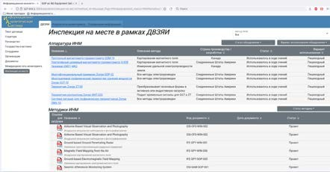
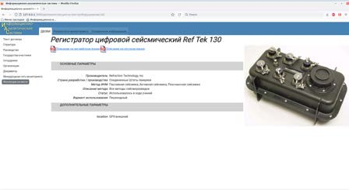
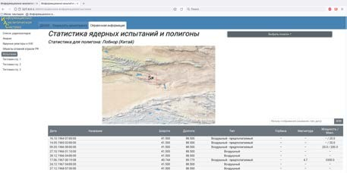
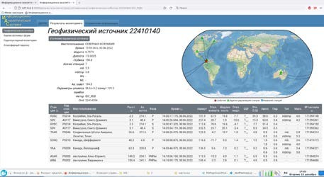
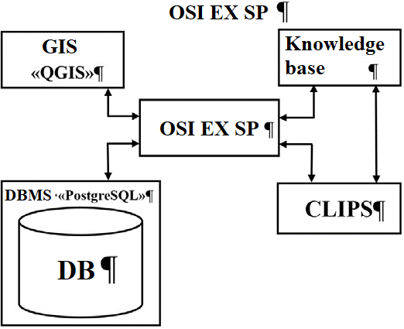
Development of Scientific and Methodical Support As Well As Hardware and Software for Provision of the CTBT On-site Inspection Activity
Place your institution logo here after removing this text box!
VNIIA executes a complex of works to ensure the development of methodical support for the inspection activity and for the negotiation process of the Russian Federation in the CTBT field.
Within the frames of these works the Information and Analytical System (IAS) is upgraded in order to be used in applied research to ensure implementation by Rosatom State Corporation of its assigned functions.
Investigation of Ways to Develop an Expert System for the OSI Purposes
VNIIA is looking for a way to develop an expert system in order to control the procedure of the on-site inspection according to the CTBT. As part of the work, the OSI expert support system software package (EX SP) has been developed.
EX SP has the following functions:
interpretation and on-screen visualization of data obtained as a result of the activities of the inspection team;
forecasting results and conditions of the OSI based on the analysis of environmental conditions;
forecasting probable locations that caused the OSI request based on a number of signs;
providing support in the decision-making process of the inspection team on solving typical situations arising during the OSI;
rendering support in making solutions while planning actions of the inspection team;
control of the OSI process according to the Treaty and the OSI Operational Manual.
Please do not use this space, a QR code will be automatically overlayed
P3.1-182

Slide 4
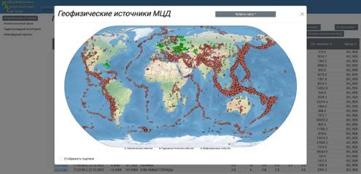
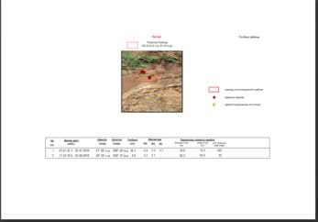
IMS Stations Monitoring Data Analysis
Place your institution logo here after removing this text box!
VNIIA carries out the analysis of the International Monitoring System (IMS) data aimed at the detection of seismic and infrasound events of interest as well as radiation situation over the terrestrial globe. The data of interest is submitted as a reference material to Rosatom State Corporation and archived in the IAS database.
Events at the DPRK test site
No. | Date, time of the event (UTC) | Latitude, ⁰ N | Longitude, ⁰ E | Magnitude | Source of information
1 | 11.02.2022 01: 35:26 | 41.30 | 129.21 | 3.1 | KMA
 | 11.02.2022 01: 35:25 | 41.29 | 129.3 | 3.7 | IDC
2 | 14. 02.2022 05:33:22 | 41.27 | 129.24 | 2.3 | KMA
 | 14. 02.2022 05:33:30 | 41.44 | 129.03 | 2.6 | IDC
3 | 14.02.2022 10:47:27 | 41.28 | 129.26 | 2.3 | KMA
 | 14.02.2022 10:47:32 | 40.99 | 129.20 | 2.6 | IDC
4 | 14.02.2022 21:52:28 | 41.29 | 129.23 | 2.5 | KMA
5 | 26.02.2022 23:05:29 | 40.16 | 129.38 | air | IDC
6 | 03.03.2022 17:15:37 | 41.24 | 129.22 | 2.1 | KMA
7 | 05.03.2022 00:02:22 | 40.57 | 130.06 | air | IDC
8 | 24.03.2022 05:30:41 | 39.16 | 126.72 | air | IDC
In February and March 2022, high seismic and acoustic activity was recorded at the DPRK test site. Five seismic and three acoustic events were recorded in the area. Table 1 shows the results of registration of these events according to the IMS data and according to the seismic stations network of South Korea (KMA), which includes about 300 seismic stations. Locations of the seismic events are shown in Figure 7. Figure 8 shows a record of the seismic event dated February 11, 2022 at the IMS station USRK. According to the data confirmed by the DPRK [1], the acoustic events represented launches of a new system of intercontinental ballistic missiles
Please do not use this space, a QR code will be automatically overlayed
Table 1Seismic and acoustic events at the DPRK test site in February and March 2022
P3.1-182

Slide 5
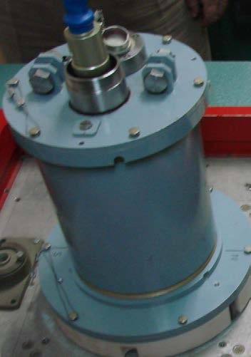
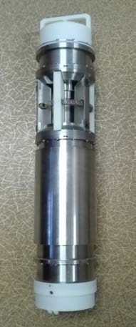
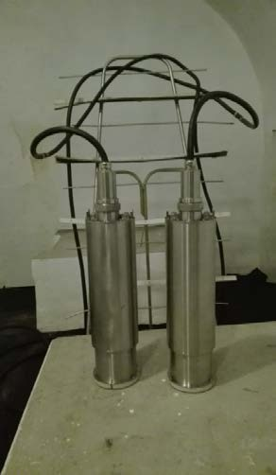
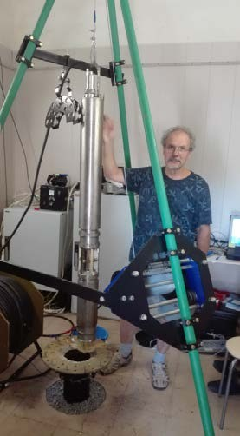
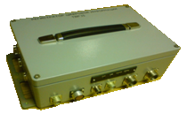
Vertical Short-Period and Broadband Three-Component Seismometers for the Seismic Monitoring Systems
Place your institution logo here after removing this text box!
VNIIA has more than a 40-year experience in research and development in the seismic instrumentation field. VNIIA has successfully developed vertical short-period and broadband three-component seismometers and associated digital recorders for seismic monitoring systems.
Seismometers:
ТБСЦ5 - pedestal broadband three-component;
ТБСЦ7, ТБСЦ8 - borehole broadband three-component (for 140-160 mm and 300-320 mm diameter boreholes, respectively);
ТБСЦ6 - single-component short-period (vertical) borehole (for 140-160 mm diameter boreholes).
Digital recorders:
ТВР35 - 4-channel; ТВР35-01 - 8-channel.
SEISMOMETERS BASIC CHARACTERISTICS
Parameter | ТБСЦ6 | ТБСЦ7, ТБСЦ8, ТБСЦ5
Converter type | magnetoelectric | capacitance
Operating frequency range | 0.5 – 100 Hz | 0.02 – 50 Hz
Conversion factor | 2000 or 20000 V·m⁻¹·s | 2000 or 20000 V·m⁻¹·s
RMS value of intrinsic noise in operating frequency band relative to the minimum seismic noise (LNM) | by 10 dB below the LNM level (LNM = 2 nm/s) | by 10-20 dB below the LNM level (LNM = 20 nm/s)
Dynamic range | ±5 mm/s (more than 136 dB) | ±5 mm/s (more than 130 dB)
Conversion non-linearity | not more than 0.01 % | not more than 0.1 %
On the vibration test stands of IDG RAS | Fixing device | In the adit of GS RAS
ТБСЦ5
Please do not use this space, a QR code will be automatically overlayed
ТВР35 (ТВР35-01)
P3.1-182

Slide 6
Digital recorders
Place your institution logo here after removing this text box!
DIGITAL RECORDERS BASIC CHARACTERISTICS
Parameter | ТВР35 | ТВР35-01
Number of channels | 4 | 8
Smallest digit value of digit code | 1.7-1.9 μV (from 0.04 to 0.05 nm/s for seismometer conversion factor – 20000 V∙s/m and gain factor – 2)
Sample rates | from 1 to 250 s⁻¹
RMS value of intrinsic noise at a sample rate of 100 s⁻¹ | 1 bit of an ADC
Dynamic range | more than 140 dB
Deviation of UTS reference | Deviation of UTS reference
Power consumption | 4 W
Digital recorders:
ТВР35 – 4-channel;
ТВР35-01 – 8-channel
Please do not use this space, a QR code will be automatically overlayed
P3.1-182

Slide 7
Protective Coating on the Scintillation Detector Cell
References
Place your institution logo here after removing this text box!
VNIIA has developed a method of using poly-chloro-para-xylylene (Parylene C) as a protective coating of the internal surface of the plastic scintillator. Poly-para-xylylene coatings are uniform in thickness and act as a good gas barrier [4]. The least gas permeation is characteristic of poly-chloro-para-xylylene coatings studied in detail in [5]. In a wide range of wavelengths, poly-para-xylylene coatings are consistent with the emission spectrum of a plastic scintillator, they practically do not absorb X-rays in a vacuum, and are resistant to high-level UV radiation. Their physical, mechanical and electrical properties do not change when irradiated with γ-rays at a dose of 10 Mrad. Poly-chloro-para-xylylene coatings are characterized by high elasticity at low temperatures, so that they can be used in a wide temperature range. Close refractive indices of the beta-detector cell material and the protective coating ensure good light collection in the detector without significant deterioration in resolution and detection efficiency. For poly-chloro-para-xylylene, the refractive index is 1.59 at a wavelength of 632.8 nm, it is close to the refractive index of the basic PVT polymer used for plastic scintillators which is 1.58.
Obtained by pyrolytic polymerization, poly-para-xylylene coating with a thickness of 4-5 μm allows to achieve a stable memory effect of the plastic scintillator at the level of 1-3%.
References
Yonhap News – URL: http://www.yonhapnews.co.kr
Introduction to Expert Systems / Peter Jackson, Moscow, Williams, 2001, 393 p.
L. Blackberg, A. Ringbom, H. Sjostrand, M. Klintenberg, Phys. Rev. B 82 (2010) 195434.
G. Li, D. Stolfi, K. Neville. New Linear Polymers, Moscow, Chemistry, 1972, 280 p.
I.E. Kardash, A.V. Pebalk, A.V. Pravednikov. Chemistry and Application of Poly-n-xylylenes. In the book: Science and Technology Results. Series: Chemistry and Technology of Macromolecular Compounds, Moscow, VINITI, 1984, V.19.
Please do not use this space, a QR code will be automatically overlayed
P3.1-182

