Slide 1
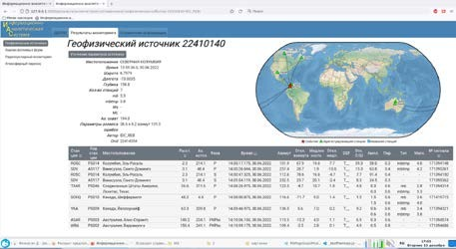
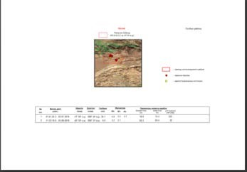
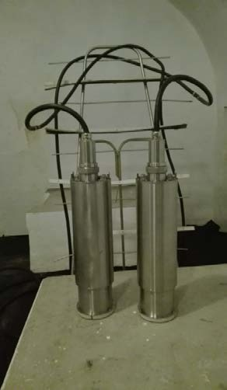
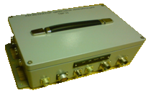
E-Poster Main VNIIA Focus Areas Related to the CTBT Technologies
O.A. Gerasimchyk, A.V. Sokovishin, E.O. Kremenetskaya, G.S. Zasimov, E.G. Zhagrin, S.A. Piskarev,
I.A. Kryuchkov]
FSUE VNIIA, ROSATOM
P3.1-182
VNIIA is a leading company of Rosatom State Atomic Energy Corporation in CTBT implementation, which currently performs a range of researches:
develops a scientific & methodical support and hardware & software for the CTBT on-site inspection activities, provides a comprehensive assessment and analysis of efficiency of controls and data information content published by the International Data Centre (IDC);
participates in the analysis of events which reveal a possible non-compliance with CTBT on the part of other State Parties, collects the geophysical and radionuclide information based on products of the International Data Centre (IDC);
improves the data analytics system to use it in applied researches for monitoring the CTBT compliance;
investigates the ways to create an expert system for checking the procedure for CTBT on-site inspections and for using it in applied researches in the framework of the Rosatom activities in the field of CTBT compliance monitoring in order to predict and evaluate the on-site inspection (OSI) results;
has developed a short-period vertical seismometer and three-component broad-band seismometers for the seismic monitoring systems.
has generated a protective coating for a scintillation beta detector to reduce diffusion of the analyzed radioactive gas (memory effect) into the material of the detector cell.
If you want to learn more about this, come see my e-poster during session 3.1 on this date or access it online on the SnT2023 Conference platform!

