Slide 1
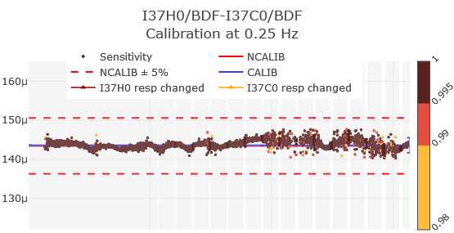
CalxPy: A Software for Calibration Against a Reference
Benoit Doury, Ichrak Ketata
CTBTO Preparatory Commission
P3.1-578
Calxpy…
enables users in performing side-by-side calibration for seismic and infrasound technologies
is a key development in the implementation of the Quality Assurance infrastructure for IMS Infrasound measurements: for acceptance testing, initial calibrations and on-site calibrations
is already running on PTS premises, and used for the yearly calibration and QC monitoring of infrasound stations
can be used as a standalone software for testing in lab or on the field
is available on request for beta testing to authorized users. It will be part of NDC-in-a-box next release.
Sensitivity (Pa/cnt)
Time (20 days)

