Slide 1
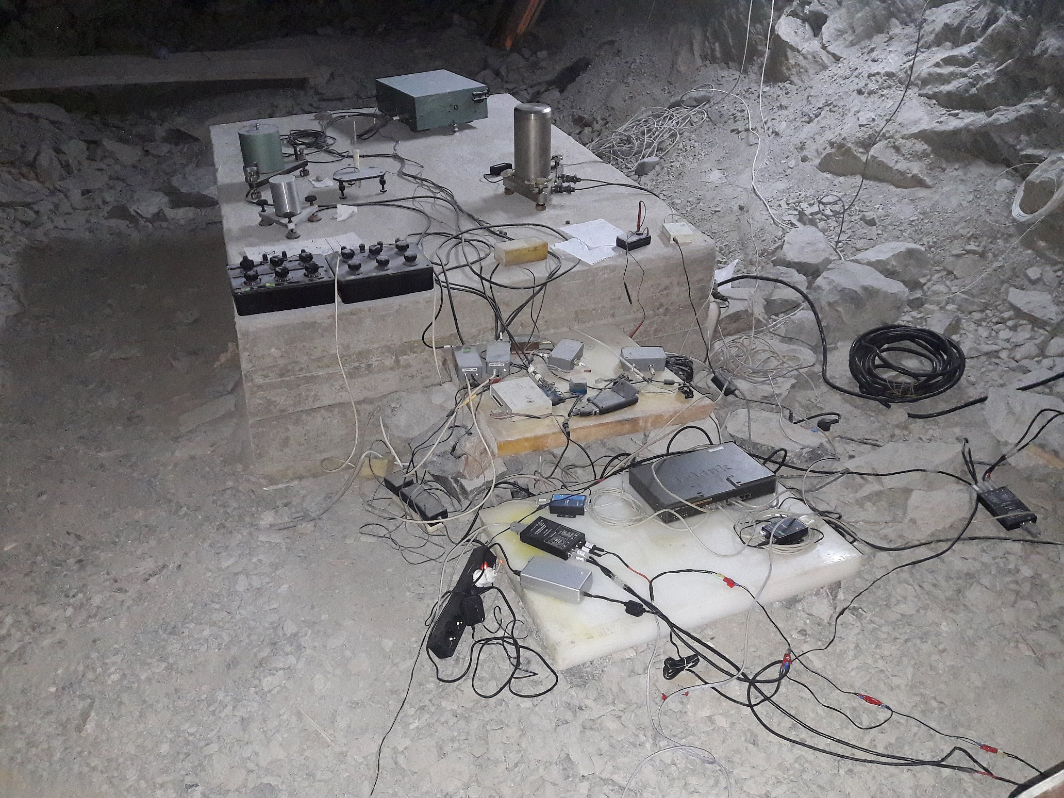
Improvements of the High-Precision Tiltmeter’s Instrumental Complex Installed in the Northern Caucasus Geophysical Observatory of IPE RAS
V. Gravirov, D.Likhodeev, A.Deshcherevskii, P.Mikhailov
The Schmidt Institute of Physics of the Earth of the Russian Academy of Sciences
.
P3.1-161
A complex of geophysical instruments on a pedestal consisting of:
Gridnev quartz tiltmeter,
Magnetic variation station,
Shirokov tiltmeter,
Barograph,
Electronic multichannel temperature monitoring system,
Digital data acquisition system.

