Slide 1
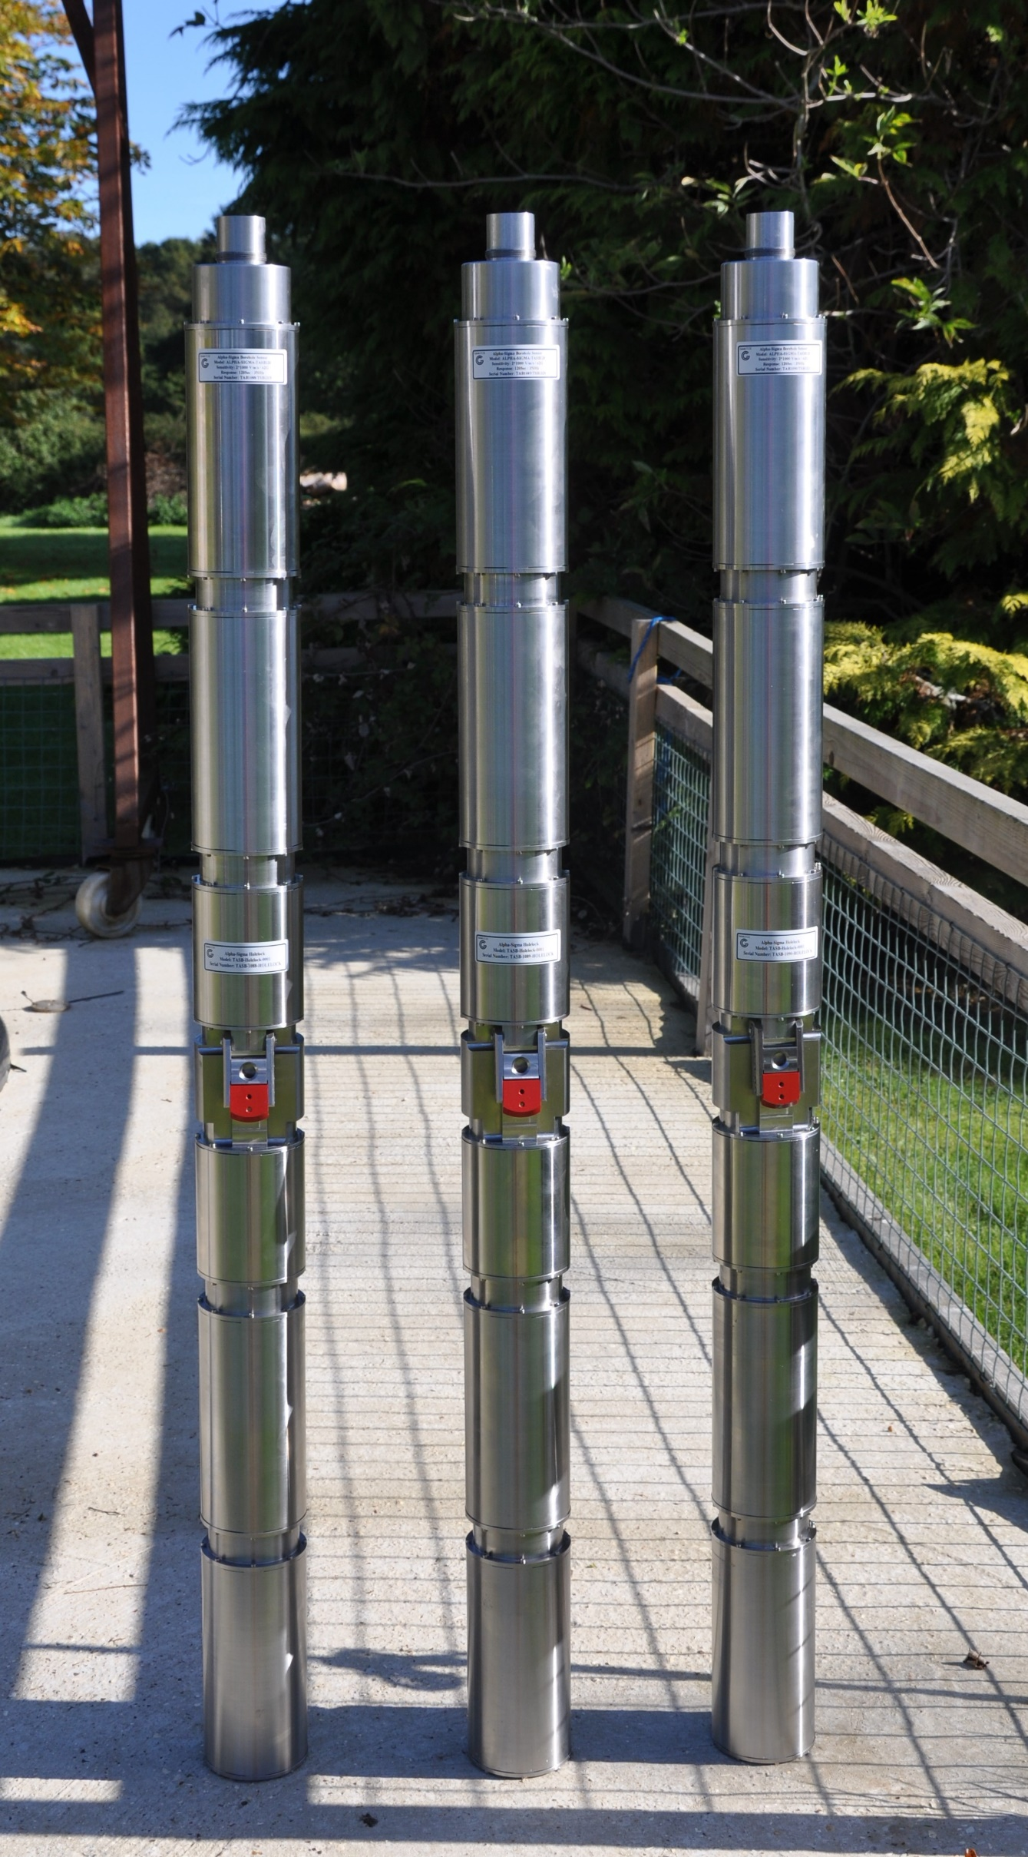
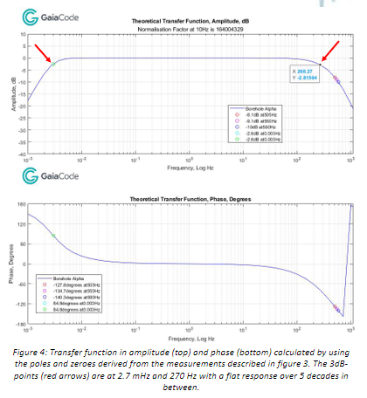
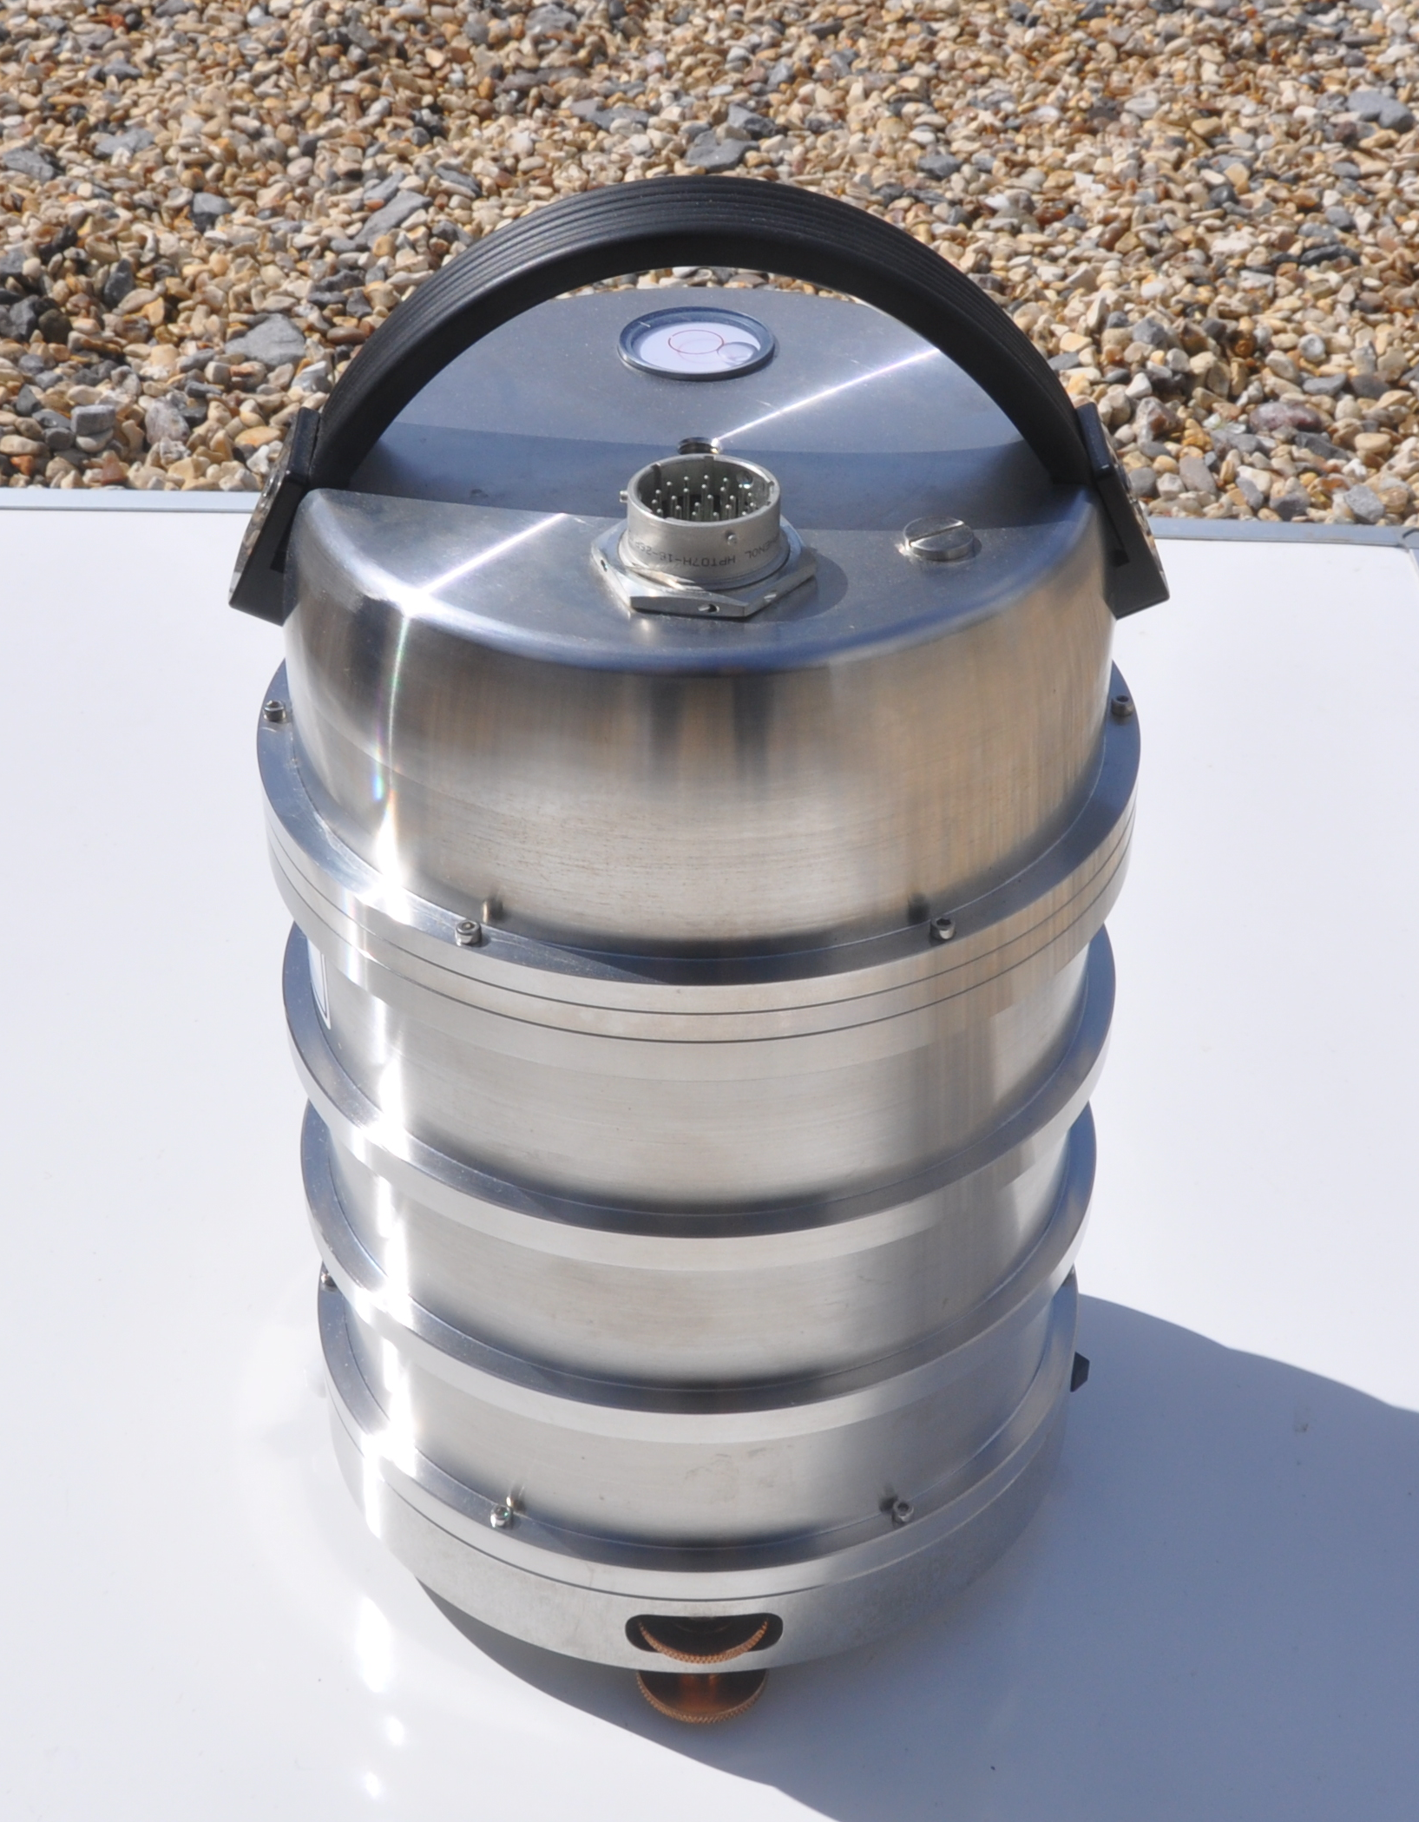
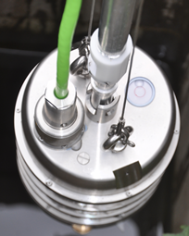
A truly Very Broad Band (VBB) borehole seismometer
with flat response over 5 decades of frequency
Güralp CM¹, Minchinton P¹, Kirrage R¹, Alimov M¹, Jones R¹, Boustead N¹, Rademacher H^{1,2}
1: Gaiacode Ltd, Dickers Farm, Bramley Road, Silchester, RG7 2LU UK
2: Berkeley Seismology Lab, UC Berkeley, USA (retired)
P3.1-595
Rationale:
Since the introduction of the first broadband seismic sensors more than 40 years ago, their response on the high frequency side (>100 Hz) of the seismic spectrum has been neglected in instrument design.
We closed this gap by drastically changing details in the design of the ALPHA Family of Gaiacode’s Seismic Broadband Sensors to significantly broaden their frequency responses,
Realization:
Products:
The new truly very broad band sensors will be available as either vault/surface instruments, in a posthole version or in a slim borehole package, which can be augmented with accelerometers of the SIGMA family of sensors
With our changes we achieved a flat frequency response of our flagship ALPHA sensor over more than five decades, from 2.7 mHz to 270 Hz and beyond

