Slide 1
A truly Very Broad Band (VBB) borehole seismometer
with flat response over 5 decades of frequency
Güralp CM¹, Minchinton P¹, Kirrage R¹, Alimov M¹, Jones R¹, Boustead N¹, Rademacher H^{1,2}
1: Gaiacode Ltd, Dickers Farm, Bramley Road, Silchester, RG7 2LU UK
2: Berkeley Seismology Lab, UC Berkeley, USA (retired)
Since the introduction of the first broadband seismic sensors more than 40 years ago, their response on the high frequency side (>100 Hz) of the seismic spectrum has been neglected in instrument design.
We drastically changed details in the design of the ALPHA Family of Gaiacode’s Seismic Broadband Sensors to significantly broaden their frequency responses.
With our changes we achieved a flat frequency response of our flagship ALPHA sensor over more than five decades, from 2.7 mHz to 270 Hz and beyond
The new truly very broad band sensors will be available as either vault/surface instruments or in a slim borehole package, which can be augmented with accelerometers of the SIGMA family of sensors.
Please do not use this space, a QR code will be automatically overlayed
P3.1-595

Slide 2
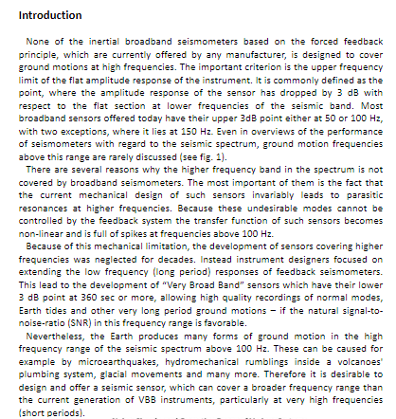
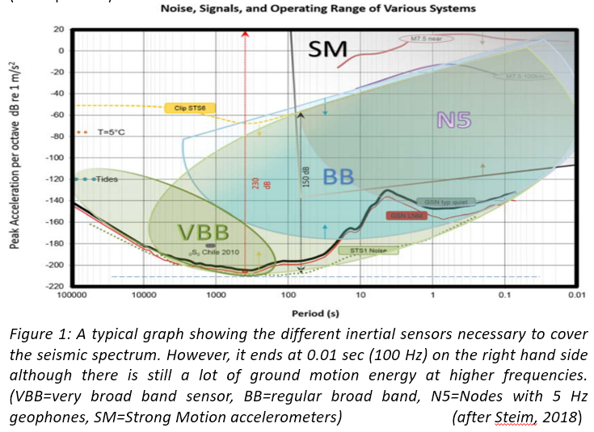
Introduction
Please do not use this space, a QR code will be automatically overlayed
P3.1-595
Introduction
None of the inertial broadband seismometers based on the forced feedback principle, which are currently offered by any manufacturer, is designed to cover ground motions at high frequencies. The important criterion is the upper frequency limit of the flat amplitude response of the instrument. It is commonly defined as the point, where the amplitude response of the sensor has dropped by 3 dB with respect to the flat section at lower frequencies of the seismic band. Most broadband sensors offered today have their upper 3dB point either at 50 or 100 Hz, with two exceptions, where it lies at 150 Hz. Even in overviews of the performance of seismometers with regard to the seismic spectrum, ground motion frequencies above this range are rarely discussed (see fig. 1).
There are several reasons why the higher frequency band in the spectrum is not covered by broadband seismometers. The most important of them is the fact that the current mechanical design of such sensors invariably leads to parasitic resonances at higher frequencies. Because these undesirable modes cannot be controlled by the feedback system the transfer function of such sensors becomes non-linear and is full of spikes at frequencies above 100 Hz.
Because of this mechanical limitation, the development of sensors covering higher frequencies was neglected for decades. Instead instrument designers focused on extending the low frequency (long period) responses of feedback seismometers. This lead to the development of “Very Broad Band” sensors which have their lower 3 dB point at 360 sec or more, allowing high quality recordings of normal modes, Earth tides and other very long period ground motions – if the natural signal-to-noise-ratio (SNR) in this frequency range is favorable.
Nevertheless, the Earth produces many forms of ground motion in the high frequency range of the seismic spectrum above 100 Hz. These can be caused for example by microearthquakes, hydromechanical rumblings inside a volcanoes' plumbing system, glacial movements and many more. Therefore it is desirable to design and offer a seismic sensor, which can cover a broader frequency range than the current generation of VBB instruments, particularly at very high frequencies (short periods).

Slide 3
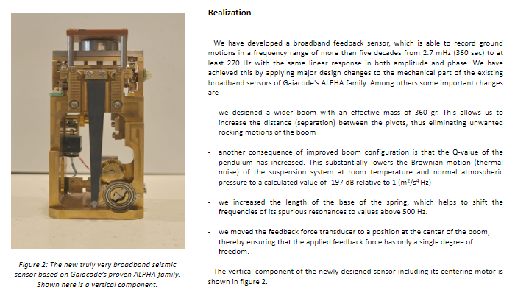
Realization
Please do not use this space, a QR code will be automatically overlayed
P3.1-595

Slide 4
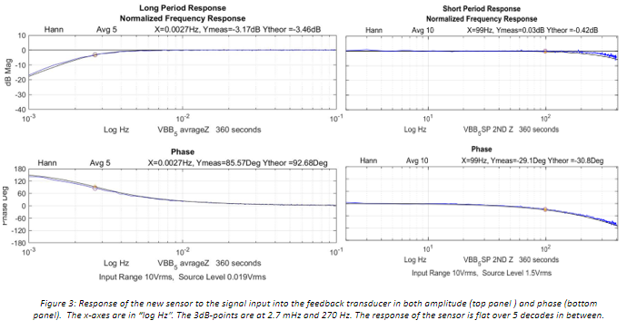
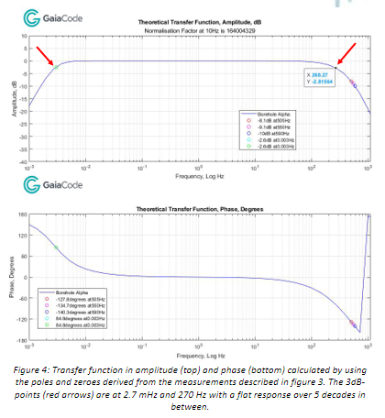
Testing and Results
Place your institution logo here after removing this text box!
Please do not use this space, a QR code will be automatically overlayed
P3.1-595

Slide 5
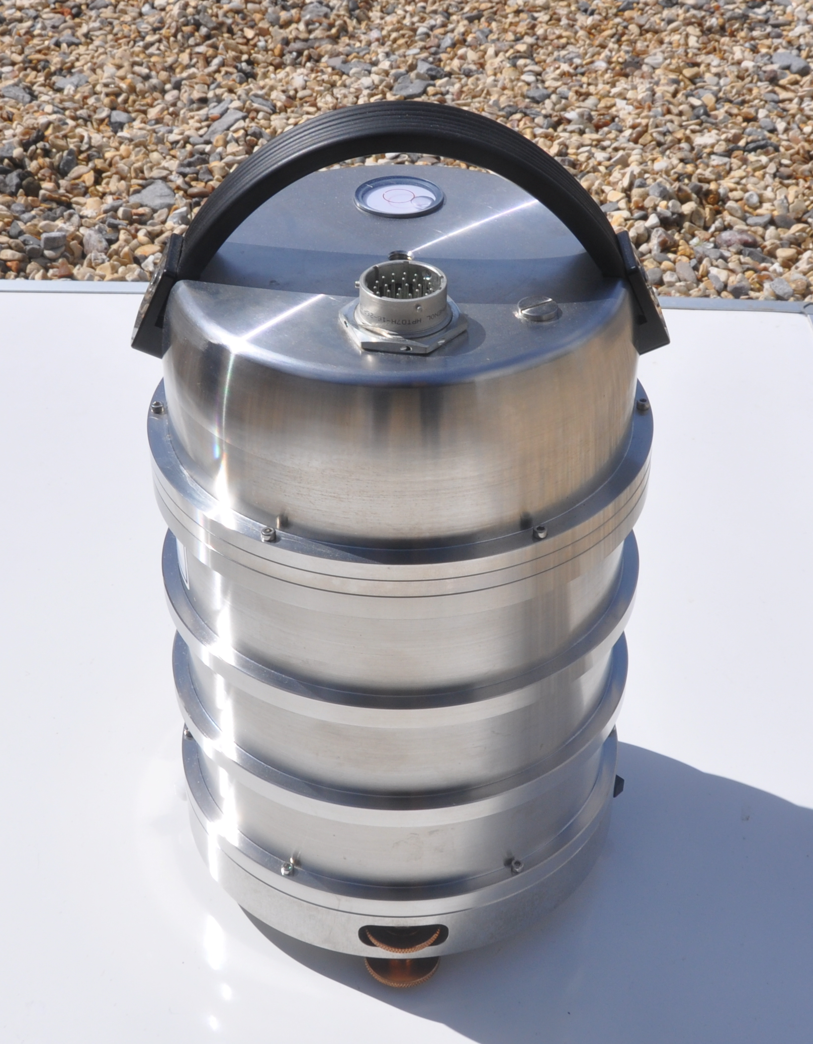
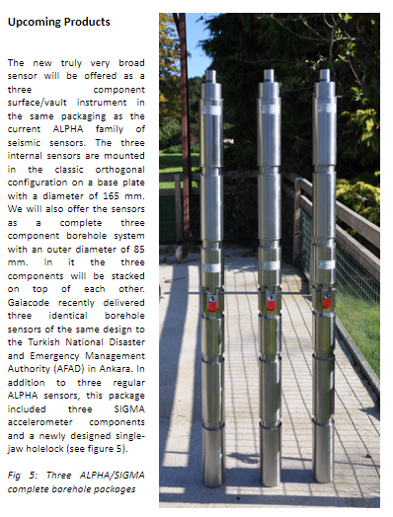
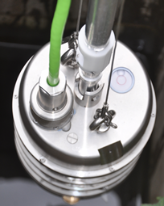
Upcoming Products
Place your institution logo here after removing this text box!
Fig. 6: Three component truly broadband instrument with a flat frequency response between 2.7 mHz and 270 Hz will also be offered as a vault/surface instrument (left) or a posthole instrument with water tight connectors and an orientation mechanism (right).
Please do not use this space, a QR code will be automatically overlayed
P3.1-595

Slide 6
Conclusions
Place your institution logo here after removing this text box!
With our design changes we achieved a flat frequency response of our flagship ALPHA sensor over more than five decades,
from 2.7 mHz (360 sec) to 270 Hz and beyond
These new truly very broad band sensors will be available as either vault/surface instruments, in a posthole version or in a slim borehole package, which can be augmented with accelerometers of the SIGMA family of sensors
Please do not use this space, a QR code will be automatically overlayed
P3.1-595

