Slide 1
Temperature Dependence of Frequency Response
of Short Period Seismometers
Nick Ackerley and Ziad Gias
Canadian Hazards Information Service, Natural Resources Canada
Ambient temperature variations make it impossible to reliably meet a ±5% gain specification at the Yellowknife Seismograph Array (YKA).
A detailed model of temperature effects predicts an equally strong effect on seismometer damping.
Pole-zero fitting of broadband calibrations
(and careful measurement of temperature) were used to verify the model.
Agreement between measured and modeled temperature coefficients:
Gain: excellent (-0.22%/°C)
Resonant frequency: poor but confirmed low
Damping: good but measured (-0.14%/°C) < predicted (-0.21%/°C).
Broadband calibration and pole-zero-gain fitting can be routine, and can be be used to detect subtle instrumentation effects.
More work needed to explain pole in the YKA response near 65 Hz
Please do not use this space, a QR code will be automatically overlayed
P3.1-860

Slide 2
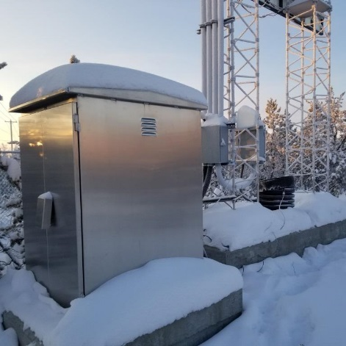
Introduction
Yellowknife Seismograph Array
Upgrade of YKA in 2013 first major since 1989.
Old system:
Digitizers: Nanometrics RD-3, 16-bit
Sensors: S-13 short-period sensors
New system:
Digitizers: Guralp CMG-DM24S3EAM, 24-bit
Sensors: Unchanged
Preamps: added to match old system gain
Short-period sensors unchanged since 1980s, with a few exceptions.
Long-standing calibration issues
Some years, most stations failed the ±5% specification on calibration gain, using a sinusoidal calibration. Other years, all stations passed.
A previous investigation concluded that to achieve calibration within this specification required:
frequency-domain analysis (rather than use of naïve peak-to-peak amplitude estimates), and
correction for temperature effects
Please do not use this space, a QR code will be automatically overlayed
P3.1-860

Slide 3
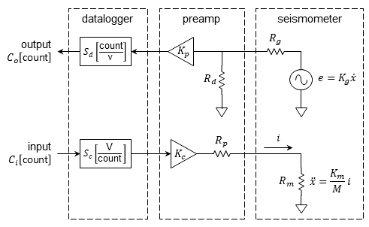
Objective: Verify detailed model of temperature effects
Seismometer response from acceleration to velocity:
$$\frac{{\dot{x}}_{o}}{{\ddot{x}}_{i}}=\frac{s}{s^{2}+2ζω_{0}s+ω_{0}^{2}}=\frac{s}{s^{2}+\frac{B}{M}s+\frac{K}{M}}$$
The natural frequency depends only on spring constant K and mass M:
$$f_{0}=\frac{ω_{0}}{2π}=\frac{1}{2π}\sqrt{\frac{K}{M}}$$
The damping depends on the natural frequency, air density and viscosity but also external resistors:
$$ζ_{s}=\frac{CDR}{R_{g}+R_{d}}$$
Temperature coefficient of sensitivity:
$$κ_{G}≅{\text{−}\text{TCR}}_{\text{Cu}}\left(\frac{1}{1+\frac{R_{d}}{R_{g}}}\right)+α_{\text{Alnico}}\left(B_{r}\right)=\text{−}\text{0.163 \%/}\text{°}\text{C}$$
Temperature coefficient of calibration gain :
$$κ_{C}≅{−\text{TCR}}_{\text{Cu}}\left(\frac{1}{1+\frac{R_{d}}{R_{g}}}+\frac{1}{1+\frac{R_{p}}{R_{m}}}\right)+2α_{\text{Alnico}}\left(B_{r}\right)=−\text{0.223 \%/°}\text{C}$$
Temperature coefficient of resonant frequency, neglecting effects due to thermal expansion:
$$α_{f}≅\frac{1}{2}β_{BeCu}=−0.017\%/°C$$
Temperature coefficient of damping:
$$α_{ζ}≅{\text{−}\text{TCR}}_{\text{Cu}}\left(\frac{1}{1+\frac{R_{d}}{R_{g}}}\right)=−\text{0.143}\text{ \%/°}\text{C}$$
Can this model be verified experimentally?
Please do not use this space, a QR code will be automatically overlayed
P3.1-860

Slide 4
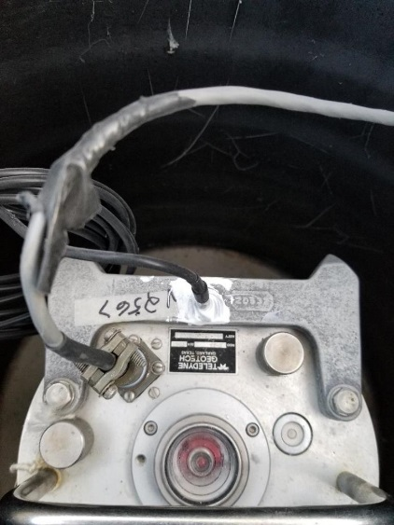
Methods/Data:
Pole-Zero Fitting of Broadband Calibrations
(and careful measurement of temperature)
Broadband calibration gives you estimates of relative transfer function $\overset{ˆ}{H}(jω_{k})$at thousands of frequencies – how to make meaning of this?
Keep zeros at zero frequency fixed (Don’t fit them).
Weight by coherence.
Compute Jacobian.
Express least-squares problem in matrix notation.
numpy/scipy readily solves these problems, fast!
Pole-zero representation:
$$H\left(jω_{k},z,p,κ\right)=κ\frac{\prod_{i=0}^{n−1}{{\left(jω_{k}+z_{i}\right)}^{i}}}{\prod_{i=0}^{m−1}{{\left(jω_{k}+p_{i}\right)}^{i}}}$$
Coefficient vector representation with $p$zeros fixed at zero frequency:
$$H(jω_{k},x)=\frac{\sum_{i=m}^{m+n−p}{x_{i}{(jω_{k})}^{m+n−i}}}{{(jω_{k})}^{m}+\sum_{i=0}^{m−1}{x_{i}{(jω_{k})}^{m−1−i}}}$$
Function to be minimized:
$$f_{k}(x)=\frac{1}{{\overset{ˆ}{ε}}_{k}∣\overset{ˆ}{H}(jω_{k})∣}\left(H(jω_{k},x)−\overset{ˆ}{H}(jω_{k})\right)$$
Jacobian:
$$J_{kl}(x)≡\frac{∂}{∂x_{l}}f_{k}(x)$$
$$J_{kl}(x)=\begin{matrix}\frac{1}{{\overset{ˆ}{ε}}_{k}∣{\overset{ˆ}{H}}_{k}∣}\frac{−{(jω_{k})}^{m−1−l}\sum_{i=m}^{m+n−p}{x_{i}{(jω_{k})}^{m+n−i}}}{{\left({(jω_{k})}^{m}+\sum_{i=0}^{m−1}{x_{i}{(jω_{k})}^{m−1−i}}\right)}^{2}} & ; & \begin{aligned}0≤l≤m−1 \\ 0≤k≤N−1\end{aligned} \\ \frac{1}{{\overset{ˆ}{ε}}_{k}∣{\overset{ˆ}{H}}_{k}∣}\frac{{(jω_{k})}^{m+n−l}}{{(jω_{k})}^{m}+\sum_{i=0}^{m−1}{x_{i}{(jω_{k})}^{m−1−i}}} & ; & \begin{aligned}m≤l≤m+n−p \\ 0≤k≤N−1\end{aligned}\end{matrix}$$
Previous experiments showed that a temperature probe tightly coupled to the case is better than a measurement of ambient air temperature.
Please do not use this space, a QR code will be automatically overlayed
P3.1-860

Slide 5
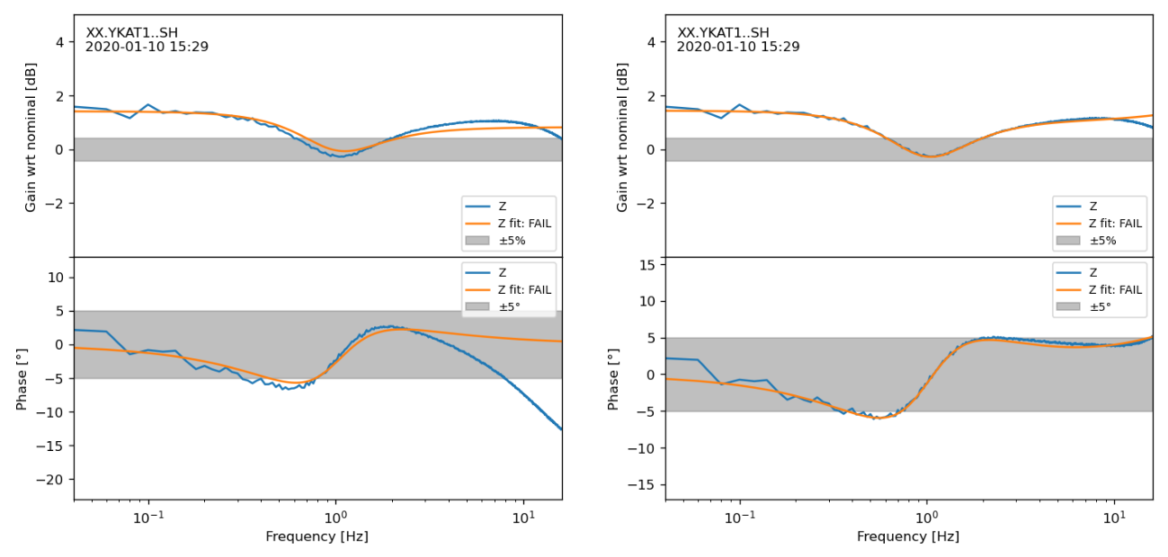
Results:
Temperature coefficients of key parameters
Original:
Additionally fit pole
near 65 Hz:
?
Measured
Fit
%/°C | model | obs. | R² | comment
gain | -0.223 | -0.221 | 0.998 | excellent agreement
damping01 | -0.143 | -0.206 | 0.990 | same sign & order of magnitude
freq01_hz | -0.017 | 0.022 | 0.684 | poor fit, poor agreement, confirmed insensitive
freq2_hz |  | -0.048 | 0.973 | minimally temperature-sensitive
Please do not use this space, a QR code will be automatically overlayed
P3.1-860

Slide 6
Conclusions and Recommendations
Conclusions
Broadband calibration and pole-zero-gain fitting can be used to detect subtle instrumentation effects.
Poles and zeros are more succinct and more informative than frequency-amplitude-phase values.
Short-period sensor damping and sensitivity are temperature-sensitive (but resonant frequency is not).
Temperature sensitivities observed at YKA are not likely to affect performance, but do result in spurious failures of ±5% and ±5° test limits.
Difference between observed and modeled temperature coefficient of damping may be explainable by temperature coefficient of damping due to air around proof ass
Recommendations
Pole-zero-gain fitting of broadband calibrations should be the rule, not the exception.
Future calibrations at YKA will be pole-zero fits of broadband calibrations, corrected to a nominal temperature.
Calibration results for other short-period arrays probably also need to be corrected for temperature in order to consistently meet specifications.
Sensor case temperature measurement should be part of any future refurbishments.
Published response of Yellowknife short-period array sensors needs correction to nominal damping (even without temperature effects).
More work needed to explain pole in the YKA response near 65 Hz (which, thankfully, is temperature-insensitive).
Please do not use this space, a QR code will be automatically overlayed
P3.1-860

Slide 7
References
Ackerley, N. and Z. Gias, 2020. Understanding calibration results at the Yellowknife short-period seismometer array (un-published report, sinusoidal calibrations only) Canadian hazards information Service, 21p.
Edwards, W.N., 2014. The Yellowknife Seismic Array: Comparative Study Between the 2013 Upgrade and its 1989 Predecessor; Geological Survey of Canada, Open File 7559, 39 p. https://doi.org/10.4095/293841.
Please do not use this space, a QR code will be automatically overlayed
P3.1-860

