Slide 1
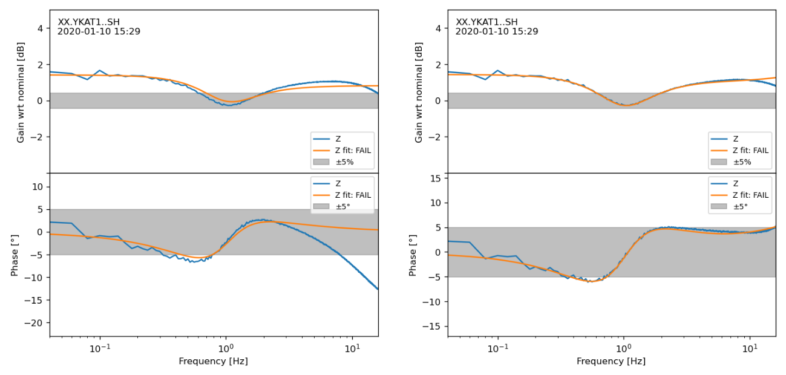
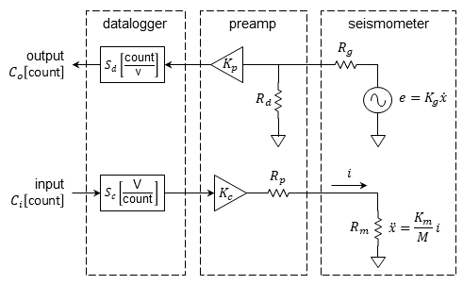
Temperature Dependence of Frequency Response
of Short Period Seismometers
N. Ackerley and Z. Gias
Canadian Hazards Information Service, Natural Resources Canada
P3.1-860
Broadband calibration and pole-zero fitting can be routine.
Single-frequency calibrations at YKA have long been affected by temperature. It is impossible to meet CTBTO ±5% specification unless this is accounted for.
Short-period sensor damping and sensitivity are temperature-sensitive (but not resonant frequency).
Published response of Yellowknife short-period array sensors needs correction.
There is an unexplained pole in the YKA response near 65 Hz.
Original fit:
Additionally fit
pole near 65 Hz:
?
%/°C | model | obs. | R^2 | comment
gain | -0.223 | -0.221 | 0.998 | excellent agreement
damping01 | -0.143 | -0.206 | 0.990 | same sign & order of magnitude
freq01_hz | -0.017 | 0.022 | 0.684 | poor fit, poor agreement
freq2_hz |  | -0.048 | 0.973 | minimally temperature-sensitive

