Slide 1
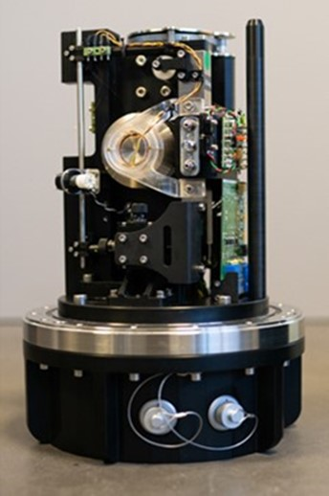
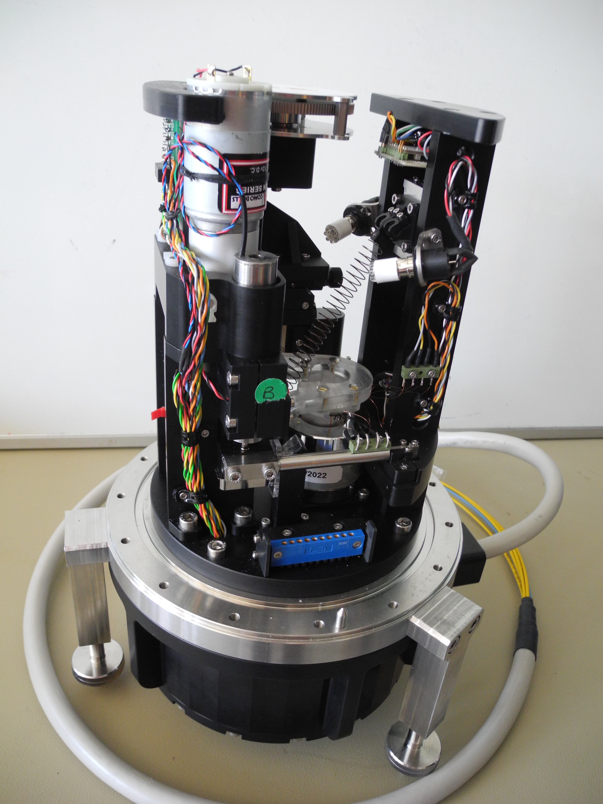
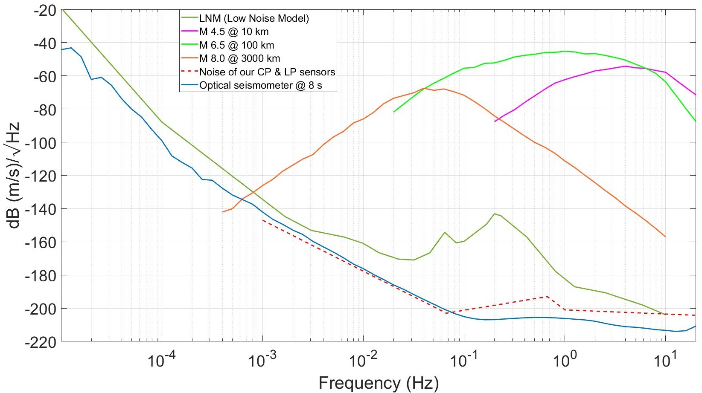
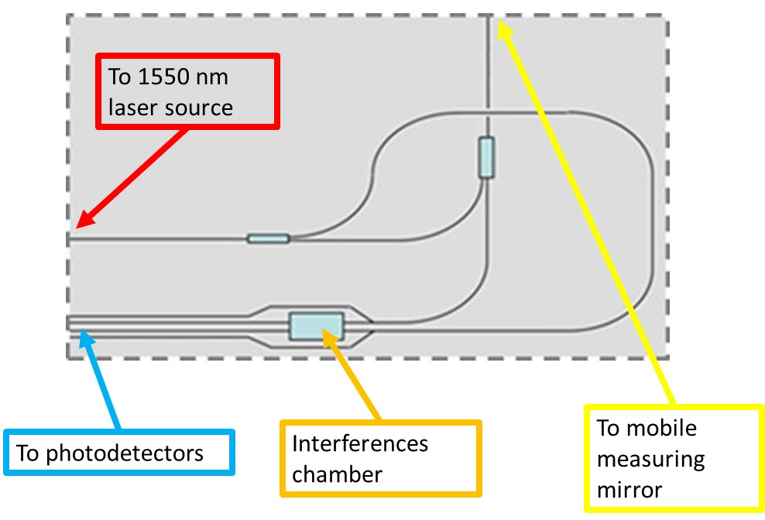
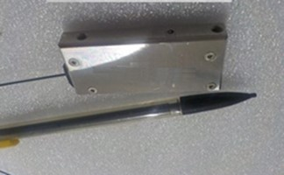
VEBOS : Design and validation of a wide band optical seismometer
Fabrice LEPOINT* / Daniel FOUQUET / Olivier ROUSSEAU
Commissariat à l’énergie atomique et aux énergies alternatives (CEA)
P3.1-333
Horizontal sensor
Vertical sensor
Some of its characteristics:
Self-noise below the seismic low noise model (LNM)
Sensitive parts in vacuum: less sensitive to thermal effects
No feed-back loop: no noise introduced by the loop
…
Can be seen at SeismoWave stand
Transducer of the sensors:
An integrated interferometer
SnT2023, P3.1-313

