Slide 1

VEBOS : Design and validation of a wide band optical seismometer
Fabrice LEPOINT* / Daniel FOUQUET / Olivier ROUSSEAU
Commissariat à l’énergie atomique et aux énergies alternatives (CEA)
Our recent research in an integrated optical interferometer^{[1]} has led to the development of a very low noise optical seismometer (VEBOS) based on such transducer.
This seismometer benefits from more than 50 years of experience in geophysic sensors design at CEA.
It has been evaluated through the measurement of its self-noise and the measurement of some instrumental and mechanical performances such as its transfer function.
Our optical seismometer has an intrinsic noise which is at least 10 dB below the seismic low noise model (LNM)^{[2]} from 10⁻⁵ Hz up to minimum 10 Hz.
The observed performances of the optical seismometer confirm that the technical choices are relevant and pass for future developments.
Please do not use this space, a QR code will be automatically overlayed
P3.1-333

Slide 2
INTRODUCTION
Our recent research in an integrated optical interferometer^{[1]} has led to the development of a very low noise optical seismometer (VEBOS) based on such transducer. The performances of the transducer combined with the appropriate technical choices for its integration lead to a seismometer which is able to measure subnanometrics earth displacements over a very wide bandwidth. Our optical seimometer has an intrinsic noise which is at least 10 dB below the seismic low noise model (LNM)^{[2]} from 10⁻⁵ Hz up to minimum 10 Hz. More generaly, this seismometer benefits from more than 50 years of experience in geophysic sensors design at CEA.
Please do not use this space, a QR code will be automatically overlayed
P3.1-333

Slide 3
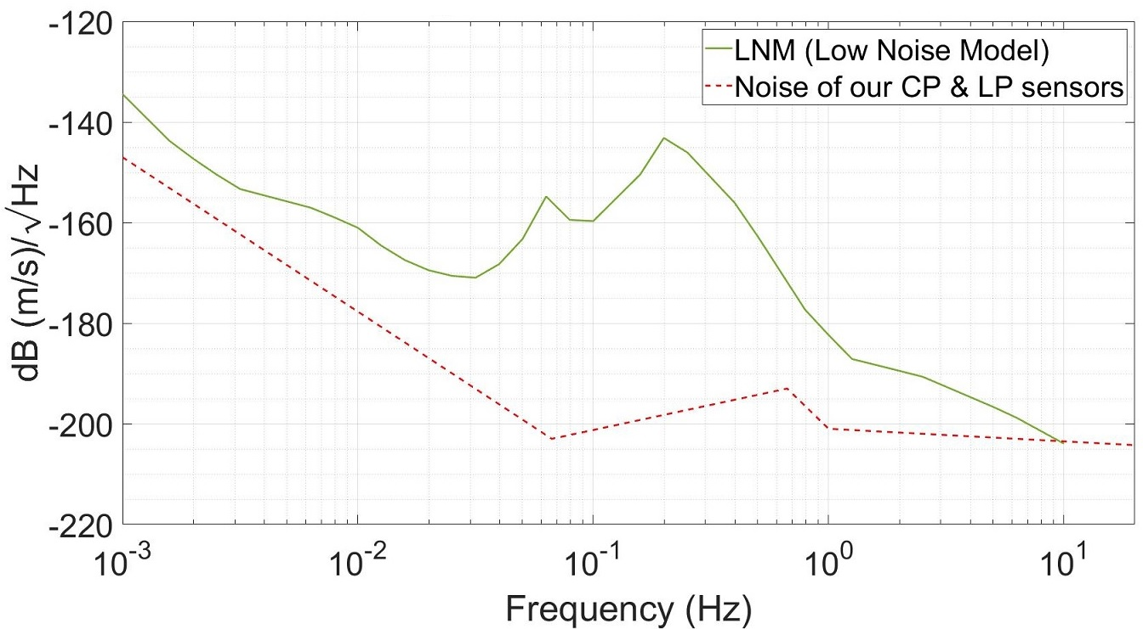
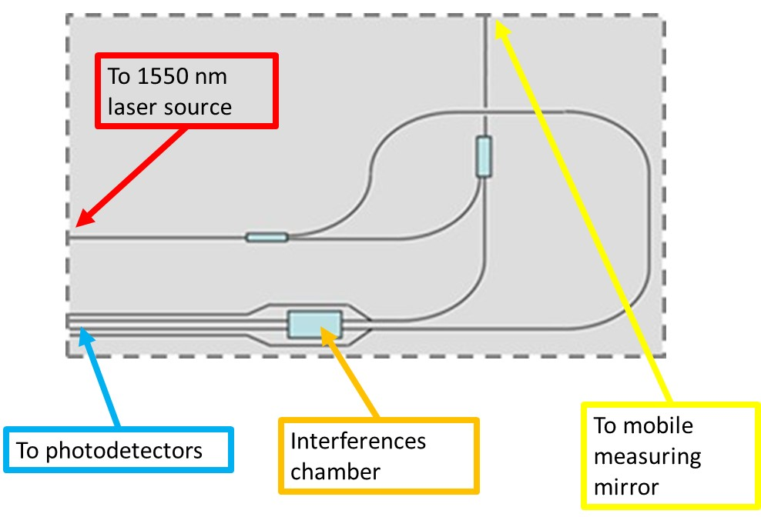
OBJECTIVES
Measurement of the 3 components
Very large band seismic sensor
Integration of our optical transducer (interferometer)^{[1][3]} for subnanometric resolution
Self-noise equal or less than our CP (Short Period) and LP (Long Period) sensors
Self-noise target
Schematic of the interferometer
Please do not use this space, a QR code will be automatically overlayed
P3.1-333

Slide 4
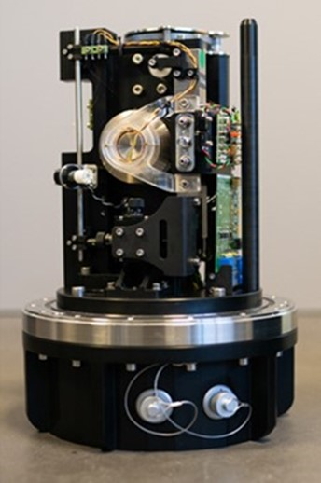
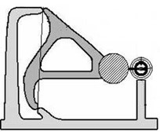
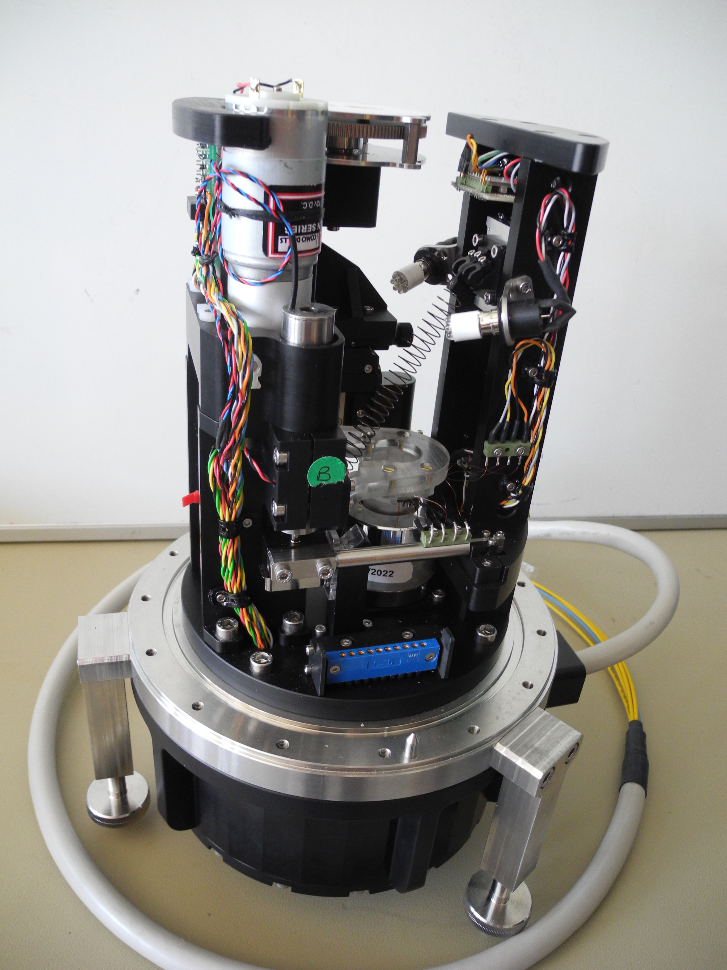
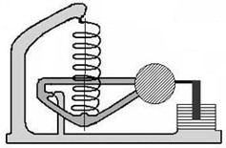
TECHNOLOGICAL CHOICES
Horizontal sensor
2 sensors: Horizontal sensor + vertical sensor
No feed-back loop:
  No noise introduced by the feed-back loop
  Self-noise of the sensor can easily be measured by locking the seismic mass
Mechanical cut off period can be easily set by tilting the sensor
Optical transducer^{[1]}:
  Michelson / Mac Zehnder interferometer
  Improved self-noise & bandwidth in comparison to traditional transducers
Mechanical and sensitive parts in vacuum:
  Less sensitive to temperature variations
Validation of the optical transducer by comparison to LVDT and magnet-coil transducers
Vertical sensor
Please do not use this space, a QR code will be automatically overlayed
P3.1-333

Slide 5
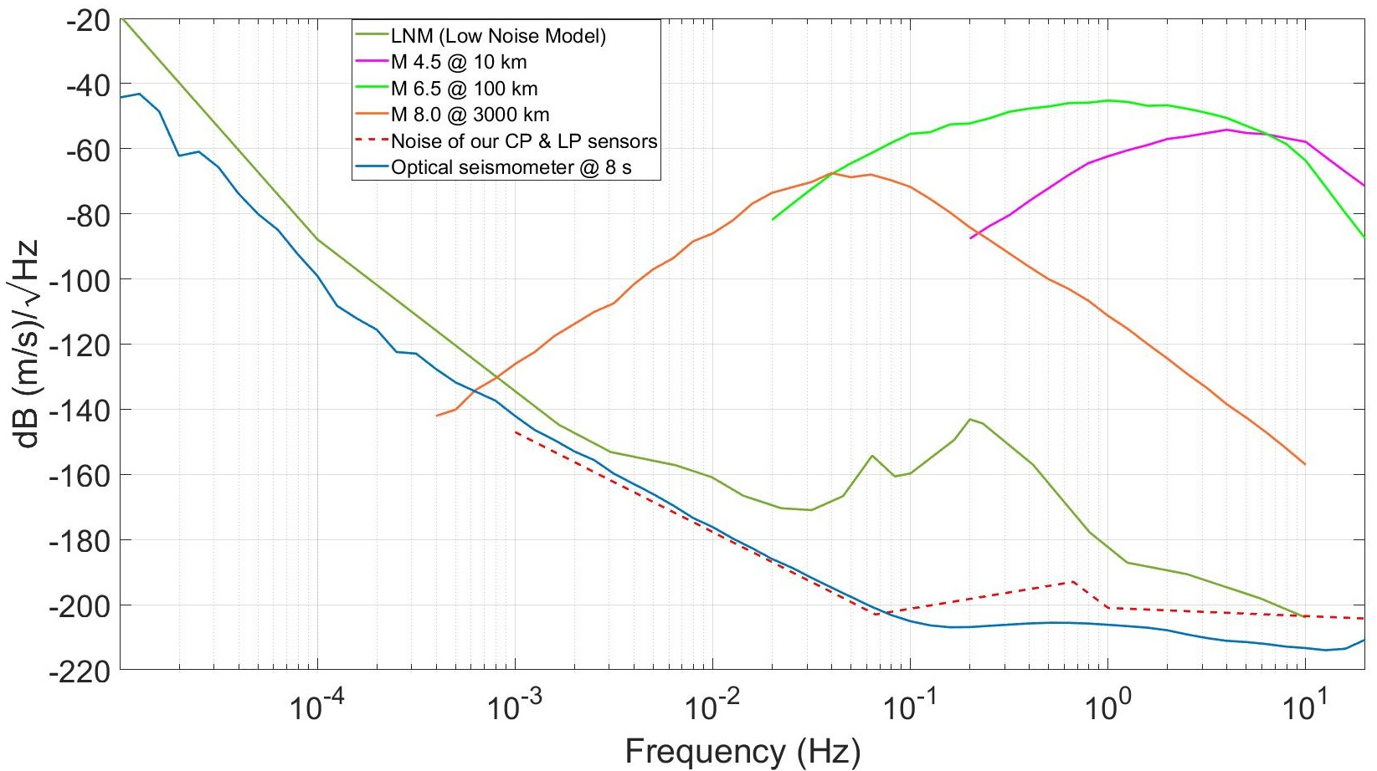
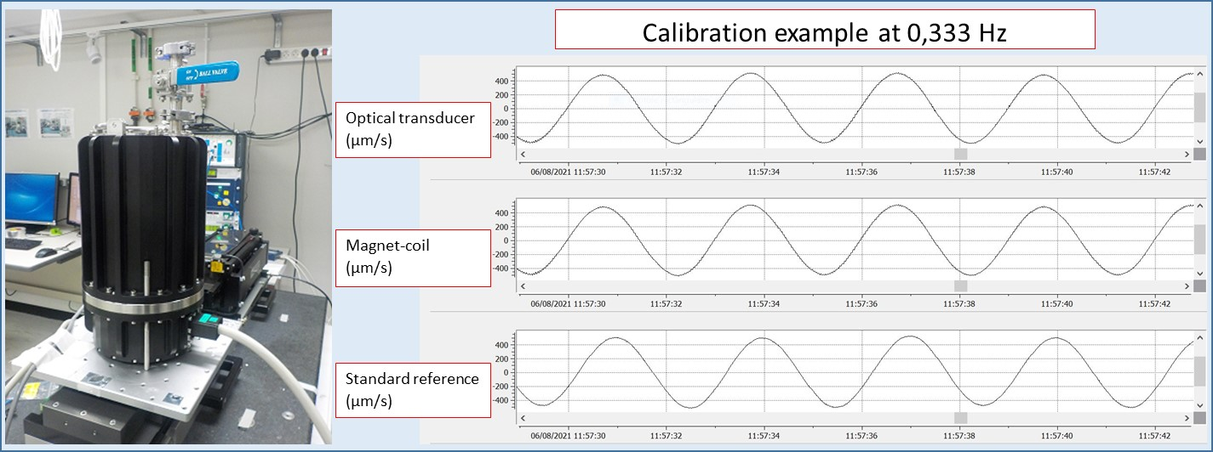
RESULTS
Mechanical validation:
  Mechanical cut-off period can be easily set up to 8 s (maximum 14 s before instability)
  Sensor does not float, lock / unlock of the seismic mass & sealing for vacuum are OK, …
Metrology:
  Sensitivity and transfer function (amplitude and phase) conform to expectations
Self-noise below the seismic LNM^{[2]} thanks to the optical transducer:
Please do not use this space, a QR code will be automatically overlayed
P3.1-333

Slide 6
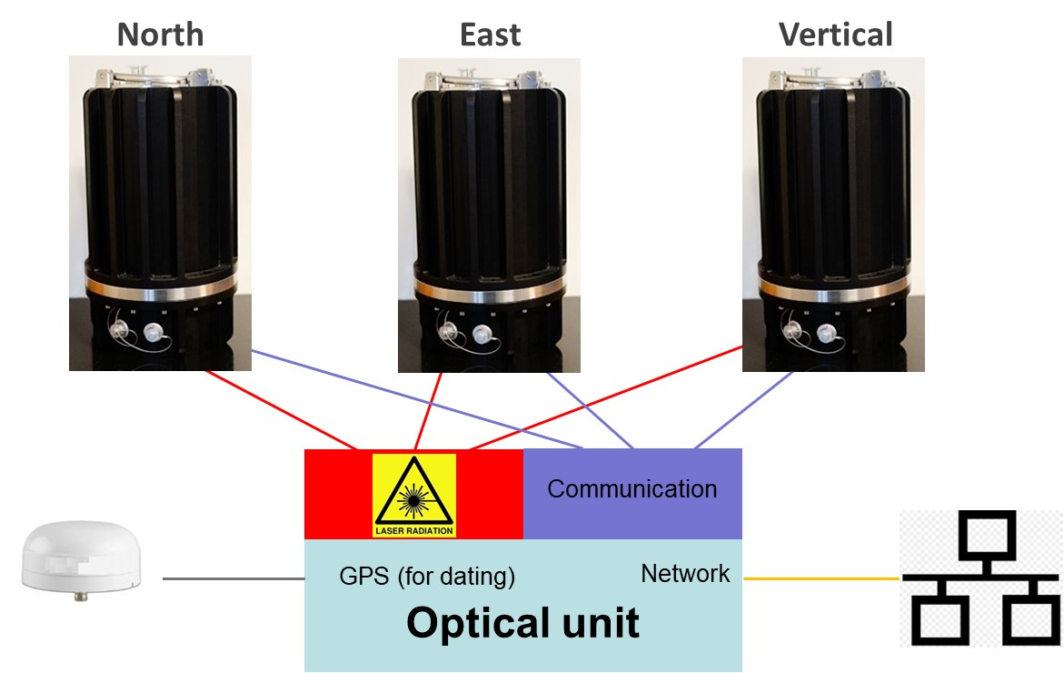
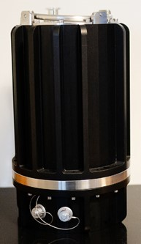

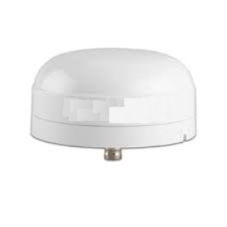

INSIGHT
Algorithm for optical treatment optimization
Optical unit optimization
Sensors optimization
Photodiodes in the sensors
…
Please do not use this space, a QR code will be automatically overlayed
P3.1-333
North
East
Vertical
Communication
GPS (for dating)
Network
Optical unit

Slide 7
REFERENCES
[1] O. ROUSSEAU, « Integration of an Optical Based Sensor in a Mechanical Seismometer », SnT 2023 P3.1-313
[2] J. PETERSON, « Observations and modeling of seismic background noise », Open-File report 93-322, 1993
[3] W. Merzouk « Highly compact and easy to use optical chip interferometer with picometric performance» Review of Scientific Instrument 87, 103103, 2018
Please do not use this space, a QR code will be automatically overlayed
P3.1-333

