Slide 1
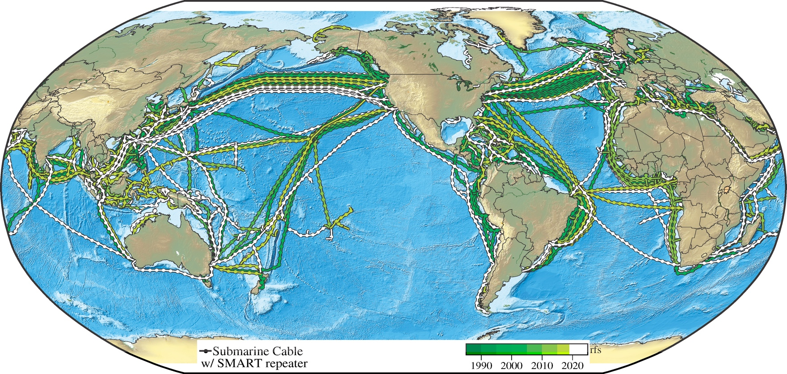
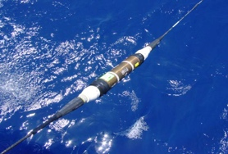
Progress of Science Monitoring And Reliable Telecommunications (SMART)
Subsea Cables for Observing the Oceans and Earth
Bruce M. Howe
Joint Task Force SMART Subsea Cables, University of Hawaiʻi at Mānoa
P3.1-797
Global Array: Climate, Oceans, Sea Level, Earthquakes, Tsunamis
Create a Planetary sensor, power, Internet network
Share
submarine cable infrastructure
Telecom + science
$
1st order addition to Ocean-Earth observing system
NO Interference
€
➜
1.2+ GM
~20,000 repeaters
20 year refresh
repeaters ~70 km
Know the environment – protect the network
e-poster: session T3.1 20 June, SnT2023 Conference platform
Bottom temperature, pressure, seismic acceleration
SMART CAM: 3700 km, install 2025, Gov’t €154M
Continent/Portugal-Azores-Madeira ring

