Slide 1
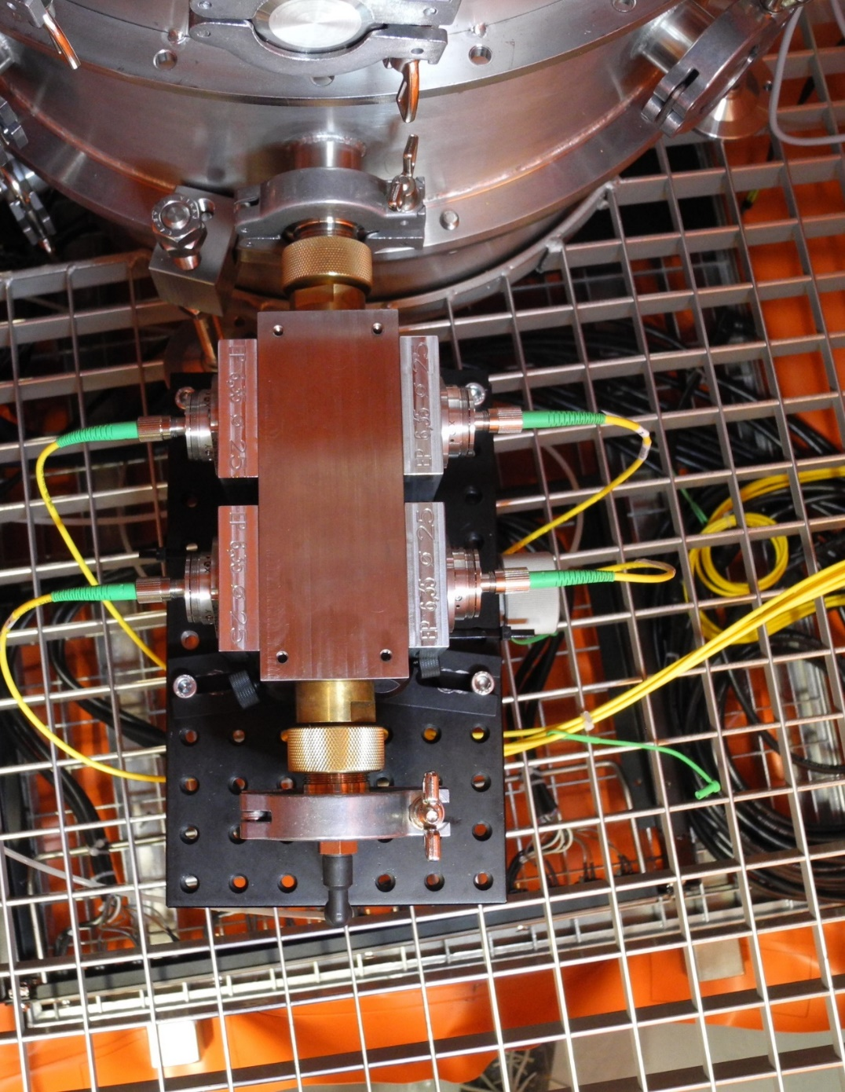
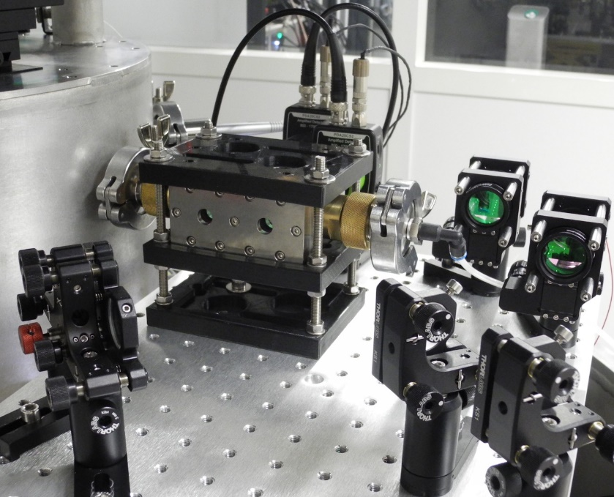
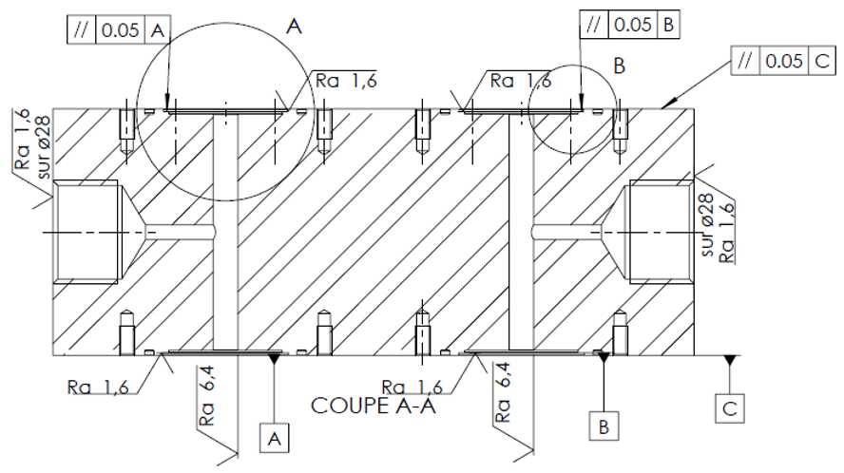
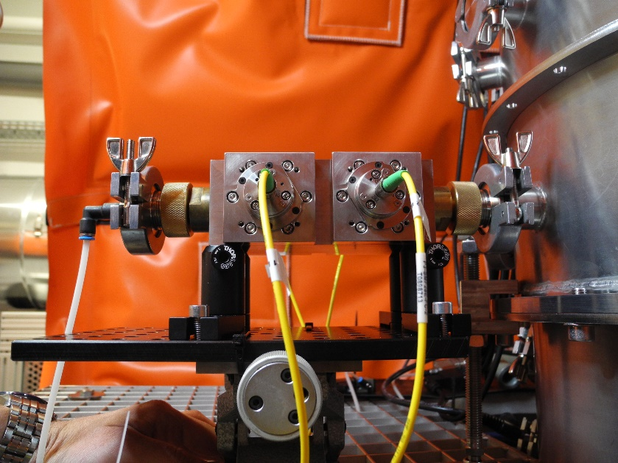


Dual Fabry-Perot refractometer for infrasound pressure measurements
Paul VINCENT, Romain KARCHER, Guillaume BOISSEAU
CEA, DAM, DIF, F-91297 Arpajon Cedex, France
P3.1-724
Conception and development of an infrasound standard
EPICL Etalon de Pression Infrasonore en Cavité Laser
5 cm
Infrasound Pressure Standard in Laser Cavity
10 cm
5 cm
  Innovative infrasound standard
  Measurement method:
      Dual Fabry-Perot laser cavities measuring the refraction index variations induced by infrasound
      Link between index and pressure with Edlèn formula
      Traceable to SI

