Slide 1
Preliminary Design of Relative Humidity Virtual Sensor in Northern Middle Java Province of Indonesia
Haryas SW, Naufal A, Ibnu SL, Agus Sail, Shodiq Winarko, Fania YK, Robiatul A, Evi Nilasari, Roni DS
Bandung Institute of Technology, Indonesia Agency for Meteorological Climatological and Geophysical (BMKG)
P3.1-557
Estimating RH sensor is an alternative troubleshooter in overcoming data unavailability. Estimation of air humidity is designed using AWS temperature and RH sensors data by generating virtual sensor values. Estimation method is identical to prediction model based on the historical data of a parameter.
Preliminary study is simulated on three AWS in northern Middle Java Province of Indonesia:
AWS Kajen
AWS Kandeman
AWS Pemalang
Period (January - March 2021)
Virtual sensor is arranged based on data fusions from physical sensors using MLP and LSTM algorithm. Three previous delayed temperature and relative humidity sensor data is utilized as inputs. Data are then segmented into 70% training and 30% testing data.

Slide 2
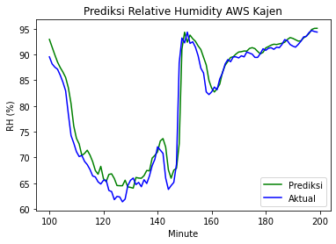
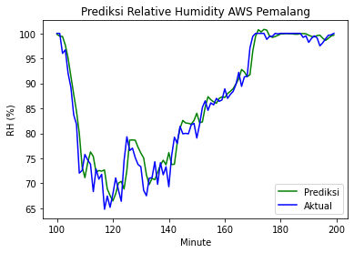
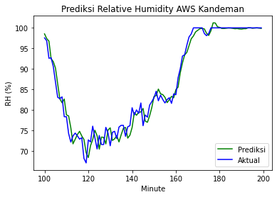
Preliminary Design of Relative Humidity Virtual Sensor in Northern Middle Java Province of Indonesia
Haryas SW, Naufal A, Ibnu SL, Agus Sail, Shodiq Winarko, Fania YK, Robiatul A, Evi Nilasari, Roni DS
Bandung Institute of Technology, Indonesia Agency for Meteorological Climatological and Geophysical (BMKG)
P3.1-557
Virtual relative humidity sensor for AWS Kajen is accurately composed by combination of delayed AWS Kandeman and Kajen data using MLP with 1.38 %RH of RMSE.
Virtual relative humidity sensor for AWS Pemalang is accurately composed by combination of delayed AWS Kandeman and Pemalang data using MLP with 2.04 %RH of RMSE.
Virtual relative humidity sensor for AWS Kandeman is accurately composed by combination of delayed all of those AWS data using MLP with 2.04 %RH of RMSE.

