Slide 1

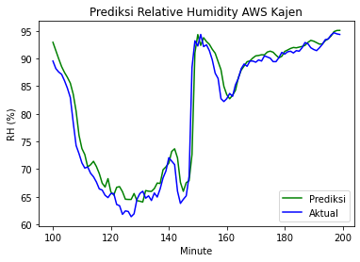
Preliminary Design of Relative Humidity Virtual Sensor in Northern Middle Java Province of Indonesia
Haryas SW, Naufal A, Ibnu Sofwan L, Agus Sail, Shodiq Winarko, Fania Yolanda K, Robiatul A, Evi Nilasari, Roni DS
Bandung Institute of Technology, Indonesia Agency for Meteorological Climatological and Geophysical (BMKG)
Automatic Weather Station and Relative Humidity Sensors
Competitive Sensing Based on MLP and LSTM
Algorithm
Estimating RH sensor is an alternative troubleshooter in overcoming data unavailability. Estimation of air humidity is designed using AWS temperature and RH sensors data by generating virtual sensor values.
Please do not use this space, a QR code will be automatically overlayed
P3.1-557

Slide 2
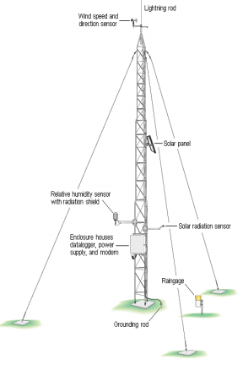
INTRODUCTION
Automatic Weather Station (AWS) is consists of seven electrical sensors, one of which is relative humidity (RH) sensor. It is a capacitive membrane with an analog voltage output.
In 2020, RH sensors have a 7% level of unavailability due to power supply leakage, sensor damage and communication network troubles. The existence of data gaps reduce the accuracy of weather forecast analysis.
Estimating RH sensor is an alternative troubleshooter in overcoming data unavailability. Estimation of air humidity is designed using AWS temperature and RH sensors data by generating virtual sensor values. Estimation method is identical to prediction model based on the historical data of a parameter.
Please do not use this space, a QR code will be automatically overlayed
P3.1-557

Slide 3
OBJECTIVES
This study proposes design of relative humidity virtual sensor according to competitive sensing concept. This study aims to design an estimation model for AWS relative humidity sensor data using predictions based on Multi Layer Perceptron (MLP) and Long-Short Term Memory (LSTM).
Furthermore, the prediction results of the two methods are compared to the actual relative humidity data to assess the performance of each method.
Please do not use this space, a QR code will be automatically overlayed
P3.1-557

Slide 4
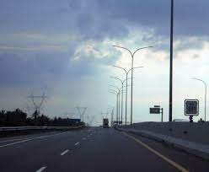
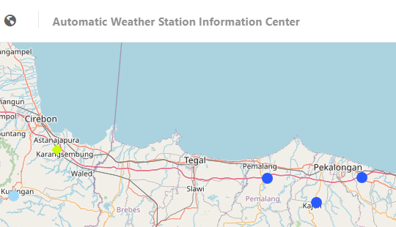
METHODS
Preliminary study is simulated on three AWS in northern Middle Java Province of Indonesia, namely AWS Kandeman, Pemalang and Kajen from January to March 2021. These AWS are installed adjacently around northern highway of Java in triangular constellation.
Virtual sensor is arranged based on data fusions from physical sensors using MLP and LSTM algorithm. Three previous delayed temperature and relative humidity sensor data is utilized as inputs. Data are then segmented into 70% training and 30% testing data.
Please do not use this space, a QR code will be automatically overlayed
P3.1-557

Slide 5
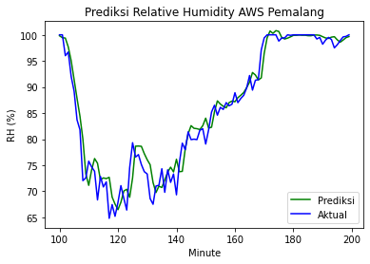
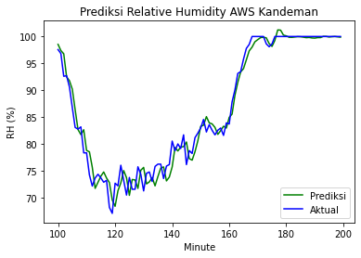
RESULTS
Please do not use this space, a QR code will be automatically overlayed
P3.1-557

Slide 6
CONCLUSION
Virtual relative humidity sensor for AWS Kajen is accurately composed by combination of delayed AWS Kandeman and Kajen data using MLP with 1.38 %RH of RMSE.
Virtual relative humidity sensor for AWS Pemalang is accurately composed by combination of delayed AWS Kandeman and Pemalang data using MLP with 2.04 %RH of RMSE.
Virtual relative humidity sensor for AWS Kandeman is accurately composed by combination of delayed all of those AWS data using MLP with 2.04 %RH of RMSE.
Please do not use this space, a QR code will be automatically overlayed
P3.1-557

