Slide 1
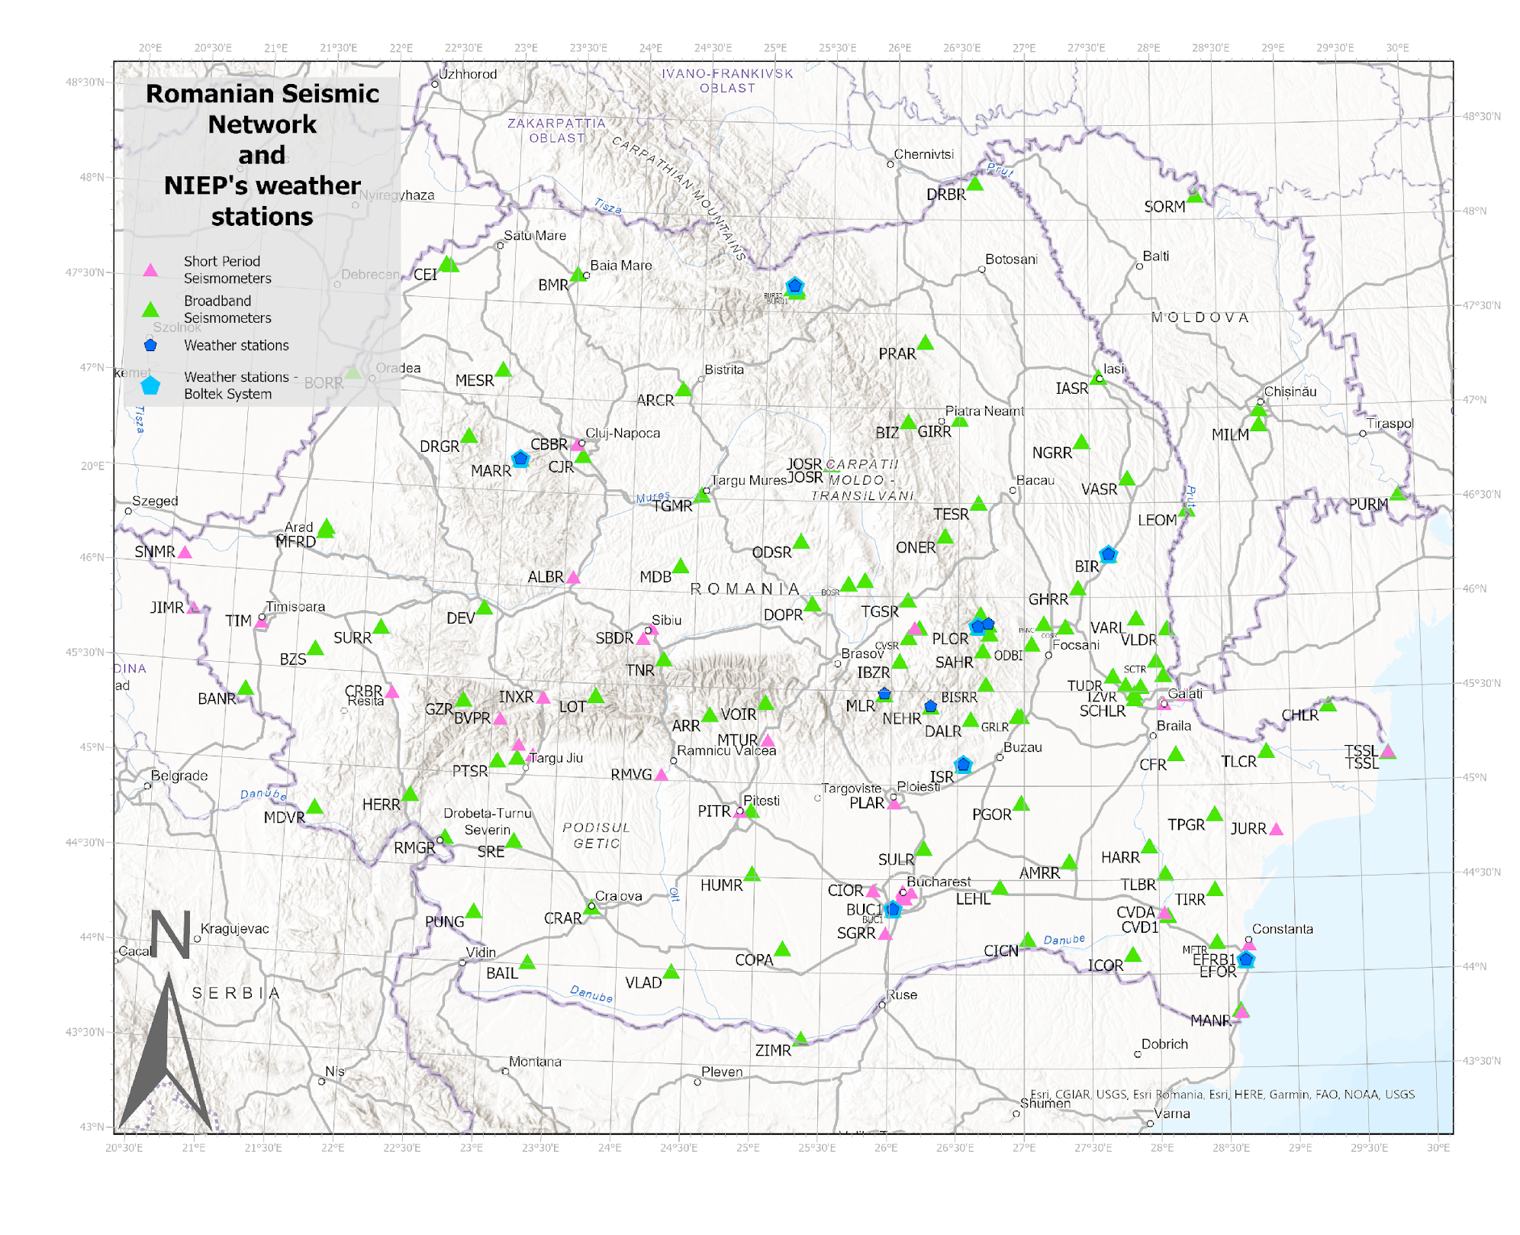
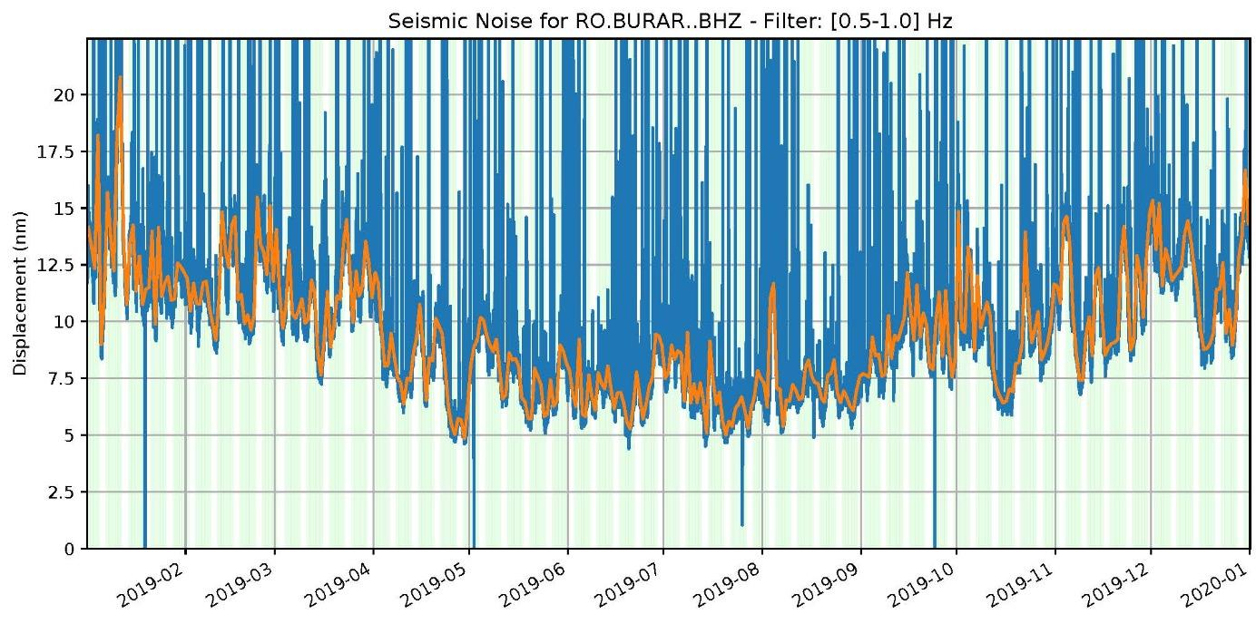
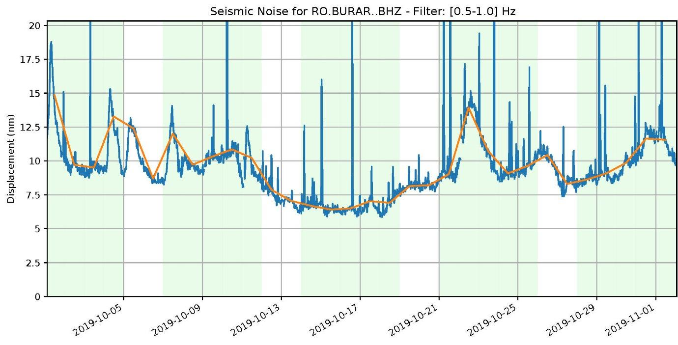
On the Influence of Atmospheric Conditions on Ambient Seismic Noise
A. TOLEA^{1,2}, B. GRECU¹, V. TOADER¹, I. MOLDOVAN¹, C. NEAGOE¹ ¹National Institute for Earth Physics, Magurele, Romania ²Faculty of Physics, University of Bucharest, Bucharest, Romania
P3.1-558
Ambient seismic noise (ASN) is primarily influenced by a variety of factors such as human activities, ocean waves, wind, and natural phenomena like storms and weather patterns. These sources tend to dominate the background vibrations and contaminate seismic data recorded by seismometers.
Studies based on ambient seismic noise (ASN) are performed regularly.
It has been shown that also atmospheric conditions contribute to these contaminated recordings.
The vertical components of the Romanian seismic stations were analyzed to characterize the noise levels at the stations and investigate noise variations in space and time for a particular period.
In this study, we examined the relationship between noise levels and weather parameters for the stations where seismic sensors are collocated with weather sensors.
If you want to learn more about this, come see my e-poster
during session P3.1-558 on 20 June 2023 or access it online on the SnT2023 Conference platform!

