Slide 1
On the Influence of Atmospheric Conditions on Ambient Seismic Noise A. TOLEA^{1,2}, B. GRECU¹, V. TOADER¹, I. MOLDOVAN¹, C. NEAGOE¹ ¹National Institute for Earth Physics, Magurele, Romania ²Faculty of Physics, University of Bucharest, Bucharest, Romania email: tolea.andreea@infp.ro
Ambient seismic noise (ASN) is defined as small vibrations recorded throughout the Earth’s surface. In this study, we examined the relationship between ASN levels and weather parameters for the stations where seismic sensors are collocated with weather sensors.
The seismic data is provided by the Romanian Seismic Network (RSN) and atmospheric data by the weather stations operated by National Institute for Earth Physics. The data processing was performed using the SeismoRMS and ObsPy package.
Good correlation between the increase in the noise level and the increase in the wind speed.
Fluctuations in the atmospheric environment can induce vibrations in microseismic noise spectra.
Noise investigations at seismic stations should be performed regularly to understand the quality of seismological data better. The results from this study are important to understand how weather conditions contribute to the ASN behavior at the RSN seismic stations.
Please do not use this space, a QR code will be automatically overlayed
P3.1-558

Slide 2
Introduction and Objectives
ASN sources
anthropogenic sources (<1 s) plants, factories, traffic
diurnal variation
natural sources (>1 s) wind, oceanic and coastal waves seasonal variation
The amplitude of ASN varies depending on those sources, the distance between sources and stations, and the site's geological structure.
The main objective of this study is to assess the potential correlations between weather condition such as temperature, wind, or atmospheric pressure and ASN;
Please do not use this space, a QR code will be automatically overlayed
P3.1-558

Slide 3
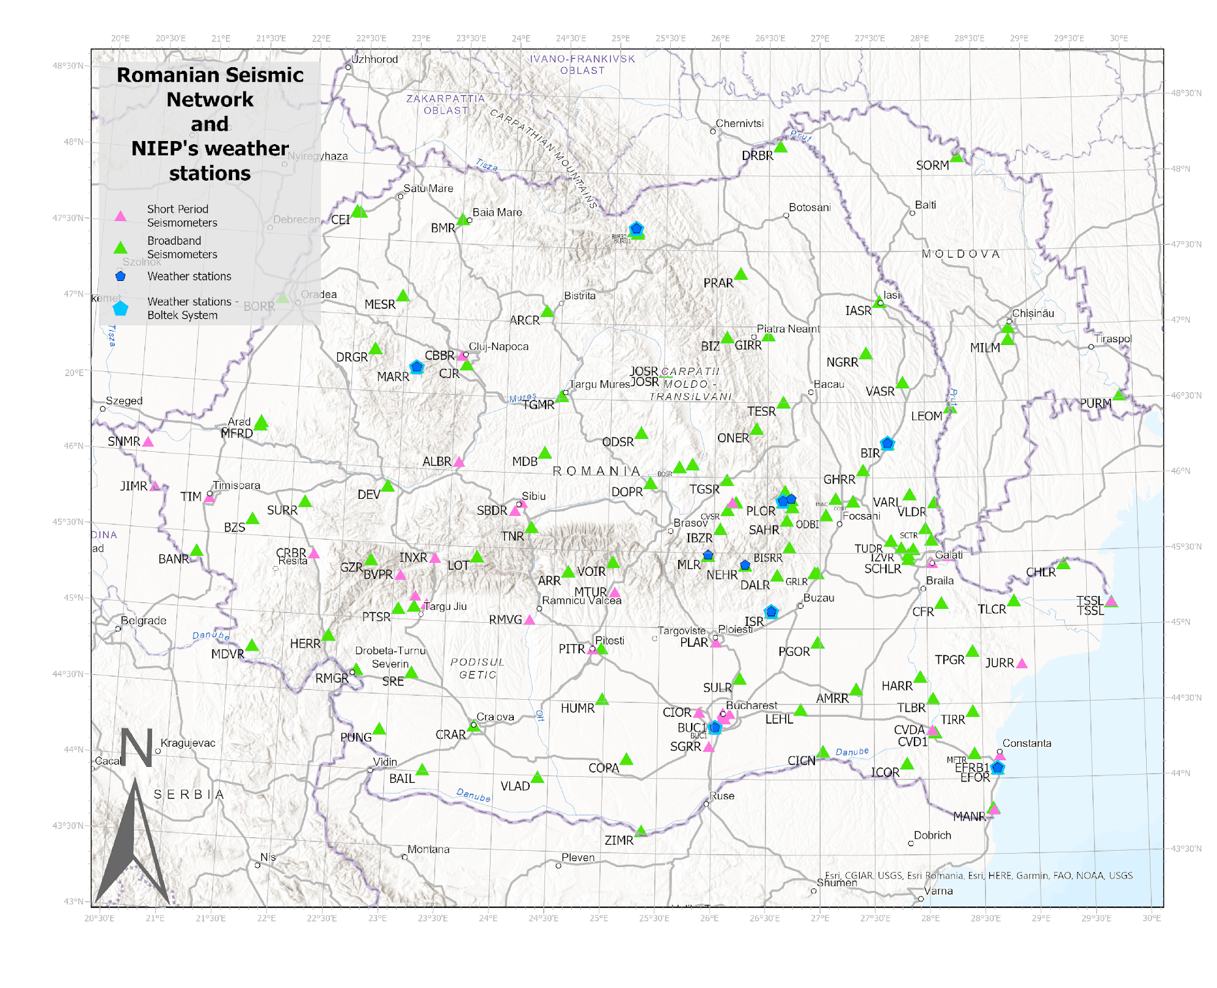
Methods and data
Seismic data was provided by the NIEP’s RSN;
Atmospheric data by the NIEP’s weather stations (http://geobs.infp.ro/);
Data processing was performed using the SeismoRMS and ObsPy package Lecocq et al. (2020a,b);
Please do not use this space, a QR code will be automatically overlayed
Figure 2. Map showing Romanian Seismic Network (RSN) and weather stations belonging National Institute for Earth Physics (NIEP)
P3.1-558

Slide 4
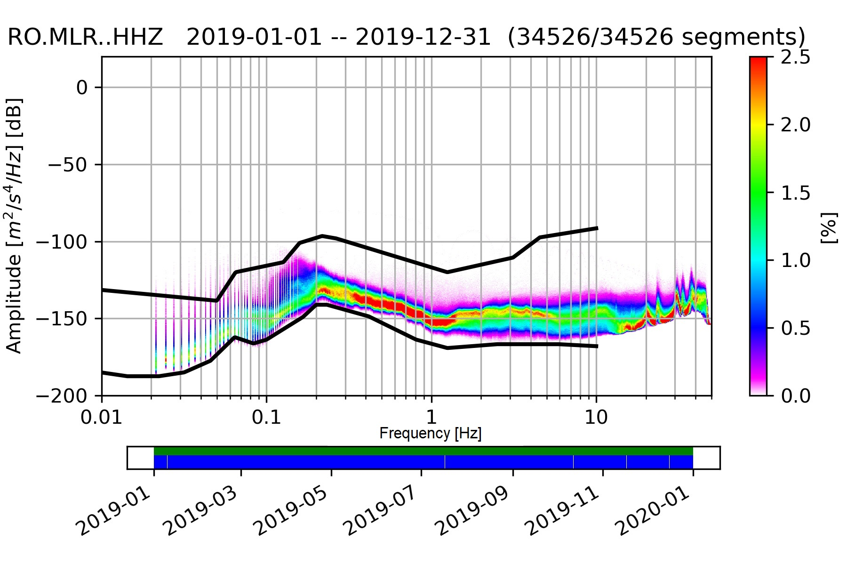
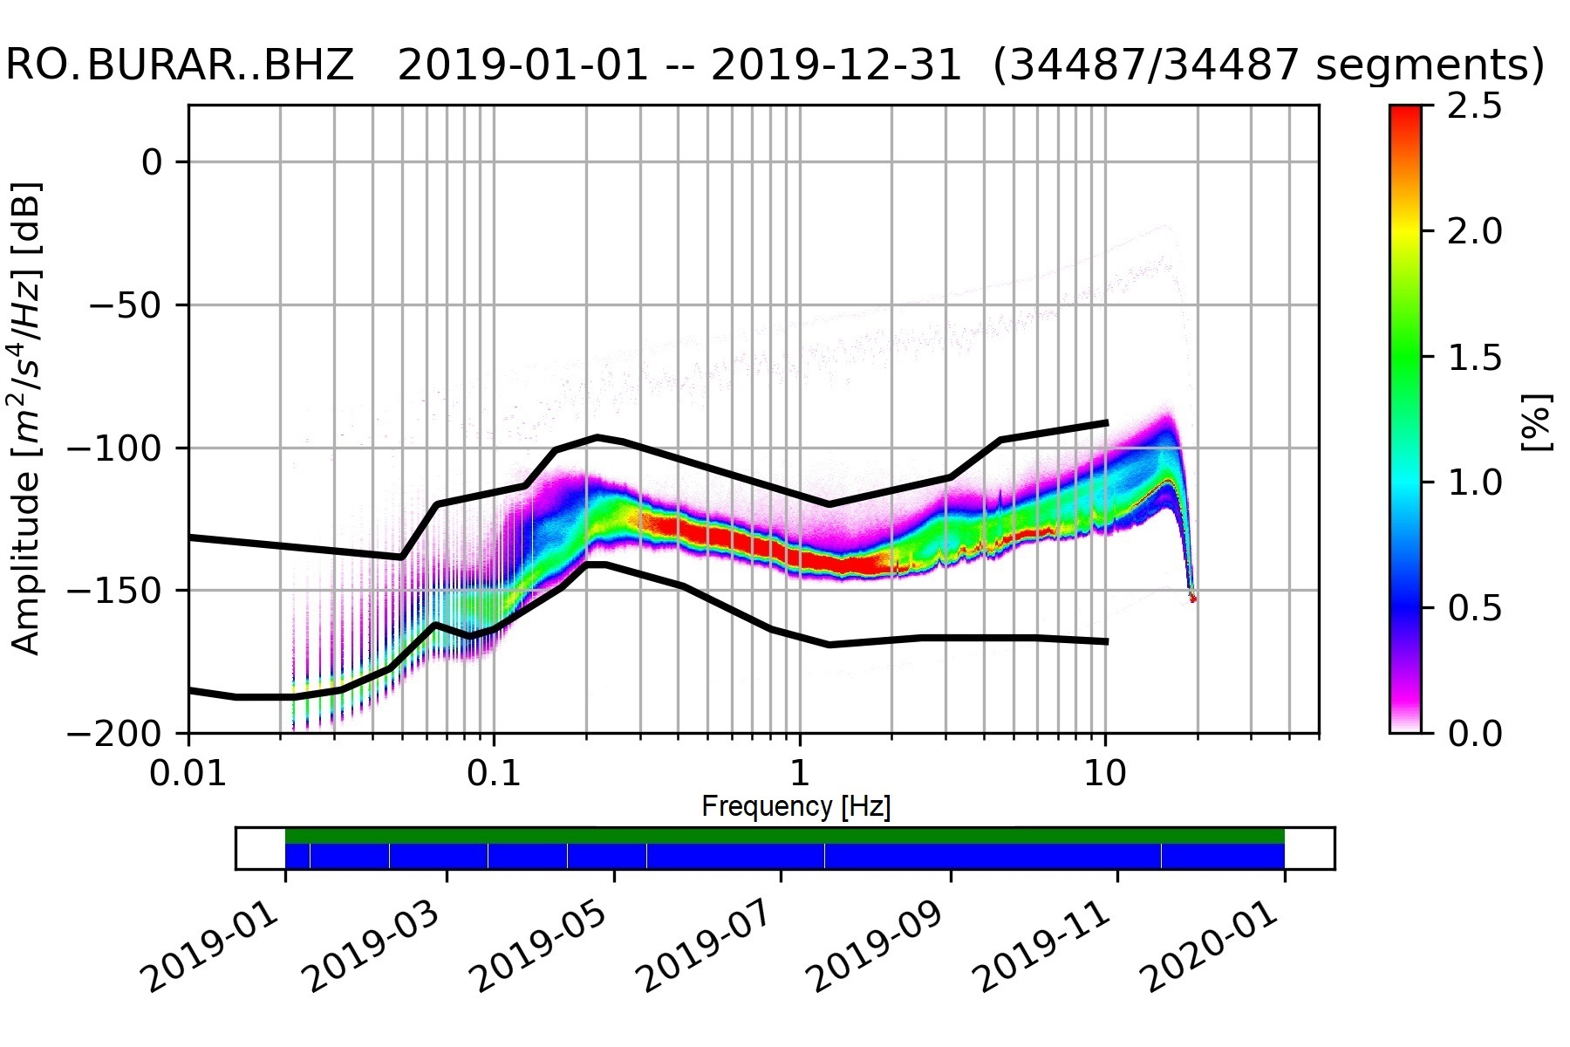
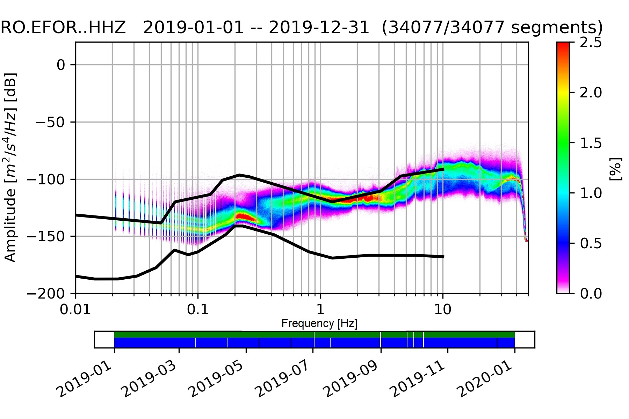
Results
Assessing the ASN levels in addition to New Low and High Noise Models (NLNM and NHNM) two globally standard models, Peterson's (1993) used as references;
ASN levels at the stations were estimated by computing the Probability Density Functions (PDFs) following the methodology described by McNamara and Buland (2004)
Figure 1. Examples of PDFs computed for Muntele Rosu (MLR), Bucovina (BURAR) and Eforie (EFOR) seismic stations for the 2019 year.
MLR and BURAR noise levels lie between NLNM and NHNM which confirms stations position far away from urban disturbance.
EFOR suggests the presence of urban activity close to the site.
Please do
not use this space, a QR code will be automatically overlayed
P3.1-558

Slide 5
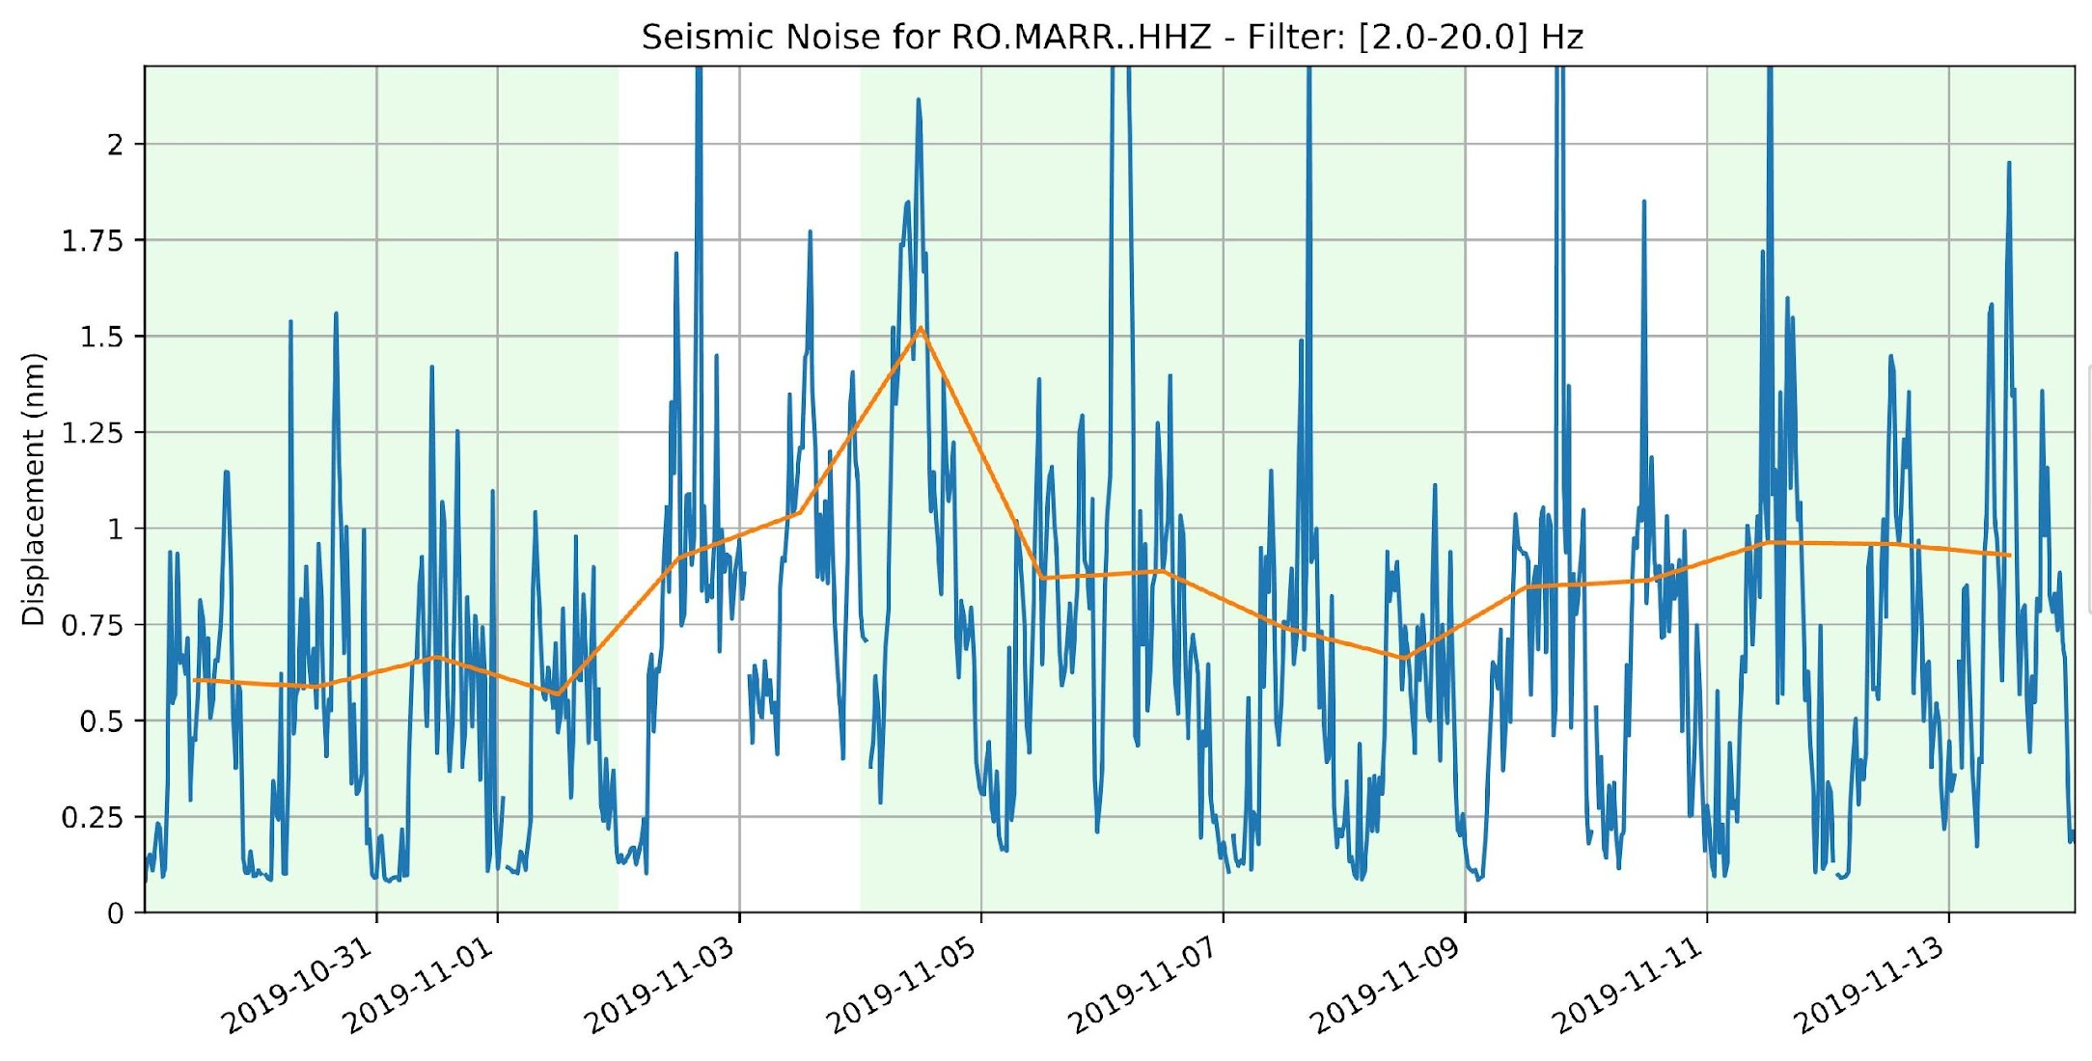
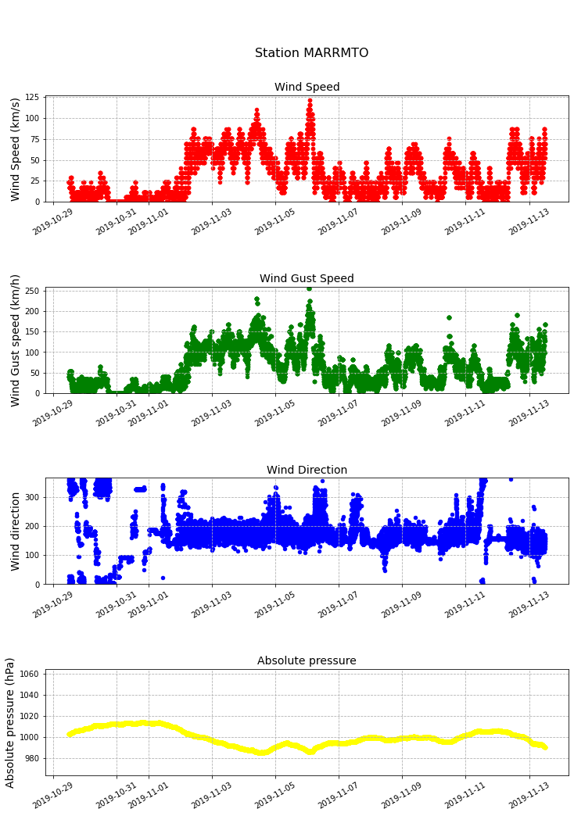
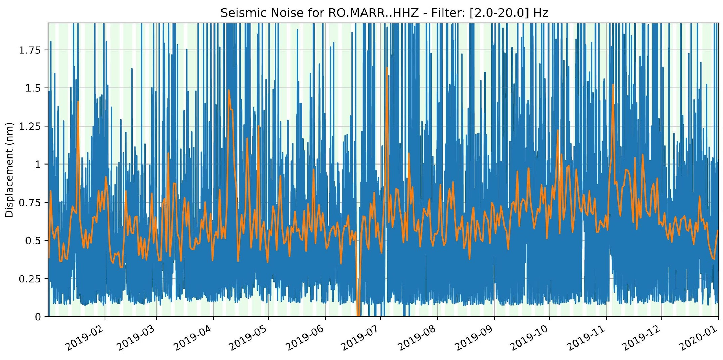
Results
Good correlation between the increase in the noise level and the increase in the wind speed.
Atmospheric pressure measurements indicate the increase of the wind speed for the same days.
Atmospheric pressure changes can affect the density and viscosity of the air, which may alter the Earth’s vibrations.
Please do not use this space, a QR code will be automatically overlayed
Figure 3. Long-term evolution of seismic noise in the frequency band 2-20 Hz observed Marisel (MARR) station.
P3.1-558

Slide 6
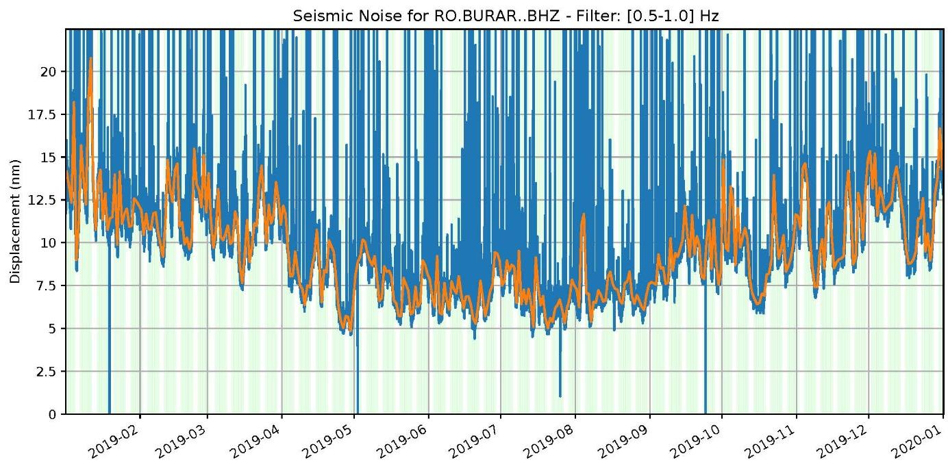
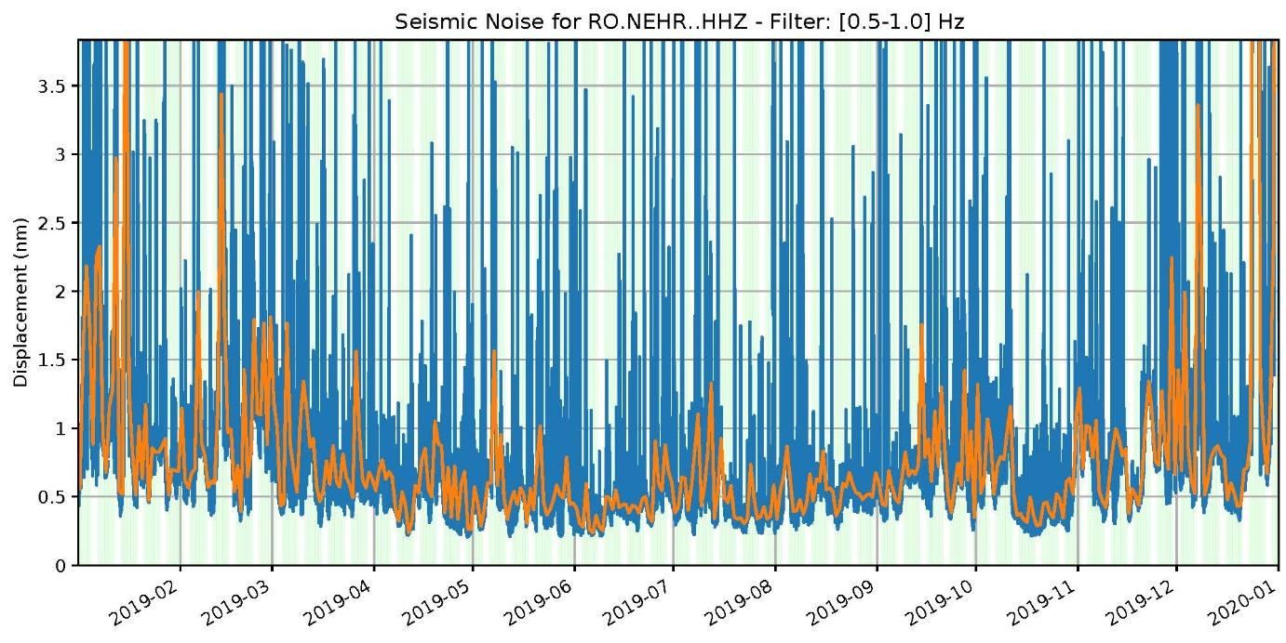
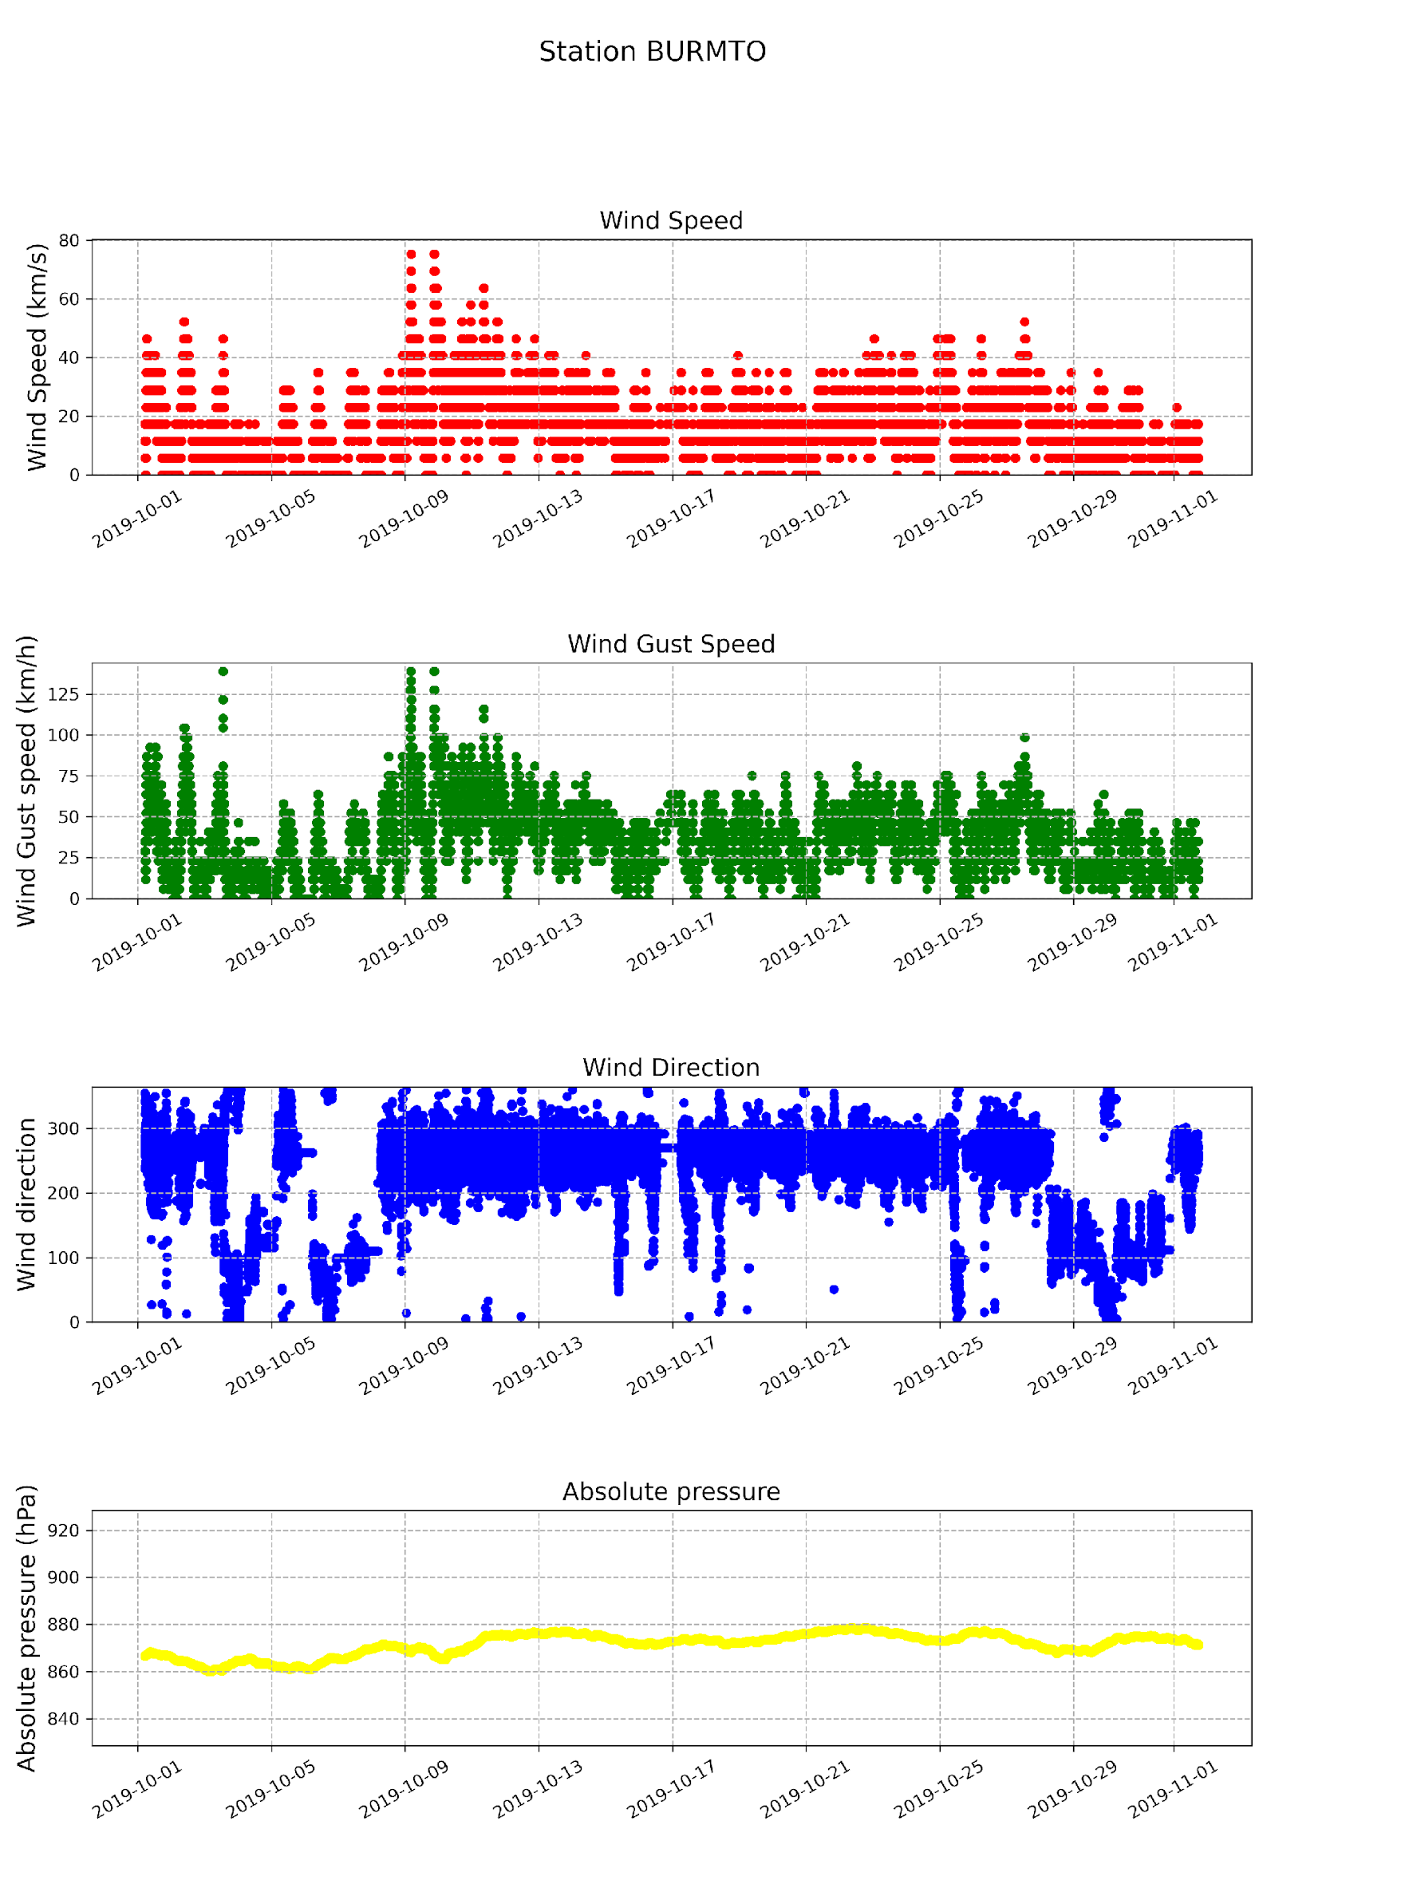
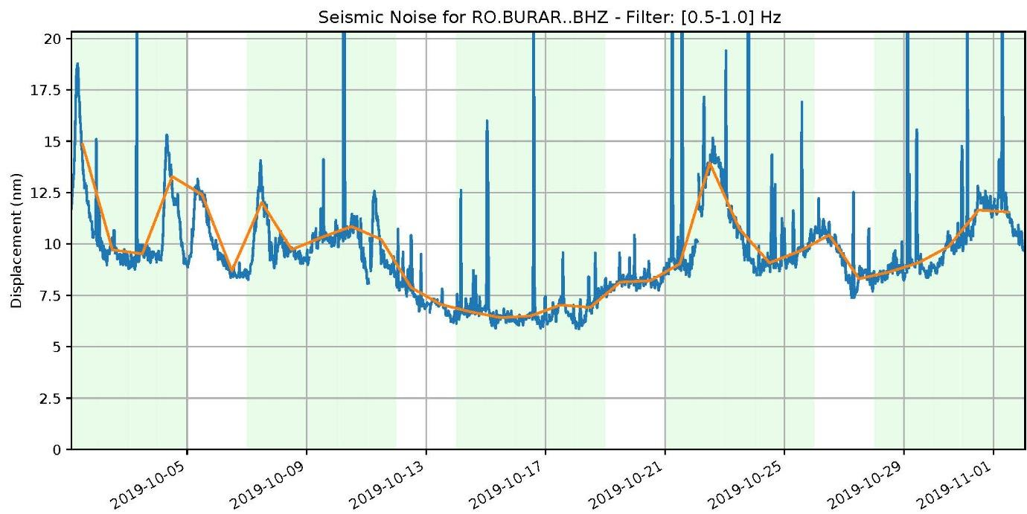
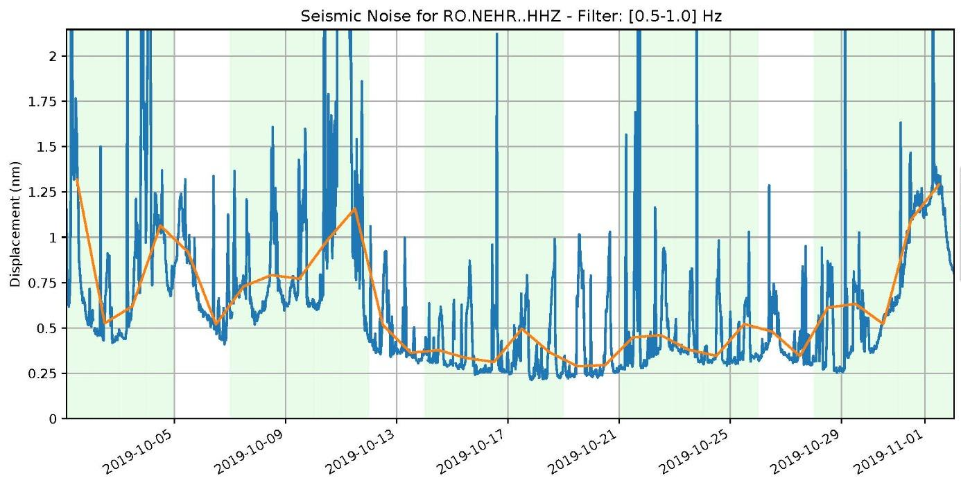
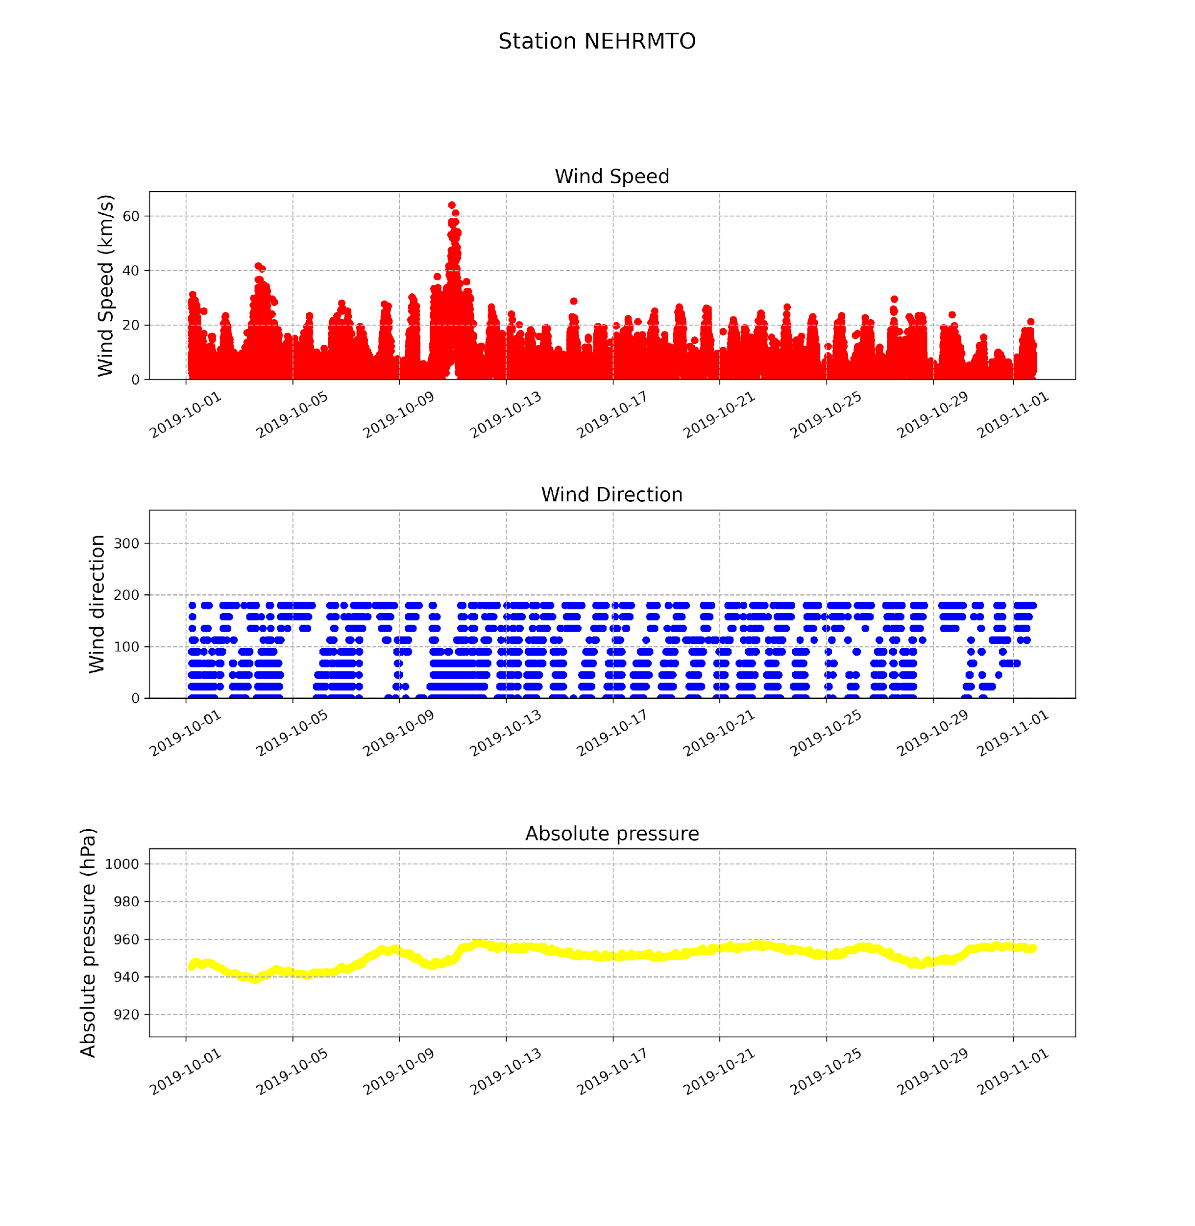
Results
The highlighted area is the investigated phenomenon characterized by a significant decrease in noise levels in October 2019 present at all broadband seismic stations in Romania.
In the 0.5-1 Hz frequency band, the microseisms of the noise spectra are still important;
The primary source noise in this frequency band is the interaction between oceanic waves and the seafloor. Nishida (2017);
Can be related to a stable atmospheric pressure which indicates calm weather conditions. According to report from the National Meteorological Administration reveals that the analyzed period, October 2019, was the 4th warmest October in the period 1961-2019;
Please do not use this space, a QR code will be automatically overlayed
Figure 4. Long-term evolution of seismic noise in the frequency band 0.5-1 Hz observed at stations Bucovina (BURAR) and Nehoiu (NEHR).
P3.1-558

Slide 7
Conclusion
The results from this study are important to understand how weather conditions contribute to the ASN behavior at the RSN seismic stations.
In this study, we examined the relationship between noise levels and weather parameters for the stations where seismic sensors are collocated with weather sensors. We show that an increase in wind speed leads to an increase in the noise level at high frequencies (> 2 Hz).
October 2019 was the 4th warmest October in the period 1961-2019, thus can explain the atmospheric stability for the second part of the month extended to the Romanian territory. When atmospheric pressure increases or decreases, it causes compression or decompression of the air. This compression or decompression affects the density of the air which may alter the Earth’s vibrations;
This is a preliminary study, further research and analysis may provide more insights into the contribution of atmospheric pressure to the ASN recordings.
References:
Peterson J., Observation And Modeling Of Seismic Background Noise, U.S. Geol. Surv. Tech. Rept., 93-322, pp 1–95, 1993.
McNamara D.E. and Buland R.P., Ambient Noise Levels in the Continental United States, Bull. Seis. Soc. Am, vol. 94, pp 1517-1527, 2004.
Lecocq, T., Hicks, S. P., Van Noten, K., Van Wijk, K., Koelemeijer, P., De Plaen, R. S., ... & Xiao, H. Global quieting of high-frequency seismic noise due to COVID-19 pandemic lockdown measures. Science, 369(6509), 1338-1343 2020a.
Lecocq, T., Massin, F., Satriano, C., Vanstone, M., and Megies, T.: SeismoRMS – A simple Python/Jupyter Notebook package for studying seismic noise changes Version 1.0, Zenodo, 2020b.
https://www.meteoromania.ro/despre-noi/raport-anual/raport-anual-2019/
Nishida, K. (2017). Ambient seismic wave field. Proceedings of the Japan Academy, Series B, 93(7), 423-448.
Acknowledgment:
This work was done in the framework of grant no. PN23360301 from “Cercetări avansate pentru modelarea fenomenelor naturale şi antropice din sistemul cuplat Pământ - Atmosferă în scopul reducerii riscurilor asociate – SOL4RISC” supported by the Ministry of Research, Innovation and Digitisation.
We thank the people involved in the development of the ObsPy package and the SeismoRMS code for sharing their work.
We would like to express our gratitude to CTBTO for their generous funding support that made our participation at the SnT2023 conference possible.
Please do not use this space, a QR code will be automatically overlayed
P3.1-558

