Slide 1
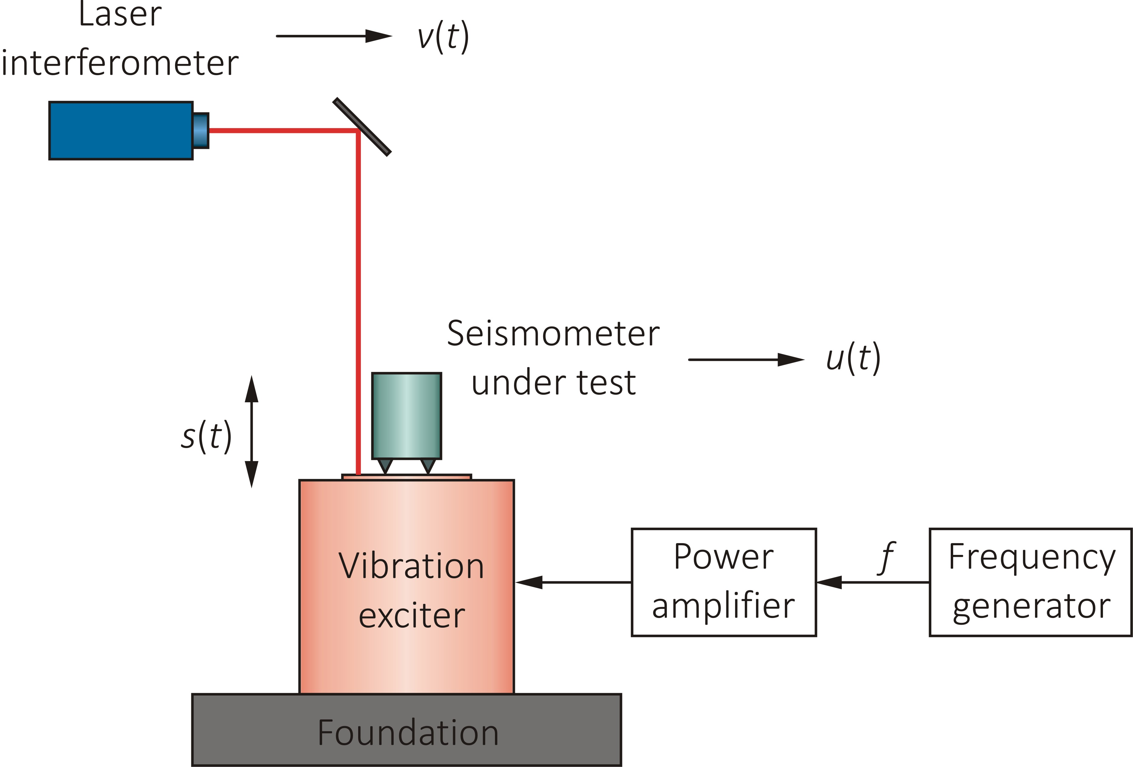
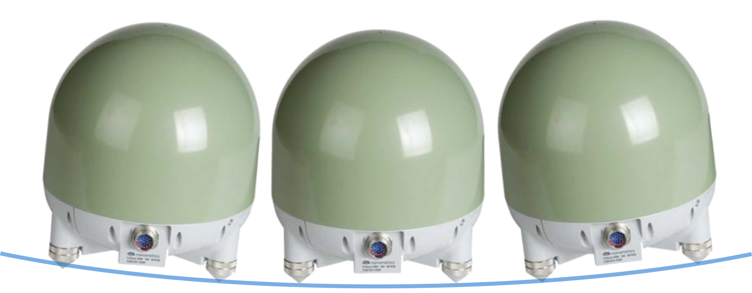
Challenges of Low Frequency Seismometer Calibrations
Leonard Klaus¹, Franck Larsonnier², Jacob H. Winther³, Thomas Bruns¹
¹Physikalisch-Technische Bundesanstalt (PTB), ²CEA DIM, ³DPLA
P3.1-618
Why calibrate?
The ‘electrical calibration’ is not sufficient to detect sensor changes and to ensure reliable results.
To obtain a realistic and independent measurement of the transfer function a calibration is necessary.
How is it done?
Reference measurements by laser interferometry
Movement of the exciter traceable to the wavelength of the laser and the time
Output signal of the seismometer is compared to the reference
Disturbances:
Disturbances from different sources influence the measurement results.
Those may be: tilting, temperature, electromagnetic disturbances
Compensation:
The magnitude of the disturbances need to be determined in order to be accounted for in the measurement uncertainty estimation of for correction
If you want to learn more about this, come see our e-poster during session 3.1 on this date or access it online on the SnT2023 Conference platform!

