Slide 1
Noise Study Examples for Infrasound Stations
P.Martysevich¹, Ichrak Ketata¹, Y.Starovoyt²
¹ CTBTO, Wagramerstrasse 5, 1220 Vienna, Austria;
² Addproject, C/Conde Duque 48, bajo izda, 28015 Madrid, Spain
This poster describes recent development in infrasound (IS) noise studies. The noise study is compliant with requirements of the IMS Operational Manual for IS monitoring.
Noise Study calculator was compiled by IMS/ED/SA, incorporating self-noise measured data for sensors and digitizers, as well as minimum infrasound noise data at operating IMS infrasound stations.
A tool was created for infrasound noise study. Infrasound noise depository created and populated by minimum local noise data for 11 IMS infrasound stations (21% of the network). Noise study performed for 10 infrasound stations passing major upgrade.
The station Noise Studies become important part for sustainment of the existing and for the upcoming infrasound installations driven by (a) development of updated acoustic noise models and (b) emerging of modern infrasound sensors and low self-noise digitizers.
Place your QR Code here after removing this text box!
P3.1-192

Slide 2
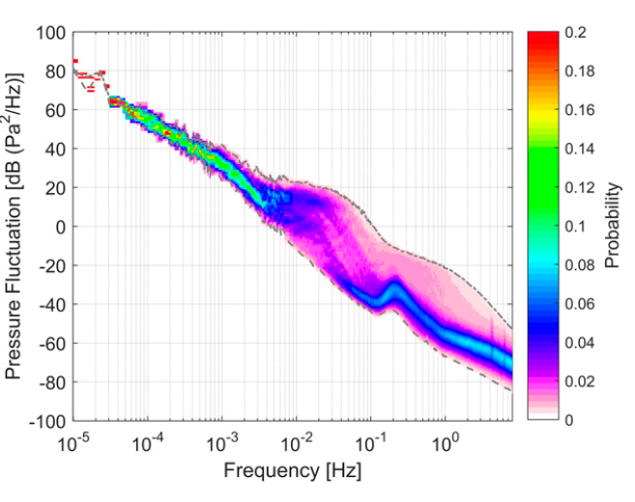
Introduction to the Noise Study: Definitions
Infrasound background noise is a generic name for a pressure variations of the low atmosphere in the infrasound passband, due to a multitude of causes, mainly wind-generated fluctuations, with contribution of microbarom infrasonic waves, auroral-generated infrasound, surf- and mountain-generated infrasonic noise, and other natural and man-made sources, such as volcanic eruptions, wind turbines, aircrafts etc.
Low- and High Noise Models: New high (NHNM) and low noise models (NLNM) were presented in 2021, by Julien Marty, Benoit Doury and Alfred Kramer. These noise curves are currently IMS accepted for generally expected limits of infrasonic noise variations at infrasound stations.
Place your QR Code here after removing this text box!
P3.1-192

Slide 3
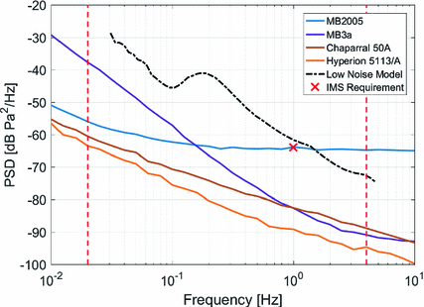
Introduction to the Noise Study: Definitions
Sensor self-noise: Random deviations in the sensor output signal that are uncorrelated with the phenomena that the sensor is intended to measure. The noise levels are analysed as power spectral density in dB relative to 1 Pa²/Hz
Digitizer self-noise: The Self-Noise is the noise present on a digitizer channel that has been terminated with a resistor whose impedance matches the nominal output impedance of a sensor. Measured for each gain. Presented as power spectral density in dB relative to 1 V²/Hz.
Place your QR Code here after removing this text box!
P3.1-192

Slide 4
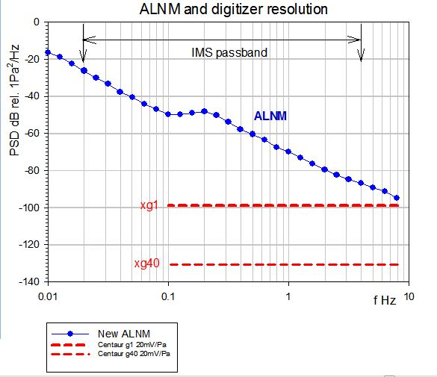
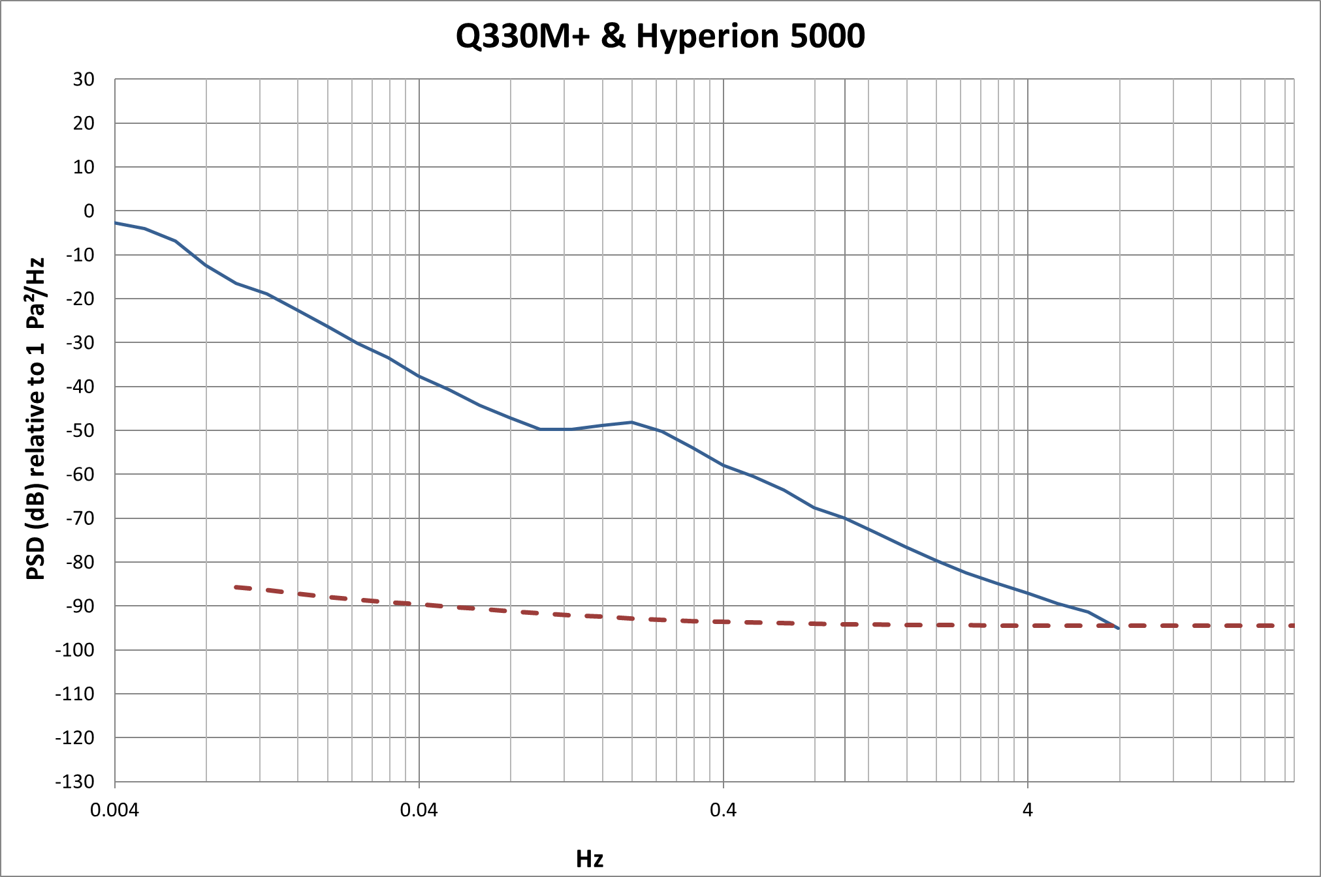
Introduction to the Noise Study: Definitions
Digitizer Equivalent Noise: The digitizer self-noise converted into the physical units of infrasound background noise power spectral density (pressure) using frequency response and sensitivity factor of the sensor “in use”. Presented in dB relative to 1 Pa²/Hz
Digitizer Resolution: The digitizer resolution is normally defined as the digitizer quantization noise floor defined by its least significant bit value.
Sensor | Sensitivity, velocity, V/Pa
Hyperion 5000 | 0.0266
Low Noise Model
Place your QR Code here after removing this text box!
P3.1-192
Digitizer Equivalent Noise

Slide 5
Objectives: Infrasound Noise Study
The Minimum Requirements for Infrasound Station Specifications are defined in the Appendix I to the Operational Manual (OM) for Infrasound Monitoring.
Among other requirements, the OM includes requirements for system noise and resolution, as well as defines minimum acoustic noise:
  Sensor Noise:
  ≤18 dB below minimum acoustic noise*
  Resolution:
  ≥1 count per 1 mPa
*minimum noise level at 1 Hz: ~5 mPa.
P3.1-192

Slide 6
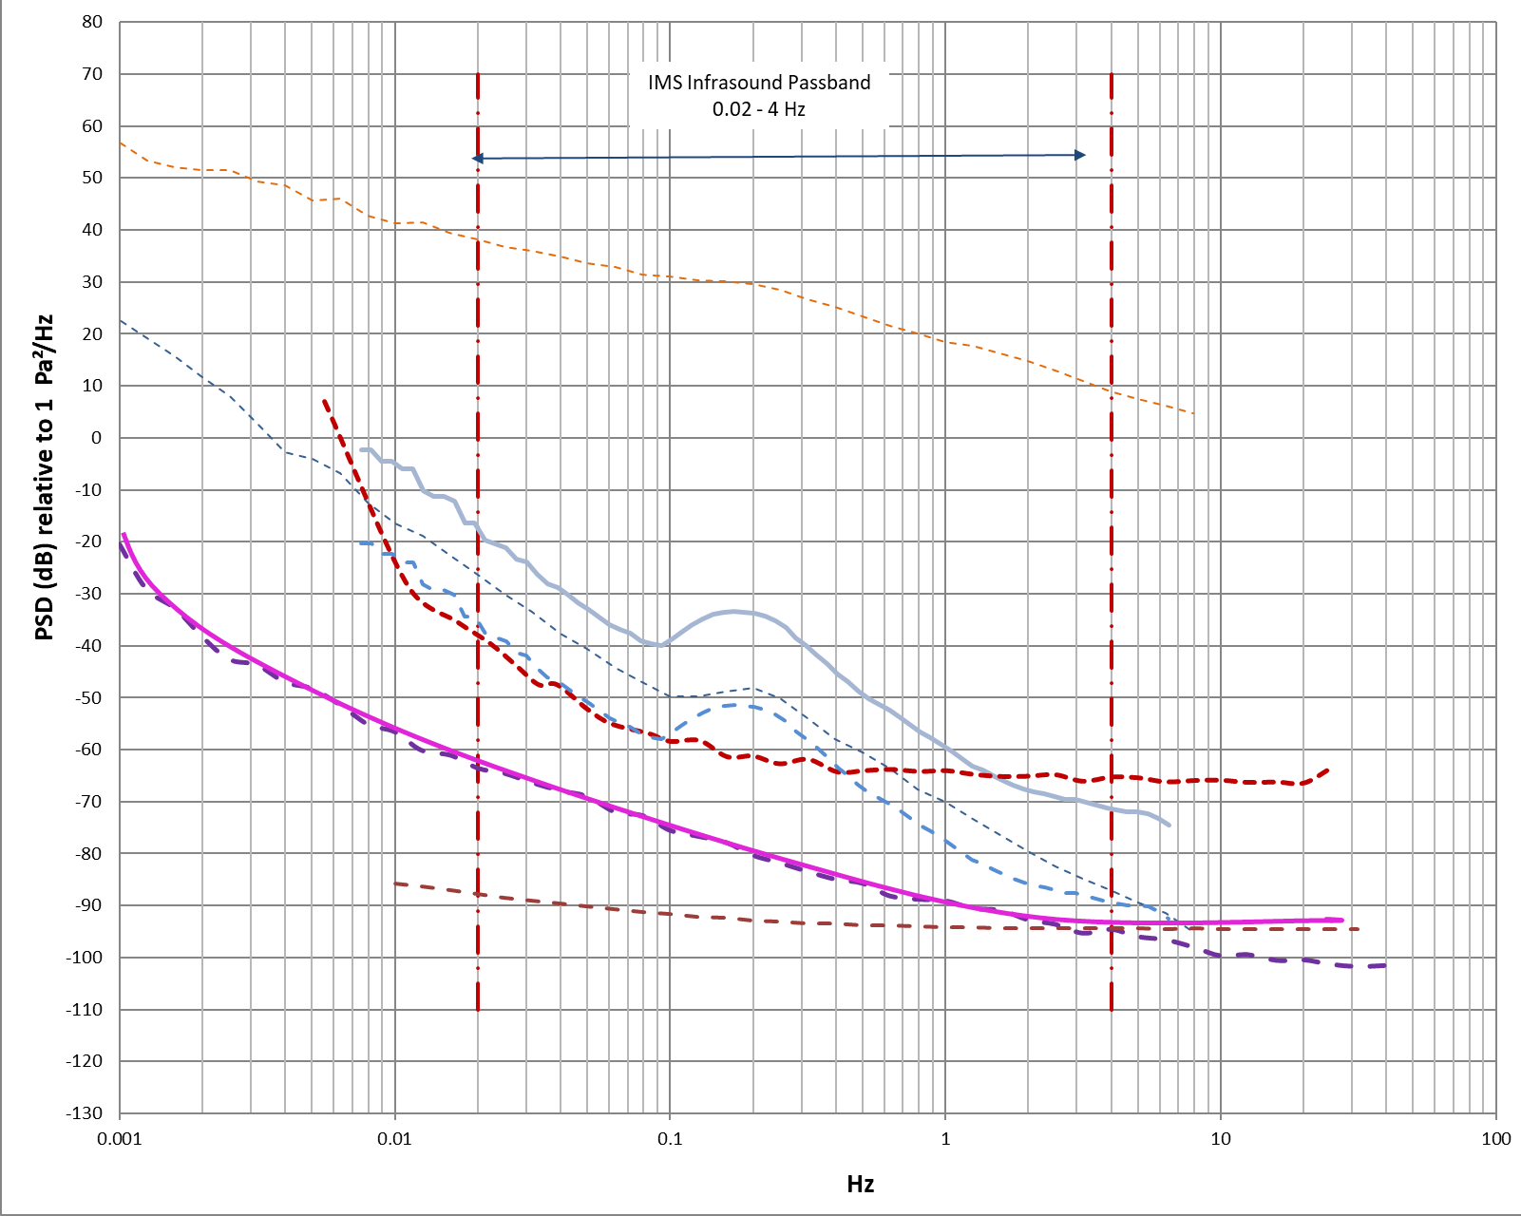
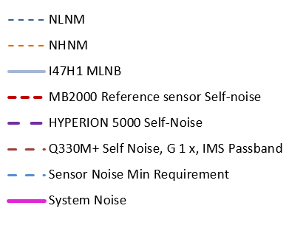
Objectives: Infrasound Noise Study
The purpose of the System Noise Studies for IMS Infrasonic stations is to assess the compliance of chosen equipment and its settings with the Minimum Requirements for Infrasound Station Specifications.
The station Noise Studies become an important part of the upcoming infrasound installations driven by (a) development of updated acoustic noise models and (b) emerging of modern infrasound sensors and digitizers with self-noise substantially below the self-noise of the first generation of the IMS microbarometers and waveform recorders.
Example of the noise study an
infrasound station.
P3.1-192

Slide 7
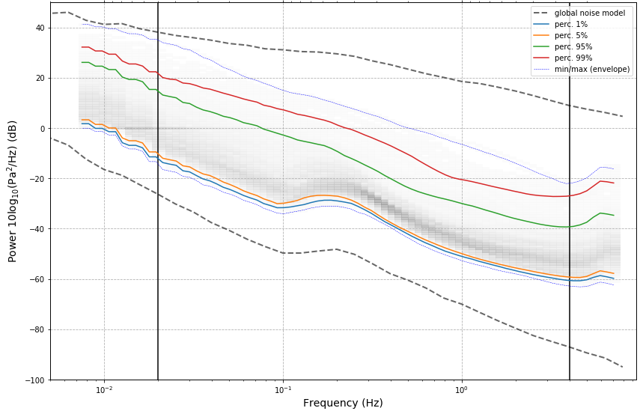
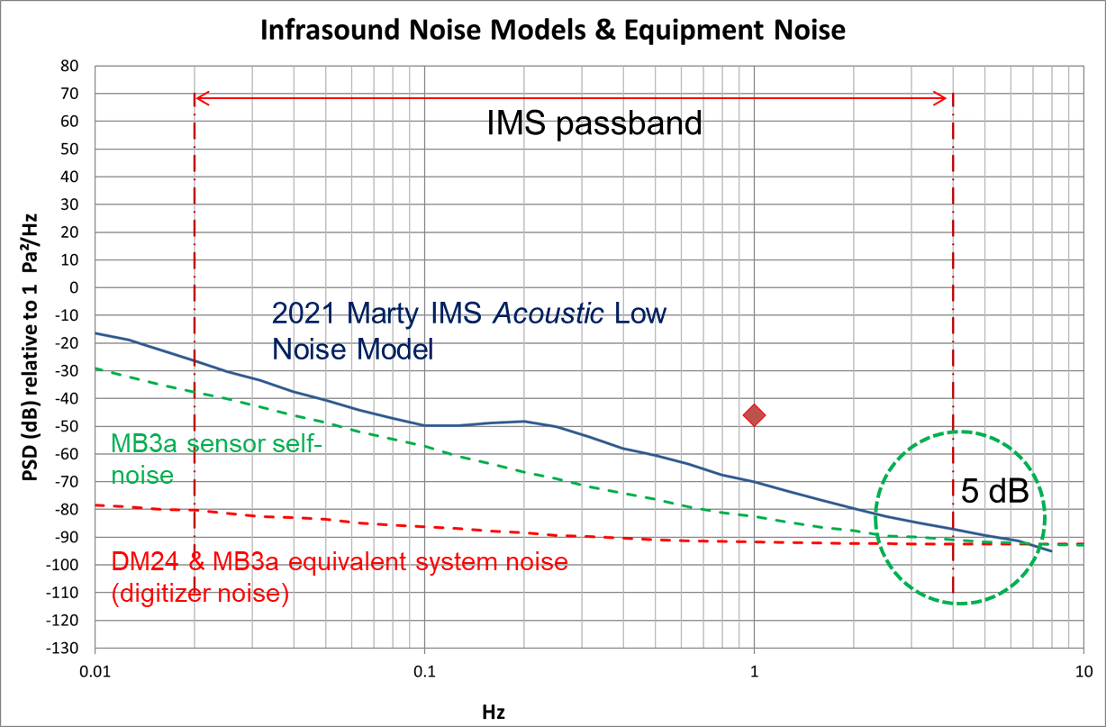
Methods/Data: Infrasound Noise Study
Prior to 2021 no systematic noise studies were performed in IMS for infrasound stations.
In 2021 the preparation of the System Noise Study documents was resumed in IMS/ED/SA, triggered by increased number of infrasound station upgrade projects and appearance of modern sensors.
The activities included:
  Calculation of minimum infrasound noise at operating IMS stations with a compilation of IMS Stations Noise Depository for easy reference in the future;
  Compilation of Equipment Noise Data Depository for sensors’ and digitizers’ self-noise data
  Development of the IMS Noise Study Calculator.
P3.1-192

Slide 8
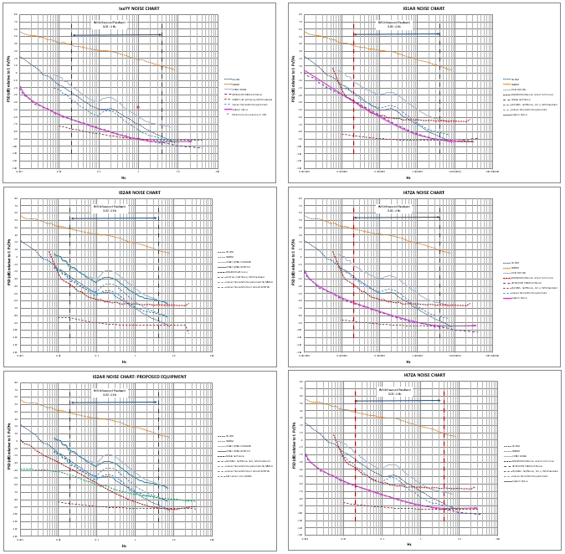
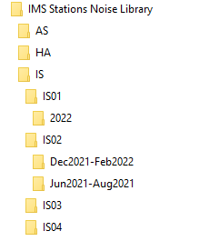
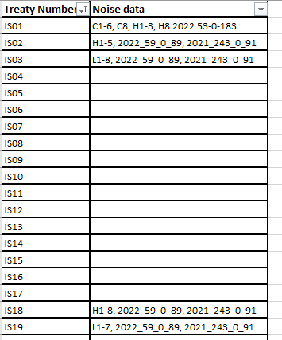
Results: Infrasound Noise Study
As of May 2023, IMS/ED and IMS/MFS prepared 11 Noise Studies for infrasound stations.
P3.1-192

Slide 9
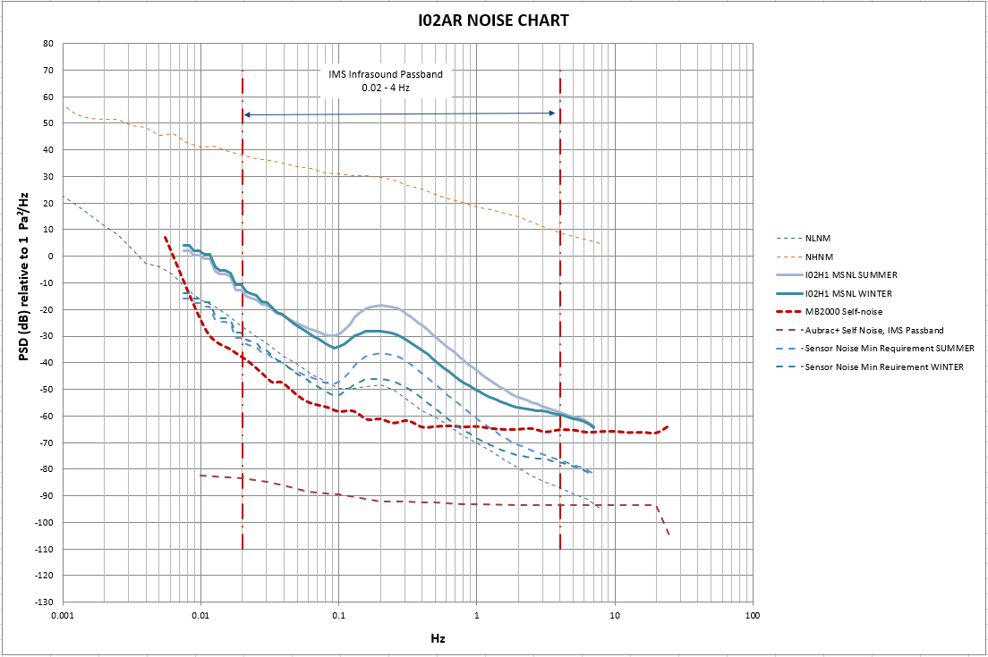
Conclusion: Infrasound Noise Study
The IMS Infrasound Stations Noise Studies become important part of the IMS work program
As of May 2023, the Noise Studies have been performed for 11 infrasound station undergoing major upgrades, which covers 21% of IMS infrasound segment.
The stored data include statistical minimum infrasound site noise for future reference.
The outcome of the Noise Studies allows ED/SA engineers to choose suitable equipment for planned station upgrades.
P3.1-192

Slide 10
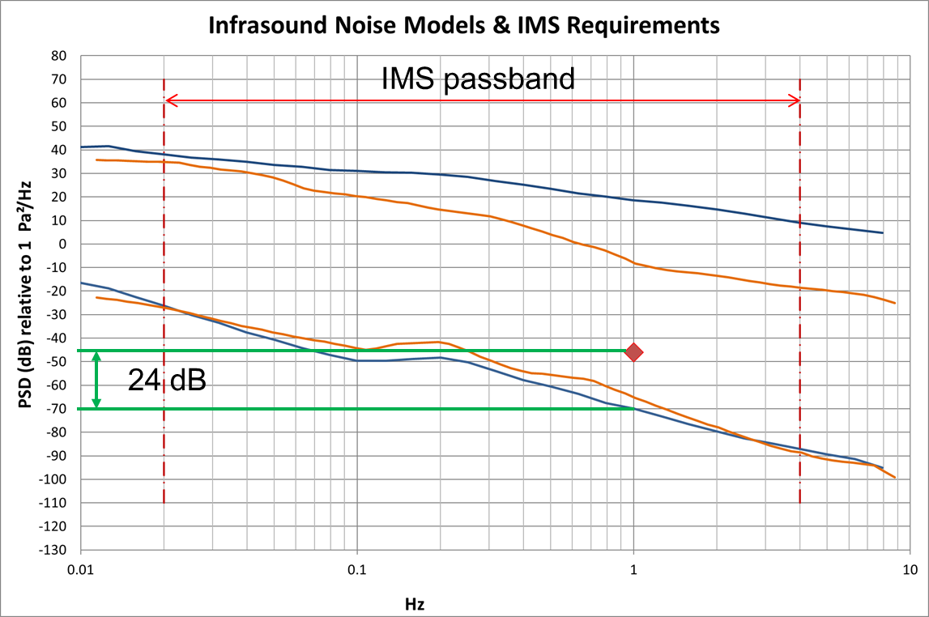
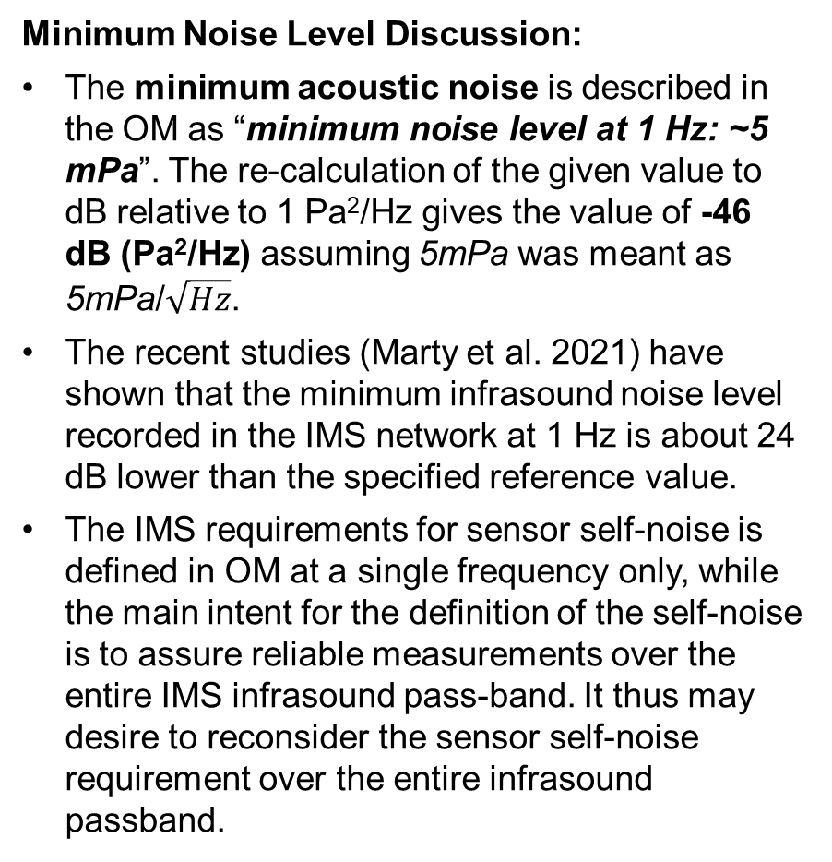
Conclusion: Infrasound Noise Study
Minimum Noise Level Discussion:
The minimum acoustic noise is described in the OM as “minimum noise level at 1 Hz: ~5 mPa”. The re-calculation of the given value to dB relative to 1 Pa²/Hz gives the value of -46 dB (Pa²/Hz) assuming 5mPa was meant as 5mPa/$\sqrt{Hz}$.
The recent studies (Marty et al. 2021) have shown that the minimum infrasound noise level recorded in the IMS network at 1 Hz is about 24 dB lower than the specified reference value.
The IMS requirements for sensor self-noise is defined in OM at a single frequency only, while the main intent for the definition of the self-noise is to assure reliable measurements over the entire IMS infrasound pass-band. It thus may desire to reconsider the sensor self-noise requirement over the entire infrasound passband.
Brown lines: D. Brown et al 2014, Acoustic Noise Models
Blue lines: J. Marty et al 2021 Acoustic Noise Models
Diamond mark: OM defined minimum noise level
P3.1-192

Slide 11
Conclusion: Infrasound Noise Study
Minimum Noise Level Discussion:
We note that at the high-frequency limit of the IMS infrasound passband the equivalent digitizer noise for some equipment pairs is only 3-5 dB below the acoustic low noise model.
Taken into account very low self-noise of modern infrasound sensors, the correct setting of digitizer gain becomes important for infrasound measurements if we strive to have digitizer noise below sensor self-noise (similar to seismic requirements) and to enhance signal detection capability at the high frequency end of the passband
P3.1-192

Slide 12
References
Operational Manual for Infrasound Monitoring and the International Exchange of Infrasound Data, CTBT/WGB/TL-11,17/17/Rev.7, 2020
Merchant, B. John (2014), Infrasound Sensor Evaluation. Definition Of Terms, Infrasound Technology Workshop 2014
Brown, D., Ceranna, L., Prior, M. et al. The IDC Seismic, Hydroacoustic and Infrasound Global Low and High Noise Models. Pure Appl. Geophys. 171, 361–375 (2014)
Marty, J.,Doury, B.,& Kramer, A. (2021). Low and High Broadband Spectral Models of Atmospheric Pressure Fluctuation. Journal of Atmospheric and Oceanic Technology. 38. 1813-1822. 10.1175/JTECH-D-21-0006.1
Infrasound Monitoring for Atmospheric Studies, 2019
Place your QR Code here after removing this text box!
P3.1-192

