Slide 1
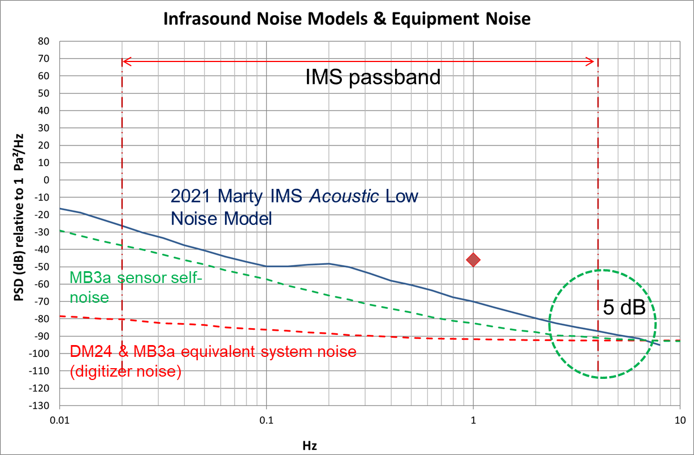
Noise Study Examples for Infrasound Stations
P.Martysevich¹, Ichrak Ketata¹, Y.Starovoit²
¹ CTBTO, Wagramerstrasse 5, 1220 Vienna, Austria;
² Addproject, C/Conde Duque 48, bajo izda, 28015 Madrid, Spain
P3.1-192
Recent development in infrasound noise models (Marty et al, 2021) and progress in digitizers’ and microbarometers’ design allows the introduction of precise infrasound noise studies for new installation and for station upgrades.
IMS/ED/SA has compiled a depository of equipment self noise data and background infrasound noise data of IMS infrasound stations based on percentile calculations.
The presented noise study charts show the results of the studies at multiple IMS stations.
The outcome may suggests revision of the IMS minimum requirements for infrasound station specifications in the part of microbarometer and system noise.
Welcome to attend our more detailed e-poster presentation P3.1-192

