Slide 1
Observations of Natural and Induced Seismic Events and
Monitoring of A Nuclear Underground Depository
Using Slim Borehole Adapted SiA Sensors
L.Zimakov¹, P. Malin¹, K. Passmore¹, F. Blümle¹
1- ASIR (Advanced Seismic Instrumentation & Research) LLC
ASIR has adapted Silicon Audio (SiA) interferometer- based accelerometers for 10 to 1500 m deep wells.
The ASIR ABB’s frequency response is from 125 sec to 1200 Hz, a clip level of ±0.5 g (1 g p-p), and a dynamic range of 172 dB.
From plate boundaries to mines, the ABB detects on scale M < -1.0 to M> 4.5.
Its 12 sec to 1 Hz response is well below the HNM; at higher frequencies it is near the LNM.
An ABB is being used to monitor of the Swiss Nagra nuclear depository.
Installed at 1km, the Nagra ABB has detected with high S/N an M-0.7 at ~1km and an M4.2 at 226km.
An industry standard surface broadband did not record these events due to high near-surface noise attenuation.
The ABB is a field proven, high dynamic range and sensitivity sensor for local-to-teleseismic monitoring.
It is being used in mission critical applications in geothermal, CO2 storage, nuclear waste disposal, and proliferation monitoring.
Please do not use this space, a QR code will be automatically overlayed
P3.1-788

Slide 2
Introduction to ASIR Borehole BB Technology
We have adapted Silicon Audio (SiA) interferometer-based accelerometers as our borehole broadband. The 3-C ABB is designed for seismic monitoring in ~10 to 1500 m deep, 76 mm (or larger) ID boreholes with tilts up to 15 degrees. Its interferometer control a high-sensitivity and high-dynamic range force-feedback circuit. Its 3 dB response is from 125 sec to 1200 Hz, a clip level of ±0.5 g (1 g p-p), and dynamic range of 172 dB. During a rapid tilt, the ABB settles with a 60 s long exponential decay.
From plate boundary to mine to subsidence sites, the ABB has returned high S/N seismograms for M < -1.0 to M > 4.5 earthquakes. Its 12 sec to 1 Hz response is well below the High Noise Model; at higher frequencies it approaches the Low Noise Model. At the Dead Sea plate boundary two 650 m deep ABB’s have improved event detection by more than 1 unit in magnitude.
In this presentation we compare standard surface BB and borehole ABB data from the Swiss National Cooperative for the Disposal of Radioactive Waste (NAGRA). The data from this site are publicly available (e.g. via FDSN).
Another example is five 1000 m borehole ABB type installations in South Korea. Each borehole has 500 and 1000 m deep AFB4.5 (Fullband) versions of the ABB. The 6 ch AFB4.5 includes both ABB plus a 4.5 Hz seismometer, further improving detection for M < -1.0 events.
An AFB4.5 was also installed in a German mine for a hydraulic stimulation study. During the stimulation the AFB4.5 picked up a 60 second long tilt events correlated with episodes of fluid flow into fractures.
P3.1-788
Please do not use this space, a QR code will be automatically overlayed

Slide 3
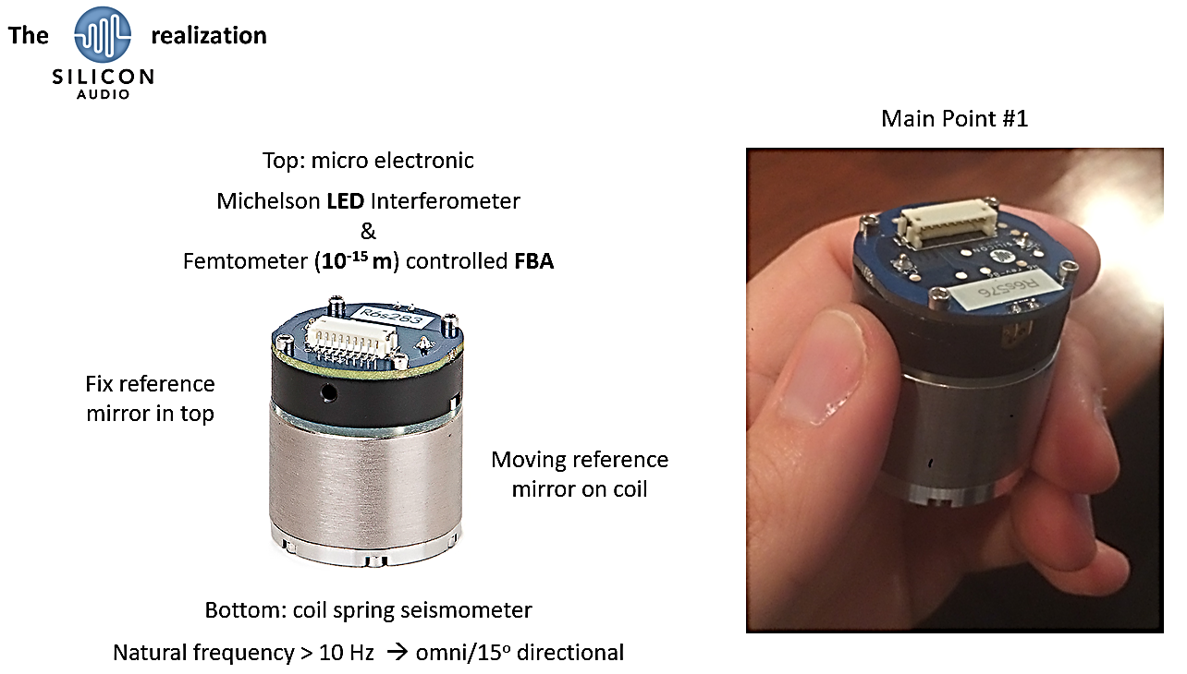
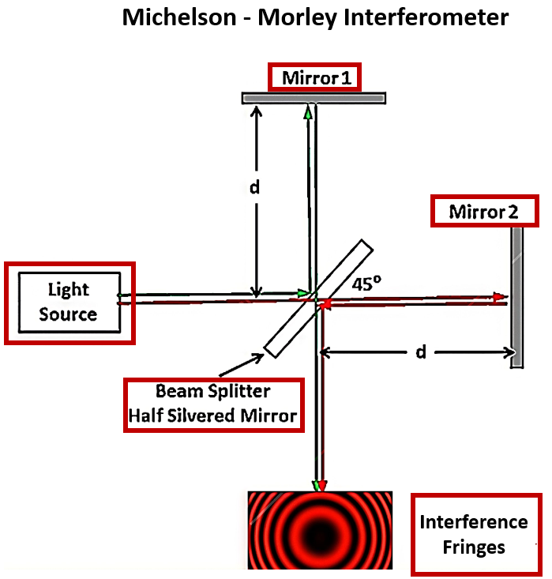
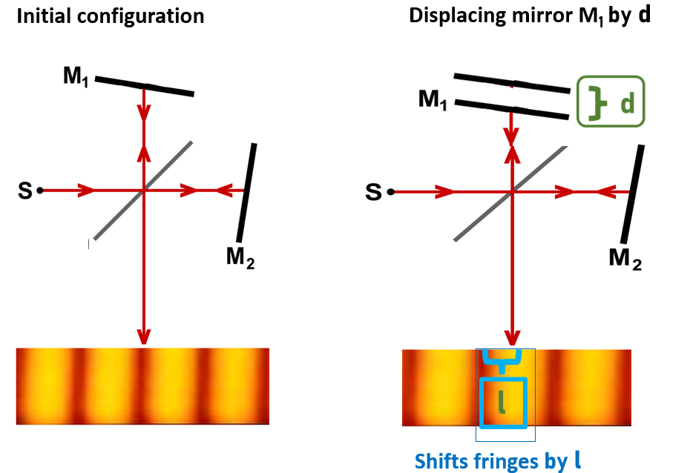
ASIR Design and Technology
P3.1-788
Please do not use this space, a QR code will be automatically overlayed

Slide 4
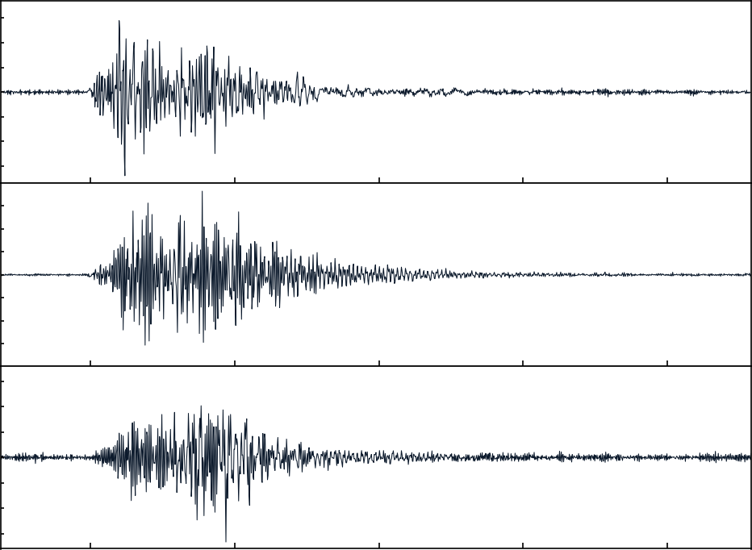
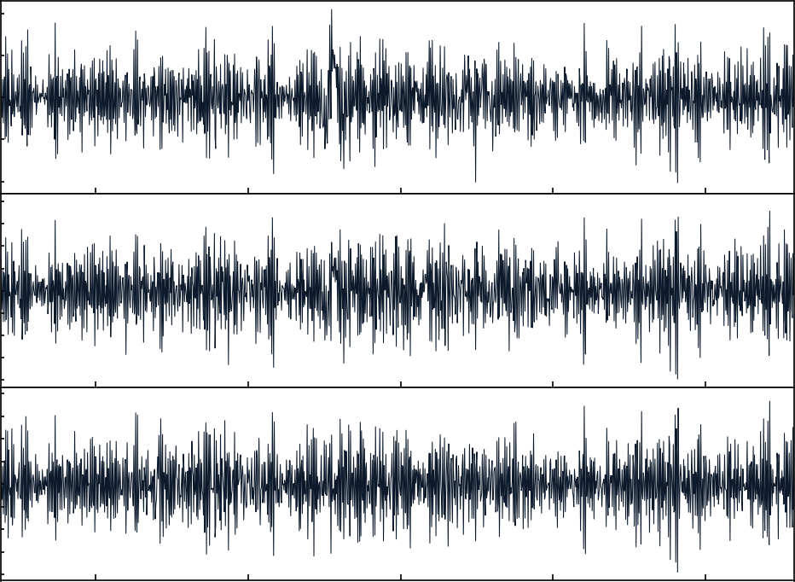
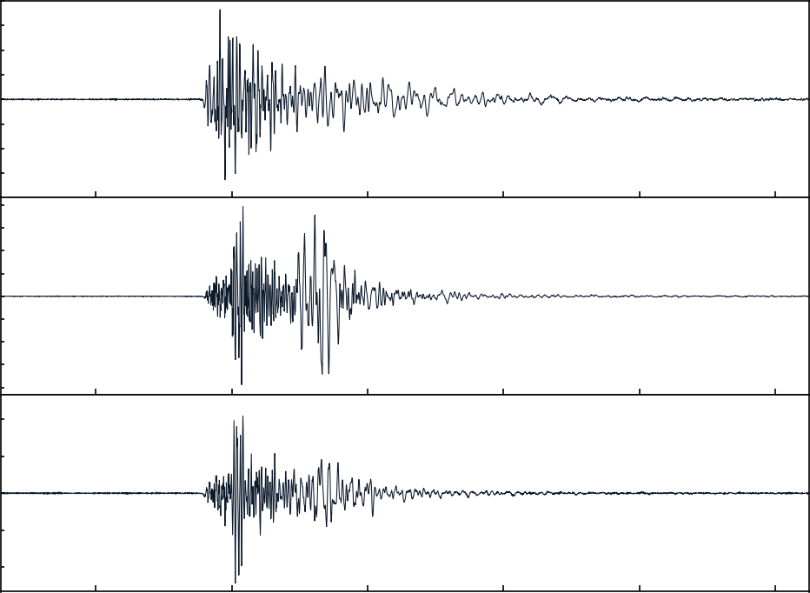
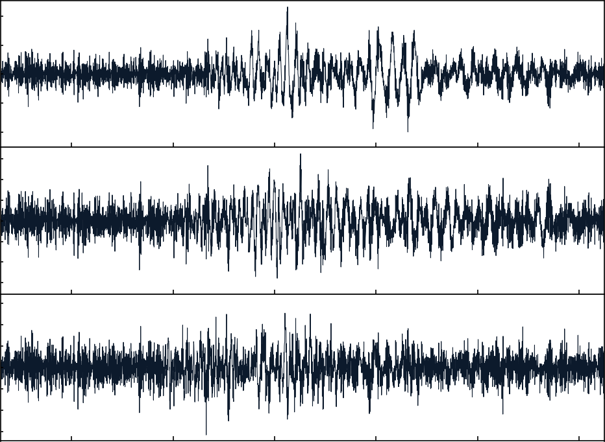
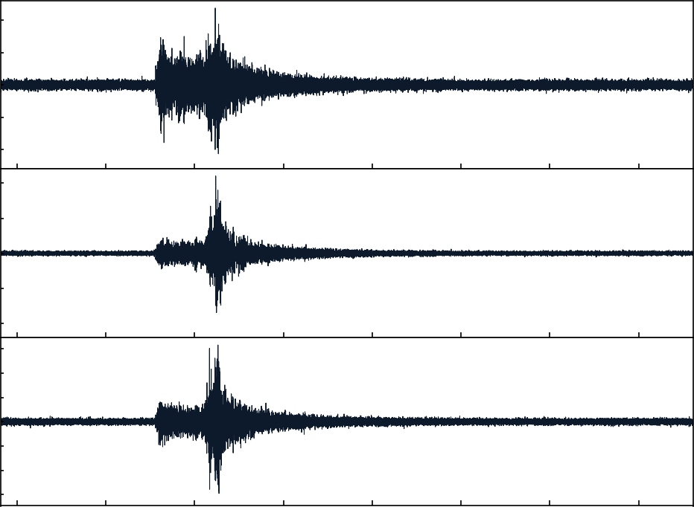
Data product from NAGRA Nuclear Depository Site
Records of ASIR ABB Broadband borehole sensor
Records of the same event recorded by a surface BB sensor
CH.BULAC.BT.HG*
2023-04-17
02:25:31
Magnitude -0.7
Distance 1.16km
CH.BULAC.SF.HG*
2023-04-17
02:25:31
Magnitude -0.7
Distance 1.53km
CH.BULAC.BT.HG*
2023-04-20
17:55:12
Magnitude 0.9
Distance 3.41km
CH.BULAC.SF.HG*
2023-04-20
17:55:12
Magnitude 0.9
Distance 3.41km
P3.1-788
CH.BULAC.BT.HG*
2022-03-11
09:31:11
Magnitude 2.1
Distance 68.64km
CH.BULAC.SF.HG*
2022-03-11
09:31:11
Magnitude 2.1
Distance 68.64km
Please do not use this space, a QR code will be automatically overlayed

Slide 5
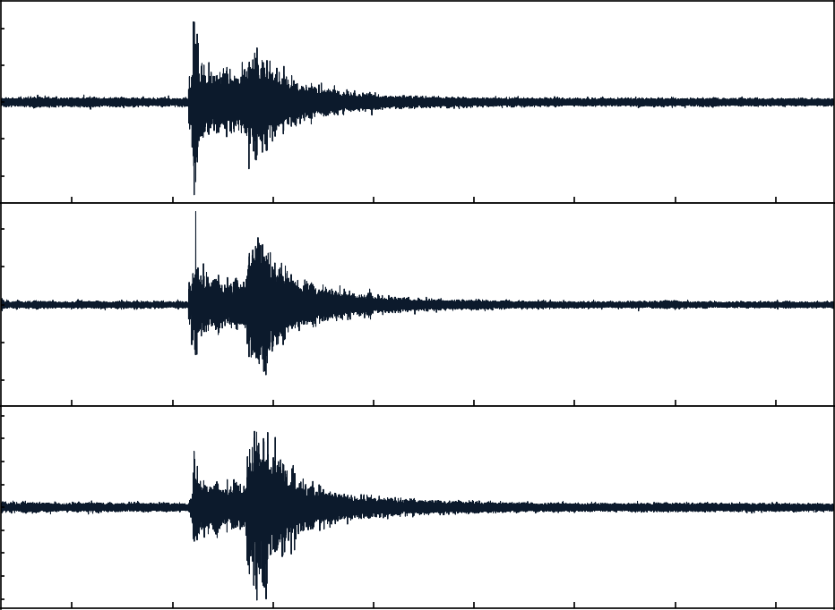
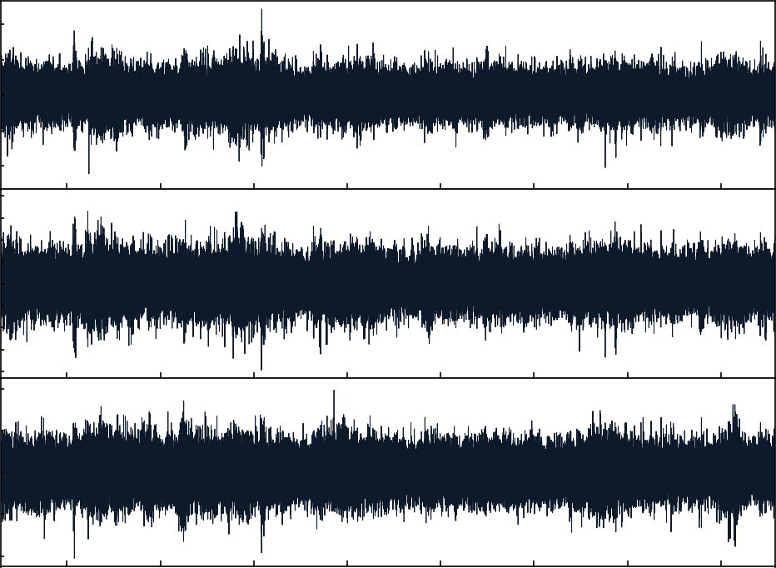
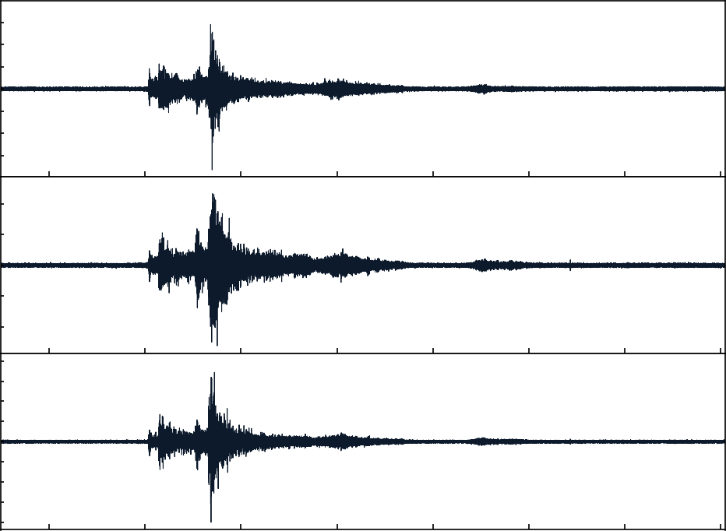
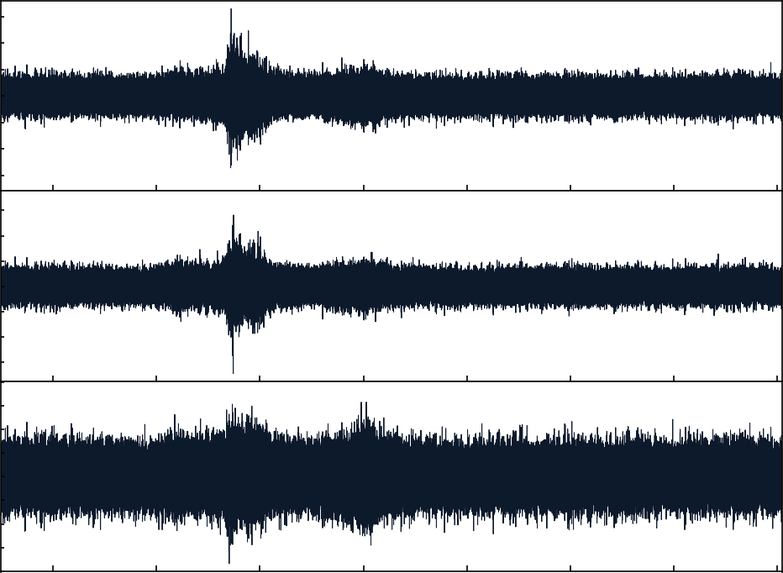
Data product from NAGRA Nuclear Depository Site
Records of ASIR ABB Broadband borehole sensor
Records of the same event recorded by a surface BB sensor
CH.BULAC.BT.HG*
2022-03-25
07:10:19
Magnitude 2.5
Distance 73.01km
CH.BULAC.SF.HG*
2022-03-25
07:10:19
Magnitude 2.5
Distance 73.01km
CH.BULAC.BT.HG*
2022-03-12
17:03:23
Magnitude 4.2
Distance 266.6km
CH.BULAC.SF.HG*
2022-03-12
17:03:23
Magnitude 4.2
Distance 266.6km
P3.1-788
Pn Pg P* Sn S
Please do not use this space, a QR code will be automatically overlayed
M4.2 at a distance of 267 km
Pn = upper mantle
Pg = bottom of the crust
P* = lower crust

Slide 6
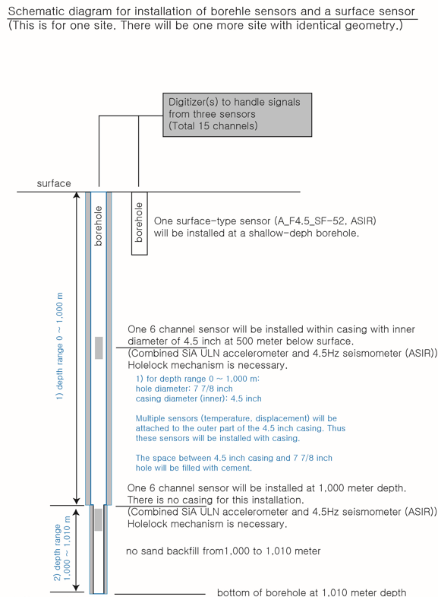
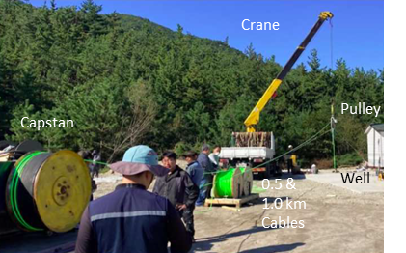
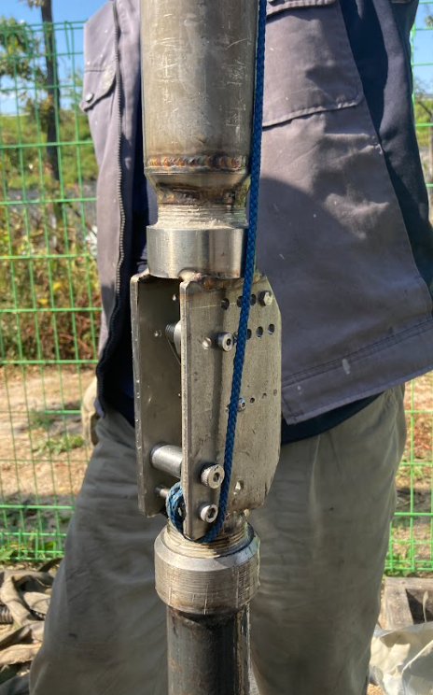
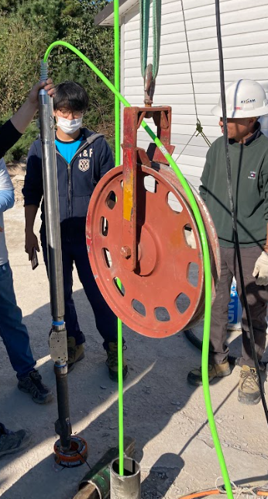
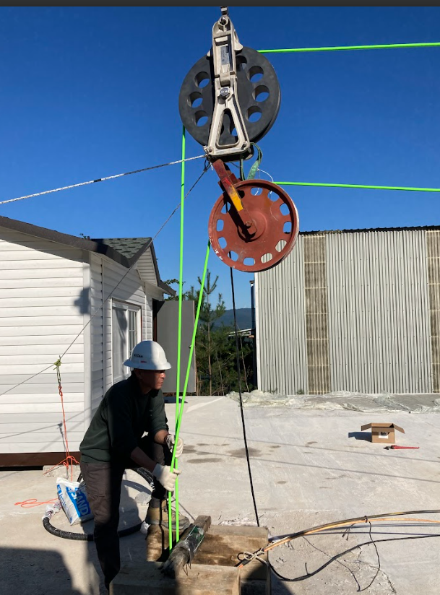
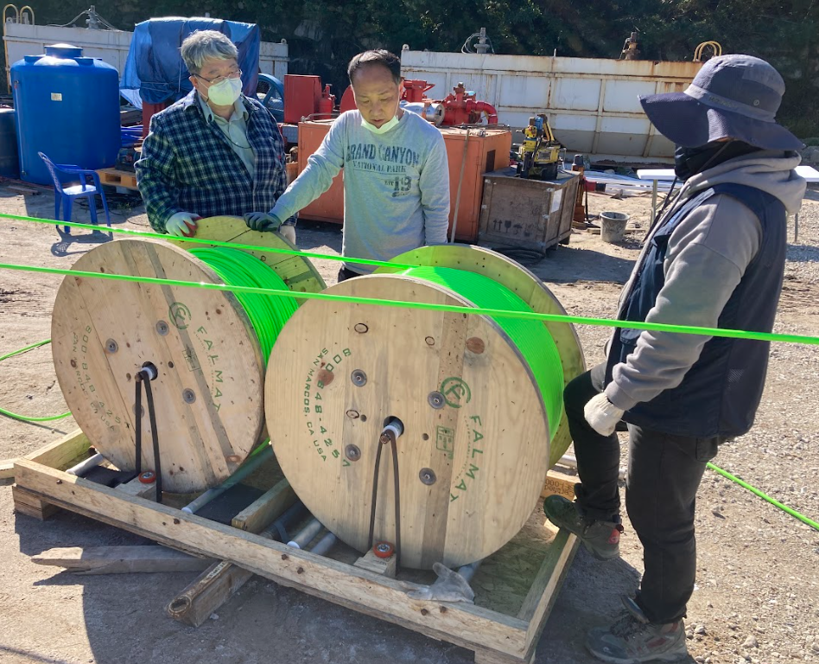
High Resolution Seismometers Deployment and Installation Tools
KIGAM South Korea 2 Level installation 0.5 & 1.0 km
HoleLock
Sheeve
P3.1-788
Please do not use this space, a QR code will be automatically overlayed
0.5 & 1.0 km depth
Double reel roll crate
Capstan

Slide 7
Conclusions
ASIR slim design borehole seismometers are field proven sensors for precise and reliable detection of local and regional / teleseismic events in mission critical applications, such as Nuclear Proliferation, Geothermal, CO2 Sequestration, Active Fault Monitoring, etc.
ASIR ABB broadband seismometer installed in a borehole well allows to detect a passive and induced seismic events 2 to 4 magnitude steps below the detection threshold of the traditional broadband seismometers installed at the surface.
We support the ABB and AFB4.5 borehole sensors by providing the full range of design, fabrication, installation, maintenance, data processing, and R&D support services for modern solid earth monitoring.
P3.1-788
Please do not use this space, a QR code will be automatically overlayed

