Slide 1

RASA 2.0: A Next Generation Aerosol Sampler/Analyzer
Harry S. Miley, Lance S. Lidey, Alex H. Couture, Sonya M. Bowyer
Pacific Northwest National Laboratory
Michael Swanwick, Clive Devoy
Creare LLC
Lessons learned from 20 years International Monitoring System of operations for aerosol and xenon sampler/analyzers have pointed the way to a new generation of aerosol monitoring equipment.
We collected lessons learned and new systems needs (speed of results, flexibility, power restrictions) and studied the sensitivity formula, driving us to new sampling technologies and collection schemes.
The new concept for RASA 2.0 contains an electrostatic precipitation collector (ESP), a sample compactor, and a spectrometer with two detectors. So designed, the system can meet sensitivity specifications on 3 samples a day, and support emergency 15-minute samples if needed.
The new RASA 2.0 concept has well developed electrostatic collector and dual germanium sensors, and a sample compacting system is being developed. New systems will be ready for recapitalization after about 5 years of development.
This presentation reflects the views of the authors, and not necessarily those of their institutions or the US Government
PNNL-SA-186204
Please do not use this space, a QR code will be automatically overlayed
P3.2-268

Slide 2
Introducing the Radionuclide Aerosol Sampler Analyzer and
Lessons We Have Learned in 20 years of Operations
RASA Purpose
  Automate and speed up sensitive monitoring
RASA Project History
  Design started 1992
  Delivered to manufacturer 1996
  Populated network starting 2000
Main Lessons Since 2000
  Even faster results wanted -> similar to xenon
  Sample cycle time -> better location/screening
  Germanium sensor uptime issues
    Redundancy -> Employ two sensors 24/7
RASA 2.0 Project History
  Electrostatic experiments 2015-2018
  Conceptual Design/MDC study 2018-2020
  Design/test (w/Creare) 2020-2023
Please do not use this space, a QR code will be automatically overlayed
Px.x-xxx

Slide 3
RASA 2.0 Design Objectives
Lesson
Post 1990s Lessons:
  Nuclear accident -> high signal level
  Power failures -> loss of service
  Long sensor replacement time
  Some very remote stations
Recent science:
  Bayesian combination of RN measurements
  Xenon on 6 hour time scale
    Better location, better screening
Objectives
  Timeliness of results
  Dealing with very high signal levels
    Short times & reduced voltages
  Improving monitoring outcomes
    Detection, Location, Discrimination
  Power budget (i.e. battery backup)
  Modularity/Flexibility/Redundancy
    Dual sensor setup
    Low background ‘lab replacement’ add on for remote locations
    Standalone collector to achieve improved results at manual stations
    Modular system repair/replacement
Please do not use this space, a QR code will be automatically overlayed
P3.2-268

Slide 4
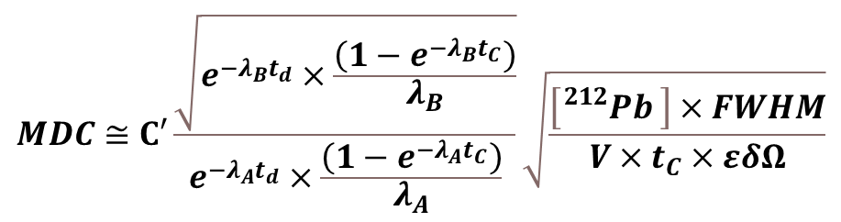
Design Space Analysis Method
Inspired by Next Gen Xenon Systems
Real-time
CZT Detection
RASA 2.0 Notional Design
Classic IMS plus 2nd sensor
Optional Lab Replacement
Starting Media
Sample Archive
Sampling
Decay
Measurement
Minimum Detectable Concentration related to times and system parameters
t_{c} = collection time
t_{d} = decay time
t_{c} = counting time
λ_{A}, λ_{B} = decay constants of analyte and background
[²¹²Pb] = background level
FWHM = resolution
V = volume/time
εδΩ = sensor efficiency
$$MDC≅C′\frac{\sqrt{e^{−λ_{B}t_{d}}×\frac{\left(1−e^{−λ_{B}t_{C}}\right)}{λ_{B}}}}{e^{−λ_{A}t_{d}}×\frac{\left(1−e^{−λ_{A}t_{C}}\right)}{λ_{A}}}\sqrt{\frac{\left[{}_{}^{212}{Pb} \right]×FWHM}{V×t_{C}×εδΩ}}$$
Please do not use this space, a QR code will be automatically overlayed
P3.2-268

Slide 5
Design Space Analysis Results
Study Minimum Detectable Concentration (MDC) Equation
Row E/F: Existing RASA can be improved with ~2.5x higher flow rate
Row T: ESP collector, folded samples, high flow rate, & dual sensors, 3 samples per day
  Still ‘mission capable’ with one sensor loss
δΩ
t_{c}
t_{d}
<- RASA 1.0
<- Winner
<- Winner
Please do not use this space, a QR code will be automatically overlayed
<- Winner
<- Winner
P3.2-268

Slide 6
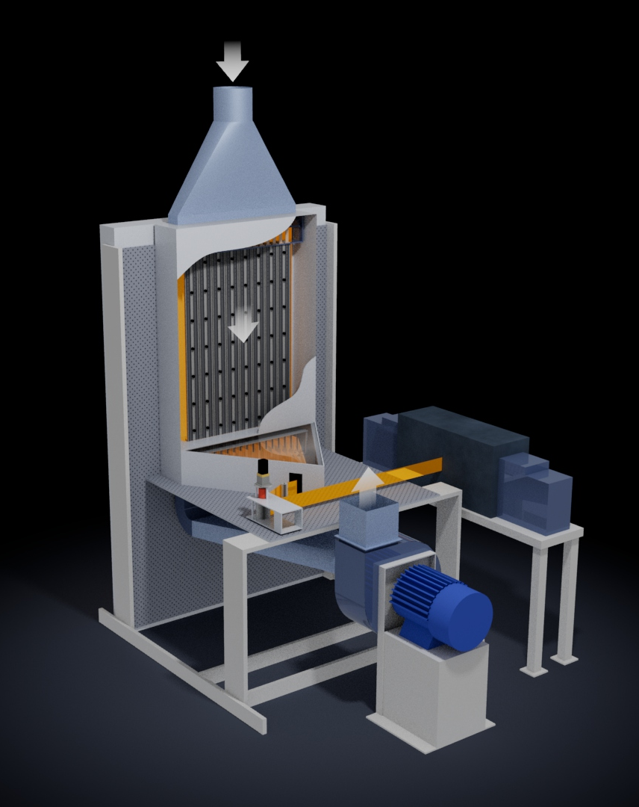
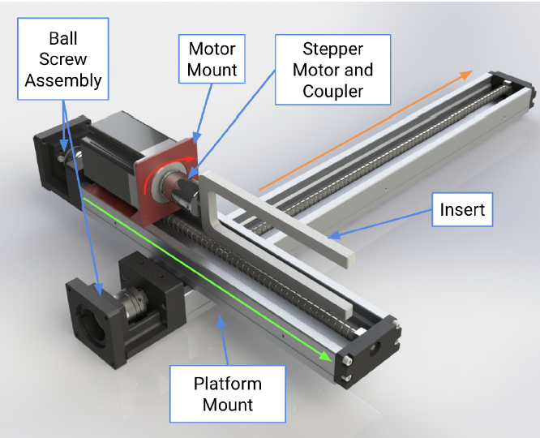
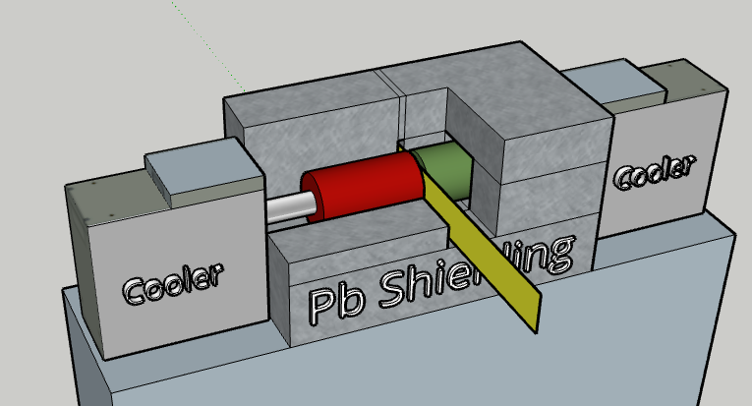
System Development Results
Preparatory work on the three main system components have reduced risk and will speed development in a coming 3-year engineering development.
Electrostatic Collector
Sample Compactor
Dual Gamma Sensor
Sensor Design with Pb Shielding
Current analysis shows a smaller germanium crystal can meet MDC with less cryogenic cooling, cost, and size.
“Moving Jelly Roll” component from recent student design.
(Sigut et al, GaTech, 2023)
Please do not use this space, a QR code will be automatically overlayed
System Design: Creare Corporation
P3.2-268

Slide 7
RASA 2.0 Conclusions
Subsystems are Ready for Integration and Full Engineering Development
Electrostatic Collector
Sample compactor
Dual Gamma Sensor
Multiple Creare SBIRs completed
  Flow, efficiency validated up to 3x RASA 1.0 flow.
Pls see Swanwick - Creare RASA poster
Next SBIR (2023) in relevant environment
Four university senior design projects (TRL3)
Current Creare component-level validation underway (TRL4)
Pls see Swanwick - Creare RASA poster
Dual gamma system built and sensitivity tested/validated
Requires only existing gamma spectrum analysis software
Current cost/benefit trade study on crystal size
Assessment:
System TRL5 -> 6
Assessment:
System TRL3 -> 4
Assessment: Components TRL9
Software TRL5 -> 6
Please do not use this space, a QR code will be automatically overlayed
RASA 2.0 Project is Ready for Accelerated Engineering Development 2024-2026
P3.2-268

Slide 8
References
SM Bowyer, et al, Automated particulate sampler for Comprehensive Test Ban Treaty verification in IEEE Transactions on Nuclear Science, vol. 44, no. 3, pp. 551-556, June 1997, doi: 10.1109/23.603709. https://ieeexplore.ieee.org/abstract/document/603709
Miley et al, Design considerations for future radionuclide aerosol monitoring systems, JER, Volumes 208–209, 2019, https://doi.org/10.1016/j.jenvrad.2019.106037.
Eslinger et al. Impact of Environmental Backgrounds on Atmospheric Monitoring of Nuclear Explosions. Pure Appl. Geophys. (2022). https://doi.org/10.1007/s00024-022-03134-5
Le Petit et al. Analysis of Radionuclide Releases from the Fukushima Dai-Ichi Nuclear Power Plant Accident Part I. Pure Appl. Geophys. 171, 629–644 (2014). https://doi.org/10.1007/s00024-012-0581-6
Britton and Davies, Next-generation particulate monitoring, ARI, Volume 184, 2022, https://doi.org/10.1016/j.apradiso.2022.110156.
Davies and Britton, Improving the sensitivity and reliability of radionuclide measurements at remote international monitoring stations, JER, Volume 216, 2020, https://doi.org/10.1016/j.jenvrad.2020.106187.
Eslinger, et al. Projected network performance for next generation aerosol monitoring systems, JER, Volume 257, 2023, https://doi.org/10.1016/j.jenvrad.2022.107088.
DOE TRL Definitions https://www.energy.gov/sites/prod/files/em/Volume_I/O_SRP.pdf
Please do not use this space, a QR code will be automatically overlayed
P3.2-268

