Slide 1
Advanced Spectroscopy in Support of Nuclear Explosion Monitoring
Ayrton S. Jenkins, Matthew A. Goodwin
AWE, Aldermaston, UK
The Comprehensive Nuclear-Test-Ban Treaty Organisation (CTBTO) monitors for signatures of nuclear explosions through a variety of technologies.
Why is radionuclide monitoring so important?
What is particulate monitoring?
And how is work being undertaken to improve the sensitivity of measurement techniques used by the IMS to identify radionuclides?
Why is it important to monitor for radioxenon?
How does work that has been undertaken by the UK’s radionuclide lab, GBL15, help the IMS to better distinguish between civil nuclear activities and weapons tests?
How can techniques discussed in this poster be used to benefit the IMS, and future research planned by GBL15

Slide 2
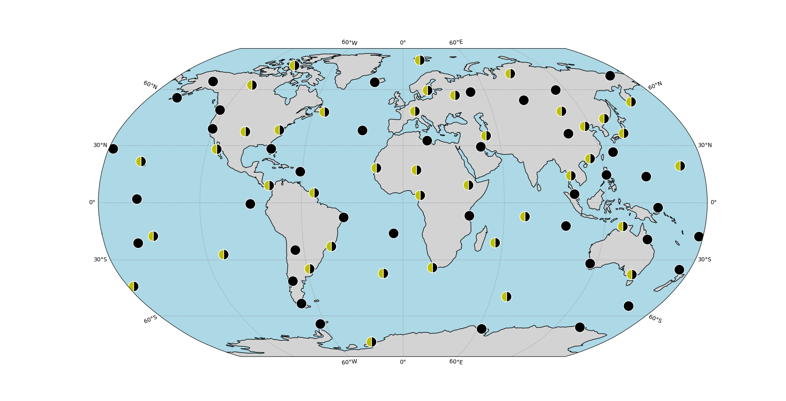
Introduction
The radionuclide station network of the International Monitoring System (IMS) is comprised of particulate and noble gas analysis, with a variety of spectroscopic techniques having been developed and in use to identify radionuclides which are indicative of a nuclear weapons test.
Gamma (γ) singles spectroscopy uses the discrete energy of γ-rays emitted by decaying radionuclides to identify which nuclides are present in a sample. However, interference from the global radioxenon background, Naturally Occurring Radioactive Material (NORM), and associated Compton continua hinder the sensitivity of the measurements, making it difficult to detect fission and activation products from a nuclear explosion without the development of more advanced spectroscopic techniques.
Ongoing efforts to increase the sensitivity of measurements and reduce detection limits have seen the development of more advanced spectroscopic techniques, for example γ-γ coincidence spectroscopy to measure low-level particulate samples ^{[1]}, and a high-resolution beta-gamma (β-γ) coincidence system, which has been developed at the UK’s CTBT radionuclide laboratory (GBL15), for radioxenon measurements ^{[2]}.
Figure 1. Map of the IMS radionuclide station network, consisting of 80 radionuclide stations. All stations have particulate monitoring capabilities, and half of the stations have additional noble gas monitoring capabilities, shown by the black and yellow circles. The IMS is supported by 16 radionuclide laboratories which provide additional independent reanalysis of particulate samples, and routine analysis of air samples for quality control.

Slide 3
Particulate (1/2)
Radionuclide particulate stations that form part of the IMS are used to monitor for fission and activation products by drawing air through a filter for 24 hours, collecting particulate material. The filter is left for a further 24 hours to allow short-lived NORM to decay which can otherwise hinder the measurement of nuclides of interest. A 24-hour measurement using a High-Purity Germanium (HPGe) detector is then conducted during which a γ-ray spectrum is produced, from which analysts can attempt to identify any radionuclides present on the filter ^{[1]}.
γ-γ coincidence spectroscopy is an advanced technique that requires 2 or more photons to be detected within a coincidence time window (usually of the order of 1-100 nanoseconds), by multiple detectors. The probability of random noise matching a coincidence signal caused by a sample is very low, improving the signal-to-noise ratio and resulting in a significantly improved resolution at the expense of detector efficiency ^{[3]}. Figure 2 clearly shows the improvement in resolution that γ-γ spectroscopy can offer by reducing the background, cleaning up the signal.
Figure 2. γ singles spectroscopy (raw spectrum) and a 1596.2 keV gated γ-γ coincidence measurement of a ¹⁴⁰La source. The background is reduced by a factor of 10⁵, and an extremely clean ¹⁴⁰La signature is extracted. Figure from Britton et al ^{[5]}.
This enhances the quality of measurements by enabling analysts to identify low-level radionuclides in samples that they may not have previously been able to detect, as well as identify signatures that would otherwise be too close in energy to distinguish through singles measurements. γ-γ spectroscopy has been shown to increase the sensitivity of measurements by multiple orders of magnitude for CTBT relevant radionuclides, for example one order of magnitude for ¹⁴⁰Ba and two orders of magnitude for ¹³⁶Cs ^{[4]}.

Slide 4
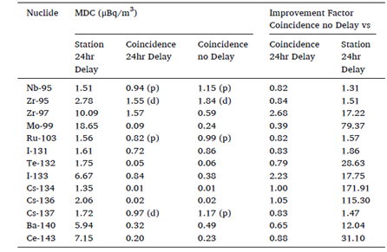
Particulate (2/2)
The IMS requires radionuclide stations to have an uptime greater then 95%. When a detector fails and performance cannot be recovered it is replaced with a spare detector that is unpacked and cooled - a process that can take up to a week from initial detector failure which already comes close to the downtime limit for the station. For remote stations, such as the UK station RN67 at St Helena, the transport times needed to ship a spare detector are in excess of a week, and warm storage of detectors at the station can lead to performance issues such as build-up of detector dead layer.
Currently, pre-cooled spare detectors that are ready for operation, called ‘Operational Spares’, are not widely utilised across the IMS. If one of the detectors were to lose functionality the operational spare can be used to minimise station downtime to just a few hours ^{[1]}.
Whilst not in operational use, the operational spare can be utilised as a second detector in a coincidence setup, allowing radionuclide stations to have improved sensitivity. This setup was trialled at RN67 by GBL15 with significantly enhanced sensitivity observed between the traditional station measurement with a 24-hour decay time, and a coincidence measurement without any delay, as shown in table 1. Removing the decay time from process would shorten the collection/measurement cycle by 24 hours, which is significant for volatile fission products, for example ¹³³I (20.8h half-life), as well as other short-lived radionuclides, e.g. ⁹⁷Zr (16.7h half-life). The combination of a shorter collection/measurement period and increased resolution using γ-γ spectroscopy resulted in Minimum Detectable Activity (MDA) improvement factors of 17.75 and 17.22 respectively for the above mentioned radionuclides.
Table 1. Comparison of the standard station measurement, and a coincidence measurement using the operational spare with and without a 24-hour delay at the RN67 station. Nuclides without a feasible coincidence signature or a poor cascade detection probability are denoted (d) and (p) respectively. Table from Britton et al ^{[1]}.

Slide 5
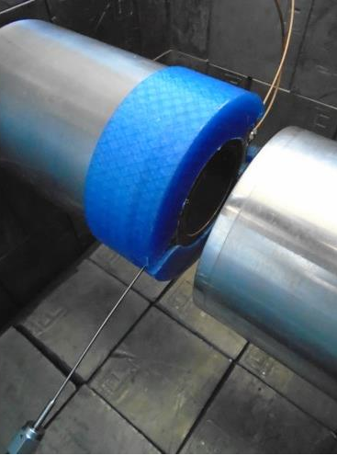
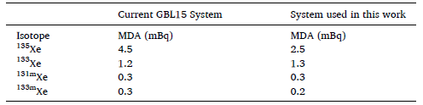
Noble Gas (1/2)
Underground or underwater nuclear explosions can release much less (if any) radioactive particulates into the atmosphere, so another method for radionuclide detection is needed. Xenon is a noble gas and therefore chemically inert, so isotopes of radioxenon produced from fission will not react following the explosion. For the case of an underground nuclear explosion, the radioxenon can seep through small cracks in the rock and escape into the atmosphere where it can be detected. Radionuclide stations with noble gas capabilities pump air onto a trap material to isolate xenon.
The four main isotopes of interest (¹³³Xe, ^{131m}Xe, ^{133m}Xe and ¹³⁵Xe) all have decay modes that involve the emission of an internal conversion electron (or beta particle) and a high energy photon (gamma-ray or X-ray) in coincidence. Therefore, the most efficient way to measure the activity of these isotopes is using electron-photon coincidence spectroscopy, a technique that requires detections where an electron and photon to be detected within a short time window of each other.
Figure 3. Photograph of two HPGe detectors and a PIPSBox held in place with a 3D printed holder. The detector setup is housed in a low-background lead shield, and is intended to improve detector resolution of the β-γ system. The stainless steel tubing from the bottom-left is the gas inlet.
GBL15 has made significant efforts to increase both the sensitivity and efficiency of the β-γ system used at the laboratory for radioxenon measurements. The current GBL15 certified noble gas capability uses a SAUNA II IMS lab system, which utilises a NaI(Tl) plastic scintillator to measure electron-photon coincidence - high detector efficiency but low resolution.
GBL15 trialled the use of a PIPSBox in conjunction with two HPGe detectors as a setup intended to improve detector resolution, shown in Figure 3. Table 2 details the MDA comparison between the current GBL15 certified system and the system used in this exploratory work ^{[2]}.
Table 2. Comparison of MDA between GBL15 certified noble gas capability and exploratory detector setup, calculated using a 7-day detector background ^{[2]}.

Slide 6
Noble Gas (2/2)
The radioxenon background, due to sources such as medical isotope production facilities and nuclear reactors, consists mostly of ¹³³Xe ^{[6,7]}, meaning that where there are IMS samples that contain isotopes from civil sources, the ¹³³Xe contribution can reduce the sensitivity of the spectrometry systems to key isomers due to Cs X–rays (approx. 30 keV) in coincidence with a β⁻ particle from the decay of ¹³³Xe. The coincidence counts detected from this decay process interfere with the internal conversion electron and Xe X–rays coincidence signatures from the decay of the metastable isomers ^{131m}Xe and ^{133m}Xe, but this effect is reduced if the Cs and Xe X–rays are resolved in the photon detector. This is shown in Figure 4 as the contribution of the β⁻ continuum is greatly reduced in the projected spectrum shown in plot B, compared to plot A ^{[2]}.
By separating these signals, the interference is reduced from the ground state isotopes (¹³³Xe and ¹³⁵Xe) to the metastable isomer regions meaning that the detection limit of ^{131m}Xe and ^{133m}Xe does not increase as much at higher activity levels of ¹³³Xe, compared to a lower-resolution system. Figure 5 shows the effect of the ¹³³Xe activity on the detection limit of ^{131m}Xe for both low-resolution and high-resolution systems, and how utilising a virtual region of interest can further improve detection sensitivity ^{[2]}.
Figure 4. Projected photon-gated electron spectra using (A) a low-resolution X–ray gate (20–40 keV) and (B) a high-resolution xenon X–ray(K_{α}) gate (29–30 keV) ^{[2]}.
Figure 5. Comparison of the effect of ¹³³Xe interference on the detectability of ^{131m}Xe in a low-resolution coincidence detector system (solid line); a high-resolution coincidence detector system using 1 HPGe detector (dotted line); and a high-resolution detector system using 2 HPGe detectors (dashed line) ^{[2]}.

Slide 7
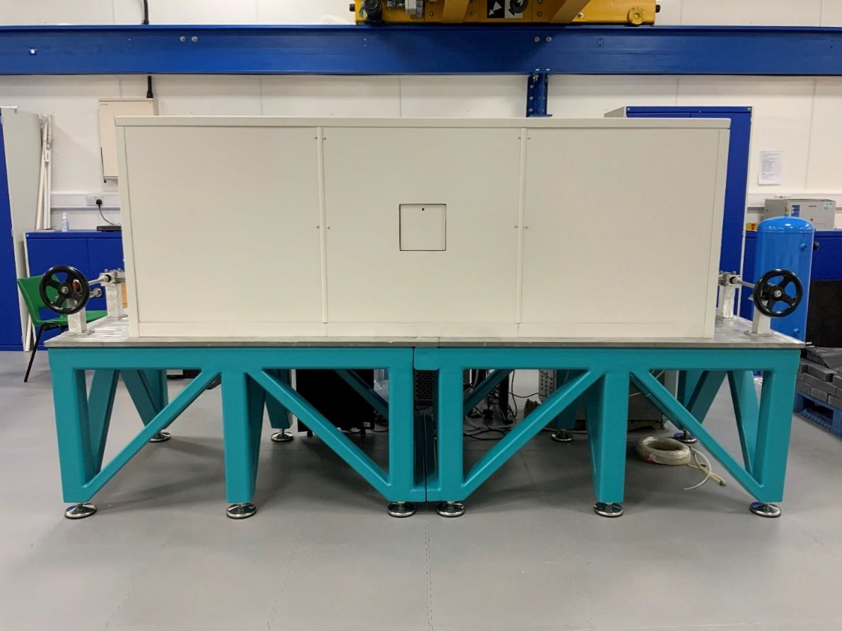
Conclusion
Advances in γ-γ coincidence spectroscopy can vastly improve the sensitivity of measurements of particulate samples, in addition to the possibility of the removal of ‘decay time’, reducing the MDA of short-lived fission or activation products. Having an operational spare can allow a second measurement to occur at stations for level 5 samples (where one or more fission products are identified in the sample) with short lived nuclides in remote locations where the nuclide may decay long before the sample is able to be reanalysed, e.g. ¹³¹I (half-life = 8 days) ^{[1]}.
Ongoing work to develop an operational laboratory β-γ coincidence system for environmental xenon sample remeasurement is an important step in supporting the ability of the IMS to distinguish between signatures of civil processes and violations of the CTBT. The ratio ^{133m}Xe/^{131m}Xe provides vital information when discriminating between the origin of a detection. The global radioxenon background means it is particularly important that advances are made in both sensitivity and detector efficiency for radioxenon measurements, since reducing signal interference from ¹³³Xe has the added benefit of improving the accuracy of the ^{131m}Xe or ^{133m}Xe measurement result ^{[6,7]}. Such an improvement may be sufficient to discriminate between a civil and non-civil radioxenon source ^{[2]}.
GBL15 is pioneering further research into advanced spectroscopy, including the installation of a γ-γ coincidence spectroscopy system housed in an ultra-low background cave, at the Boulby Underground laboratory. This provides the opportunity to improve spectroscopic techniques in a controlled environment which can be utilised by the IMS in the future. This is similar to work being carried out by USL16 at Pacific Northwest National Laboratory (PNNL) in their shallow underground laboratory, where two low-background γ-spectrometers have been developed, significantly enhancing their capability to detect low-levels of fission products in particulate samples from the IMS, demonstrating a MDA for ¹⁴⁰Ba of 3 mBq over a 7 day count (IMS requires 24 mBq) ^{[8]}.
Figure 6. γ-γ coincidence system housed in ultra-low background cave at Boulby Underground Laboratory (1.1 km below the surface), operated by GBL15.

Slide 8
References
[1] Britton R., Davies A.V. Improving the Sensitivity and Reliability of Radionuclide Measurements at Remote International Monitoring Stations. Journal of Environmental Radioactivity, 216, 106187 (2020)
[2] Goodwin M.A., Regan P.H., Bell S.J., Britton R., Davies A.V. Enhancing the Detection Sensitivity of a High-Resolution β-γ Coincidence Spectrometer. Journal of Environmental Radioactivity, 250, 106915 (2022)
[3] Britton R., Davies A.V. Next-Generation Particulate Monitoring. Applied Radiation and Isotopes, 184, 110156 (2022)
[4] Britton R., Davies A.V. Limits of detection — Enhancing Identification of Anthropogenic Radionuclides. Nuclear Instruments and Methods in Physics Research Section A: Accelerators, Spectrometers, Detectors and Associated Equipment, 947, 162818 (2019)
[5] Britton R., Davies A.V., Goodwin M.A. Hyper-sensitive Gamma Spectrometry – Approaching the Ultimate Limit. [Poster]. CTBT Science and Technology Conference (2019)
[6] Bowyer, T.W. A Review of Global Radioxenon Background Research and Issues. Pure Appl. Geophys, 178, 2665–2675 (2021)
[7] Goodwin M.A., Britton R., Davies A.V. Analysis of Environmental Radioxenon Detections in the UK. Journal of Environmental Radioactivity, 234, 106629 (2021)
[8] Greenwood L.R., Cantaloub M.G, Burnett J.L., Myers A.W., Overman C.T., Forrester J.B., Glasgow B.G., Miley H.S. Low-Background Gamma-Ray Spectrometry for the International Monitoring System. Applied Radiation and Isotopes, 126, 240-242 (2017)

