Slide 1
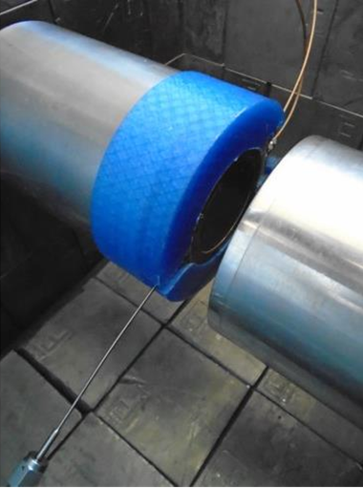
UK Ministry of Defence © Crown Owned Copyright 2023/AWE
Advanced Spectroscopy in Support of Nuclear Explosion Monitoring
Ayrton S. Jenkins, Matthew A. Goodwin
AWE, Aldermaston, UK
P3.2.599
The radionuclide station network of the International Monitoring System (IMS) is comprised of particulate and noble gas analysis.
So what is particulate monitoring? How can γ-γ coincidence spectroscopy improve detection limits, and even open the possibility for shorter sample collection/measurement cycles?
Why is it important to monitor for radioxenon? How does work that’s been undertaken by the UK’s radionuclide lab, GBL15, on high resolution β-γ systems help the IMS to better distinguish between civil nuclear activities and weapons tests?
If you want to learn more about this, come see my e-poster during session P3.2 on 22/06 or access it online on the SnT2023 Conference platform!

